Slide 1
Research Design and Analysis: Models with Multiple Categorical Predictors
Keith Lohse, PhD, PStat
Department of Health and Kinesiology
Department of Physical Therapy and Athletic Training
University of Utah
e: rehabinformatics@gmail.com

Slide 2



Multi-variable Regression
Usually, conditioning our predictions on a single variable won’t be enough.
This is because most variables we might measure (height, academic achievement, probability of winning a match) are caused by multiple factors or at least associated with multiple factors.
$$X1$$
$$Y$$
If $X1$ is the only thing that relates to $Y$, any $e_{i}$ in our data would be due to measurement error.

Slide 3





Multi-variable Regression
Usually, conditioning our predictions on a single variable won’t be enough.
This is because most variables we might measure (height, academic achievement, probability of winning a match) are caused by multiple factors or at least associated with multiple factors.
$$X_{3}$$
$$X1$$
$$Y$$
$$X1$$
$$Y$$
If $X1$ is the only thing that relates to $Y$, any $e_{i}$ in our data would be due to measurement error.
$$X_{2}$$
Usually, however, $e_{i}$ in our data will arise due variables we haven’t accounted for.

Slide 4




Multi-variable Regression
$$X_{3}$$
$$X1$$
$$Y$$
$$X_{2}$$
The trick, however, is that the X’s don’t only relate to Y, they also relate to each other.
E.g., Weight is related to Age and Height, …
… but Height is also related to Age…
… so how much of Weight~Height is actually due to age?

Slide 5
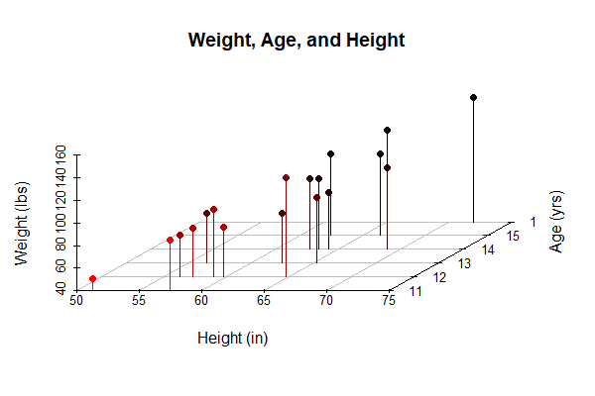
Unpacking a multi-variable relationship
For this example, we will look at the relationship between students’ heights, weights, and ages presented in the chapter.
> head(dat)
Name Sex Age Height Weight
1 Alfred M 14 69.0 112.5
2 Alice F 13 56.5 84.0
3 Barbara F 13 65.3 98.0
4 Carol F 14 62.8 102.5
5 Henry M 14 63.5 102.5
6 James M 12 57.3 83.0

Slide 6
Going from univariable to multivariable regression:
Multivariable model:
Intercept
The effect of X₁ on Y_{P}
The effect of X₂ on Y_{P}

Slide 7
Going from univariable to multivariable regression:
Multivariable model:
Intercept
The effect of X₁ on Y_{i}
The effect of X₂ on Y_{i}
$${\hat{Wt}}_{i}=−141.22+3.60∗{Ht}_{i}+1.28∗{Age}_{i}$$

Slide 8
Univariable to multivariable regression:
How do we interpret a single variable in the multivariable model?
$${\hat{Wt}}_{i}=−141.22+3.60∗{Ht}_{i}+1.28∗{Age}_{i}$$
This is the effect of Height controlling for Age.
But what does it mean to control for age?

Slide 9
Univariable to multivariable regression:
How do we interpret a single variable in the multivariable model?
$${\hat{Wt}}_{i}=−141.22+3.60∗{Ht}_{i}+1.28∗{Age}_{i}$$
This is the effect of Height controlling for Age.
But what does it mean to control for age?
Similarly, this is the effect of Age controlling for Height, but what does it mean to control for height?

Slide 10
Controlling for Shared Variance

Slide 11
Weight
Circles represent the total variance in a variable.
Areas of overlap represent shared variance.
Height
Age

Slide 12
Weight
The effect of HEIGHT controlling for age means that we remove the shared variance (Height-Age and Weight-Age) and look only at the parts of HEIGHT and WEIGHT that vary independent of age.
Height
Age

Slide 13
Relationship between height and weight controlling for age.
Weight
In more simple terms, we can think of this as the effect of HEIGHT while “holding age constant”.
That is, assuming we had lots of people of exactly the same age, how would we expect their weight to vary as a function of their height.
Height
Age

Slide 14
Relationship between age and weight controlling for height.
Weight
In more simple terms, we can think of this as the effect of HEIGHT while “holding age constant”.
That is, assuming we had lots of people of exactly the same age, how would we expect their weight to vary as a function of their height.
Height
Age

Slide 15
Note that the shared variance is completed excluded from both variables. This can be a problem is both variables are highly related.
Weight
Height
Age

Slide 16
Collinearity
Left Leg Length
On it’s own, the length of the left of a person’s left leg is a very good predictor of their total height.
Total Height

Slide 17
Collinearity
Left Leg Length
However, if we put both left leg length and right leg length in the same model, their shared variance will be excluded.
This collinearity (i.e., correlation) between left leg length and right leg length means that neither of these variables is a very good predictor controlling for the other.
Total Height
Right Leg Length

Slide 18
Important Notes
Moving forward, we will start with situations were the correlation between X-variables is 0 or at least trivial.
E.g., experimental designs where participants are randomly assigned to conditions.
If you work with observational data, collinearity is more a problem and it is a topic for future courses/videos.

Slide 19
Important Notes
Moving forward, we will start with situations were the correlation between X-variables is 0 or at least trivial.
Also, note that this approach to excluding shared variance is known as the Type III formulation for the sum of squared errors.
Type I (sequential): the order of the variables matters, error is assigned based on the order in which the variables are entered into the model.
Type II (hierarchical/partially sequential): compares the reduction in error between the full model and a model that excludes all cases of term of interest (main effect of A, A x B interactions, etc).
Type III (marginal/orthogonal): shared variance is excluded from all variables. The residuals of these variables are then regressed onto each other, allowing us to interpret one variable “controlling for” all others in the model.

