Slide 1
Research Design and Analysis: “Controlling for” Other Predictors
Keith Lohse, PhD, PStat
Department of Health and Kinesiology
Department of Physical Therapy and Athletic Training
University of Utah
e: rehabinformatics@gmail.com

Slide 2
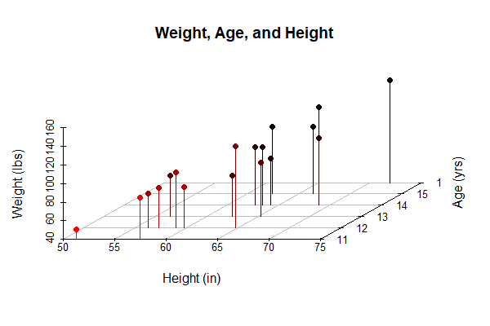
Unpacking a multi-variable relationship
For this example, we will look at the relationship between students’ heights, weights, and ages.
> head(dat)
Name Sex Age Height Weight
1 Alfred M 14 69.0 112.5
2 Alice F 13 56.5 84.0
3 Barbara F 13 65.3 98.0
4 Carol F 14 62.8 102.5
5 Henry M 14 63.5 102.5
6 James M 12 57.3 83.0

Slide 3
Interpreting the R output:
lm(formula = Weight ~ Height + Age, data = dat)
Residuals:
Min 1Q Median 3Q Max
-17.962 -6.010 -0.067 7.553 20.796
Coefficients:
Estimate Std. Error t value Pr(>|t|)
(Intercept) -141.2238 33.3831 -4.230 0.000637 ***
Height 3.5970 0.9055 3.973 0.001093 **
Age 1.2784 3.1101 0.411 0.686492
---
Signif. codes: 0 ‘***’ 0.001 ‘**’ 0.01 ‘*’ 0.05 ‘.’ 0.1 ‘ ’ 1
Residual standard error: 11.51 on 16 degrees of freedom
Multiple R-squared: 0.7729, Adjusted R-squared: 0.7445
F-statistic: 27.23 on 2 and 16 DF, p-value: 7.074e-06

Slide 4
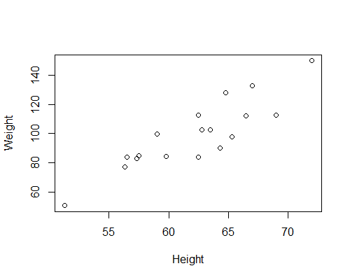
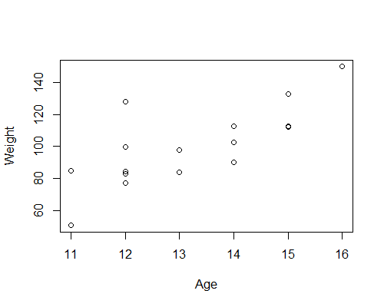
Plot of Weight as a Function of Height and Age
Phillip
Phillip
Joyce
Joyce

Slide 5
Height, Controlling for Age
Weight
Height
Age

Slide 6
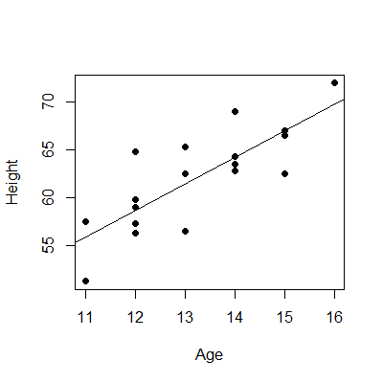
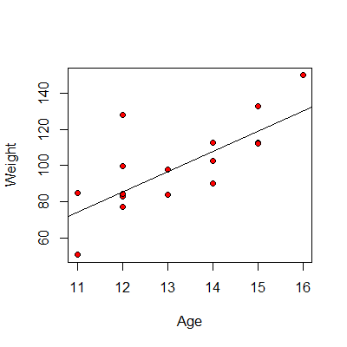
Height, Controlling for Age
We need to remove the shared variance.
Weight
Height
Age

Slide 7
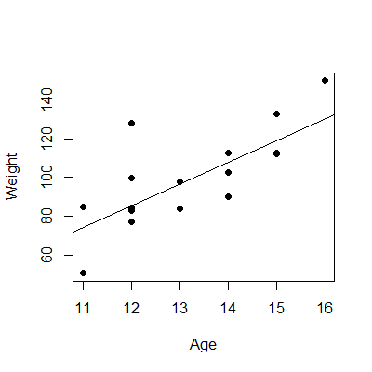

Height, Controlling for Age
We need to remove the shared variance.
Weight
To get the parts height and weight that are independent of age, we need to extract the residuals from these models.
$$y_{i}=b_{0}+b_{1}\left(x_{i}\right)+ε_{i}$$
Height
Age

Slide 8
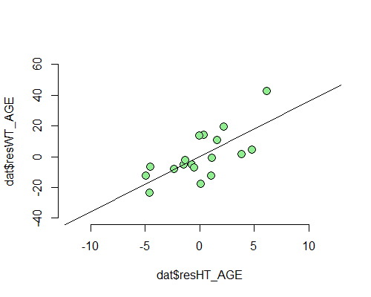
Plot of Residuals Controlling for Age
Coefficients:
Estimate Std. Error t value Pr(>|t|)
(Intercept) 8.374e-16 2.562e+00 0.000 1.000000
resHT_AGE 3.597e+00 8.784e-01 4.095 0.000755 ***
Heavy
for Age
Phillip
Typical
for Age
Joyce
Light
for Age
Short for Age
Typical
for Age
Tall for Age

Slide 9
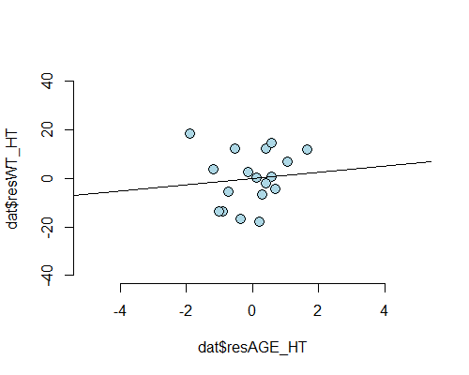
Plot of Residuals Controlling for Age
Coefficients:
Estimate Std. Error t value Pr(>|t|)
(Intercept) 4.975e-16 2.562e+00 0.000 1.000
resAGE_HT 1.278e+00 3.017e+00 0.424 0.677
Heavy
for Height
Phillip
Typical
for Height
Joyce
Light
for Height
Young for Height
Typical
for Height
Old for Height

Slide 10
Multivariable Regression
Regressing these residuals onto each other gives us the same parameter estimates as the multivariable model.
# Full Multivariable Model
Coefficients:
Estimate Std. Error t value Pr(>|t|)
(Intercept) -141.2238 33.3831 -4.230 0.000637 ***
Height 3.5970 0.9055 3.973 0.001093 **
Age 1.2784 3.1101 0.411 0.686492
---
# Weight residuals predicted by height residuals.
# Age variance is removed.
Coefficients:
Estimate Std. Error t value Pr(>|t|)
(Intercept) 8.374e-16 2.562e+00 0.000 1.000000
resHT_AGE 3.597e+00 8.784e-01 4.095 0.000755 ***

Slide 11
Multivariable Regression
Regressing these residuals onto each other gives us the same parameter estimates as the multivariable model.
# Full Multivariable Model
Coefficients:
Estimate Std. Error t value Pr(>|t|)
(Intercept) -141.2238 33.3831 -4.230 0.000637 ***
Height 3.5970 0.9055 3.973 0.001093 **
Age 1.2784 3.1101 0.411 0.686492
---
# Weight residuals predicted by age residuals.
# Height variance is removed.
Coefficients:
Estimate Std. Error t value Pr(>|t|)
(Intercept) 4.975e-16 2.562e+00 0.000 1.000
resAGE_HT 1.278e+00 3.017e+00 0.424 0.677

