Slide 1
Research Design and Analysis: One Categorical Factor with Multiple Levels/ One-Way ANOVA
Keith Lohse, PhD, PStat
Department of Health and Kinesiology
Department of Physical Therapy and Athletic Training
University of Utah
e: rehabinformatics@gmail.com

Slide 2
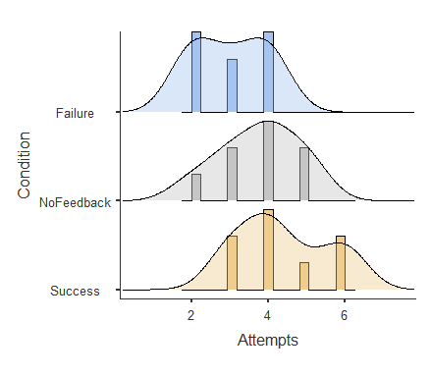
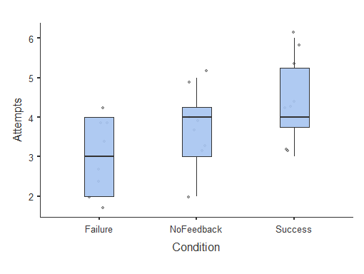
Feedback and Number of Attempts
Condition | Task
Failure | 2
Failure | 2
Failure | 2
Failure | 3
Failure | 4
Failure | 4
Failure | 3
Failure | 4
NoFeedback | 4
NoFeedback | 3
NoFeedback | 4
NoFeedback | 5
NoFeedback | 5
NoFeedback | 2
NoFeedback | 4
NoFeedback | 3
Success | 4
Success | 6
Success | 5
Success | 4
Success | 6
Success | 4
Success | 3
Success | 3

Slide 3
How do we represent categorical differences numerically?
Contrast codes: the levels of our code sum to zero.
Equivalent to mean-centering of continuous variables.
Treatment/ ‘Dummy’ codes: levels of the code do not sum to zero. One group is coded as zero across all levels of the code.
Analogous to having an interpretable 0 in your continuous variable.

Slide 4
How do we represent categorical differences numerically?
Contrast codes: the levels of our code sum to zero.
With multiple codes, we also need to assure their cross-products sum to zero:
 | Failure | No Feedback | Success
λ1 | -1 | 0 | 1
λ2 | 1 | -2 | 1
λ1 * λ2 | -1 | 0 | 1

Slide 5
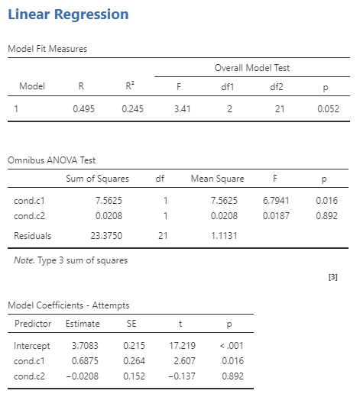
Contrast Coded Factors
 | Failure | No Feedback | Success
λ1 (cond.c1) | -1 | 0 | 1
λ2 (cond.c2) | 1 | -2 | 1
Note that the omnibus test for the overall model has a p=0.052.
Individually, our contrasts have p-values of p=0.016 and p=0.892.

Slide 6
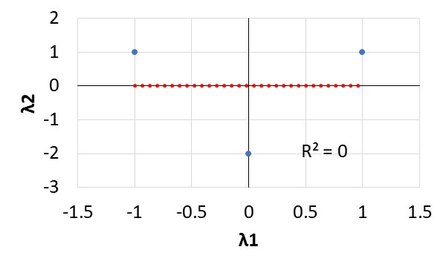
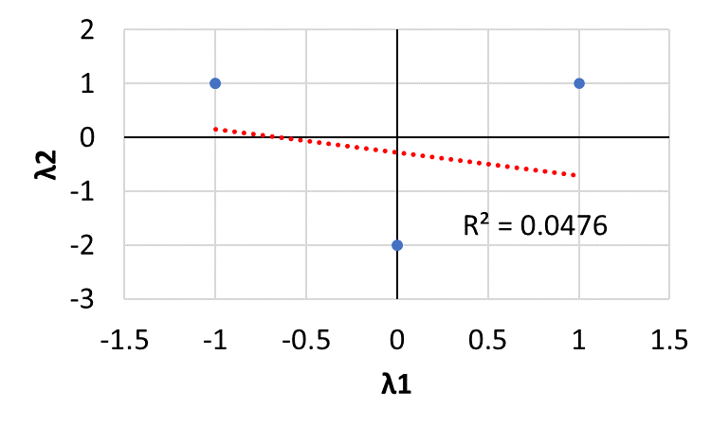
Contrast Codes are Orthogonal with Equal Groups
Group | C.1 | C.2
Failure | -1 | 1
NoFeeback | 0 | -2
Success | 1 | 1
Failure | -1 | 1
NoFeeback | 0 | -2
Success | 1 | 1
Group | C.1 | C.2
Failure | -1 | 1
NoFeeback | 0 | -2
Success | 1 | 1
Failure | -1 | 1
NoFeeback | 0 | -2
Success

Slide 7
How do we represent categorical differences numerically?
Treatment/ ‘Dummy’ codes: levels of the code do not sum to zero. One group is coded as zero across all levels of the code.
 | Failure | No Feedback | Success
λ1 | 1 | 0 | 0
λ2 | 0 | 0 | 1
Note that the no feedback group is our reference group across all codes.

Slide 8
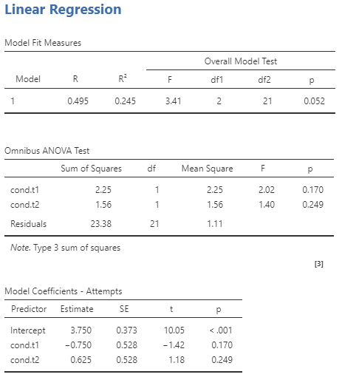
Treatment Coded Factors
 | Failure | No Feedback | Success
λ1 (cond.t1) | 1 | 0 | 0
λ2 (cond.t2) | 0 | 0 | 1
Note that the omnibus test for the overall model still has a p=0.052.
However, our contrasts have p-values of p=0.170 and p=0.249.
Thus, our coding effects the individual coefficients and t-tests, but not the overall model fit and F-test.

Slide 9
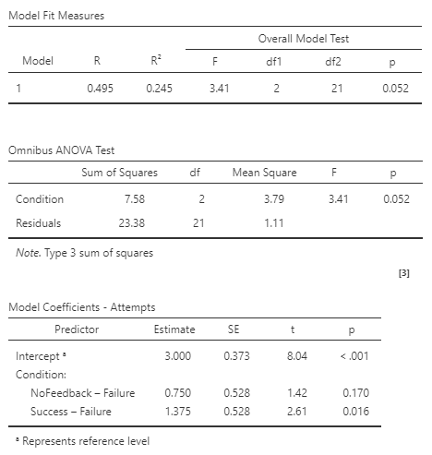
The Omnibus F-test
An omnibus test refers to the simultaneous test of multiple parameters.
Note that the omnibus F-test here has 2 and 21 degrees of freedom, F(2,21)=3.41, p=0.052.

Slide 10
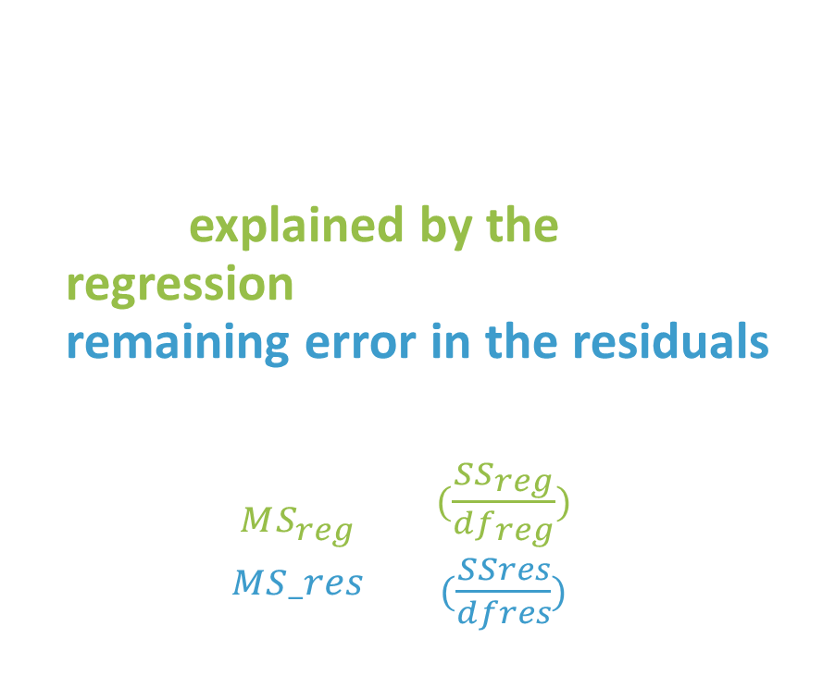
The Omnibus F-test
As we will explain more in the next video, note that the F-test is also a ratio of the mean squared error explained by the regression relative to the remaining error in the residuals.
$F_{obs}=\frac{MS_{reg}}{MS_res}=\frac{(\frac{SS_{reg}}{df_{reg}})}{(\frac{SSres}{dfres})}$

Slide 11
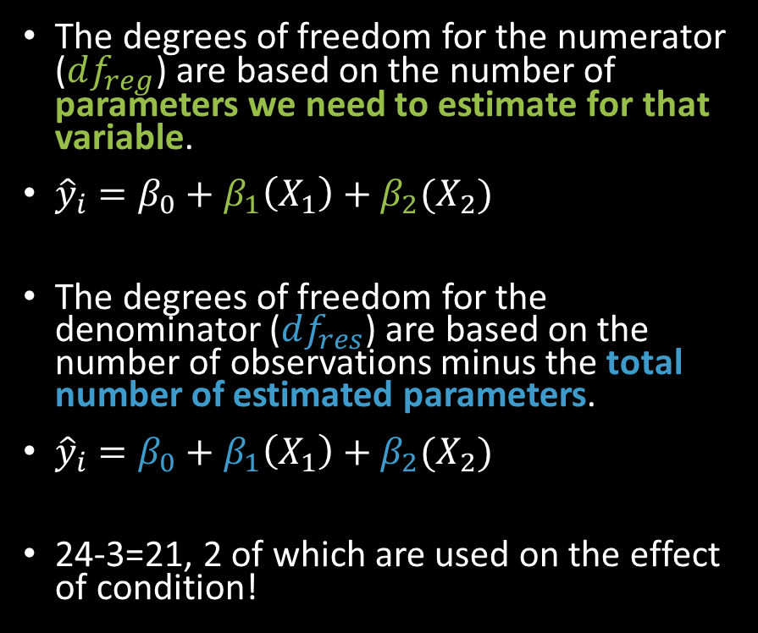
Degrees of Freedom
The degrees of freedom for the numerator ($df_{reg}$) are based on the number of parameters we need to estimate for that variable.
${\hat{y}}_{i}=β_{0}+β_{1}\left(X_{1}\right)+β_{2}(X_{2})$
The degrees of freedom for the denominator ($df_{res}$) are based on the number of observations minus the total number of estimated parameters.
${\hat{y}}_{i}=β_{0}+β_{1}\left(X_{1}\right)+β_{2}(X_{2})$
24-3=21, 2 of which are used on the effect of condition!

Slide 12
Choosing Your Contrasts
Different statistical programs choose your contrasts for you.
For instance, Jamovi uses treatment coding by default, using the first alphabetical level as the reference level.
Understanding how your program is coding these contrasts is essential to interpreting the parameters correctly.

