Slide 1
Research Design and Analysis: Standardized Effect Sizes, r² and η².
Keith Lohse, PhD, PStat
Department of Health and Kinesiology
Department of Physical Therapy and Athletic Training
University of Utah
e: rehabinformatics@gmail.com

Slide 2
Omnibus Tests versus Specific Contrasts
Diet
Exercise
Diet x Exercise
$${Full Model: y}_{i}=β_{0}+β_{1}\left(X_{1i}\right)+β_{2}\left(X_{2i}\right)+β_{3}\left(X_{3i}\right)+β_{4}\left(X_{4i}\right)+β_{5}\left(X_{5i}\right)+ε_{i}$$
 | SS | Df | MS | F | p | r²/η_{p}²
Regression (Full Model) | 960 | 5 | 192.0 | 46.1 | 0.001 | r² ⁼ 0.95
Diet | 450 | 1 | 450 | 108.0 | 0.001 | η_{p}² =0.90
Exercise | 453 | 2 | 226.5 | 53.9 | 0.001 | 0.90
-- X2 | 441 | 1 | 441 | 105.8 | 0.001 | 0.90
-- X3 | 12 | 1 | 12 | 2.9 | 0.110 | 0.19
Diet x Exercise | 57 | 2 | 28.5 | 6.8 | 0.010 | 0.53
-- X4 | 9 | 1 | 9 | 2.2 | 0.160 | 0.15
-- X5 | 48 | 1 | 48 | 11.5 | 0.005 | 0.49
Residuals | 50 | 12 | 4.2
Total | 1010.0 | 17

Slide 3
Omnibus Tests versus Specific Contrasts
Diet
Exercise
Diet x Exercise
$${Full Model: y}_{i}=β_{0}+β_{1}\left(X_{1i}\right)+β_{2}\left(X_{2i}\right)+β_{3}\left(X_{3i}\right)+β_{4}\left(X_{4i}\right)+β_{5}\left(X_{5i}\right)+ε_{i}$$
 | SS | Df | MS | F | p | r²/η_{p}²
Regression (Full Model) | 960 | 5 | 192.0 | 46.1 | 0.001 | r² ⁼ 0.95
Diet | 450 | 1 | 450 | 108.0 | 0.001 | η_{p}² =0.90
Exercise | 453 | 2 | 226.5 | 53.9 | 0.001 | 0.90
-- X2 | 441 | 1 | 441 | 105.8 | 0.001 | 0.90
-- X3 | 12 | 1 | 12 | 2.9 | 0.110 | 0.19
Diet x Exercise | 57 | 2 | 28.5 | 6.8 | 0.010 | 0.53
-- X4 | 9 | 1 | 9 | 2.2 | 0.160 | 0.15
-- X5 | 48 | 1 | 48 | 11.5 | 0.005 | 0.49
Residuals | 50 | 12 | 4.2
Total | 1010.0 | 17
Finally, we can calculate standardized effect sizes such as r², or the related effect-size η², to get a standardized value for the variance explained by each effect.
More on these effect-sizes in another video.

Slide 4
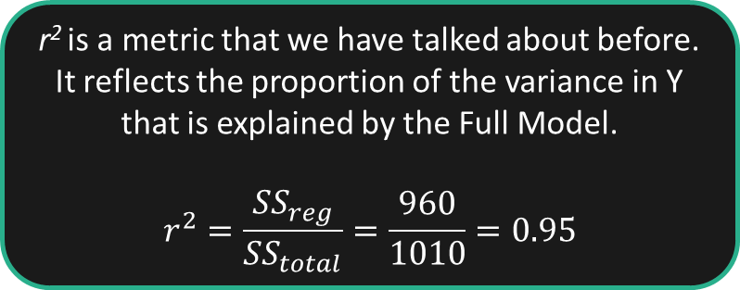
Omnibus Tests versus Specific Contrasts
Diet
Exercise
Diet x Exercise
$${Full Model: y}_{i}=β_{0}+β_{1}\left(X_{1i}\right)+β_{2}\left(X_{2i}\right)+β_{3}\left(X_{3i}\right)+β_{4}\left(X_{4i}\right)+β_{5}\left(X_{5i}\right)+ε_{i}$$
 | SS | … | r²/η_{p}²
Regression (Full Model) | 960 | … | r² ⁼ 0.95
Diet | 450 | … | η_{p}² =0.90
Exercise | 453 | … | 0.90
-- X2 | 441 | … | 0.90
-- X3 | 12 | … | 0.19
Diet x Exercise | 57 | … | 0.53
-- X4 | 9 | … | 0.15
-- X5 | 48 | … | 0.49
Residuals | 50
Total | 1010.0
r² is a metric that we have talked about before. It reflects the proportion of the variance in Y that is explained by the Full Model.
$$r^{2}=\frac{SS_{reg}}{SS_{total}}=\frac{960}{1010}=0.95$$

Slide 5
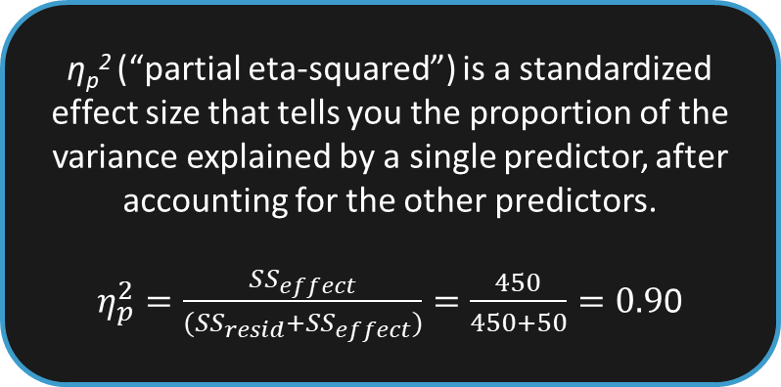
Omnibus Tests versus Specific Contrasts
Diet
Exercise
Diet x Exercise
$${Full Model: y}_{i}=β_{0}+β_{1}\left(X_{1i}\right)+β_{2}\left(X_{2i}\right)+β_{3}\left(X_{3i}\right)+β_{4}\left(X_{4i}\right)+β_{5}\left(X_{5i}\right)+ε_{i}$$
 | SS | … | r²/η_{p}²
Regression (Full Model) | 960 | … | r² ⁼ 0.95
Diet | 450 | … | η_{p}² =0.90
Exercise | 453 | … | 0.90
-- X2 | 441 | … | 0.90
-- X3 | 12 | … | 0.19
Diet x Exercise | 57 | … | 0.53
-- X4 | 9 | … | 0.15
-- X5 | 48 | … | 0.49
Residuals | 50
Total | 1010.0
η_{p}² (“partial eta-squared”) is a standardized effect size that tells you the proportion of the variance explained by a single predictor, after accounting for the other predictors.
$η_{p}^{2}=\frac{SS_{effect}}{(SS_{resid}+SS_{effect})}=\frac{450}{450+50}=0.9$0

Slide 6
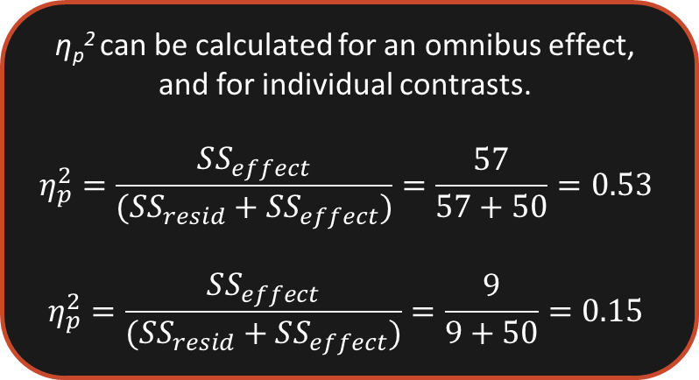
Omnibus Tests versus Specific Contrasts
Diet
Exercise
Diet x Exercise
$${Full Model: y}_{i}=β_{0}+β_{1}\left(X_{1i}\right)+β_{2}\left(X_{2i}\right)+β_{3}\left(X_{3i}\right)+β_{4}\left(X_{4i}\right)+β_{5}\left(X_{5i}\right)+ε_{i}$$
 | SS | … | r²/η_{p}²
Regression (Full Model) | 960 | … | r² ⁼ 0.95
Diet | 450 | … | η_{p}² =0.90
Exercise | 453 | … | 0.90
-- X2 | 441 | … | 0.90
-- X3 | 12 | … | 0.19
Diet x Exercise | 57 | … | 0.53
-- X4 | 9 | … | 0.15
-- X5 | 48 | … | 0.49
Residuals | 50
Total | 1010.0
η_{p}² can be calculated for an omnibus effect, and for individual contrasts.
$$η_{p}^{2}=\frac{SS_{effect}}{(SS_{resid}+SS_{effect})}=\frac{57}{57+50}=0.53$$
$$η_{p}^{2}=\frac{SS_{effect}}{(SS_{resid}+SS_{effect})}=\frac{9}{9+50}=0.15$$

Slide 7
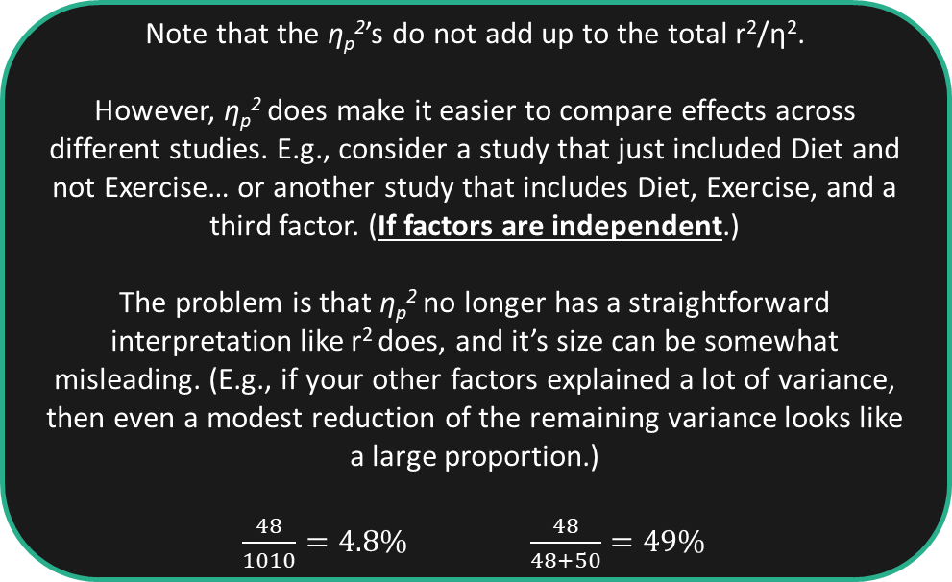
Omnibus Tests versus Specific Contrasts
Diet
Exercise
Diet x Exercise
$${Full Model: y}_{i}=β_{0}+β_{1}\left(X_{1i}\right)+β_{2}\left(X_{2i}\right)+β_{3}\left(X_{3i}\right)+β_{4}\left(X_{4i}\right)+β_{5}\left(X_{5i}\right)+ε_{i}$$
 | SS | … | r²/η_{p}²
Regression (Full Model) | 960 | … | r² ⁼ 0.95
Diet | 450 | … | η_{p}² =0.90
Exercise | 453 | … | 0.90
-- X2 | 441 | … | 0.90
-- X3 | 12 | … | 0.19
Diet x Exercise | 57 | … | 0.53
-- X4 | 9 | … | 0.15
-- X5 | 48 | … | 0.49
Residuals | 50
Total | 1010.0
Note that the η_{p}²’s do not add up to the total r²/η².
However, η_{p}² does make it easier to compare effects across different studies. E.g., consider a study that just included Diet and not Exercise… or another study that includes Diet, Exercise, and a third factor. (If factors are independent.)
The problem is that η_{p}² no longer has a straightforward interpretation like r² does, and it’s size can be somewhat misleading. (E.g., if your other factors explained a lot of variance, then even a modest reduction of the remaining variance looks like a large proportion.)
$\frac{48}{1010}=4.8\%$ $\frac{48}{48+50}=49\%$

Slide 8
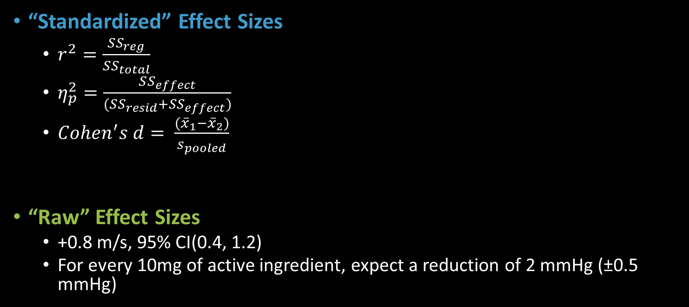
A Note on Effect Sizes
“Standardized” Effect Sizes
$r^{2}=\frac{SS_{reg}}{SS_{total}}$
$η_{p}^{2}=\frac{SS_{effect}}{(SS_{resid}+SS_{effect})}$
$Cohen^{′}s d= \frac{({\overline{x}}_{1}−{\overline{x}}_{2})}{s_{pooled}}$
“Raw” Effect Sizes
+0.8 m/s, 95% CI(0.4, 1.2)
For every 10mg of active ingredient, expect a reduction of 2 mmHg (±0.5 mmHg)

Slide 9

A Note on Effect Sizes
Arbitrary units make them helpful for comparing across studies and different outcome measures.
Often combine “signal to noise” ratios into a single number that make power analysis easier.
“Standardized” Effect Sizes
$r^{2}=\frac{SS_{reg}}{SS_{total}}$
$η_{p}^{2}=\frac{SS_{effect}}{(SS_{resid}+SS_{effect})}$
$Cohen^{′}s d= \frac{({\overline{x}}_{1}−{\overline{x}}_{2})}{s_{pooled}}$
“Raw” Effect Sizes
+0.8 m/s, 95% CI(0.4, 1.2)
For every 10mg of active ingredient, expect a reduction of 2 mmHg (±0.5 mmHg)

Slide 10
A Note on Effect Sizes
Arbitrary units make them helpful for comparing across studies and different outcome measures.
Often combine “signal to noise” ratios into a single number that make power analysis easier.
“Standardized” Effect Sizes
$r^{2}=\frac{SS_{reg}}{SS_{total}}$
$η_{p}^{2}=\frac{SS_{effect}}{(SS_{resid}+SS_{effect})}$
$Cohen^{′}s d= \frac{({\overline{x}}_{1}−{\overline{x}}_{2})}{s_{pooled}}$
“Raw” Effect Sizes
+0.8 m/s, 95% CI(0.4, 1.2)
For every 10mg of active ingredient, expect a reduction of 2 mmHg (±0.5 mmHg)
Real units make differences/relationships easier to understand. Practical/clinical relevance is clearer.
A little more work is needed in power analysis.
Not as useful for survey measures/psychological constructs.

