Slide 1
Research Design and Analysis: Strategies for Post-Hoc Tests.
Keith Lohse, PhD, PStat
Department of Health and Kinesiology
Department of Physical Therapy and Athletic Training
University of Utah
e: rehabinformatics@gmail.com

Slide 2
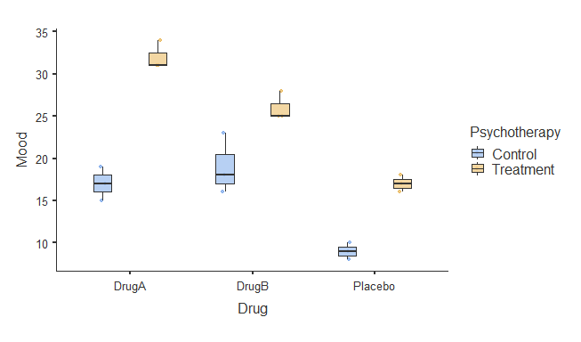
2 x 3 Factorial ANOVA Example
Hypothetical test of the combined effects of psychotherapy and pharmaceutical treatment on depressive symptoms.

Slide 3
2 x 3 Factorial ANOVA Example
ANOVA - Mood
 | Sum of Squares | df | Mean Square | F | p
Overall model | 960.0 | 5 | 192.00 | 46.08 | < .001
Psychotherapy | 450.0 | 1 | 450.00 | 108.00 | < .001
Drug | 453.0 | 2 | 226.50 | 54.36 | < .001
Psychotherapy ✻ Drug | 57.0 | 2 | 28.50 | 6.84 | 0.0104
Residuals | 50.0 | 12 | 4.17

Slide 4
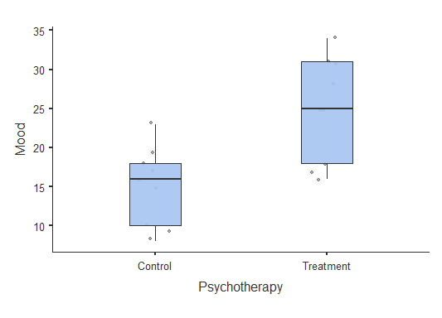
Main Effect of Therapy
ANOVA - Mood
 | Sum of Squares | df | Mean Square | F | p
Overall model | 960.0 | 5 | 192.00 | 46.08 | < .001
Psychotherapy | 450.0 | 1 | 450.00 | 108.00 | < .001
Drug | 453.0 | 2 | 226.50 | 54.36 | < .001
Psychotherapy ✻ Drug | 57.0 | 2 | 28.50 | 6.84 | 0.0104
Residuals | 50.0 | 12 | 4.17

Slide 5
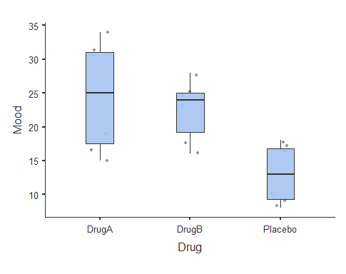
Main Effect of Drug
ANOVA - Mood
 | Sum of Squares | df | Mean Square | F | p
Overall model | 960.0 | 5 | 192.00 | 46.08 | < .001
Psychotherapy | 450.0 | 1 | 450.00 | 108.00 | < .001
Drug | 453.0 | 2 | 226.50 | 54.36 | < .001
Psychotherapy ✻ Drug | 57.0 | 2 | 28.50 | 6.84 | 0.0104
Residuals | 50.0 | 12 | 4.17

Slide 6
Drug x Therapy Interaction
ANOVA - Mood
 | Sum of Squares | df | Mean Square | F | p
Overall model | 960.0 | 5 | 192.00 | 46.08 | < .001
Psychotherapy | 450.0 | 1 | 450.00 | 108.00 | < .001
Drug | 453.0 | 2 | 226.50 | 54.36 | < .001
Psychotherapy ✻ Drug | 57.0 | 2 | 28.50 | 6.84 | 0.0104
Residuals | 50.0 | 12 | 4.17

Slide 7
Post-Hoc Testing Strategies
Strategies for Post-Hoc Testing
Pairwise Comparisons
“Simple Effects”
Correcting for Multiple Comparisons
No Correction
The Bonferroni Correction
Lot’s of things in between…

Slide 8
Pairwise Comparisons
Everything is compared to everything else.
Pros:
Very informative,
Cons:
A high number of tests,
Not all comparisons are meaningful.

Slide 9
Simple Effects Tests
Test the effect of Variable A and every level of Variable B.
Simple effect of Therapy.

Slide 10
Simple Effects Tests
Test the effect of Variable A and every level of Variable B.
Simple effect of Therapy.
Simple effect of Drug
Note that you could also conduct a One-Way ANOVA for the effect of Drug at each level of Therapy before jumping into t-tests.

Slide 11
Simple Effects Tests
Test the effect of Variable A and every level of Variable B.
Simple effect of Therapy.
Simple effect of Drug.
By choosing to do one or both of these simple effects tests, we can reduce the number of post-hoc tests we need to run.

Slide 12
Correcting for Multiple Comparisons
Regardless of the approach we take, post-hoc tests will always lead to multiple comparisons.
Pairwise Comparisons (15 tests)
Simple Effects Tests (3 to 9 tests)

Slide 13
Correcting for Multiple Comparisons
So, how do we control our Type 1 error rate when we need to run a large number of tests?
First, we should almost always avoid conducting individual comparisons unless the omnibus F-test is statistically significant.
Second, we can adjust the α level for each post-hoc test in order to control the Type 1 error rate overall.
No Correction (very liberal)
Bonferroni Correction (very conservative)
There are also many corrections in between.

Slide 14
Correcting for Multiple Comparisons
No correction for multiple comparisons.
The total Type 1 error rate will be higher.
However we also need to worry about the Type 2 error rate.
No correction is only appropriate when the cost of a Type 1 error is lower than a Type 2 error.
Simple Effects Tests (9 tests)
t
t
t
t
t
t
t
t
t
$${Total Error Rate=1−{\left(1−α\right)}^{c}=1−0.95}^{9}=0.37$$

Slide 15

Correcting for Multiple Comparisons
Bonferroni correction for multiple comparisons.
Divide the Type 1 error rate by the total number of comparisons,
$α^{′}=\frac{α}{c}=\frac{0.05}{9}=0.0056$.
Thus, across all of the comparisons you run, the total Type 1 error rate stays the same.
The Bonferroni correction is very conservative and will be most appropriate with the cost of a Type 1 error is high and there are a low-to-moderate number of tests.
Simple Effects Tests (9 tests)
t
t
t
t
t
t
t
t
t

Slide 16
Correcting for Multiple Comparisons
Bonferroni correction for multiple comparisons.
Divide the Type 1 error rate by the total number of comparisons,
$α^{′}=\frac{α}{c}=\frac{0.05}{9}=0.0056$.
Thus, across all of the comparisons you run, the total Type 1 error rate stays the same.
The Bonferroni correction is very conservative and will be most appropriate with the cost of a Type 1 error is high and there are a low-to-moderate number of tests.
Simple Effects Tests (9 tests)
t
t
t
t
t
t
t
t
t
Note that some stats programs adjust the p-value, $p’=p∗c$, rather than the alpha level. Mathematically these are equivalent adjustments.

Slide 17
Correcting for Multiple Comparisons
We can adjust the α level for each post-hoc test in order to control the Type 1 error rate overall.
No Correction (very liberal)
Bonferroni Correction (very conservative)
There are also many corrections in between:
Tukey’s HSD, Holm, Sidak, etc…
The best adjustment to use depends on the number of tests you are going run and the relative cost of Type 1 and Type 2 errors.
However, you should commit to your plan in advance, not make a decision after the fact based on what returns statistically significant results!

