Slide 1
Research Design and Analysis: Models with Repeated Measures (the Dependent Samples T-Test).
Keith Lohse, PhD, PStat
Department of Health and Kinesiology
Department of Physical Therapy and Athletic Training
University of Utah
e: rehabinformatics@gmail.com

Slide 2
The Problem: Keith’s Medical Reasoning Test
Let’s pretend that I have created a test of diagnostic decision making for the AMA. On average, people score about 500 points on this test. If someone scores over 600 points, they show very exceptional diagnostic and medical reasoning.
To the right are the data from 10 subjects who took the medical reasoning test.
Condition 1 is the control condition, where the test was taken prior to being fatigued.
Condition 2 is the experimental condition, the same individuals worked for 12 operational hours prior to re-taking the test.
Subject # | Cond 1 | Cond 2
1 | 567 | 530
2 | 512 | 492
3 | 509 | 510
4 | 593 | 580
5 | 588 | 600
6 | 491 | 483
7 | 520 | 512
8 | 588 | 575
9 | 529 | 530
10 | 508 | 490

Slide 3
540.5
530.2
Individuals
The mean of condition 1 (540.5) and the mean of condition 2 (530.2) are very close to each other. Given the large overlap (spread) it is unlikely that this effect will be significant.

Slide 4

The Independent T-Test
x₁ – x₂= the difference between our sample means
$$t_{obs}=\frac{({\overline{x}}_{1}−\overline{x_{2}})}{s_{{\overline{x}}_{1}−\overline{x_{2}}}}$$
S_{x1-x2} = the standard error of the differences.
Thus, what the t-statistic is asking: Is the difference between our sample means an unusually large difference given the variance?

Slide 5
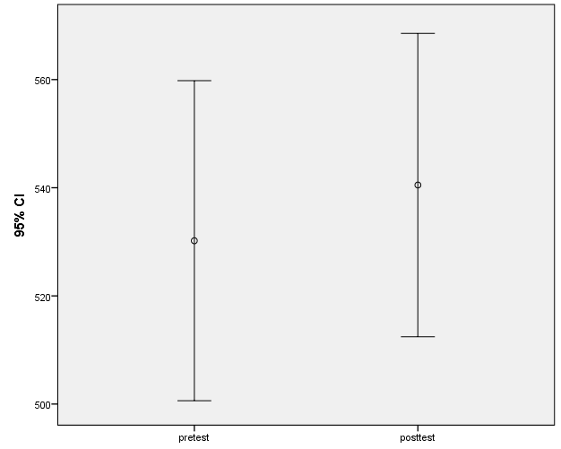
d.f. | t | Sig. (2-tailed) | Mean Difference | Std. Error Difference
18 | -.571 | p = .575 | -10.30000 | 18.02347
There is no significant difference between the mean of Group 1 and the mean of Group 2, t(18) = -.571, p = .58.

Slide 6

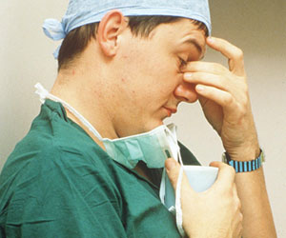
So, what do we conclude?
Based on these data, and the statistical methods we used, we did not find evidence that fatigue has an effect on medical decision making.

Slide 7
But!
...there is a problem with this study. What is wrong with the study the way we tested it?
We used an independent t-test when we have dependent data and this a problem.

Slide 8
This should be a dependent t-test!
Remember that Cond 1 and Cond 2 were the same people at different times!
Subject # | Cond 2 (Pre) | Cond 2 (Post) | Gender | Hand | Age
1 | 567 | 530 | M | R | 24
2 | 512 | 492 | F | R | 26
3 | 509 | 510 | M | R | 25
4 | 593 | 580 | M | L | 27
5 | 588 | 600 | F | L | 24
6 | 491 | 483 | F | R | 25
7 | 520 | 512 | M | R | 26
8 | 588 | 575 | F | R | 26
9 | 529 | 530 | F | L | 25
10 | 508 | 490 | M | R | 24
Notes:
People who score high on the pretest are more likely to score high on the post-test. Thus, the is statistical “dependence” between these observations (i.e., they come from the same people).
People are more likely to be like themselves than other people. In our between subjects test, the effects of fatigue were being “washed out” by individual differences (i.e., variation between individuals was larger than variation as a result of fatigue).
Can I control for variation between individuals to get a better understanding of the effects of fatigue?

Slide 9
Why is dependence a problem?
Individual differences: Data are noisy because people are different.
Some people score high, some people score low, a lot people are in between.
Ability
Experience
Acute effects (hunger, caffeine, etc.)
In a hypothesis test, we want to know what variation in the DV is explained by the IV, and what variance is due to other factors.

Slide 10
Why is dependence a problem?
Repeated measures from the same subjects create a problem, because these scores are statistically dependent on each other!
Dependence means that the occurrence of one event makes another event more or less probable.
Thus, to understand what variance in the DV is explained by the IV, we need to control for this dependence.

Slide 11
Dependence and explained variance.
The basic formula for hypothesis testing statistics:
(variance explained by IV)
(residual variance unexplained)
The bottom part of the equation (unexplained variance) is composed of many parts:
1. due to measurement error 2. due to individual differences
3. due to other factors…
(variance explained by IV) (error + individual differences)
There are many things we can do statistically and experimentally to control for these factors.

Slide 12
Removing individual differences:
0

Slide 13
Dependent t-test
First we can calculate the actual statistical dependence in our data with a correlation:
Subject | Pretest | Posttest
1 | 567 | 530
2 | 512 | 492
3 | 509 | 510
4 | 593 | 580
5 | 588 | 600
6 | 491 | 483
7 | 520 | 512
8 | 588 | 575
9 | 529 | 530
10 | 508 | 490
Paired Samples Correlations
 |  | N | Correlation | Sig.
Pair 1 | pretest & posttest | 10 | .945 | .000
Notes:
Individuals who are high on the pretest are also high on the post test; individuals low on the pretest are low on the posttest. Thus, most of posttest performance is dependent on who you are (better decision makers or worse from the beginning), but the question is that within each subject, is there a significant effect of fatigue?

Slide 14
Dependent t-test
Instead of comparing the difference between means, we subtract paired scores from each other to create difference scores:
Subject | Pretest | Posttest | Difference
1 | 567 | 530 | -37
2 | 512 | 492 | -20
3 | 509 | 510 | 1
4 | 593 | 580 | -13
5 | 588 | 600 | 12
6 | 491 | 483 | -8
7 | 520 | 512 | -8
8 | 588 | 575 | -13
9 | 529 | 530 | 1
10 | 508 | 490 | -18
We now have 10 independent observations!
Knowing the difference score for a single subject does not allow us to predict the score for a different subject.

Slide 15
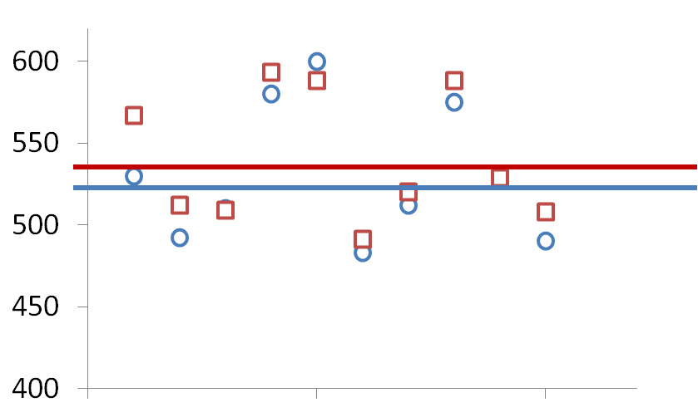
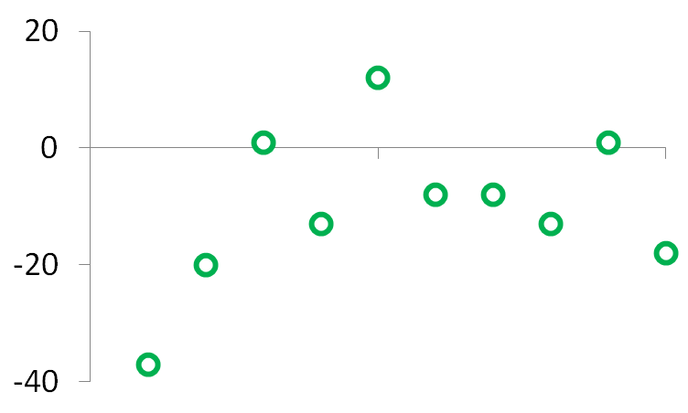



Raw Score
Difference Score
$${\overline{x}}_{D}$$ | = -10.3
s_{D} | = 13.51
SE_{D} | = 4.27
t_{D} | = -2.41
$${\overline{x}}_{D}$$
$$t_{obs}=\frac{{\overline{x}}_{D}−μ_{0}}{\frac{s_{D}}{\sqrt{N}}}$$
By computing the appropriate t-statistic, a dependent t-test, we see that there is a significant effect of fatigue, t(9) = -2.41, p = .03.

Slide 16
So, what do we conclude:
We were interested in the effects of fatigue on a test of diagnostic and medical decision making.
A random sample of 10 medical residents were given a pre-test, worked a 12 hour shift and were then given a post-test.
There was a statistically significant decrease in subjects’ decision making ability from the pre-test (540.5) to the post-test (530.2), t(9) = -2.41, p = .03.
Thus, we conclude that working a full 12-hour shift has a negative effect on medical residents diagnostic and medical decision making.

Slide 17
As an independent T-Test (Incorrect).
d.f. | t | Sig. (2-tailed) | Mean Difference | Std. Error Difference
18 | -.571 | p = .575 | -10.30000 | 18.02347
As a dependent T-Test (Correct).
d.f. | t | Sig. (2-tailed) | Mean Difference | Std. Error Difference
9 | -2.41 | p = .039 | -10.30000 | 4.27
Because scores were nested within subjects, variability due to individual differences were “washing out” the effects of our IV.
By controlling for this nesting (creating independent difference scores) we get a clearer understanding of variation in the DV that is attributable to the IV.

