Slide 1
Research Design and Analysis: Mixing Continuous and Categorical Predictors (ANCOVA).
Keith Lohse, PhD, PStat
Department of Health and Kinesiology
Department of Physical Therapy and Athletic Training
University of Utah
e: rehabinformatics@gmail.com

Slide 2
What makes participants different?
In an experiment, the critical manipulation is our IV.
Ideally, that is the only real difference, on average, between our groups (assuming random assignment and large samples).
We are interested in measuring the DV to understand the effect of the IV.
But there is a lot of variability with the DV.
Due to random samples, individual differences, experimenter error, etc.

Slide 3
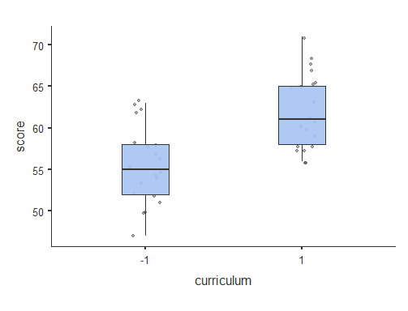
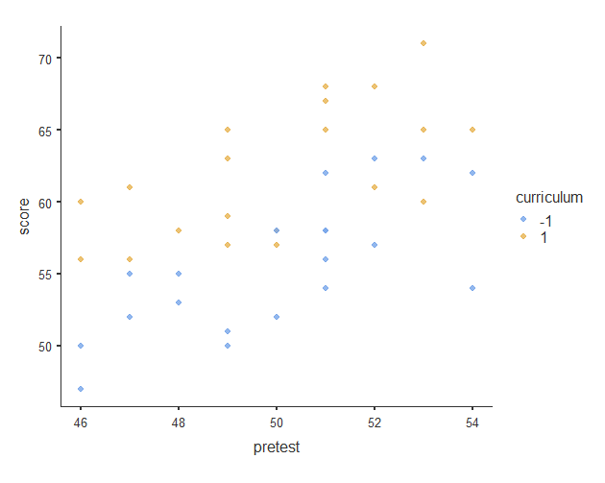
Hypothetical Teaching Intervention

Slide 4
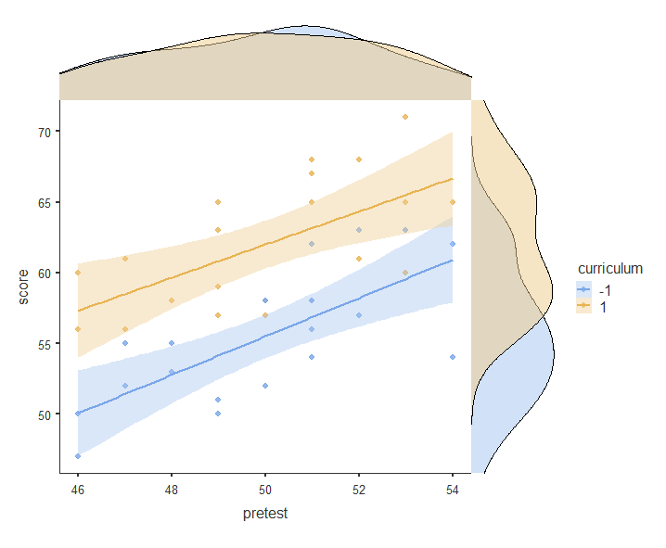
Hypothetical Teaching Intervention

Slide 5



What makes participants different?
Factorial ANOVA
$$SS_{total}=SS_{effect}+SS_{error}$$
$$SS_{effect}$$
SS_{total}
$$SS_{error}$$

Slide 6



What makes participants different?
Factorial ANOVA
ANCOVA
$$SS_{total}=SS_{effect}+SS_{error}$$
$$SS_{total}=SS_{effect}+SS_{subject}+SS_{error}$$
$$SS_{effect}$$
$$SS_{effect}$$
SS_{total}
SS_{total}
$$SS_{subject}$$
$$SS_{error}$$
$$SS_{error}$$

Slide 7



What makes participants different?
Factorial ANOVA
ANCOVA
$$SS_{total}=SS_{effect}+SS_{error}$$
$$SS_{total}=SS_{effect}+SS_{baseline}+SS_{error}$$
$$SS_{effect}$$
$$SS_{effect}$$
SS_{total}
SS_{total}
$$SS_{baseline}$$
$$SS_{error}$$
$$SS_{error}$$
$$F_{obs}=\frac{MS_{effect}}{MS_{error}}$$
$$F_{obs}=\frac{MS_{effect}}{MS_{error}}$$
By accounting for baseline differences, MS_{error} gets smaller, and F_{obs} will be larger, all else being equal.

Slide 8


Analysis of Covariance (ANCOVA)
Including a covariate can remove variability from our DV.
Students differ a lot in their test performance at the end of the intervention. Some that variability is due to the intervention (SS_{effect}), but a lot of that variability is also due to baseline differences in our participants (SS_{baseline}).
By accounting for baseline differences, we can more accurately (powerfully) assess the effect of our intervention.
$$F_{obs}=\frac{MS_{effect}}{MS_{error}}$$

Slide 9
Situation A:
Total Variance in test scores.
Variance explained by curriculum.
Error Variance
Situation B:
Covariate is independent of IV.
Total Variance in radial error.
Variance explained by curriculum.
Error Variance
Variance explained by covariate.
Situation C:
Covariate is correlated with IV and DV.
Total Variance in radial error.
Variance explained by curriculum.
Variance explained by covariate.
Error Variance

Slide 10

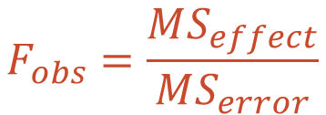
Teaching Intervention
Factorial ANOVA
$$y_{i}=β_{0}+β_{1}\left(Curriculum_{i}\right)+ε_{i}$$
 | SS | Df | MS | F
Regression | 422.5 | 1 | 422.5 | 20.2
Curriculum | 422.5 | 1 | 422.5 | 20.2
Residuals | 795.0 | 38
Total | 1218.0 | 39
$$F_{obs}=\frac{MS_{effect}}{MS_{error}}$$

Slide 11


Teaching Intervention
Factorial ANOVA
ANCOVA
$$y_{i}=β_{0}+β_{1}\left(Curriculum_{i}\right)+ε_{i}$$
$$y_{i}=β_{0}+β_{1}\left(Base_{i}\right)+β_{2}(Curriculum_{i})+ε_{i}$$
 | SS | Df | MS | F
Regression | 422.5 | 1 | 422.5 | 20.2
Curriculum | 422.5 | 1 | 422.5 | 20.2
Residuals | 795.0 | 38
Total | 1218.0 | 39
 | SS | Df | MS | F
Regression | 784.4 | 1 | 392.21 | 33.51
Curriculum | 422.5 | 1 | 422.5 | 36.10
Baseline | 361.9 | 1 | 361.9 | 30.92
Residuals | 433.1 | 37
Total | 1218.0 | 39
$$F_{obs}=\frac{MS_{effect}}{MS_{error}}$$
By accounting for baseline differences, MS_{error} gets smaller, and F_{obs} will be larger, all else being equal.
$$F_{obs}=\frac{MS_{effect}}{MS_{error}}$$

Slide 12
Why is ANCOVA useful?
Removing variability from our error term:
In an ANCOVA, we are interested in the same thing as an ANOVA; the effect of an IV with multiple levels. The problem is that increased variability within our groups might be “masking” the effect of the IV.
When our assumptions are met, we can remove variance that is shared with between the DV and the Covariate.
By reducing the size of SSerror relative to SSeffect, we have a more powerful statistical comparison.
But only when the assumptions are met! Randomly throwing in covariates or adding covariates associated with the IV can actually reduce power.

Slide 13
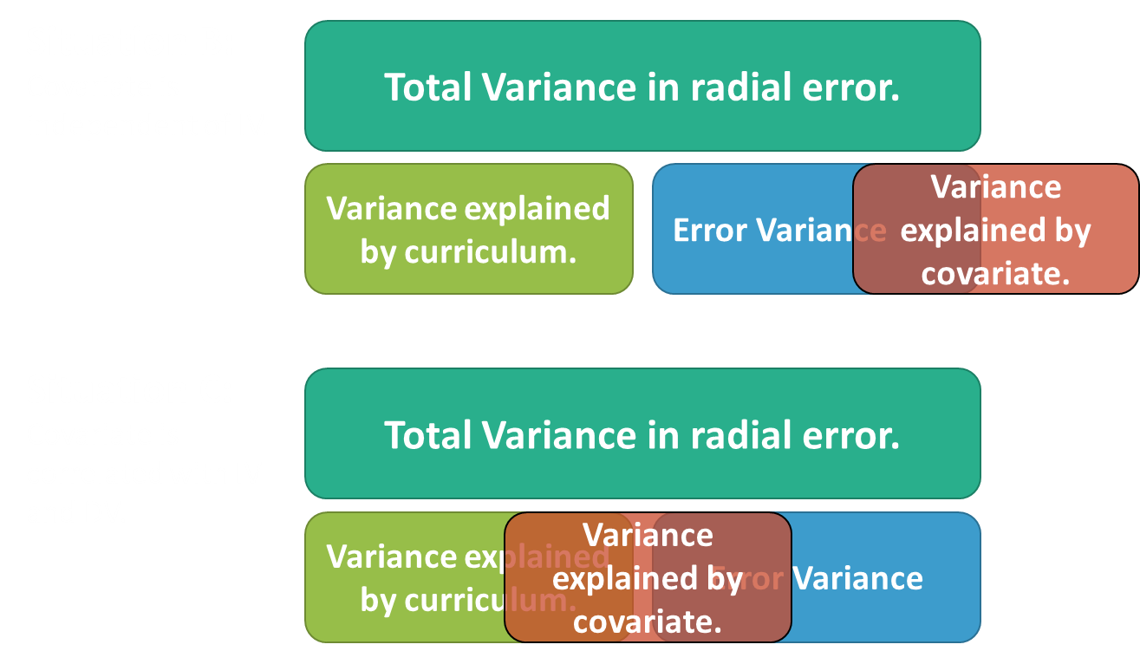
ANCOVA Consideration #1.
ANCOVA can be a useful technique for improving the statistical power of an ANOVA.
Improves statistical power.
Can lower statistical power and may spuriously alter the effect of the IV (depending on IV-DV-Covariate relationships).

Slide 14
ANCOVA Consideration #1.
Independence of the covariate and the categorical factor can be violated by a number of reasons, but a common one is baseline differences.
E.g., what if my experimental curriculum group already had higher scores?
Many people will thus use ANCOVA to “correct for” baseline imbalances between the two groups.
This works statistically (e.g., multivariable regression with Type III SS), but it is not as simple as that.
I won’t delve into the full complexity of the issue here (see Lord’s paradox), but here are some things to keep in mind:
You can run an ANCOVA when groups differ at baseline and get unbiased estimates of treatment effects.
ANCOVA will generally be preferable to other methods of adjusting for baseline (e.g., change scores or percent change).
However, do not select covariates based on statistically significant baseline differences.

Slide 15
ANCOVA consideration #2
It is important to recognize that ANCOVA is just a special case of the GLM where we are adjusting for a continuous covariate in order to test the effect of our categorical factor.
However, look at the model:
We are assuming that there is no interaction between these two terms and only main-effects are needed.
$$y_{i}=β_{0}+β_{1}\left(Base_{i}\right)+β_{2}(Curriculum_{i})+ε_{i}$$

Slide 16
ANCOVA consideration #2
This assumption is referred to as homogeneity of regression slopes:
i.e., effect of covariate is the same at all levels of the factor.
Different stat programs handle testing this assumption differently, but note it is just adding an interaction to your regression:
$$y_{i}=β_{0}+β_{1}\left(B_{i}\right)+β_{2}\left(C_{i}\right)+β_{3}(BxC_{i})+ε_{i}$$

Slide 17
ANCOVA consideration #2
Homogeneity of regression slopes
Predictor | Estimate | SE | t | p
Intercept | 58.75 | 0.547 | 107.38 | <0.001
Baseline | 1.26 | 0.230 | 5.49 | <0.001
Curriculum | 6.5 | 1.094 | 5.94 | <0.001
B x C | -0.19 | 0.460 | -0.41 | 0.6822
Note that continuous predictors are mean centered and categorical predictors are contrast coded.
$$y_{i}=β_{0}+β_{1}\left(B_{i}\right)+β_{2}\left(C_{i}\right)+β_{3}(BxC_{i})+ε_{i}$$

Slide 18
ANCOVA
ANCOVA is a really efficient method of analysis for parallel group trials where participants are randomized to different conditions and you need to control for baseline variables.
It can also be used in non-randomized/cohort studies where participants are not randomly assigned to groups.
$$y_{i}=β_{0}+β_{1}\left(B_{i}\right)+β_{2}\left(C_{i}\right)+β_{3}(BxC_{i})+ε_{i}$$
Categorical Factor
Continuous Covariate
Test for homogeneity of regression slopes

