Slide 1
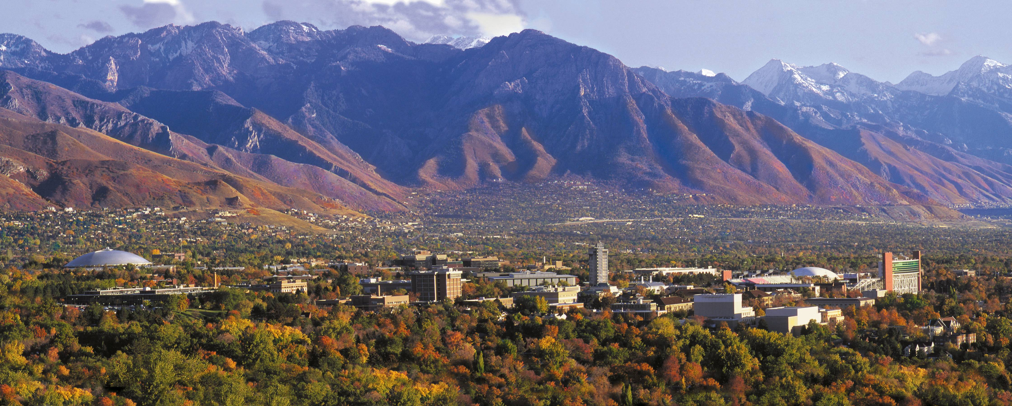



Models with Ill-Mannered Error
Keith Lohse, PhD, PStat
Assistant Professor
Department of Health, Kinesiology, and Recreation
Department of Physical Therapy and Athletic Training
University of Utah
keith.lohse@health.utah.edu
@keith_lohse

Slide 2

Assumptions so far…
$$Data=Model+Error$$
$$y_{i}=β_{0}+β_{1}x_{1i}+β_{2}x_{2i}…+β_{n}x_{ni}+ε_{i}$$
In these models, we have made important assumptions about the residuals (ε’s).
They are independent of each other. (independence assumption)
They are normally distributed. (normality assumption)
They have a constant variance. (homoscedasticity/homogeneity of variance assumption)

Slide 3
Assumptions so far…
$$Data=Model+Error$$
$$y_{i}=β_{0}+β_{1}x_{1i}+β_{2}x_{2i}…+β_{n}x_{ni}+ε_{i}$$
In these models, we have made important assumptions about the residuals (ε’s).
They are independent of each other. (independence assumption)
They are normally distributed. (normality assumption)
They have a constant variance. (homoscedasticity/homogeneity of variance assumption)
Chapter 11

Slide 4
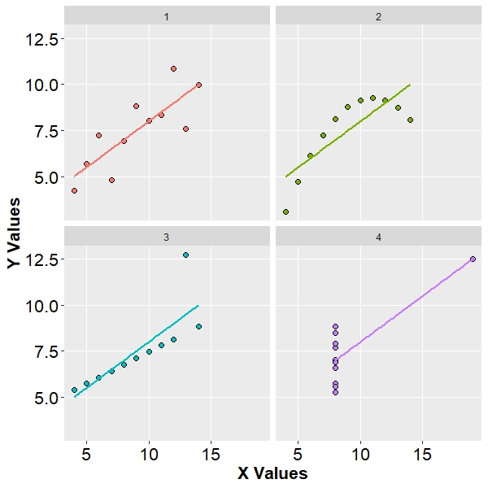
All of these datasets have exactly the same slopes and intercepts:
b0 = 3.0, p = 0.026
b1 = 0.5, p = 0.002
However, only example Number 1 represents what we would really think of as a “fair” linear relationship between X and Y.
These four examples are known as Anscombe’s Quartet (Anscombe, 1973).
These figures highlight the importance of graphing our data before we analyze it, checking our regression diagnostics, and checking our regression assumptions.

Slide 5
Regression Diagnostics and Statistical Assumptions
Diagnostics (checking for “Idiosyncratic” Errors):
Leverage (extreme values in X)
Outliers (extreme values in Y)
Influence (data-points that substantially affect the model)
Assumptions (checking for “Systematic” Errors):
Normality
Homosckedasticity/Homogeneity of Variance

