Slide 1




Leverage – Unusual Values in X
Keith Lohse, PhD, PStat
Assistant Professor
Department of Health, Kinesiology, and Recreation
Department of Physical Therapy and Athletic Training
University of Utah
keith.lohse@health.utah.edu
@keith_lohse

Slide 2
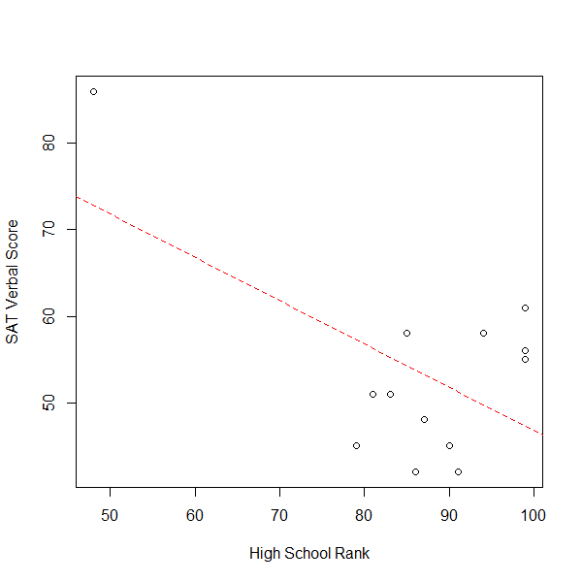
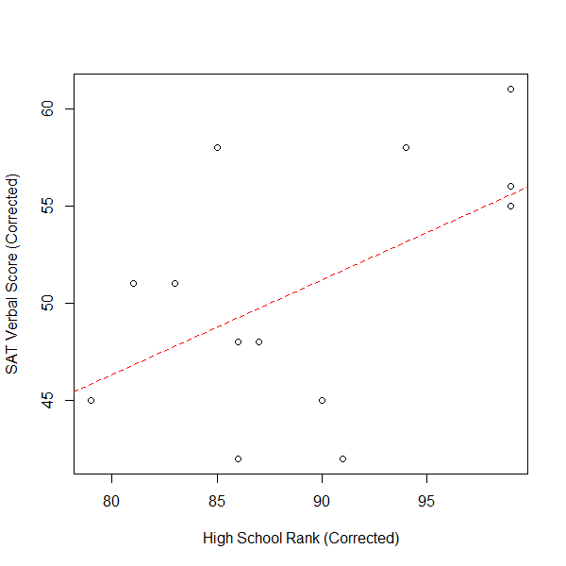
Identifying “Levers”
> DAT2
ID SAT HSR
1 42 91
2 48 87
3 58 85
4 45 79
5 45 90
6 86 48
7 51 83
8 56 99
9 51 81
10 58 94
11 42 86
12 55 99
13 61 99

Slide 3
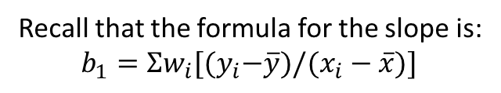
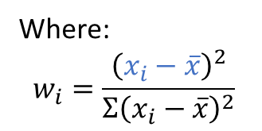
Identifying “Levers”
Recall that the formula for the slope is:
$$b_{1}=Σw_{i}[{(y}_{i}−\overline{y})/(x_{i}−\overline{x})]$$
Where:
$$w_{i}=\frac{{\left(x_{i}−\overline{x}\right)}^{2}}{Σ{\left(x_{i}−\overline{x}\right)}^{2}}$$
Thus, the farther away a single data-point is, relative to the total distance in the data-points, the more weight that data point will have over the slope.
Thus, we refer to these data points as “levers” because the farther away they are, the easier it is to move the slope around.

Slide 4
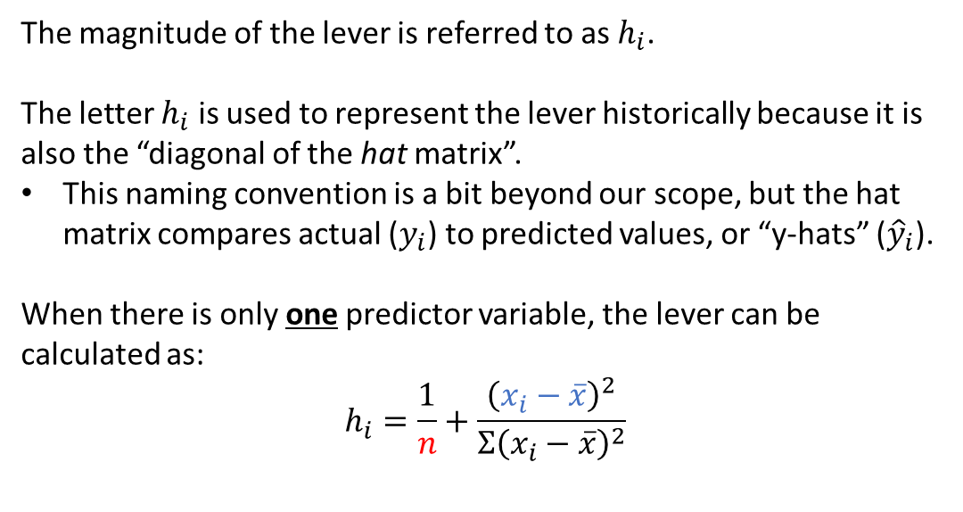
Calculating a Lever
The magnitude of the lever is referred to as $h_{i}$.
The letter $h_{i}$ is used to represent the lever historically because it is also the “diagonal of the hat matrix”.
This naming convention is a bit beyond our scope, but the hat matrix compares actual ($y_{i}$) to predicted values, or “y-hats” (${\hat{y}}_{i}$).
When there is only one predictor variable, the lever can be calculated as:
$$h_{i}=\frac{1}{n}+\frac{{\left(x_{i}−\overline{x}\right)}^{2}}{Σ{\left(x_{i}−\overline{x}\right)}^{2}}$$

Slide 5
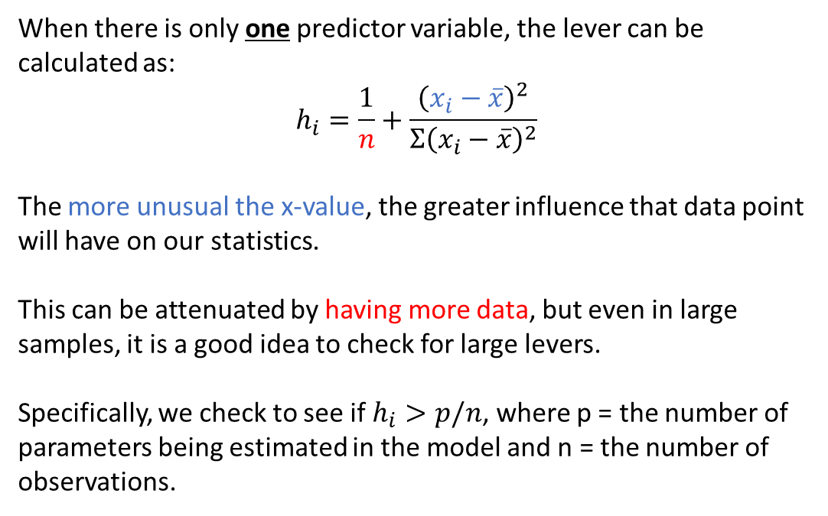
Calculating a Lever
When there is only one predictor variable, the lever can be calculated as:
$$h_{i}=\frac{1}{n}+\frac{{\left(x_{i}−\overline{x}\right)}^{2}}{Σ{\left(x_{i}−\overline{x}\right)}^{2}}$$
The more unusual the x-value, the greater influence that data point will have on our statistics.
This can be attenuated by having more data, but even in large samples, it is a good idea to check for large levers.
Specifically, we check to see if $h_{i}>p/n$, where p = the number of parameters being estimated in the model and n = the number of observations.

Slide 6
Why is leverage bad?
Ideally, we want a model that accurately represents all of the data.
If leverage is high, that means one data point has disproportionate influence on the model.
Having the model driven by a single observation is clearly inconsistent with the goal of having the model describe all of the data.

