Slide 1




Outliers – Unusual Values in Y
Keith Lohse, PhD, PStat
Assistant Professor
Department of Health, Kinesiology, and Recreation
Department of Physical Therapy and Athletic Training
University of Utah
keith.lohse@health.utah.edu
@keith_lohse

Slide 2
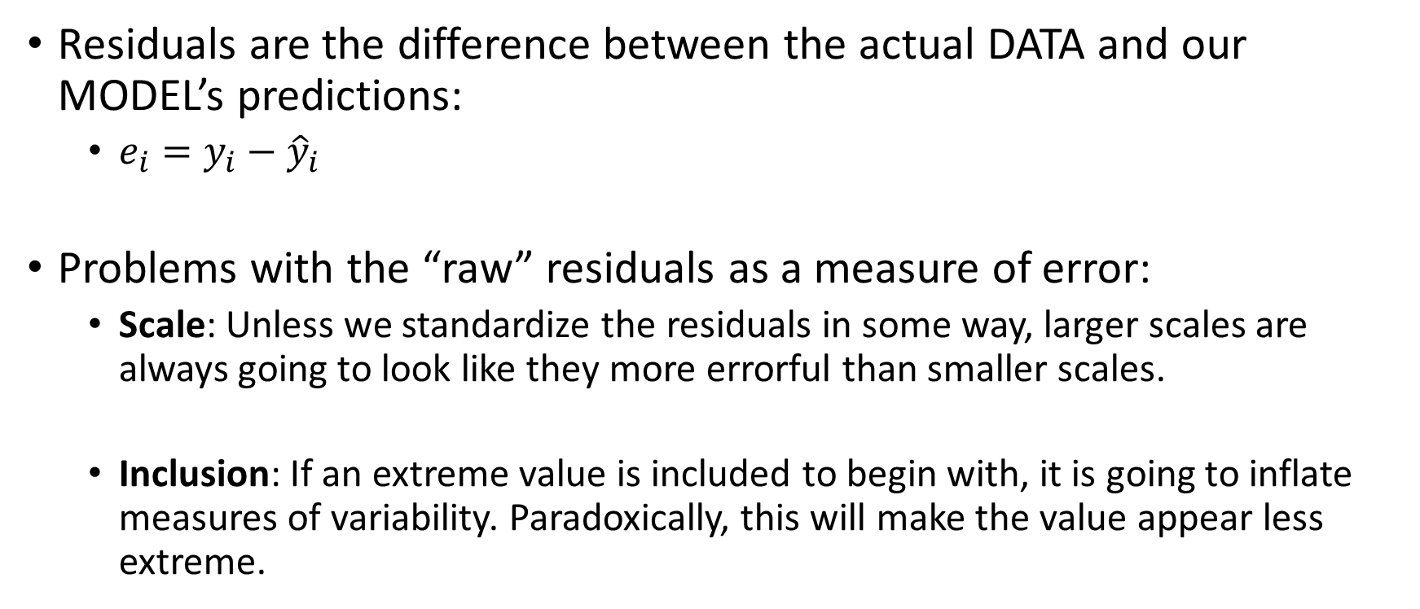
Identifying Residual “Outliers”
Residuals are the difference between the actual DATA and our MODEL’s predictions:
$e_{i}=y_{i}−{\hat{y}}_{i}$
Problems with the “raw” residuals as a measure of error:
Scale: Unless we standardize the residuals in some way, larger scales are always going to look like they more errorful than smaller scales.
Inclusion: If an extreme value is included to begin with, it is going to inflate measures of variability. Paradoxically, this will make the value appear less extreme.

Slide 3
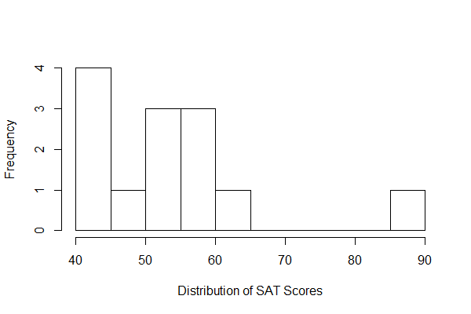
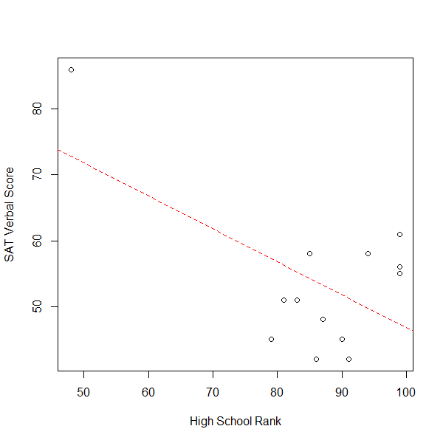
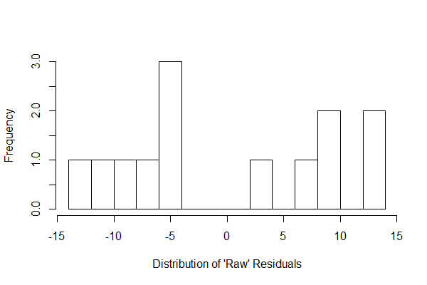
Identifying Residual “Outliers”
> DAT2
ID SAT HSR
1 42 91
2 48 87
3 58 85
4 45 79
5 45 90
6 86 48
7 51 83
8 56 99
9 51 81
10 58 94
11 42 86
12 55 99
13 61 99

Slide 4
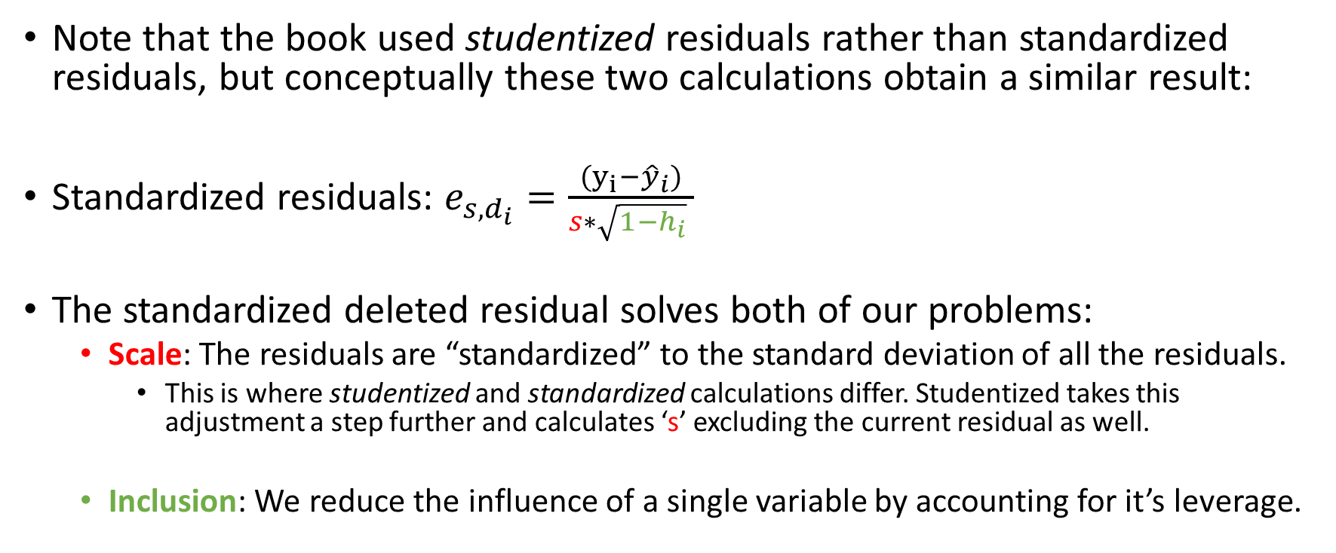
R uses Standardized Deleted Residuals by Default
Note that the book used studentized residuals rather than standardized residuals, but conceptually these two calculations obtain a similar result:
Standardized residuals: $e_{s,d_{i}}=\frac{(y_{i}−{\hat{y}}_{i})}{s∗\sqrt{1−h_{i}} }$
The standardized deleted residual solves both of our problems:
Scale: The residuals are “standardized” to the standard deviation of all the residuals.
This is where studentized and standardized calculations differ. Studentized takes this adjustment a step further and calculates ‘s’ excluding the current residual as well.
Inclusion: We reduce the influence of a single variable by accounting for it’s leverage.

Slide 5
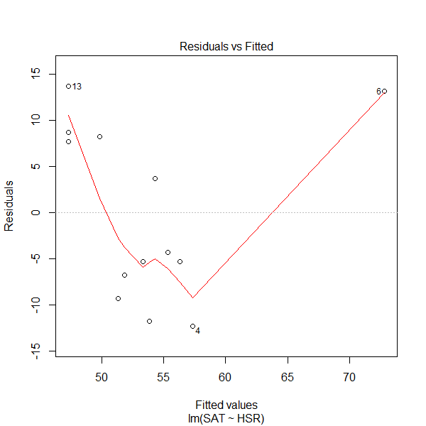
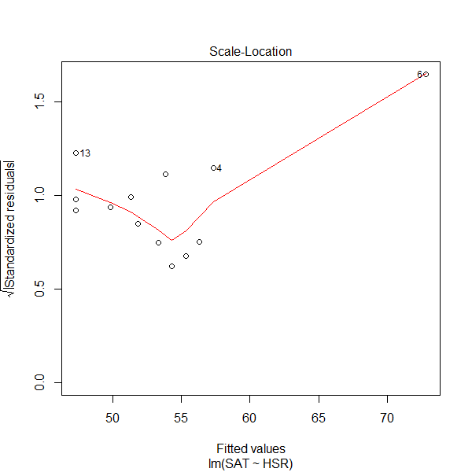
Identifying Residual “Outliers”

Slide 6
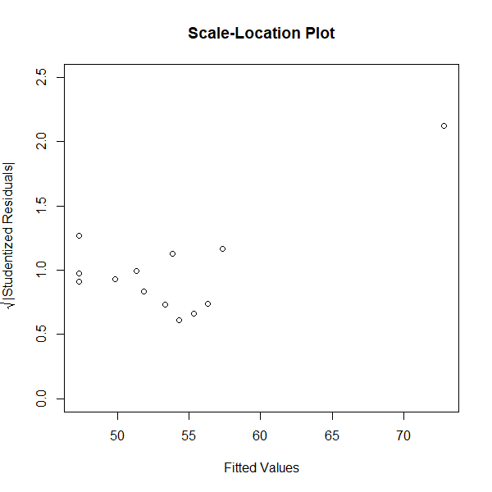
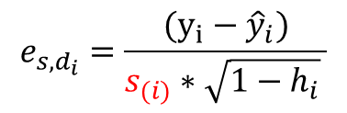
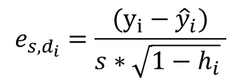
Standardized versus Studentized Residuals
$$e_{s,d_{i}}=\frac{(y_{i}−{\hat{y}}_{i})}{s∗\sqrt{1−h_{i}} }$$
$$e_{s,d_{i}}=\frac{(y_{i}−{\hat{y}}_{i})}{s_{(i)}∗\sqrt{1−h_{i}} }$$

Slide 7
Why are outliers bad?
Ideally, we want a model that accurately represents all of the data.
If a single (or several data points) are large outliers, this could be diagnostic of several things:
Some error has occurred in the coding/recording of the data,
That data point does not actually belong to the sample in question,
That data point could be pulling our model away from the other data points.
Thus, the presence of an outlier is not grounds for exclusion of data in itself, but it should raise questions that force us to take a harder look at our data and our model.

