Slide 1




Influence – Changing the Model
Keith Lohse, PhD, PStat
Assistant Professor
Department of Health, Kinesiology, and Recreation
Department of Physical Therapy and Athletic Training
University of Utah
keith.lohse@health.utah.edu
@keith_lohse

Slide 2
Identifying “Influential” Data Points
Thus far we have discussed how we detect unusual values in x (levers) and unusual values in y (outliers).
Combining these two factors, we can measure the “influence” of individual data points.
Influence refers to the affect that a data point has on our model when it is present compared to when it is absent.
An influential data point can change our parameter estimates in either their magnitude, their statistical significance, or both.
As such, influential data points are often excluded (and models re-run) because we want our model to reflect all the data, not be swayed by a single strange point.

Slide 3
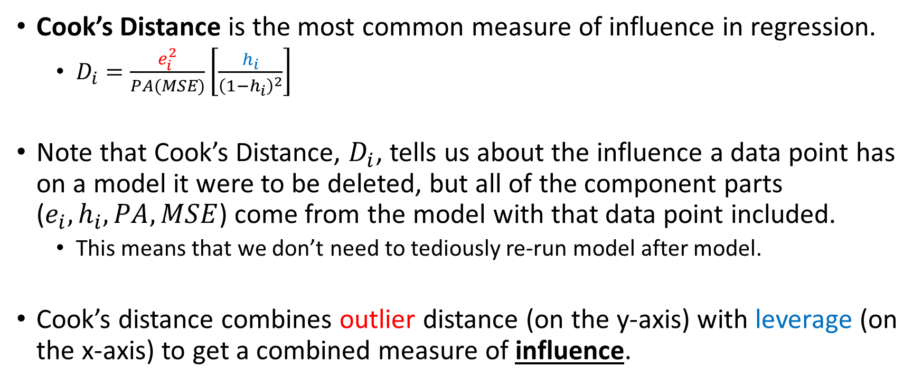
Calculating Influence
Cook’s Distance is the most common measure of influence in regression.
$D_{i}=\frac{e_{i}^{2}}{PA(MSE)}\left[\frac{h_{i}}{{\left(1−h_{i}\right)}^{2}}\right]$
Note that Cook’s Distance, $D_{i}$, tells us about the influence a data point has on a model it were to be deleted, but all of the component parts ($e_{i}, h_{i}, PA, MSE$) come from the model with that data point included.
This means that we don’t need to tediously re-run model after model.
Cook’s distance combines outlier distance (on the y-axis) with leverage (on the x-axis) to get a combined measure of influence.

Slide 4
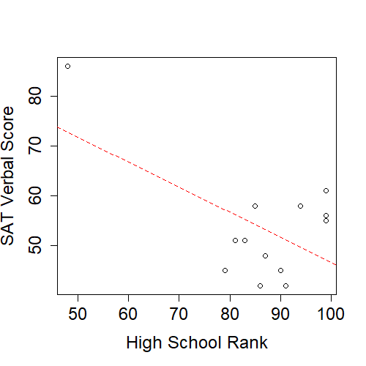
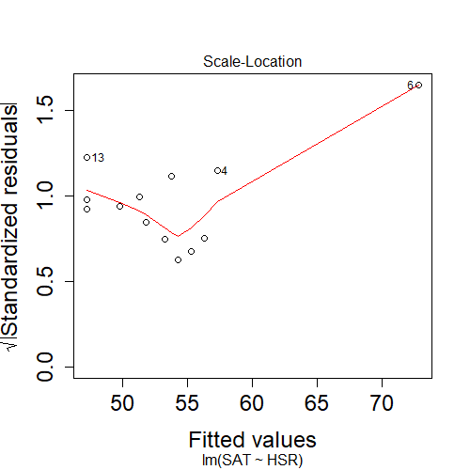
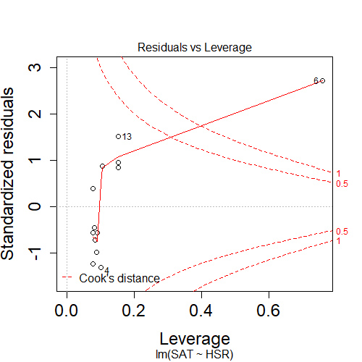

Slide 5
Influential data point included:
Influential data point removed:
Coefficients:
Estimate Std. Error t value Pr(>|t|)
(Intercept) 96.8852 18.6356 5.199 0.000295 ***
HSR -0.5009 0.2138 -2.343 0.038946 *
Coefficients:
Estimate Std. Error t value Pr(>|t|)
(Intercept) 8.2919 22.6394 0.366 0.7218
HSR 0.4776 0.2525 1.892 0.0878 .

