Slide 1




Systematics Violations of Error Assumptions
Keith Lohse, PhD, PStat
Assistant Professor
Department of Health, Kinesiology, and Recreation
Department of Physical Therapy and Athletic Training
University of Utah
keith.lohse@health.utah.edu
@keith_lohse

Slide 2
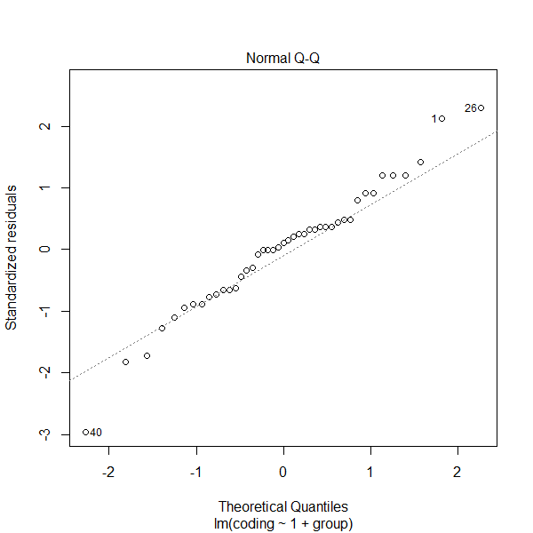
1. Normality
Assumption: Our residuals follow a normal distribution.
This assumption can be checked with a quantile-quantile normal plot, histogram, or density plot of the residuals.
It can also be checked with goodness of fit tests like the Shapiro-Wilk test or the Kolmogorov-Smirnov test.
But remember that violation is continuous not categorical.

Slide 3
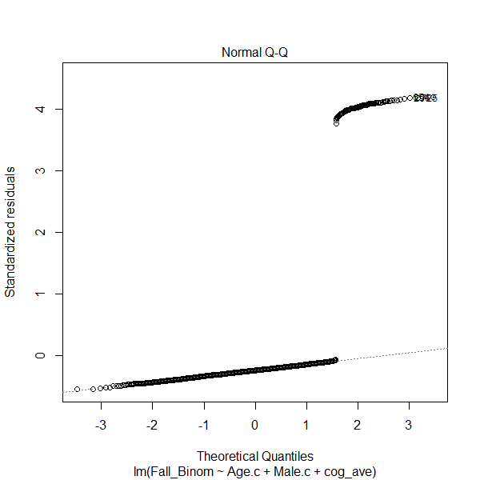
1. Normality
Assumption: Our residuals follow a normal distribution.
What happens if we violate this assumption?
Violation of the normality assumption does not create bias or inefficiency in our estimation.
However, it does affect our error terms and thus the calculation of p-values.
The more your residuals depart from normality, the less reliable your p-values are.

Slide 4
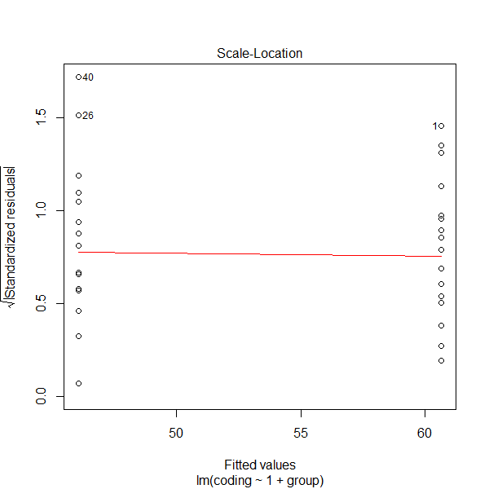
2. Homoscedasticity
Assumption: Our residuals have an equal variance across all levels of the fitted-values.
This assumption can be checked with a Scale-Location plot, or by regressing the standardized/studentized residuals onto the fitted values.

Slide 5
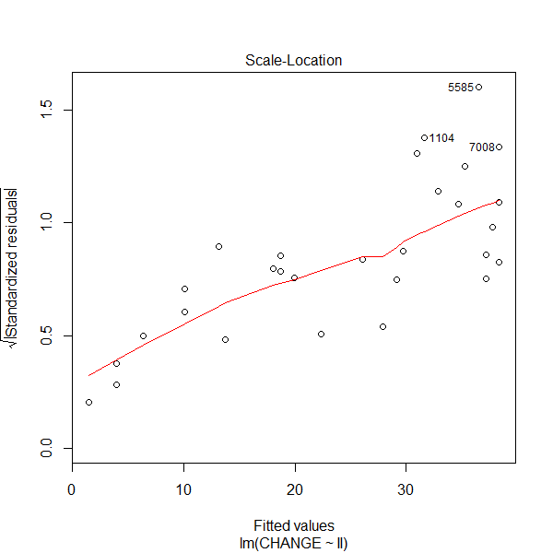
2. Homoscedasticity
Assumption: Our residuals have an equal variance across all levels of the fitted-values.
What happens if we violate this assumption?
In OLS regression, we assume constant variance in the calculation of standard errors, which are necessary for the calculation of p-values.
The more heterogeneous your residuals, the less reliable your p-values are.

Slide 6
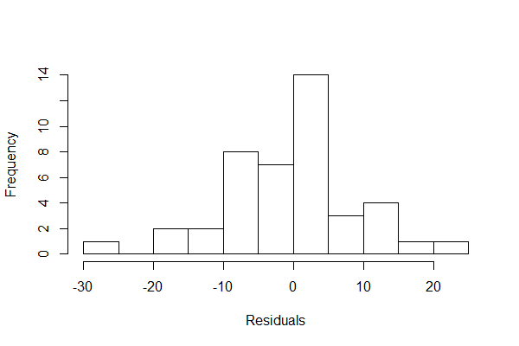
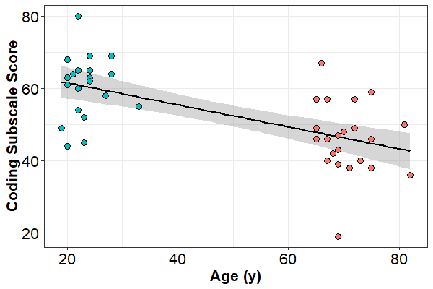
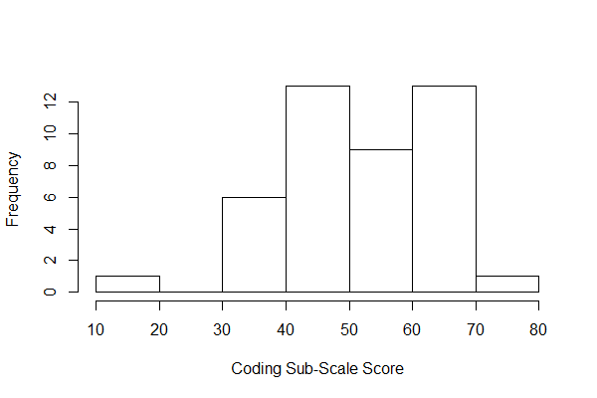
3. Well-Behaved Residuals

Slide 7
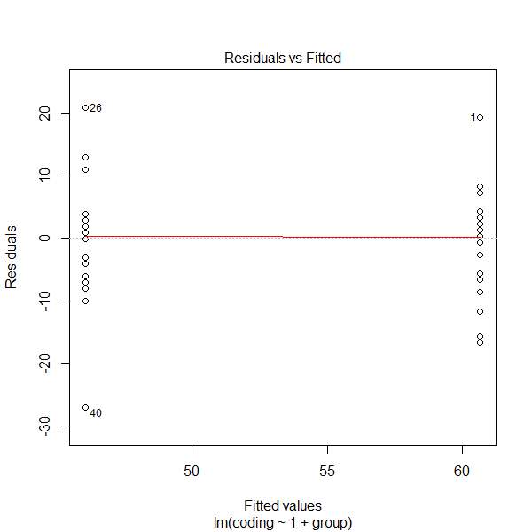
3. Well-Behaved Residuals
plot(model_name)
$$Coding =β_{0}+β_{1}\left(Age Group_{i}\right)+ε_{i}$$

Slide 8
3. Well-Behaved Residuals
plot(model_name)
$$Coding =β_{0}+β_{1}\left(Age Group_{i}\right)+ε_{i}$$

Slide 9
3. Well-Behaved Residuals
plot(model_name)
$$Coding =β_{0}+β_{1}\left(Age Group_{i}\right)+ε_{i}$$

Slide 10
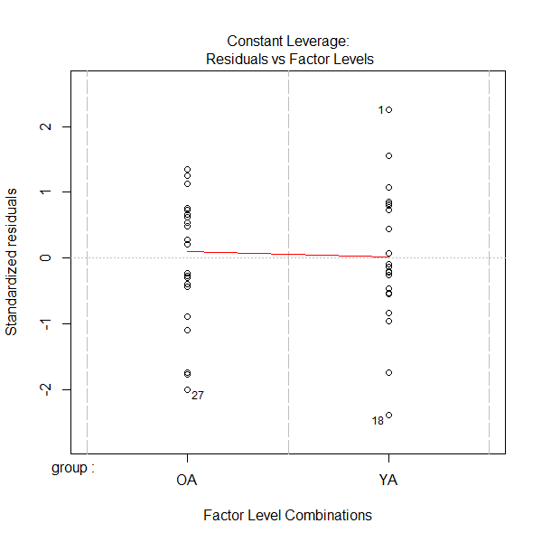
3. Well-Behaved Residuals
plot(model_name)
$$Coding =β_{0}+β_{1}\left(Age Group_{i}\right)+ε_{i}$$

Slide 11
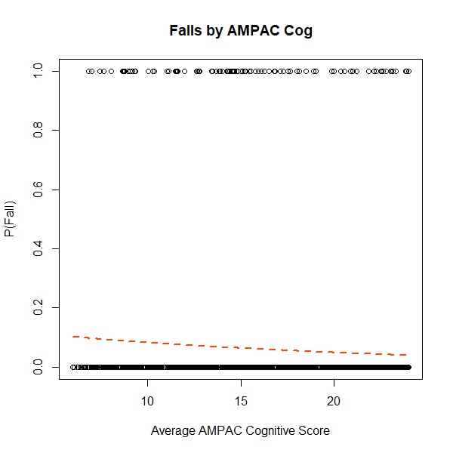
4. Clear Violations
In this example, we will be looking at a binomial outcome (did a person experience a fall or not) as a function of their score on a cognitive assessment.
We would never want to do this, as the binomial data will lead to substantial violations of our assumptions, but it is illustrative for educational purposes.

Slide 12
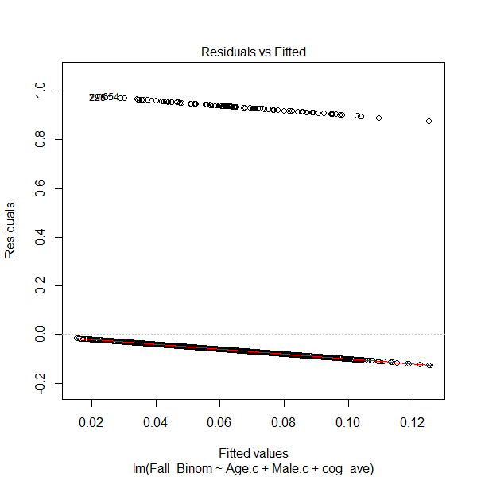

4. Clear Violations
plot(model_name)
$$Fall =β_{0}+β_{1}\left(AMPAC_{i}\right)+ε_{i}$$

Slide 13
4. Clear Violations
plot(model_name)
$$Fall =β_{0}+β_{1}\left(AMPAC_{i}\right)+ε_{i}$$

Slide 14
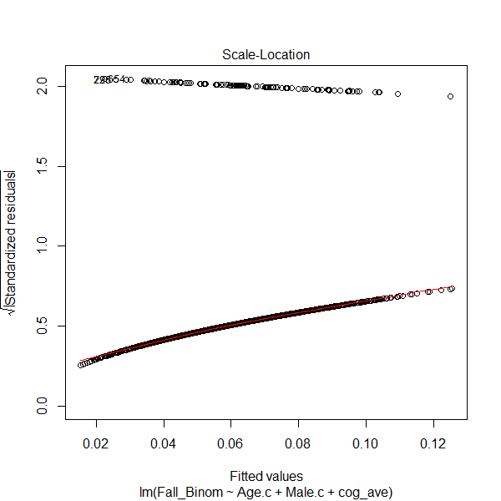
4. Clear Violations
plot(model_name)
$$Fall =β_{0}+β_{1}\left(AMPAC_{i}\right)+ε_{i}$$

Slide 15
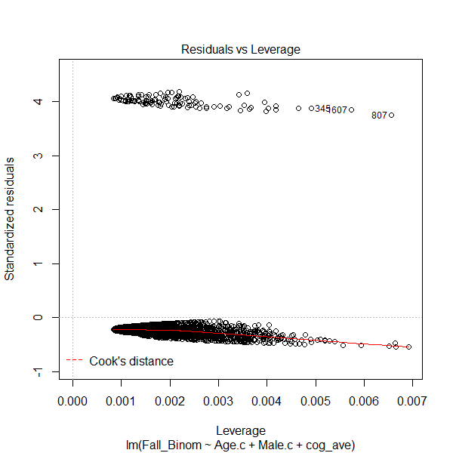
4. Clear Violations
plot(model_name)
$$Fall =β_{0}+β_{1}\left(AMPAC_{i}\right)+ε_{i}$$

Slide 16
4. Clear Violations
What do we do in these situations?
Generally, when our assumptions are this substantially violated, that means we have chosen a poor statistical model to explain our data.
This will require us to use “generalized linear models”, of which there are several families:
For instance, with a binomial outcome we should use a logistic regression.
For count data, we will need to use poisson regression.
For categorical data (e.g., choices among multiple candidate), we will need to use multinomial logistic regression.
For ordinal data (e.g., ranks), we will need to use ordered logistic regression.
Fortunately, everything we have learned carriers over, so you should be well suited to tackle these advanced topics in future classes.

Slide 17
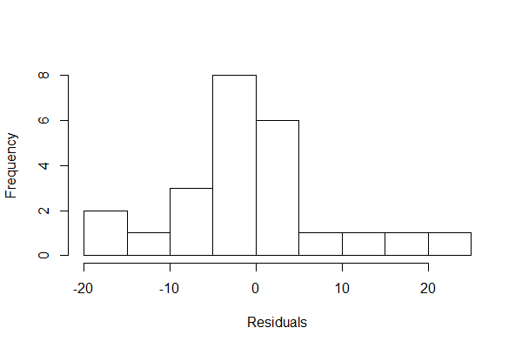
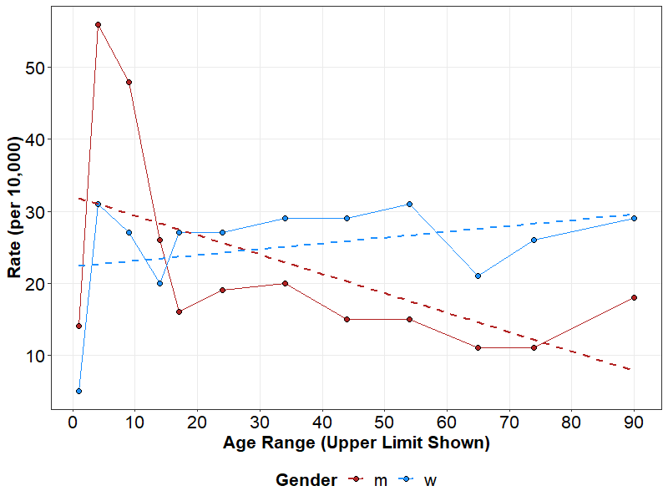
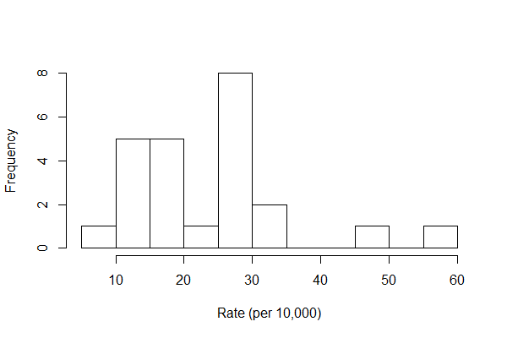
5. Difficult Residuals

Slide 18
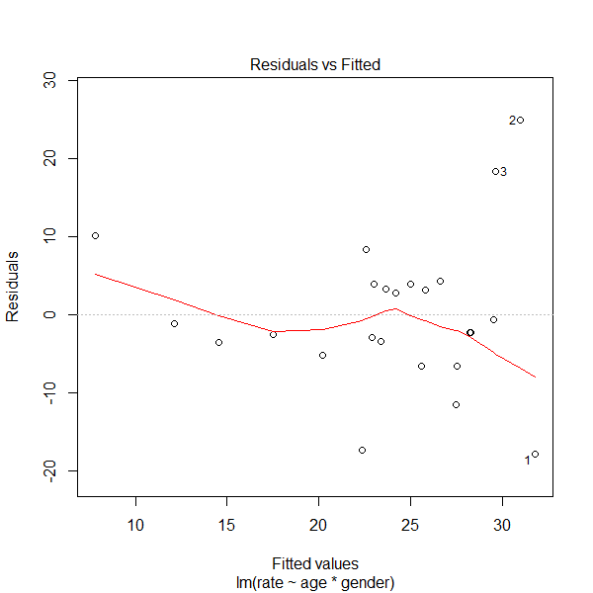
5. Difficult Residuals
plot(model_name)
$$Rate =β_{0}+β_{1}\left(A_{i}\right)+β_{2}\left(G_{i}\right)+β_{3}(AxG_{i})+ε_{i}$$

Slide 19
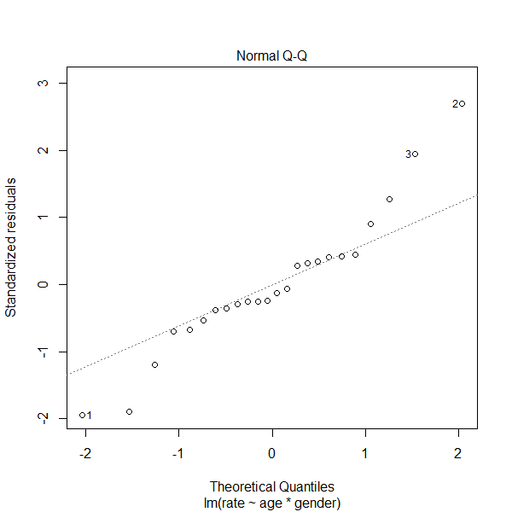
5. Difficult Residuals
plot(model_name)
$$Rate =β_{0}+β_{1}\left(A_{i}\right)+β_{2}\left(G_{i}\right)+β_{3}(AxG_{i})+ε_{i}$$

Slide 20
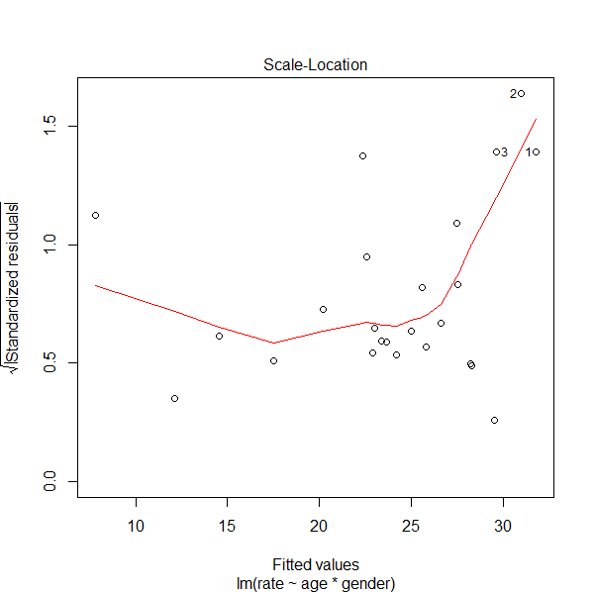
5. Difficult Residuals
plot(model_name)
$$Rate =β_{0}+β_{1}\left(A_{i}\right)+β_{2}\left(G_{i}\right)+β_{3}(AxG_{i})+ε_{i}$$

Slide 21
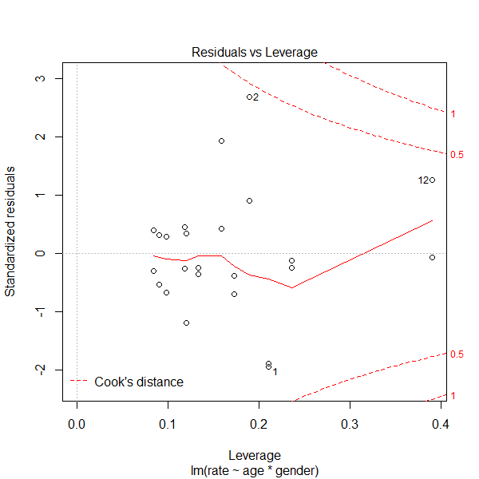
5. Difficult Residuals
plot(model_name)
$$Rate =β_{0}+β_{1}\left(A_{i}\right)+β_{2}\left(G_{i}\right)+β_{3}(AxG_{i})+ε_{i}$$

Slide 22
5. Difficult Residuals
What do we do in these situations?
In these situations, we might transform of the outcome variable.
E.g., the square-root or log-transformation to remove positive skew.
Visually assessing our data, we might also consider different models.
E.g., in this example we have a non-linear relationship between Age and Rate, but specifically at low values of Age.
Splines, polynomials, or a categorical approach to age might prove to be a better explanation of our data, and lead to better behaved residuals.
In cases when homoscedasticity is violated, there are other methods for getting “robust” standard errors that lead to more accurate p-values.

