Slide 1

Sample Size Planning Concepts: Statistical Intuitions
Keith R. Lohse, PhD, PStat
Associate Professor in Physical Therapy and Neurology
e: lohse@wustl.edu

Slide 2
Intuitions versus precise answers.
Statistical power and sample size calculations can get complicated very quickly.
I highly recommend you work with a statistician when designing the study.
That said, we often can’t get perfect answers for our sample size calculations, so it is important to build up some statistical intuitions.
And then consider a range of assumptions when estimating the sample size.
Any power analysis is only as good as it’s assumptions!

Slide 3
Intuitions versus precise answers.
Building Intuition #1: What kind of the effect am I trying to study?
Building Intuition #2: How many observations do I need?

Slide 4
Intuition #1: What kind of the effect am I trying to study?

Slide 5

Help me find a dragon.
Often, researchers will say something like “we don’t know how big an effect is because we haven’t done the study yet”.
And therefor, no meaningful power analysis can be undertaken.
Let’s put this in another context and say “I’m putting an expedition together to find a dragon”.
"Here be dragons" (Latin: hic sunt dracones) was a phrase used to indicate dangerous or unexplored territories in medieval maps.
[https://www.nintendo.com/store/products/here-be-dragons-switch/]

Slide 6
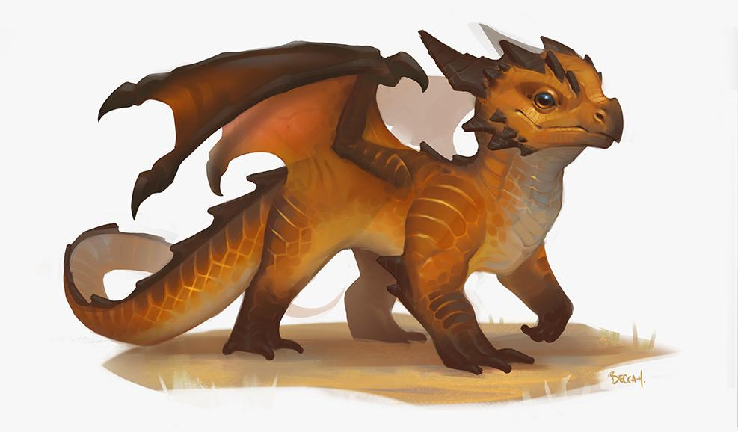
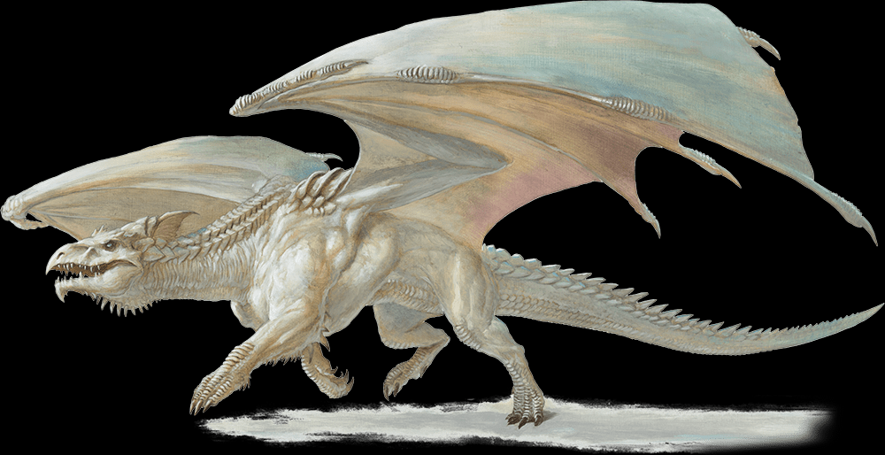
Help me find a dragon.
[https://www.dndbeyond.com/monsters/436652-desert-pseudodragon]
If I’m selling you on joining my expedition, you might reasonably have some questions.
Where does the dragon live?
How big is it?
What are the risks?
What tools will we need?
If my answer is, “we don’t know because no one has ever seen one”… then my quest might seem like a waste of time.
[https://www.dndbeyond.com/monsters/16784-ancient-white-dragon]

Slide 7
Help me find a dragon.
So… researchers will say something like “we don’t know how big an effect is because we haven’t done the study yet”.
But asking “What is the precise effect?” is usually not the right question.
Good question: “What is the smallest effect that would be reasonably important?” (a priori power)
Good question: “Given the budget, what is the smallest effect we can reasonably study?” (sensitivity)

Slide 8
The dragon is a hypothetical “true effect”.
Approximately where does the dragon live?
Approximately how big is it?
What are some potential risks?
What kind of tools will we need?
Are there certain individuals/conditions in which we expect the effect to be strongest?
Can we use tighter exclusion/inclusion criteria to reduce variance?

Slide 9
The dragon is a hypothetical “true effect”.
Approximately where does the dragon live?
Approximately how big is it?
What are some potential risks?
What kind of tools will we need?
Is there a minimum value that would be important?
How much background noise (e.g., SD, residual variance) would we expect?
Be conservative and make a low-end estimate of the effect.

Slide 10
The dragon is a hypothetical “true effect”.
Approximately where does the dragon live?
Approximately how big is it?
What are some potential risks?
What kind of tools will we need?
[False negative] what happens if we miss an effect that exists?
[False positive] what happens if declare an effect and we’re wrong?
What are the costs associated with the study?

Slide 11
The dragon is a hypothetical “true effect”.
Approximately where does the dragon live?
Approximately how big is it?
What are some potential risks?
What kind of tools will we need?
Do we have reliable and valid outcome measures?
What is the most cost-effective way to collect the data?
What is the most cost-effective way to do the intervention?

Slide 12
What kind of effect am I trying to study?
Approximately where does the dragon live?
Approximately how big is it?
What are some potential risks?
What kind of tools will we need?
If you can answer these questions, you likely have more information than you think and you can design a better study!
The surest way to miss a dragon is to look in the wrong place, not look for long enough, and not know what a dragon looks like.

Slide 13
Intuition #2: How many observations do I need?

Slide 14
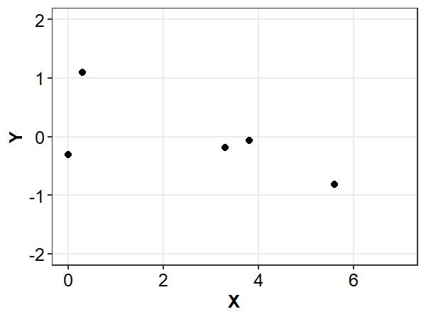
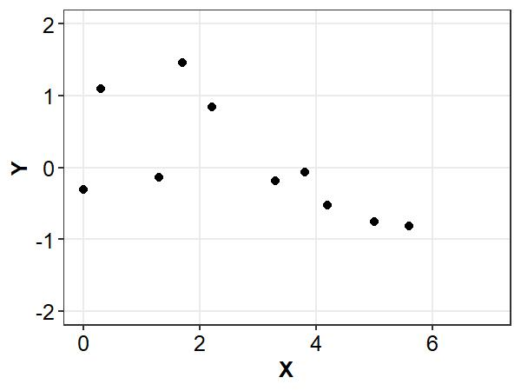
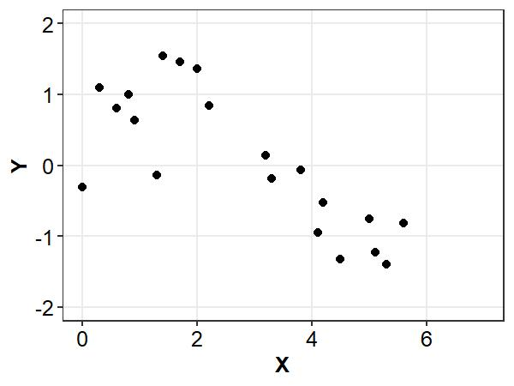
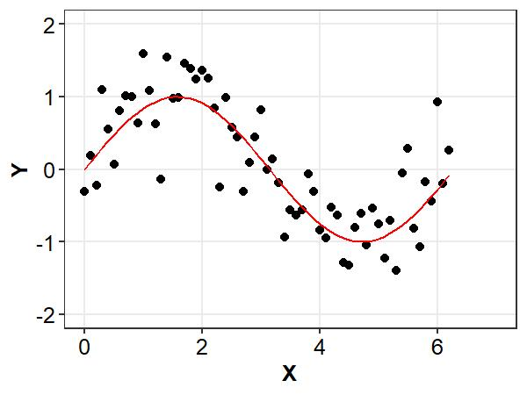

How many observations do I need?
$$\# of measurements∝\frac{noise}{signal}$$
As I add observations, random noise cancels out and the true signal becomes clear.

Slide 15
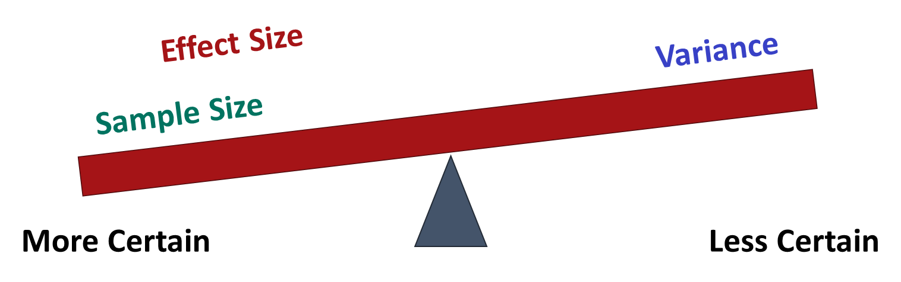
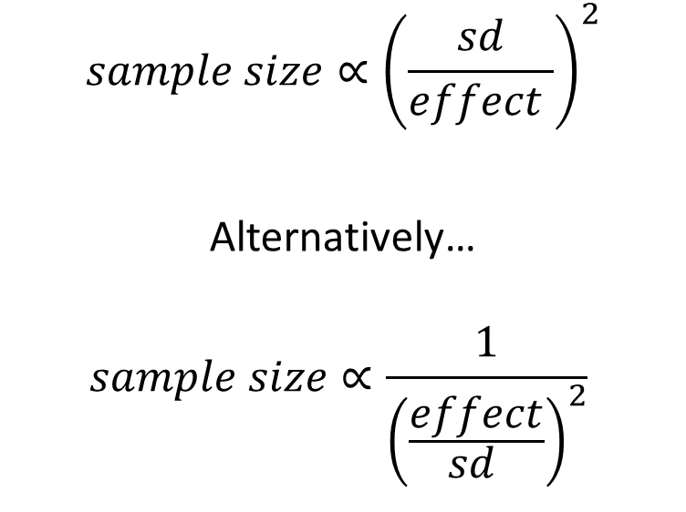
How many observations do I need?
The same principle applies to drawing random samples from a population.
$$sample size∝{\left(\frac{sd}{effect }\right)}^{2}$$
Alternatively…
$$sample size∝{\frac{1}{{\left(\frac{effect}{sd }\right)}^{2}}}^{ }$$

Slide 16
How many observations do I need?

Slide 17
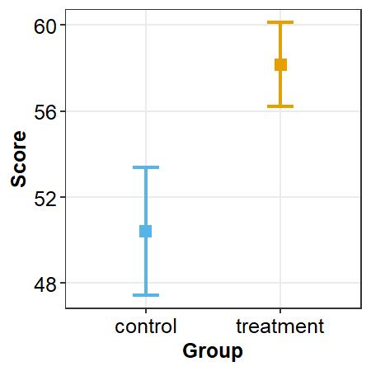
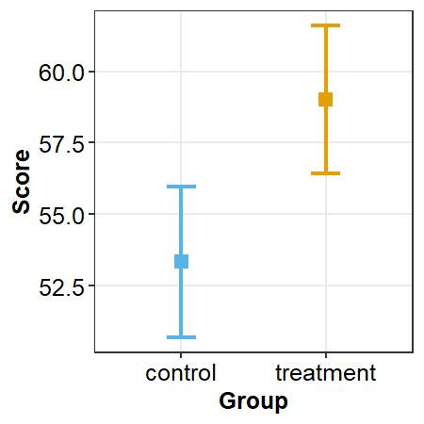
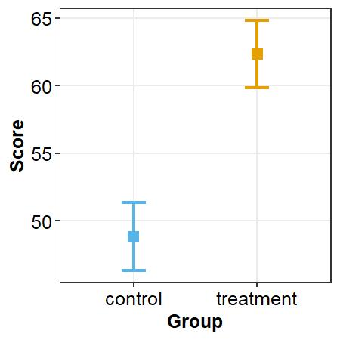
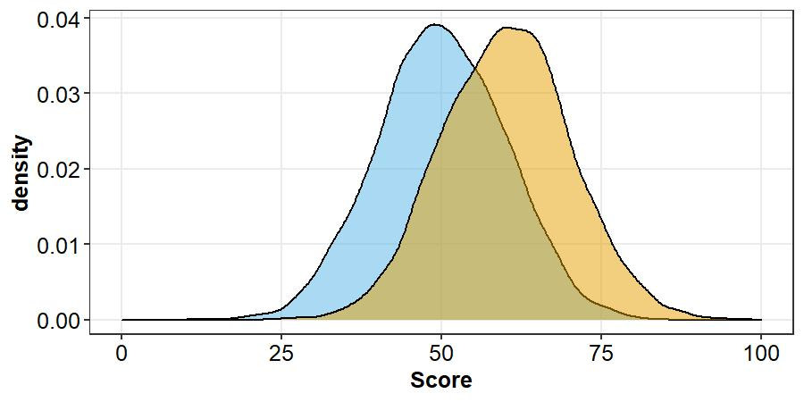

Visualizing $\frac{effect}{sd }$
N=34
N=34
N=34
….
Cohen’s d = 1.0
N_{0.8}=34
Cohen’s d = 1

Slide 18
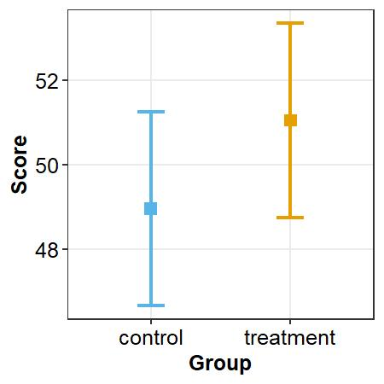
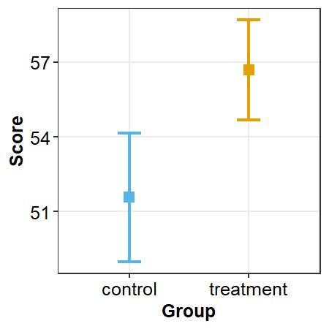
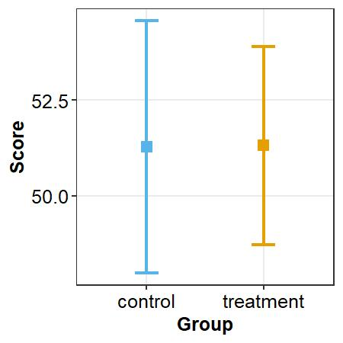
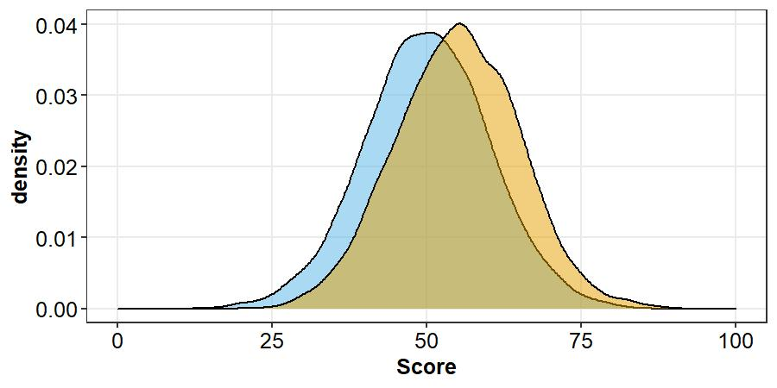
Visualizing $\frac{effect}{sd }$
N=34
N=34
N=34
….
Cohen’s d = 0.5
N_{0.8}=128
Cohen’s d = 0.5

Slide 19
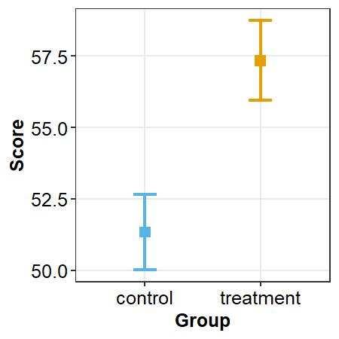
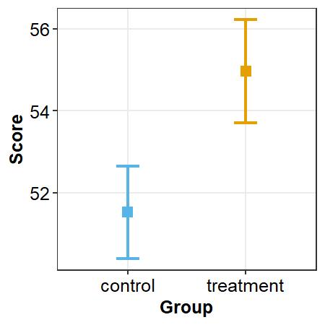
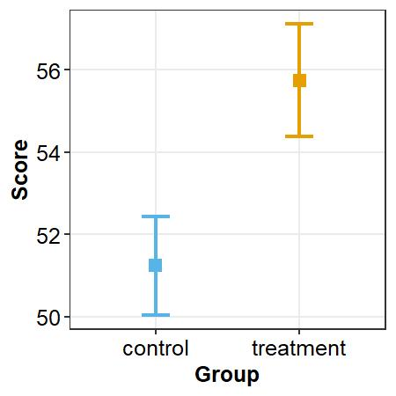
Visualizing $\frac{effect}{sd }$
N=128
N=128
N=128
….
Cohen’s d = 0.5
N_{0.8}=128
Cohen’s d = 0.5

Slide 20
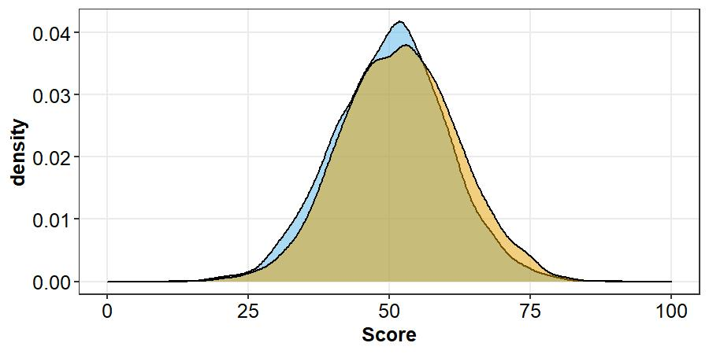

Visualizing $\frac{effect}{sd }$
Uh oh! Rather than recruit 800 people, can you do something to make the effect bigger or the variance smaller?
It is often more cost effective to improve effect/variance ratios through the design (if you can).
Cohen’s d = 0.2
N_{0.8}=788
Cohen’s d = 0.2

Slide 21
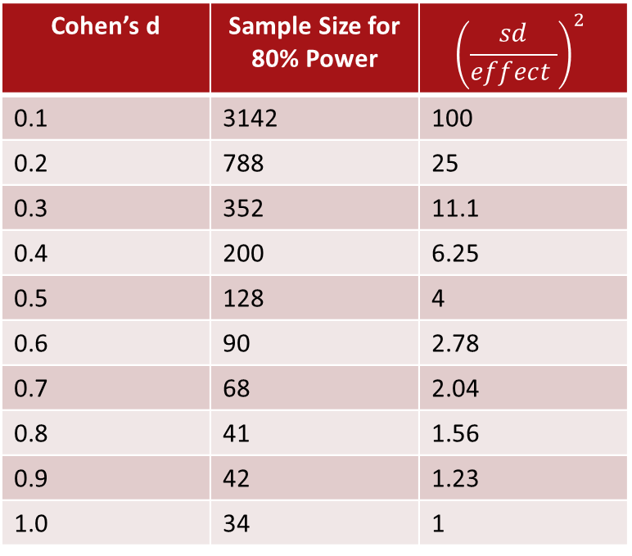
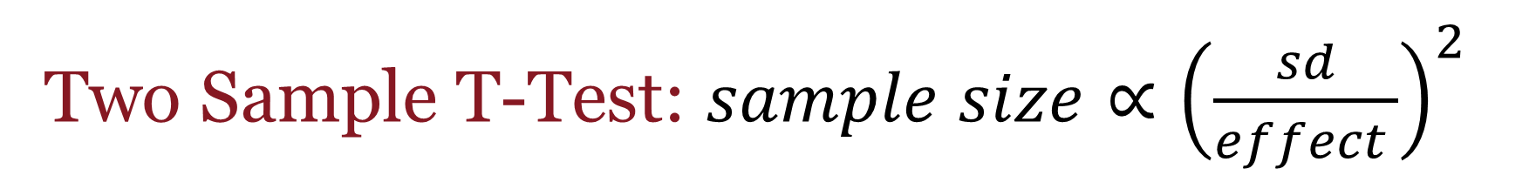
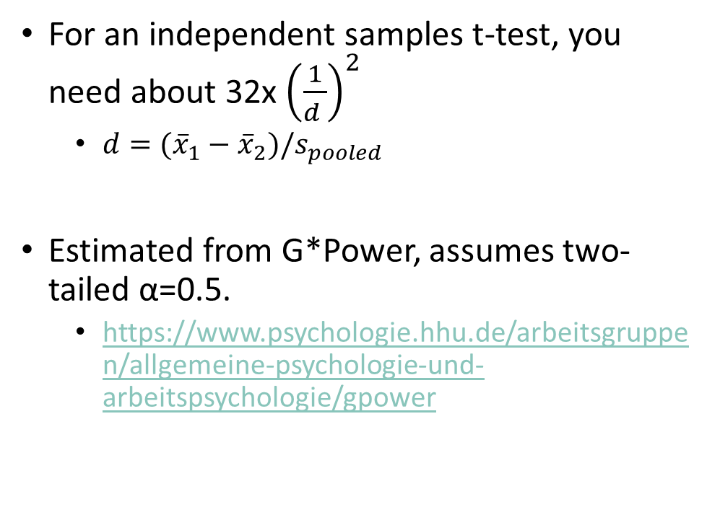
Two Sample T-Test: $sample size∝{\left(\frac{sd}{effect }\right)}^{2}$
Cohen’s d | Sample Size for 80% Power | $${\left(\frac{sd}{effect }\right)}^{2}$$
0.1 | 3142 | 100
0.2 | 788 | 25
0.3 | 352 | 11.1
0.4 | 200 | 6.25
0.5 | 128 | 4
0.6 | 90 | 2.78
0.7 | 68 | 2.04
0.8 | 41 | 1.56
0.9 | 42 | 1.23
1.0 | 34 | 1
For an independent samples t-test, you need about 32x ${\left(\frac{1}{d }\right)}^{2}$
$d=({\overline{x}}_{1}−{\overline{x}}_{2})/s_{pooled}$
Estimated from G*Power, assumes two-tailed α=0.5.
https://www.psychologie.hhu.de/arbeitsgruppen/allgemeine-psychologie-und-arbeitspsychologie/gpower

Slide 22
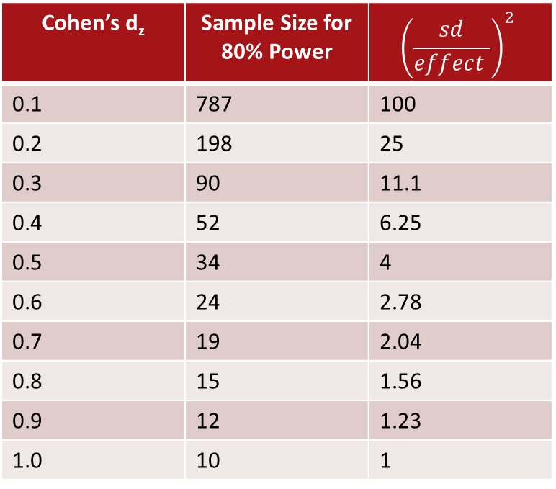
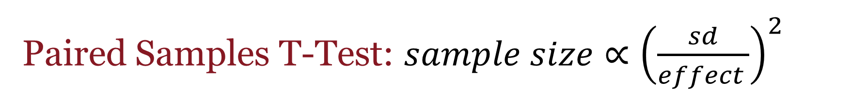
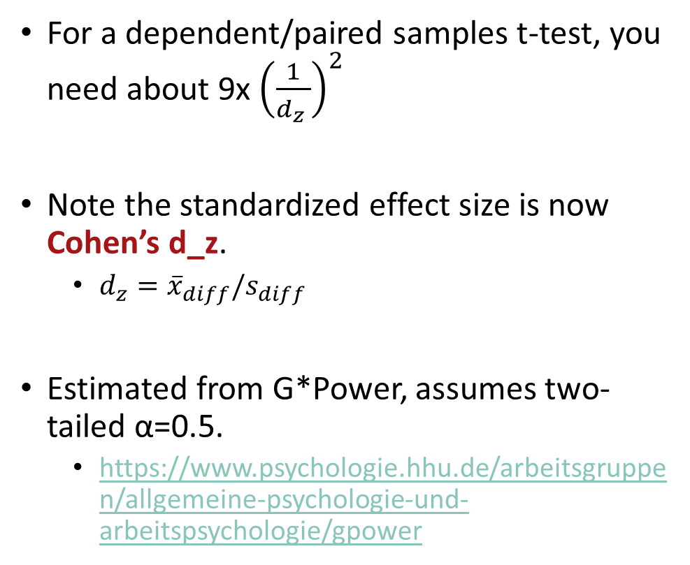
Paired Samples T-Test: $sample size∝{\left(\frac{sd}{effect }\right)}^{2}$
Cohen’s d_{z} | Sample Size for 80% Power | $${\left(\frac{sd}{effect }\right)}^{2}$$
0.1 | 787 | 100
0.2 | 198 | 25
0.3 | 90 | 11.1
0.4 | 52 | 6.25
0.5 | 34 | 4
0.6 | 24 | 2.78
0.7 | 19 | 2.04
0.8 | 15 | 1.56
0.9 | 12 | 1.23
1.0 | 10 | 1
For a dependent/paired samples t-test, you need about 9x ${\left(\frac{1}{d_{z} }\right)}^{2}$
Note the standardized effect size is now Cohen’s d_z.
$d_{z}={\overline{x}}_{diff}/s_{diff}$
Estimated from G*Power, assumes two-tailed α=0.5.
https://www.psychologie.hhu.de/arbeitsgruppen/allgemeine-psychologie-und-arbeitspsychologie/gpower

Slide 23
To Recap…
We have talked about the complexities of power analysis in different designs and why it is important to build up statistical intuitions.
We discussed important questions to ask yourself when deciding what kind of effect you are trying to study.
We introduced some rough ideas about how many observations you might need when trying to study different effects.
In subsequent videos, we are going to introduce simulations for more complex designs and avoid standardized effect sizes.

