Slide 1
JUNIORDEV AUCKLAND
BEYOND
THE
PROMPT.
Keith Patton
Software engineering & technology leader
AUCKLAND / SEPTEMBER 2026
Notes:
0:00–0:45 — Promise
Promise: I will show a small control system that lets agents do more work while your judgement remains visible.
Say: You already know an AI can produce code. The interesting question is how we remain responsible for what gets built.

Slide 2

01 / BEFORE AGENTS
I used to write every line myself.
LATE 1990s
No Stack Overflow
Enormous red books
One exhausted developer
Coffee as architecture
1998
KEITH PATTON / JUNIORDEV AUCKLAND
02 / 15
Notes:
0:45–2:30 — Personal history and empathy
Tell the Wrox-book story: no Stack Overflow, a CRT, huge red books and coffee as architecture.
Joke: some of you were not born; some of those books were nearly as heavy as you.
Connect young and old: the fear is different, but both generations face an unfamiliar shift in what competence looks like.
[Sources]
- OpenAI-generated illustration commissioned for this talk: presentation/assets/late-90s-developer.png
[/Sources]

Slide 3
02 / THE TURN
“
The valuable unit
is not the prompt.
It is the loop.
(judgement stays visible)
KEITH PATTON / JUNIORDEV AUCKLAND
03 / 15
Notes:
2:30–3:45 — Core thesis
Pause after “It is the loop.”
A prompt is a moment. A loop keeps intent, challenge, decisions, evidence and memory visible.
Use stronger gates only when ambiguity, consequence or blast radius earns them.

Slide 4
03 / BEGIN
A prompt begins the work.
THE HUMAN BRINGS
IDEA
Intent
Consequences
DISCUSSION
Constraints
Unknowns
PLAN
SHOW THE TRAIL
KEITH PATTON / JUNIORDEV AUCKLAND
04 / 15
Notes:
3:45–5:15 — A prompt begins, discussion shapes
The human does not need a complete specification. They do need to stay present while the idea acquires meaning.
SHOW → open presentation/demo/01-idea-discussion.md. Read only the starting request, two questions and the reframed outcome.
RETURN → “The idea changed before the code did.”

Slide 5
04 / HUMAN CONTROL
The loop keeps the human inside the work.
SHAPE
AUTHORISE
EVALUATE
Interrogate
Choose the outcome
Inspect the result
Surface assumptions
→
Own trade-offs
→
Test boundaries
Plan
Set the evidence
Judge the evidence
Challenge the plan
Approve or redirect
Update the context
KEITH PATTON / JUNIORDEV AUCKLAND
05 / 15
Notes:
5:15–6:45 — Three human control moments
Shape the task. Authorise consequential decisions. Evaluate the result.
Between those checkpoints, agents may explore, draft, implement, test and recover.
The human is not absent; human attention is moved to higher-leverage moments.

Slide 6
05 / CHECKPOINTS
SPEND HUMAN ATTENTION ON CONSEQUENCES.
DO NOT REVIEW EVERY TOKEN
CHECK IN AT
Generation
Consequential moments
Edits
Retries
Intent • risk • uncertainty • irreversible choices • approval • proof
Tool calls
Implementation detail
CHECKPOINT
KEITH PATTON / JUNIORDEV AUCKLAND
06 / 15
Notes:
6:45–8:15 — Checkpoints, not token watching
Do not confuse ownership with watching every edit. Spend scarce human attention where consequences change: intent, risk, uncertainty, irreversible choices, approval and proof.
Transition: we need a portable way to remember those gates.

Slide 7
06 / THE TAF
A small Markdown layer makes the gates portable.
INTAKE
PLAN + CHALLENGE
APPROVAL + PROOF
Problem + outcome
Proposal
Human gate
Questions
→
Criteria
→
Execution evidence
Assumptions
Critique
Remaining risk
Unknowns
Revision
Durable learning
KEITH PATTON / JUNIORDEV AUCKLAND
07 / 15
Notes:
8:15–9:45 — The small Task Automation Framework
TAF is plain Markdown: intake, plan and challenge, approval and proof. It is deliberately model-agnostic and proportionate.
SHOW → open plans/README.md at “Planning loop,” then presentation/demo/02-plan-v1.md at “Assumptions requiring challenge.”
RETURN → “A plan is a proposal, not permission.”
[Sources]
- https://openai.com/index/harness-engineering/
- https://www.anthropic.com/engineering/building-effective-agents
[/Sources]

Slide 8
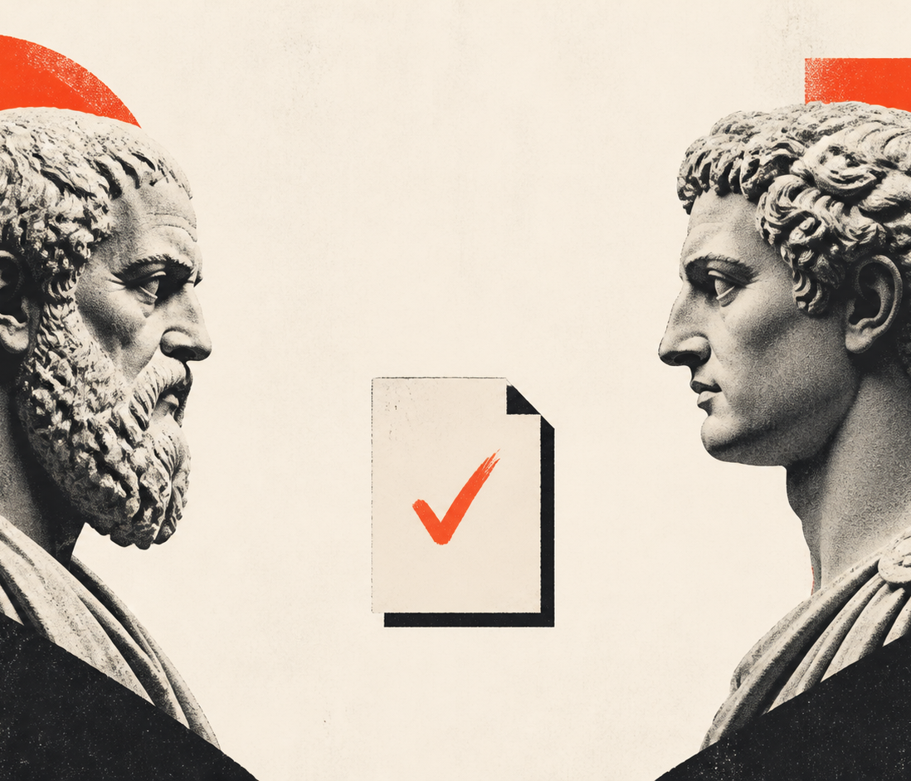
07 / SOCRATIC LOOP
The core loop is Socratic.
PROPOSE
CHALLENGE
REVISE
HUMAN CHECKPOINT
approve or redirect
criteria + evidence keep the loop honest
CHALLENGE
KEITH PATTON / JUNIORDEV AUCKLAND
08 / 15
Notes:
9:45–12:15 — Socratic adversarial loop
Point at the flow: propose → challenge → revise. The loop recurs against criteria and evidence, then reaches a human checkpoint.
This is not agents arguing until truth appears. Long debates can drift. Keep roles bounded, findings criterion-based, and iteration capped.
SHOW → open presentation/demo/03-socratic-plan-review.md. Show one complete finding: question, consequence and required revision.
RETURN → “Challenge prepares the decision; it does not own it.” Move to the human-gate slide.
[Sources]
- https://proceedings.mlr.press/v235/du24e.html
- https://arxiv.org/abs/2303.17651
- https://aclanthology.org/2026.findings-eacl.268/
- OpenAI-generated illustration commissioned for this talk: presentation/assets/socratic-adversary.png
[/Sources]

Slide 9
08 / HUMAN GATE
“
The agent can propose.
It cannot own
the decision.
(outcome • risk • approval • accountability)
KEITH PATTON / JUNIORDEV AUCKLAND
09 / 15
Notes:
12:15–13:15 — Human approval
The agent can recommend an outcome, architecture, boundary or proof strategy. It cannot accept accountability for the consequence.
Approval does not mean reviewing every line. It means owning the decision frame and any explicit deferrals.
SHOW → open presentation/demo/04-approved-plan.md at “Human decision” and the conditions.
RETURN → “Now the agent has permission to act—inside an explicit decision frame.”

Slide 10
09 / ORCHESTRATE
Delegate the work. Keep the decision frame.
AGENT STRENGTHS
Explore
HUMAN OWNS
Draft
Intent
Risk
Approval
Outcome
Implement
Compare + recover
SHOW THE WORK
KEITH PATTON / JUNIORDEV AUCKLAND
10 / 15
Notes:
13:15–15:15 — Orchestration
Agents are strong at exploration, drafting, implementation, comparison and recovery. Humans own intent, risk, approval and outcome.
SHOW → open presentation/demo/05-build-up.md, then app.js at chooseNext(). Show the running app for no more than 20 seconds: “yes, agents can build software—whoop-de-doo.”
RETURN → “The website is not the punchline. The inspectable chain of decisions is.”

Slide 11
10 / EVALUATE
Check in on claims, not lines.
01
02
03
OUTCOME
BOUNDARIES
REALITY
Did it solve the agreed problem?
Did any contract or invariant break?
Do tests, runtime and user behaviour agree?
“Grade what the agent produced, not the path it took.” — Anthropic
KEITH PATTON / JUNIORDEV AUCKLAND
11 / 15
Notes:
15:15–17:30 — Evaluate claims, not performance theatre
Use outcome, boundaries and reality as three review lenses.
SHOW → use one editor split: data-boundaries.js beside privacy.test.js. Optionally run npm test.
Tell the real recovery: one rehearsal had green unit tests and a broken browser module load. Runtime evidence caught what the focused test did not.
RETURN → “A passing feature is not enough if the system boundary is wrong.”
[Sources]
- https://www.anthropic.com/engineering/demystifying-evals-for-ai-agents
- Historical local rehearsal record: https://github.com/keithpatton/junior-dev-agentic-demo/blob/f2f8699/docs/validation/VALIDATION-REPORT.md
[/Sources]

Slide 12

11 / CONTEXT
Love the context more than the code.
THE CONTEXT SPINE
Product + language
Architecture + seams
Invariants + evidence
Direction + deferrals
GARDEN
KEITH PATTON / JUNIORDEV AUCKLAND
12 / 15
Notes:
17:30–20:00 — Bonsai and metacognition
In use, the task trail records how meaning changed. This repository keeps presentation-ready samples of those moments; the spine describes what the system means now.
Love this layer: product, language, architecture, seams, invariants, evidence, direction and deferrals. Prune it. Do not dump chat history into it.
SHOW → open presentation/demo/07-proof-and-memory.md, then docs/spine/INVARIANTS.md. Optionally run npm run test:spine. Explain that the guard proves structure, not wisdom.
RETURN → “A proved decision helps once. A remembered decision shapes the next change.”
[Sources]
- https://openai.com/index/harness-engineering/
- OpenAI-generated illustration commissioned for this talk: presentation/assets/context-spine-bonsai.png
[/Sources]

Slide 13
12 / TWO MODES
BUILD UP. STRENGTHEN ACROSS.
FEATURE SLICES
SYSTEM FOUNDATIONS
Outcome
Privacy • contracts • tests
Flow
Behaviour
Boundaries, observability, standards and context reach across every feature slice.
Feedback
Move upward through the stack
ONE BUILDER
KEITH PATTON / JUNIORDEV AUCKLAND
13 / 15
Notes:
20:00–22:15 — Build up and strengthen across
Feature slices build upward through outcome, flow, behaviour and feedback. Foundations strengthen across slices: privacy, contracts, tests, observability, standards and context.
Historically these concerns often crossed roles and teams. An agentic builder can context-switch between them rapidly, while still knowing when specialist judgement is required.
Do not leave the slide again. Point back to the feature and privacy examples already shown.

Slide 14
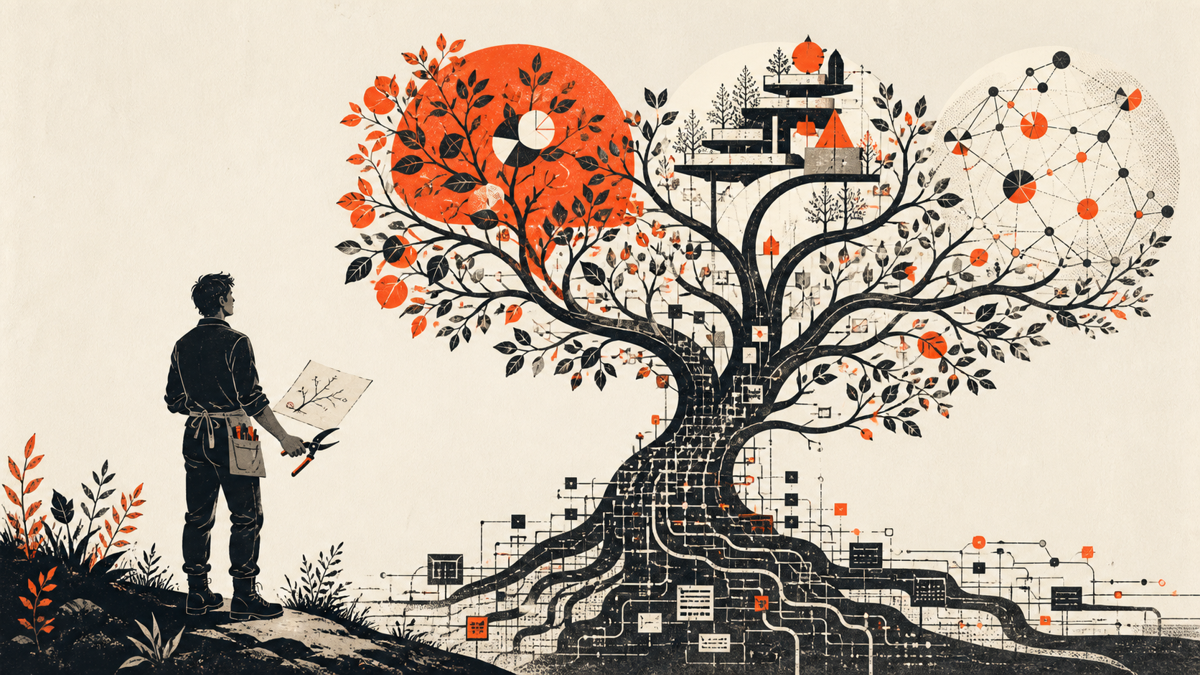
13 / THE ROLE
You are gaining more of engineering.
THE AGENTIC BUILDER
Shapes intent
Designs boundaries
Orchestrates capabilities
Evaluates evidence
BUILDER
KEITH PATTON / JUNIORDEV AUCKLAND
14 / 15
Notes:
22:15–24:00 — The agentic builder
This is not instant seniority and not the end of technical foundations. It is earlier access to product intent, architecture, operations, risk and evidence.
The role becomes part engineer, architect, product thinker, editor and gardener of a living system. Curiosity, intentionality and judgement matter more because reach has increased.
[Sources]
- https://openai.com/index/harness-engineering/
- OpenAI-generated illustration commissioned for this talk: presentation/assets/agentic-builder-gardener.png
[/Sources]

Slide 15
14 / OVER TO YOU
What will you build
when code is no longer
the bottleneck?
The valuable unit is the loop.
Curiosity. Intentionality. Judgment. Evidence.
Questions?
KEITH PATTON / JUNIORDEV AUCKLAND
15 / 15
Notes:
24:00–25:30 — Resolve and questions
Return to the opening promise: the point was never that AI can type code. It was that a visible loop lets agents build while humans keep consequential judgement.
Question: what will you build when code is no longer the bottleneck?
At 25:30, stop. Leave this slide visible for questions.

