Slide 1
BEYOND THE PROMPT
In 25 minutes, we’ll build the whole loop.
Idea → product → better question → system insight → tested promise. Without writing the implementation code.
Notes:
TIMING — 0:00–1:30
OPEN WITH THE PROMISE: By the end of the next 25 minutes I’ll show you one developer taking a vague idea to a working product, challenging the product, understanding its system, updating its context, and enforcing a safety promise—without writing the implementation code.
PAUSE: Let the final sentence land. Clarify that this is not ‘AI writes a function’; it is the complete product-building loop.
[Sources]
- Original talk material; no external sources.

Slide 2
The valuable role moves up a level
Print worker → digital editor
Publishing did not simply make the same hands faster. Value moved toward composition, audience, distribution, and judgment.
Software engineer → product builder
Agents make implementation cheaper. Value moves toward outcomes, context, system boundaries, feedback loops, and evidence.
2
Notes:
TIMING — 1:30–3:00
TALK TRACK: Use the print analogy as reassurance, not extinction. The worker does not vanish; the useful unit of work moves up a level.
LINE: If you love building things, this is an extraordinary time to be a developer—the job becomes more about curiosity and less about mechanical production.
[Sources]
- Original talk material; no external sources.

Slide 3
The human job is to shape the system around the work
FRAME What outcome matters? What is deliberately out of scope?
LOOP What context, checkpoint, and feedback will steer the agent?
PROVE What evidence makes the product promise believable?
3
Notes:
TIMING — 3:00–3:30
TALK TRACK: Curiosity about the whole system becomes the defining developer skill: user behaviour, business process, data flow, APIs, incentives, and failure modes.
TRANSITION: Let’s make that concrete with a deliberately ordinary product.
[Sources]
- Original talk material; no external sources.

Slide 4
DEMO · PHASE 1
“Build me a job application tracker.”
A broad product goal. A bounded technical box. A visible stop condition.
Notes:
TIMING — 3:30–6:15
DEMO CUE: Open Codex and paste the phase 1 prompt from PRESENTER-GUIDE.md.
WHILE IT RUNS: Explain that the spoken prompt stays natural; the repository context bounds the work to local, single-user, two-minute walkthrough scope.
CHECKPOINT: Scope nudge at 5:45 talk time if needed. Switch to run-3-phase-1 at 6:15.
[Sources]
- Original talk material; no external sources.

Slide 5
The first request was not the real product
Track my applications
A record of companies, roles, stages, deadlines, and notes. Useful—but centred on data entry.
Tell me what to do next
One defensible action for the next 30 minutes, explained by the application’s stage and deadline.
5
Notes:
TIMING — 6:15–10:15
DEMO CUE: Reveal the first version, then paste the phase 2 interrogation prompt. Give the three fixed answers: 5–20 applications; pain is deciding the next 30 minutes; success is one defensible next action.
POINT: Product judgment changed more value than adding another tracker feature.
FALLBACK: run-3-phase-2.
[Sources]
- Original talk material; no external sources.

Slide 6
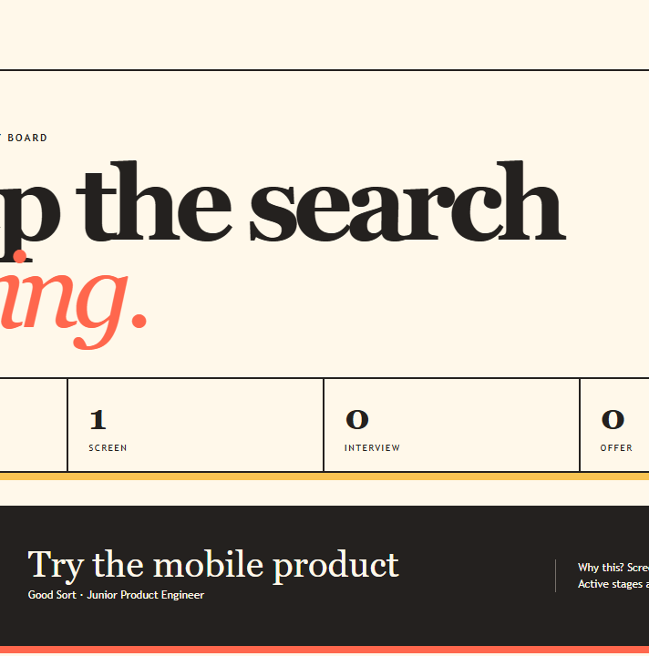
Now it answers the real question
One next move
The recommendation changes when the underlying application changes—and explains why. The ledger supports the decision instead of dominating it.
6
Notes:
TIMING — use as the phase 2 reveal
TALK TRACK: Change one stage in the browser. Point first to the changed recommendation, then to its reason. Do not explain the ranking implementation.
[Sources]
- Internal browser capture: output/playwright/final/run-3.png

Slide 7
Review boundaries and promises—not every generated line
Storage
What data survives a reload? What happens when a write fails?
Rendering
Do counts, the board, and the recommendation agree?
Decision policy
Are ranking and explanation driven by the same signals?
Export
Which fields are safe to cross a shareable boundary?
7
Notes:
TIMING — 10:15–12:45
DEMO CUE: Paste the phase 3 system-inspection prompt. Ask for seams, contracts, invariants, failure modes, and observable evidence—explicitly not a line review.
REVEAL: All three rehearsals independently found notes crossing both storage and export seams.
FALLBACK: run-3-phase-3 and SYSTEM-INSPECTION.md.
[Sources]
- Original talk material; no external sources.

Slide 8
Context is part of the product
Product
Outcome, user, success signal, and deliberate scope.
Architecture
Components, data flow, seams, and pressure points.
Invariants
Promises that must keep holding as agents change the system.
Workflow
How work is framed, verified, recovered, and checkpointed.
8
Notes:
TIMING — 12:45–14:15
DEMO CUE: Paste phase 4. Reveal the four short documents, but do not read them. Phase 4’s measured worst case was under five seconds; its narrative value is the habit, not the typing animation.
LINE: Documentation is not a postscript here. It is the context the next loop inherits.
FALLBACK: run-3-phase-4.
[Sources]
- Original talk material; no external sources.

Slide 9
DEMO · PHASE 5
Notes are session-private.
Never persist. Never export. Turn the promise into an executable invariant.
Notes:
TIMING — 14:15–15:00
TALK TRACK: This is the human selecting the risk and stating the promise. The agent’s job is now to make that promise executable and prove the whole path.
DEMO CUE: Paste phase 5 prompt before advancing.
[Sources]
- Original talk material; no external sources.

Slide 10
A test is evidence; the browser still gets the final vote
RED
GREEN
REAL
Make it fail
The old serializer proves the private note still crosses the boundary.
Make it pass
The smallest boundary projection removes notes and preserves safe fields.
Reload the product
Company and action remain. The secret note does not.
10
Notes:
TIMING — 15:00–19:15
DEMO CUES: On red: ‘The failure is the product promise becoming visible.’ On green: ‘Passing is necessary; the browser still gets the final vote.’ Then show reload proof.
RECOVERY STORY: In run 1, unit tests passed while browser module loading failed. End-to-end evidence caught it.
HARD FALLBACK: Switch to run-3-phase-5 by 18:15 talk time.
[Sources]
- Original talk material; no external sources.

Slide 11
Three rehearsals made the risk visible
EMPIRICAL RESULT
The workflow was consistently fast. Reliability came from the checkpoints and the browser loop—not from assuming the first output was correct.
15 / 15
0
4:01
Phase stop conditions passed
Presenter nudges required
Worst full-run time
11
Notes:
TIMING — 19:15–21:00
TALK TRACK: Median full run was 3:05; worst was 4:01. Phase 1 worst was 2:09. Privacy worst was 1:13. These are capacity timings; the talk intentionally spends longer so the audience can understand the loop.
CAVEAT: Three rehearsals with one agent are evidence of repeatability, not a universal benchmark.
[Sources]
- Internal empirical validation: VALIDATION-REPORT.md and RUN-LOG.md

Slide 12
A live demo should have engineered exits
Scope nudge
At 90 seconds: stop expanding scope and exercise the promised browser path.
Phase checkpoint
At two minutes: switch to the next known-good tag and preserve the story.
Prepared evidence
Keep the final app, privacy output, and screenshots open before the audience arrives.
90 SECONDS
2 MINUTES
TECH CHECK
12
Notes:
TIMING — 21:00–22:00
TALK TRACK: Checkpoints are not cheating. They are production thinking applied to communication: bounded failure, quick recovery, intact outcome.
REMINDER: Never debug local server startup, downloads, or browser permissions on stage.
[Sources]
- Original talk material; no external sources.

Slide 13
Start with one small agent-owned loop this week
Choose a real workflow with a visible user outcome—not a toy function. Keep the human on the loop: ask better questions, choose the risk, and demand evidence.
The goal is not to supervise every generated line. It is to design a system in which useful work can move quickly without losing understanding or ownership.
Then update the context so the next loop starts smarter.
1 · Outcome
2 · Boundaries
3 · Evidence
4 · Context + invariant
5 · Repeat the loop
13
Notes:
TIMING — 22:00–25:30
CLOSE THE LOOP: What did the human actually do? Framed the outcome, challenged the first product, selected a boundary risk, stated the invariant, and demanded end-to-end proof.
CALL TO ACTION: Pick one small workflow this week and build the context, checkpoints, and evidence around it. Do not start by optimising the prompt.
RETURN TO THE PROMISE: We built the whole product loop without writing the implementation code. The engineering did not disappear; it moved up a level.
[Sources]
- Original talk material; no external sources.

Slide 14
QUESTIONS
Build the loop, not the line.
Frame the outcome
Inspect the system
Demand the evidence
Notes:
TIMING — 25:30–30:00
Q&A — 4 minutes 30 seconds reserved.
If the room is quiet, ask: Which part of your current development loop is still relying on a human remembering to check it? Or: Which invariant would you make executable first in your own product?
[Sources]
- Original talk material; no external sources.

