Slide 1
Governor’s Challenge 2015 Ryerson University

Slide 2
Presentation Overview
Recent Developments
Methodology
Forecasts
Policy Recommendation
Risks and Scenarios

Slide 3
Recent Developments
The Decline of Oil Prices
Low energy prices a global concern
Causing problems in export sector
⇒ Concern to growth
Fall in oil prices has disinflationary effect on Canada
Oil and Gas: 9% of GDP
Shock reduced GDP growth by 1.25% in 2015 (Bank of Canada)

Slide 4
Recent Developments
The Decline of the CAD/USD Exchange Rate
Oil exporting countries such as Canada have seen a decline in their exchange rates due to the lower prices of oil (Bank of Canada).
Correlation between oil price and exchange rate around 0.4 in 2008-2010 (Reboredo, 2012).
Pass-through of 59% means that the exchange rate has a significant effect on import prices (Devereux, Dong & Tomlin, 2015).
Benefit: it will increase net exports.
Downside: it will increase inflation.

Slide 5
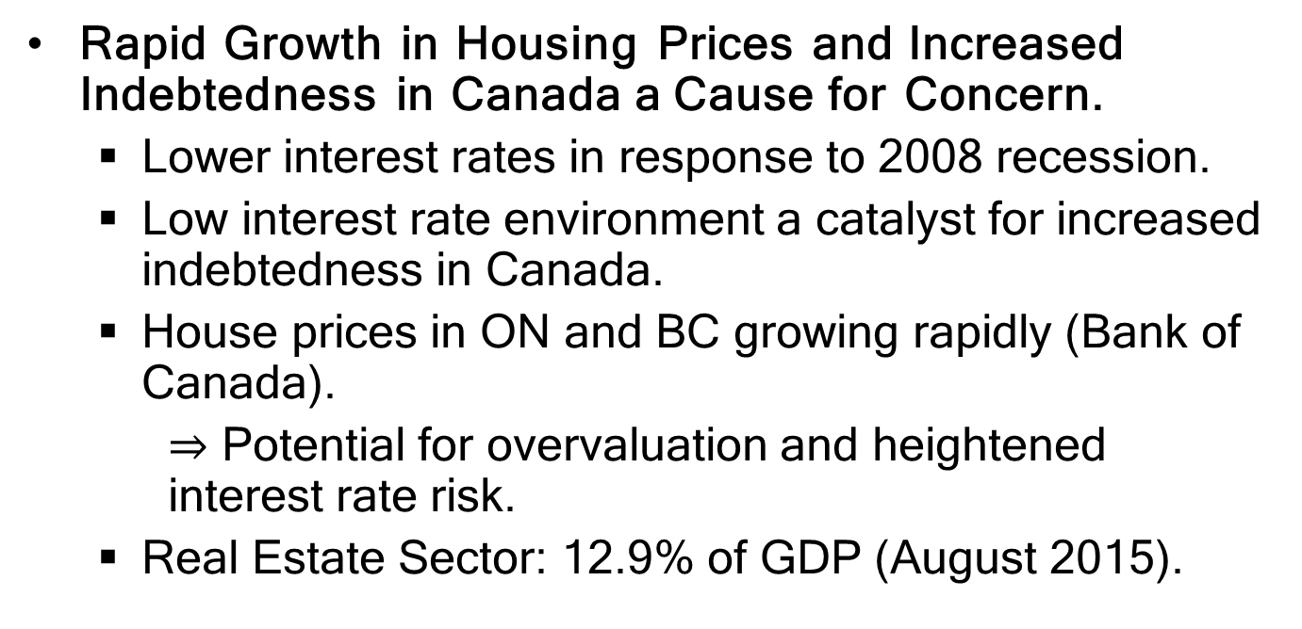
Recent Developments
Rapid Growth in Housing Prices and Increased Indebtedness in Canada a Cause for Concern.
Lower interest rates in response to 2008 recession.
Low interest rate environment a catalyst for increased indebtedness in Canada.
House prices in ON and BC growing rapidly (Bank of Canada).
$⇒$ Potential for overvaluation and heightened interest rate risk.
Real Estate Sector: 12.9% of GDP (August 2015).

Slide 6
Methodology
Use ARMA models to forecast:
the growth rate of GDP, core CPI inflation, the output gap and house prices;
consumption, investment, government spending, net exports, energy prices
Estimate Taylor Rule using Threshold Regression model.
Use forecasts of core CPI inflation and the output gap in the estimated Taylor Rule to make a policy recommendation for the interest rate.

Slide 7
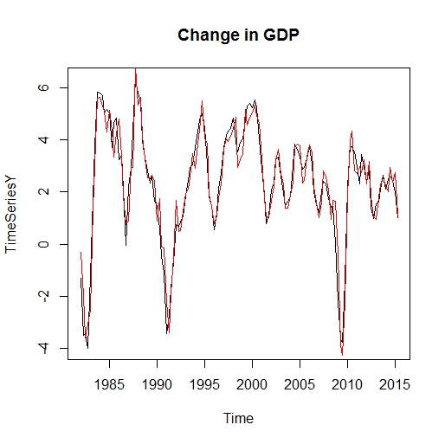
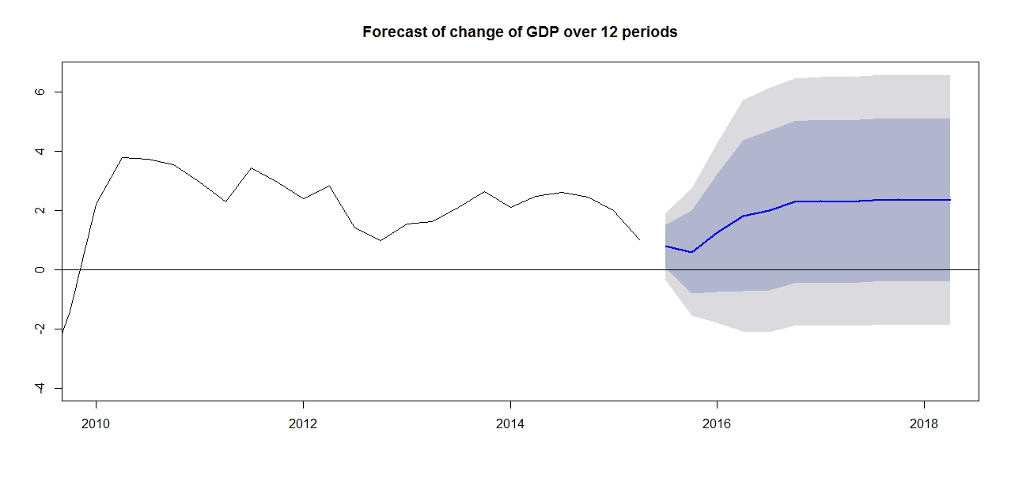
Forecasts: Growth Rate of real GDP
 | 2015 | 2016 | 2017 | 2018
Forecast | 1.23 | 1.84 | 2.33 | 2.35
Bank of Canada | 1.13 | 2.05 | 2.43
IMF | 1.041 | 1.662 | 2.413 | 2.136

Slide 8
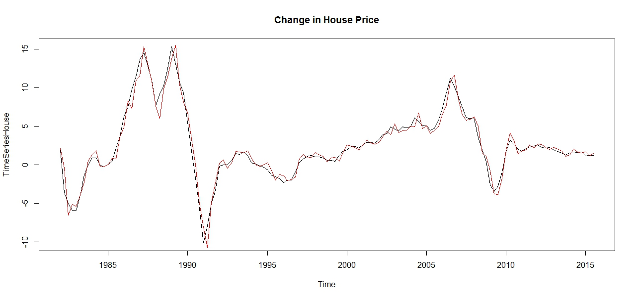
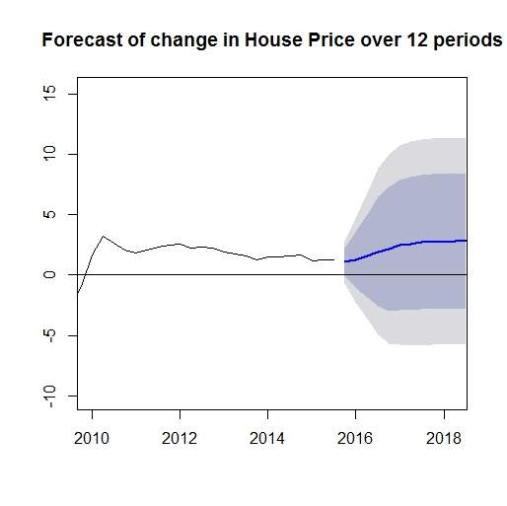
Forecasts: Growth Rate of House Prices
 | 2015 | 2016 | 2017 | 2018
Forecast | 1.23 | 2.24 | 2.78 | 2.78
Stronger than anticipated prices growth in Ontario (17% in Toronto alone) and BC are expected to increase nationwide price average (CRNA, 2015)

Slide 9
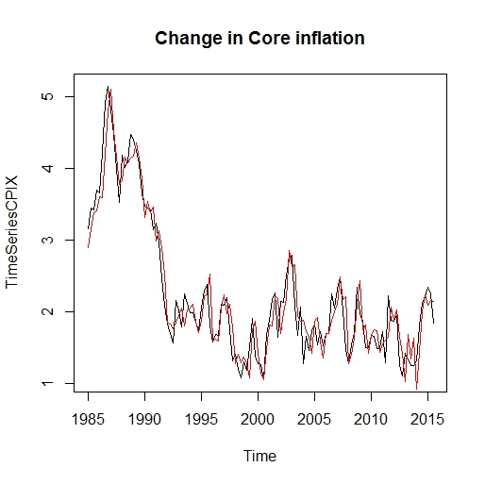
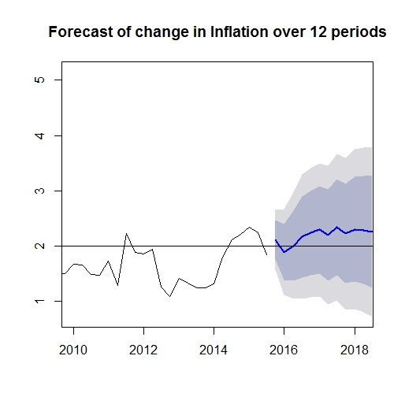
Forecasts: Core CPI Inflation
 | 2015 | 2016 | 2017 | 2018
Forecast | 2.14 | 2.07 | 2.26 | 2.28
Bank of Canada | 2.18 | 2.05 | 2.00

Slide 10
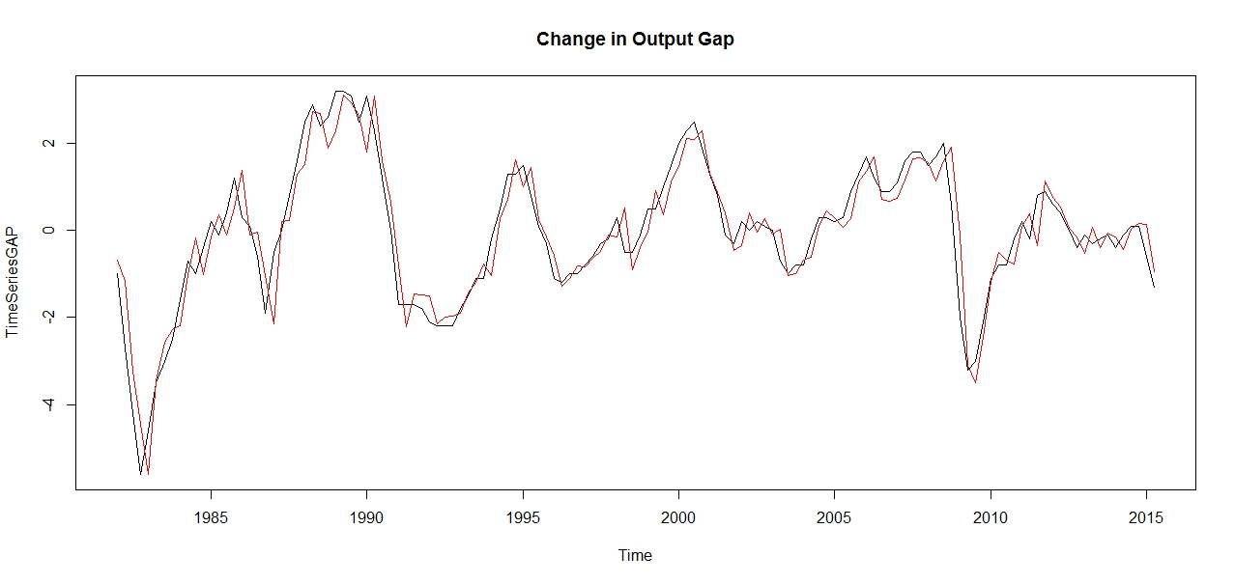
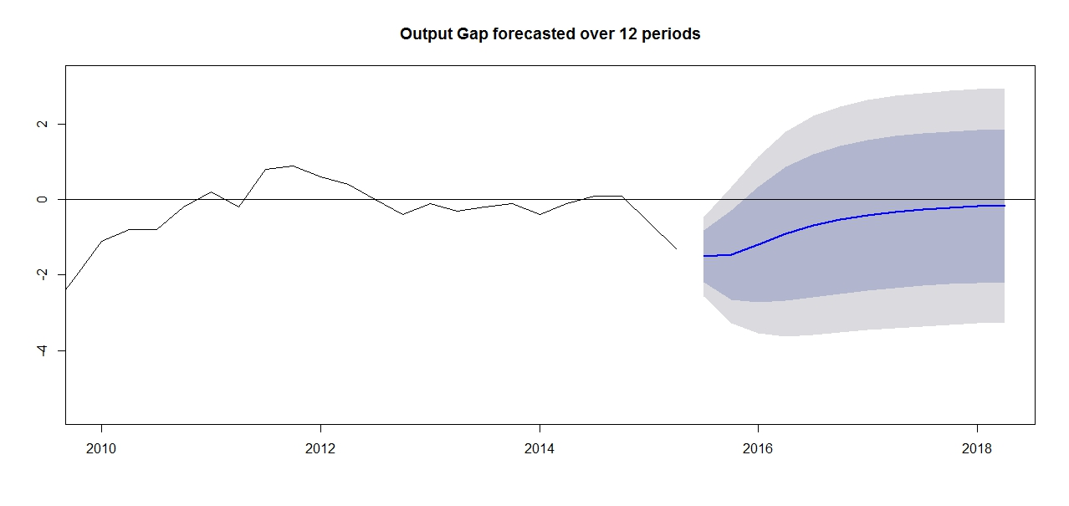
Forecasts: Output Gap
 | 2015 | 2016 | 2017 | 2018
Forecast | -1.49 | -0.83 | -0.30 | -0.17
IMF | -1.266 | -1.336 | -0.702 | -0.324
Bank of Canada expects output gap to close by 2017

Slide 11
Policy Strategy
BOC adjusts interest rate to keep inflation within target.
Asymmetric shocks in Oil Prices, USD/CAD exchange rate and Housing Prices threatens inflation target.
Output Gap also affected due to changes in potential GDP.

Slide 12
Asymmetric Monetary Policy
Threshold Regression Model of Taylor Rule.
Threshold Variables considered for x are the one-quarter lag in the annual change in:
Energy Prices
House Prices
CAD/USD FX Rate
Core Inflation
Output Gap

Slide 13
Annual Change in House Prices Best for Estimating the Taylor Rule
The annual change in House Prices have a Threshold of 2.11% gives best fit model
House price growth above threshold correlate with high inflation - Stemmed by increasing interest rate.

Slide 14

 | Core Inflation | Output gap | House Price Growth Lag | Recommendation
 |  |  |  | Threshold Regression
2015Q4 | 2.12 | -1.47 | 1.24 | 0.50
2016Q1 | 1.89 | -1.20 | 1.23 | 0.50
2016Q2 | 2.00 | -0.91 | 1.75 | 0.50
2016Q3 | 2.17 | -0.69 | 2.19 | 0.50
2016Q4 | 2.24 | -0.53 | 2.40 | 0.50
2017Q1 | 2.29 | -0.41 | 2.60 | 0.75
2017Q2 | 2.20 | -0.33 | 2.80 | 0.75
2017Q3 | 2.34 | -0.26 | 2.74 | 1.00
2017Q4 | 2.22 | -0.21 | 2.78 | 1.25
2018Q1 | 2.30 | -0.18 | 2.77 | 1.50
2018Q2 | 2.29 | -0.15 | 2.78 | 1.50
$$x_{t−1}>2.11$$

Slide 15
Comparison of Forecasts
 | Recommendation | RBC | CIBC | TD | BMO | Scotia
 | Threshold
2015 Q4 | 0.50 | 0.50 | 0.50 | 0.50 | 0.50 | 0.50
2016 Q1 | 0.50 | 0.50 | 0.50 | 0.50 | 0.50 | 0.50
2016 Q2 | 0.50 | 0.50 | 0.50 | 0.50 | 0.50 | 0.50
2016 Q3 | 0.50 | 0.50 | 0.50 | 0.50 | 0.50 | 0.50
2016 Q4 | 0.50 | 1.00 | 0.50 | 0.50 | 0.50 | 0.50

Slide 16
Econometric Risks
Standard error of forecasts increase over time, encompassing economy-wide risks.
Convergence to mean over longer periods.
Risk scenarios include unanticipated shocks in housing, oil and Canadian-US exchange rates.

Slide 17

Scenario: Correction in Housing Prices
30% decline in residential unit sales, 50% decline in multi-unit (CD Howe).
Estimated loss: $17 billion (1% GDP)
May lead to lower output and inflation and would delay increases in interest rates.
Use scenario for to decelerate interest rate hikes.
$$x_{t−1}≤2.11$$

Slide 18
Scenario: Decline in Oil Production
Global oil producers to slash spending by $130b (OECD).
In U.S. 9.2m bbl/d in 2015 → 8.9m b/d in 2016 (EIA).
Oil Prices may start increasing in 2016.
Direction of oil prices will have major effect on policy recommendations.

Slide 19
Scenario: Further Appreciation of USD
Global unrest and uncertainty: terrorism, civil wars, other sources of tension.
Flight to quality: US Dollar.
Increase in net exports from lower Canadian dollar.
Increase in import prices, inflation.
Accelerate interest rate increases.

Slide 20
Conclusion
As growth picks up, output gap will close by 2018, while inflation remains stable at 2%.
Threshold regression to develop a modified Taylor Rule.
Policy Recommendation: hold rates at 0.5% until 2017, and raise to 1.5% by the end of 2018.
Subject to unanticipated shocks.

Slide 21

QUESTIONS?

Slide 22
APPENDIX

Slide 23
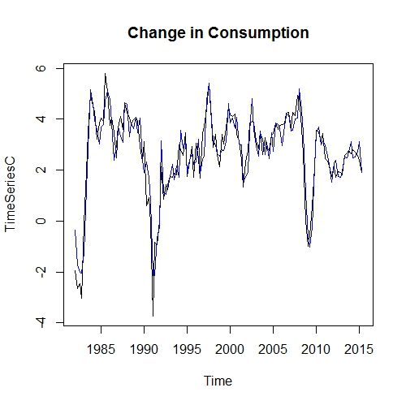
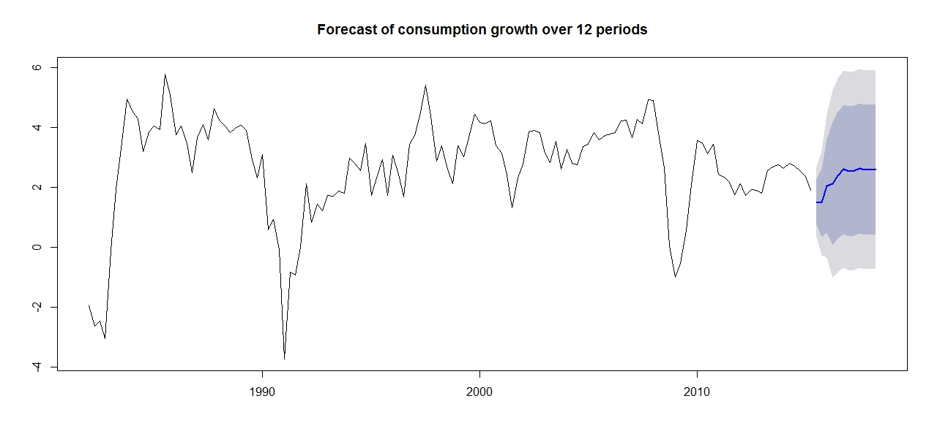
Forecast: Consumption

Slide 24
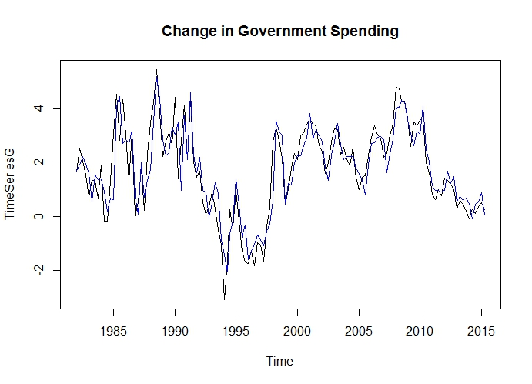
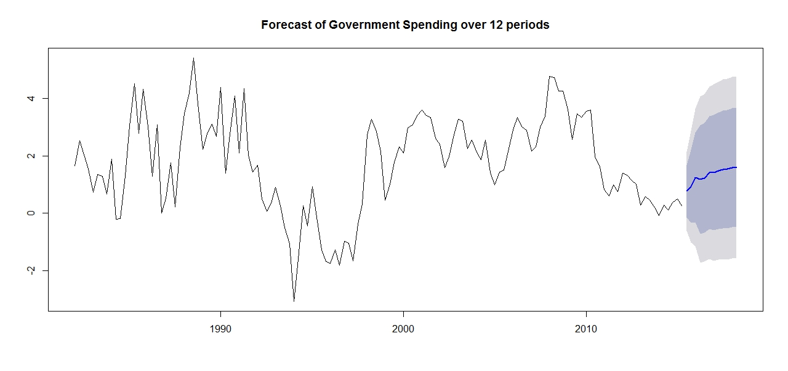
Forecast: Government Spending

Slide 25
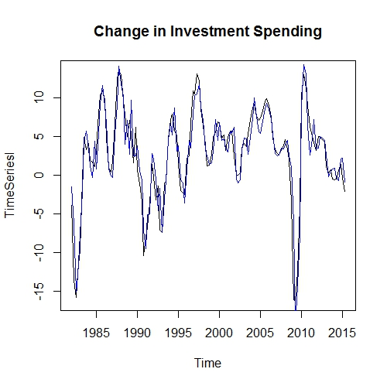
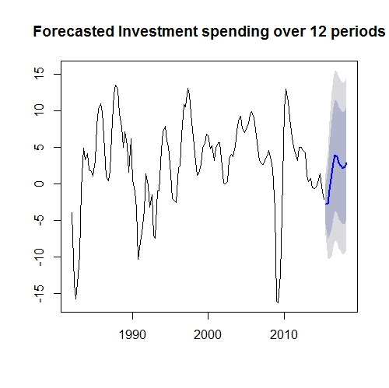
Forecast: Investment Spending

Slide 26
Models used for ARIMA Forecast
Variable | Model | RMSE
GDP | ARIMA(4,0,6) | 0.5775691
Consumption | ARIMA(4,0,5) | 0.5877882
Government Spending | ARIMA(5,0,3) | 0.6969494
Investment Spending | ARIMA(8,0,2) | 2.158997
House Prices | ARIMA(1,0,7) | 0.8840623
GDP Gap | ARIMA(1,0,3) | 0.5389029
Net Export
Energy Price
CPI Inflation | ARIMA(5,0,7) | 0.2769114

Slide 27



Estimating Threshold,
$$τ$$
Trim data at 15%. Middle 70% of data.
Threshold estimated endogenously.
Run series of F tests (Hansen).
Lowest value of SSR, BIC, AIC provides best estimate of threshold.
Threshold Variable:
Threshold Value:
$$x_{t−1}$$
$$τ$$

Slide 28
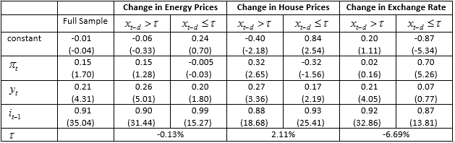
Threshold Regressions

Slide 29
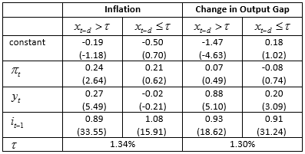
Threshold Regressions

Slide 30
Works Cited
Devereux, M., Tomlin, B., & Dong, W. (2015). Exchange Rate Pass-Through, Currency of Invoicing and Market Share. Retrieved November 5, 2015, from http://www.bankofcanada.ca/2015/08/working-paper-2015-31/
Bank of Canada. (2015, October 21). Monetary Policy Report October 2015. Retrieved November 5, 2015, from http://www.bankofcanada.ca/wp- content/uploads/2015/10/mpr-2015-10-21.pdf
Marr, G. (2015, October 29). CMHC Warns That Canadian Housing Market is Overvalued in Most Major Cities. Retrieved November 18, 2015, from http://business.financialpost.com/personal-finance/mortgages-real-estate/cmhc- warns-that-canadian-housing-market-is-overvalued-in- most-cities
Milstead, D. (2015, September 19). The Bottom for Oil Prices is as Clear as Mud. The Globe and Mail, p. B11.
Parkinson, D. (2015, September 18). Fed Holds the Line on Rates Amid Global Uncertainty. The Globe and Mail, p. B1.
Reboredo, J. (2012). Modelling Oil Price and Exchange Rate Co- Movements. Journal of Policy Modeling, 419-440. doi:10.1016/j.jpolmod.2011.10.005

Slide 31
Works Cited
Statistics Canada. (2015). Gross domestic product at basic prices, by industry (monthly). Retrieved November 8, 2015, from http://www.statcan.gc.ca/tables-tableaux/sum-som/l01/cst01/gdps04a-eng.htm
Enders, W. (2010). Applied econometric time series (Third edition. ed.) Wiley.
Hansen, B.E. STATA programs; http://www.ssc.wisc.edu/~bhansen/progs/progs_threshold.html
Faucon, B. OPEC Sees U.S. Oil Output Dropping Next Year. Wall Street Journal. October 12, 2015. http://www.wsj.com/articles/u-s-annual-oil-output-to-drop-for-first-time-in-eight-years-1444647601

Slide 32
Works Cited
Canadian Real Estate Association . (2015). CREA Updates Resale Housing Forecast. Récupéré sur CREA: http://www.crea.ca/stats/quarterly-forecasts
The Economist Intelligence Unit Limited. (2015, Nov 13). Canada: 5-year forecast table. Récupéré sur The Economist : http://viewswire.eiu.com.ezproxy.lib.ryerson.ca/index.asp?layout=VWArticleVW3&article_id=11367859
International Monetary Fund . (2015). Report for Selected Countries and Subjects. Récupéré sur International Monetary Fund : http://www.imf.org/external/pubs/ft/weo/2015/02/weodata/weorept.aspx?pr.x=52&pr.y=3&sy=2013&ey=2020&scsm=1&ssd=1&sort=country&ds=.&br=1&c=156%2C132&s=NGAP_NPGDP%2CPCPIPCH%2CLUR&grp=0&a=#cs1

