Slide 1
Chinese dialectal cleft constructions: microparametric ‘lateral’ grammaticalization
Keith Tse (謝嘉麒)
Lancaster University/Ronin Institute/Institute for Globally Distributed Open Research and Education
North American Conference in Chinese Linguistics (NACCL-34)
25th September 2022
My sincerest thanks to many people who helped me with this piece of work, namely Professor 馮勝利 for teaching me Classical Chinese (文言) and diachronic Chinese syntax, and Professor Edith Aldridge (李琦) for commenting on earlier drafts of this piece of work. My gratitude also to members of CPP lab, especially Professor Nancy Hedberg, for many illuminating and insightful discussions on cleft constructions in Chinese and beyond. This presentation is dedicated to all of you.

Slide 2
Chinese cleft constructions (shi-de 是…的)
Chinese cleft constructions (shi-de 是…的) (Lee (2005), Hole (2011), Meng (2014)):
Mandarin:
張三 是 昨天 買 票 的
Zhangsan SHI yesterday buy ticket DE
‘It was yesterday that Zhangsan bought books.’ (Simpson and Wu (S&W) (2002:169))
COP (是/係) + 的
Historical formation of Chinese clefts: 龍/肖 (2009, 2011), Long (2013), Zhan (2012), Zhan and Traugott (2019):
Collocations of 是 and 的 in historical texts: 是 (copula) + 的 (complement)
Comparative dialectal distribution of adnominalisers de/ge (的/個/嘅 /个) (曹 (1994, 1995), 李 (2016)):
Cantonese:
張三 係 琴日 買 非 嘅
Zoengsaam HAI yesterday buy ticket GE
‘It was yesterday that Zoengsaam bought books.’ (Lee and You (1998), cf Fung (2000))
Historical formation (Long and Xiao (2009, 2011), Long (2013), Zhan

Slide 3
Simpson and Wu (2002): ‘lateral’ grammaticalization (LG)
Northern Mandarin: VOde (sentence-final de) / VdeO (sentence-medial de)
張三 是 昨天 買 票 的 / 張三 是 昨天 買 的 票
ZS SHI yesterday buy ticket DE ZS SHI yesterday buy DE ticket
‘It was yesterday that Zhangsan bought tickets.’ (S&W (2002:169))
VOde (all Tense/Aspect/Mood (TAM) values) / VdeO (past tense)
他 是 明天 才 會 去 北京 的 / *他 是 明天 才 會 去 的 北京
He SHI tomorrow only.then FUT go Beijing DE he SHI tomorrow only.then FUT go DE Beijing
‘It is tomorrow that he will go to Beijing.’ (S&W (2002:177, 189))
S&W (2002:171-175): V de i O t i (historical-comparative assumption)
VdeO (northern Mandarin dialects) <
VOde (all Chinese dialects)
‘Lateral’ grammaticalization: sentence-medial/verbal affix de (T(past)) < sentence-final de (D)
(cf Abney (1987) on D/T parallels (nominal/clausal)) VdeO VOde

Slide 4
Research Background and Questions:
S&W (2002) (VdeO < VOde) is a historical-comparative assumption, not a historical-comparative analysis
龍/肖 (2009, 2011) openly challenge S&W (2002): VOde (earliest in Yuan (元) dynasty (元雜劇)), VdeO (earliest in Northern Song (北宋) dynasty (五燈會元));
Zhan (2012), 韓 (2012): VOde in Tang (唐) dynasty (敦煌變文集)
Comparative dialectal analysis of de/ge (Northern vs Southern):
VOde vs VOge / VdeO vs *VgeO
Cantonese:
張三 係 琴日 買 非 嘅 / *張三 係 琴日 買 嘅 非
ZS HAI yesterday buy ticket GE ZS HAI yesterday buy GE ticket
‘It was yesterday that ZS bought tickets.’ (Lee and Yiu (1998:11), cf Tang (2011))
Historical-comparative analysis of Chinese clefts: VOde/VOge
(sentence-final de/ge is pan-Chinese)
VdeO/*VgeO (sentence-medial de/ge is not)

Slide 5
Cleft constructions: focus + presupposition
Cleft constructions: focus + presupposition (Heggie (1993), Kiss (1998, 1999), cf Chomsky (1977))
e.g. it-clefts (English, Romance) (Heggie (1993:3-4), Hedberg (2000:96), Reeve (2011:152)):
pro BE XP relative clause
expletive COP Focus Presupposition
Matrix verb
Assigning focus (Higgins (1973, 1979), pace Kiss (1998))
A’/operator-movement (left-periphery)
(cf WH-movement (Chomsky (1977))
Verbal properties of BE in it-clefts (negation, TAM values):
It was Clinton who won (Hedberg (2000:891))
Although it probably was not John who cooked the stew, it might have been. (Reeve (2012:155))

Slide 6
Chinese cleft constructions: focus + presupposition
張三 是 昨天 買 書 的
Zhangsan SHI yesterday buy book DE
‘It was yesterday that Zhangsan bought books.’ (S&W (2002:169))
Subject i COP Focus PRO i Presupposition
Matrix verb
A’/operator-movement (left-periphery)
Verbal properties of 是 in shi-de construction (V-neg-V, negation, TAM values):
你 是-不-是 昨天 來 的？
you SHI-NEG-SHI yesterday come DE
‘Was it or was it not yesterday that you came?’ (S&W (2002:196))
又/不 是 他 姐姐 開 的 門
again/NEG SHI he sister open DE door
‘It was again/not his sister who opened the door.’ (Paul and Whitman (P&W) (2008:439))
會 是 我 明天 要 在 公園-裏 見 她 的
FUT SHI I tomorrow have.to at park-LOC see her DE
‘It will be I who have to see her in the park tomorrow.’ (adapted from Cheng (1983:76))

Slide 7
Chinese cleft constructions: VOde/VdeO
it-clefts: pro BE Focus Presupposition
XP relative clause
shi-de: subject BE (shi) Focus Presupposition
XP relative clause (-de)
COP A’/operator-movement
(matrix verb) (left-periphery of embedded (relative) clause)
In addition to TAM values (VdeO denoting past tense), VOde permits narrow and broad foci whereas VdeO only has narrow foci (P&W (2008:427-429), cf Selkirk (1968), Lambrecht (1994)):
是 希臘人 最 先 開始 釀 酒 的 (VOde)
SHI Greek most early start brew wine DE
EITHER ‘it was the Greeks who first brewed wine’ (narrow subj-focus) OR ‘it was the case that Greeks were the first to brew wine.’ (Cheng (2008:253))
If broad focus, VOde is required:
是 張三 寫 詩 的
SHI ZS write poem DE
‘It is/was ZS who writes/wrote the poem’ (narrow subj-focus) OR
It is case that ZS writes/wrote the poem.’ (broad focus)
是 張三 寫 的 詩 (VdeO)
SHI ZS write DE poem
‘It was Zhangsan who wrote the poem’
(past tense/narrow subj-focus only) (Hole (2011:1711))

Slide 8
Formal representation of Chinese clefts (VOde)
PredP
SpecPredP Pred’
(Subject) Pred FocP
shi SpecFocP Foc’
[u-foc]subject Foc LowCP
adverb [i-foc] SpecLowCP LowC’
verb TP i LowC TP
TP SpecT T’ de/ge t i
pro i T VP
V’
V DP
de and, by extension, ge are sentence-final particles (SFPs) merged in LowC below Foc (Paul (2014, 2015),
cf Rizzi (1997), Belletti (2004))
Copula assigning focus
(Cheng (2008), Meng (2014))
A’/operator-movement applicable to specific elements (narrow) or the embedded clause (broad)

Slide 9
Formal representation of Chinese clefts (VdeO)
PredP
SpecPred Pred’
(Subject) Pred FocP
shi SpecFoc Foc’
[u-foc]subject Foc TP
adverb [i-foc] SpecT T’
T(past) vP
(de) v’
v VP
V i-de V’
*ge V DP
t i
Copula assigning focus
A’/operator-movement only for subject and adverb in the embedded relative clause (narrow focus)

Slide 10
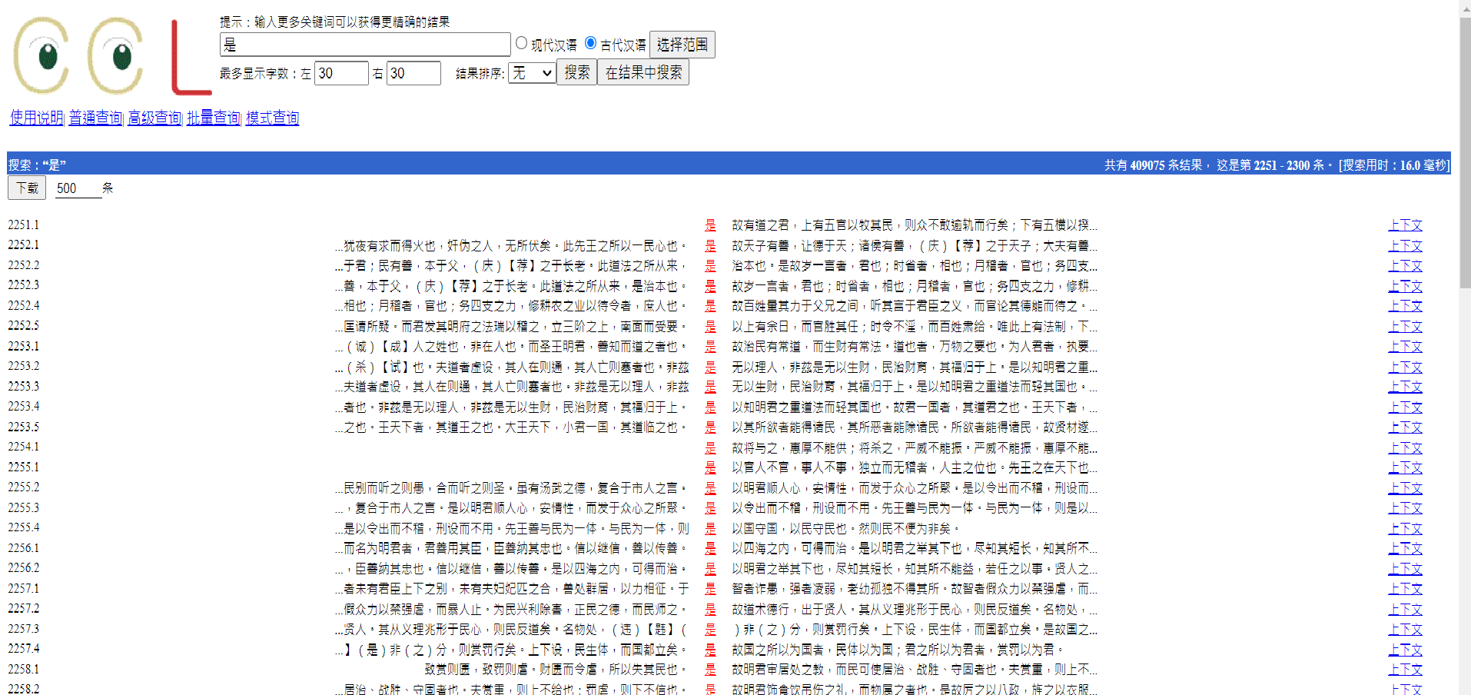
Historical-comparative distribution
Recent work on history of Chinese shi-de constructions: 龍/肖 (2009, 2011), Zhan (2012), Long (2013) etc
shi-de constructions are copular i.e. shi is a matrix copular verb selecting a clausal complement (VOde/VdeO):
Historical corpora: http://ccl.pku.edu.cn:8080/ccl_corpus/ (PKU), ctext.org (中國哲學書電子化計劃)
(online word searches/concordancers)
Key Word In Context (KWIC) (concordances): 是

Slide 11
Chinese cleft constructions: VOde
非 是 菩薩 行藏 此 是 俗人 做 底
NEG SHI divine.beings behaviour This COP laymen do DI
‘This is not divine intervention but the doings of laymen’ (敦煌變文記) (唐)
底 is old form of 的 (Feng (1990))
Contrastive focus (semantic alternatives: 非是菩薩行藏/此是俗人做底) >
‘it was laymen who did this’ (narrow subj-focus) OR ‘it is the case that laymen did this’ (broad focus)
師 云： 人人 盡 有 底 衣 既 是
Teacher say everyone all have DI clothes then BE
僧 云： 既 是 人人 盡 有 底， 用 被 坐 甚摩？
Monk say as BE everyone all have DI, use garment do what
Teacher says, ‘The clothes which everyone has then.’ Monk says, ‘as it is the clothes which everyone has, what use for garments?’
(祖堂集) (唐)
Omission of lexical noun > ‘if it is the case that everyone has it’ (> -的話)
(的 as LowC + 話 denoting conditional (Zhang (2009))
Contexts in which de loses its nominal characteristics (semantic alternatives/omission of lexical noun): de is reanalyzed as clausal (nominal > clausal) (‘lateral’ grammaticalization)
那 兩 個 人
those two CL people
是 如此如此 這般這般 使 的 手段
SHI thus so use DE manipulation (元雜劇)
娘 原 是 氣惱-上 起 的 病
Mother originally SHI angry-LOC become DE illness
‘It was originally through anger that my mother got the illness.’ (元雜劇)

Slide 12
Chinese cleft constructions (VdeO)
天下 人 總 是 參 得 底 禪，
World people always SHI study obtain DI enlightenment
某 是 悟 得 底
I SHI understanding obtain DI
‘For most people, it is always enlightenment obtained via studying, whereas for me, it is enlightenment obtained via understanding (五燈會元) (北宋)
Contrastive focus (semantic alternatives 參得底禪/悟得底(禪)) >
‘it is always via studying that most people obtained enlightenment, but it is via understanding that I obtained it.’
前者 打 太醫 那 兩 個 人 是 如此 這般 使 的 手段
formerly hit Chinese.medicine those two CL people SHI thus so use DE manipulation
‘Formerly as for those two people who practice Chinese medicine, it is manipulation used thus and in such way.’ (元雜劇) (元)
Abstract lexical noun (手段) (non-referential) > ‘it was in this way that those two people used manipulation.’
娘 原 是 氣惱-上 起 的 病
Mother originally SHI anger-LOC contract DE illness
‘As for mother, it was originally illness contracted via anger’ (金瓶梅詞話) (明)
Abstract non-concrete (non-referential) lexical noun (病) > ‘it was due to anger that mother contracted illness’
悟空， 你 是 哪 世 修-來 的 緣法？
Wukong you SHI which life practise-obtain DE karma
Wukong, as for you, which life was karma obtained? (西游記) (明)
abstract lexical noun (緣法) > ‘In which life did you obtain karma?

Slide 13
Chinese cleft constructions (VOge / *VgeO)
Examples of ge (個/棝/固) are rare (Liu (2008))… however:
師 指 面-前 狗子 云： 明明-個，明明-個
Teacher point face-front dog say bright-GE bright-GE
僧 便 問 師： 既 是 明明個， 爲 個 摩 頭 在 裏許?
Monk then ask teacher as SHI bright-GE for CL what head at inside?
Teacher points at the dog in front and says, ‘It is bright, bright.’ Monk then asks him, ‘As it is bright, why is its head inside?’ (祖堂集) (唐)
Lexical noun omitted (既是明明個(狗子)) > as it is bright (-個話): 個 (LowC) + 話 (conditional) (李 (2016))
我 是 看 個 書
Wo shi kan ge shu
I SHI read GE book
‘I read a book.’ (金瓶記) (cf 朱子語類) (北宋)
你 還 是 取 個 頭
Ni hai shi qu ge tou
You still SHI take GE head
‘Why don’t you take a head?’
Ge has inherent countability as a numeral classifier (individualizer (+count)) (Bisang and Li (2012), Zhang (2013)), which denotes event quantification and prevents it from being reanalyzed as a sentence-medial clausal particle (*VgeO).
VOge

Slide 14
‘Lateral’ grammaticalization of de/ge (VOde/VOge vs VdeO/*VgeO)
VOde/VOge (sentence-final de and ge (n/CL) > SFP (LowC)) (no noun coming after de/ge > weakening of nominal interpretation)
CLP
CL ModP
ge Mod nP
[+count] de/ge n NP di
‘Lateral’
VdeO/VgeO (ge has [+count] whereas de does not): sentence-medial de (VdeO) reanalysable as verbal suffix (T(past)/v) whereas sentence-medial ge (*VgeO) not due to [+count]
LowCP
LowC TP
de/ge T vP
v VP de/*ge

