Slide 1
DFCU Payment Gateway – Preliminary Interview Project
Software Developer Role
Keith Tumusiime

Slide 2
Problem Statement
Build a Payment Gateway System with the following features:
Payment initiation and verification.
A client interface to initiate payments and check transaction statuses.
Simple, secure, and scalable architecture.

Slide 3
Solution Overview
API (Backend): Built using PHP with MySQL database for payment transactions.
Frontend (Client): Web-based interface in HTML, Bootstrap, and jQuery.
Database: MySQL for storing transaction details like payer, payee, amounts, references, and transaction status.

Slide 4
API Architecture
Endpoints:
- POST /payment/initiate: Initiates a payment.
- GET /payment/verify/{transaction_reference}: Verifies the payment status.
Database Schema:
- transactions table with fields such as id, payer_account, payee_account, amount, currency, payer_reference, transaction_reference, status, created_at.
Technology Stack: PHP, MySQL, Apache/Nginx.

Slide 5
Client-Side Design
User Interface: Clean UI with Bootstrap and interactive elements using jQuery.
Key Features:
- Input fields for payer and payee accounts, amount, and currency.
- Payment initiation form and transaction status checker.
Workflow: User submits payment, receives a transaction reference and message description, and can later check the status.

Slide 6
Database Schema
CREATE TABLE `transactions` ( `id` int(11) NOT NULL, `payer_account` varchar(10) NOT NULL, `payee_account` varchar(10) NOT NULL, `amount` decimal(10,2) NOT NULL, `currency` varchar(3) NOT NULL, `payer_reference` varchar(255) DEFAULT NULL, `transaction_reference` varchar(36) NOT NULL, `status` enum('PENDING','SUCCESSFUL','FAILED') NOT NULL, `created_at` timestamp NOT NULL DEFAULT current_timestamp()) ENGINE=InnoDB DEFAULT CHARSET=utf8mb4 COLLATE=utf8mb4_general_ci;

Slide 7
Security Considerations
CORS: API configured to handle external requests.
SQL Injection Protection: Prepared statements used for database queries.
Input Validation: Ensures payment data integrity.
HTTPS: Recommending production deployment over HTTPS.

Slide 8
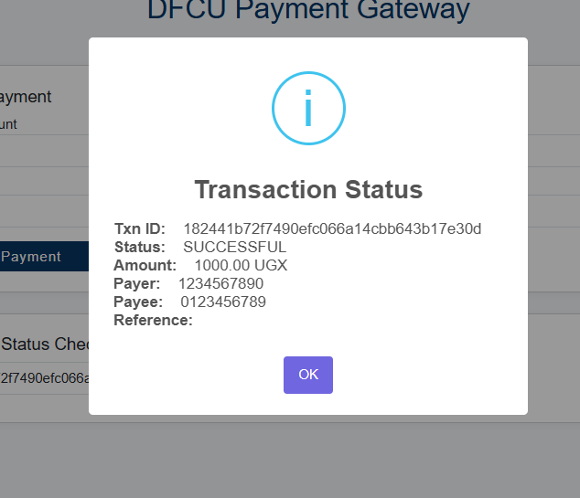
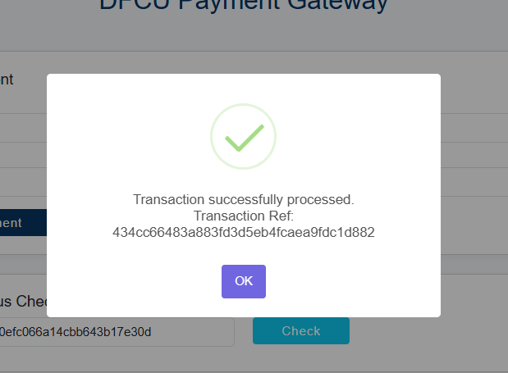
Live Demo
- Screenshots

Slide 9
Next Steps / Future Enhancements
Authentication: Adding user authentication (e.g., JWT).
Webhooks: Implementing a notification system for transaction status updates.

Slide 10
Conclusion
The DFCU Payment Gateway API and Client successfully meet the requirements for secure and efficient payment processing.
Ready for production deployment with optional enhancements for scalability and security.

Slide 11
Resources
Github: https://github.com/keithtumusiime/dfcu-Preliminary-Interview-Project
API documentation: https://documenter.getpostman.com/view/15114051/2sB2j98p3F
Deployment Guide: https://github.com/keithtumusiime/dfcu-Preliminary-Interview-Project/blob/main/README.md

Slide 12
Q&A
Any questions or clarifications?

