Slide 1
Total Times for configs
Configuration [notch on in MHz] | Duration in configuration
A [260] | 10 mins
B [260,375] | > 331 hours
C[260,460] | 18 mins
G[260,385] | 77 hours
O[260,365] | 112 hours
P[260,375,460] | 110 hours

Slide 2
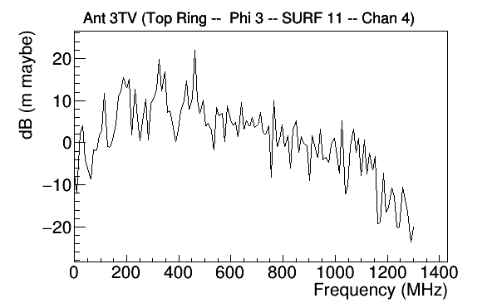
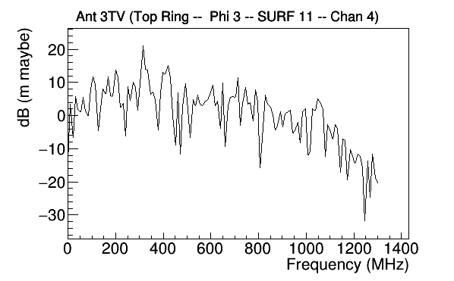

Slide 3
Pulser
Ch3
Scope
Ch1
Ch2
High Pass Filter
LNA
Variable Attenuator
(33,34,….43dB)
16-way Splitter
Hybrid
LNA

