Slide 1
CSC 2506/412 Course Project Comparing Several Inference Algorithms and Learning in Probabilistic Graphical Models
Weijian Zhou
ChenXing Zhao
Wenzhangzhi Guo
March 31, 2015

Slide 2
Introduction
Compare different inference and learning algorithms by experimenting with a simple image segmentation problem
Following the approaches in paper “A Comparison of Algorithms for Inference and Learning in Probabilistic Graphical Models”

Slide 3
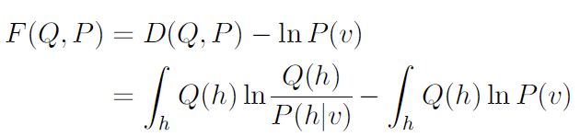



Basic Idea
Unify different learning algorithms into free energy framework by imposing different constraints on Q distribution

Slide 4





Data Generation
foreground: f ∈ {1,…,5}
binary mask
background: b ∈ {1,…,7}
Gaussian noise
combined image
final result

Slide 5
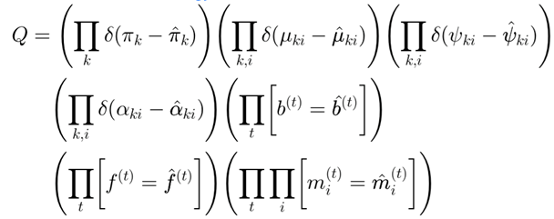
Learning
Iterated Conditional Modes (ICM)
E-step: Fixing model parameters, update pixel label assignments
M-step: Based on the current pixel labels, update the model parameters
Easy to implement, but can get stuck at poor local minima

Slide 6
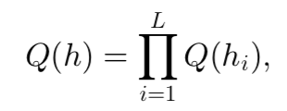
Learning (cont’d)
Exact Expectation-Maximization (EM) Algorithm
Place no constraint on Q distribution
E Step: Minimize free energy with regard to Q using exact inference (variable update)
M Step: Minimize free energy with regard to the model parameters (parameter update)
Variational EM (Mean-field)
Assume the Q distribution in the EM algorithm can be fully factorized

Slide 7
Learning (cont’d)
Gibbs Sampling EM
Similar to ICM but uses sampling to update the pixel labels in the E-step

Slide 8
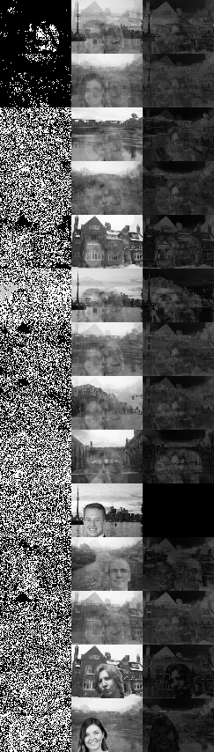
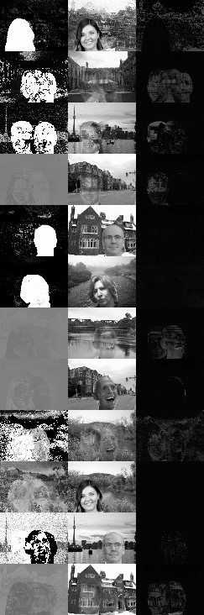
Current Progress
ICM and Exact EM done
Working on Variational EM
ICM
Exact EM

