Slide 1
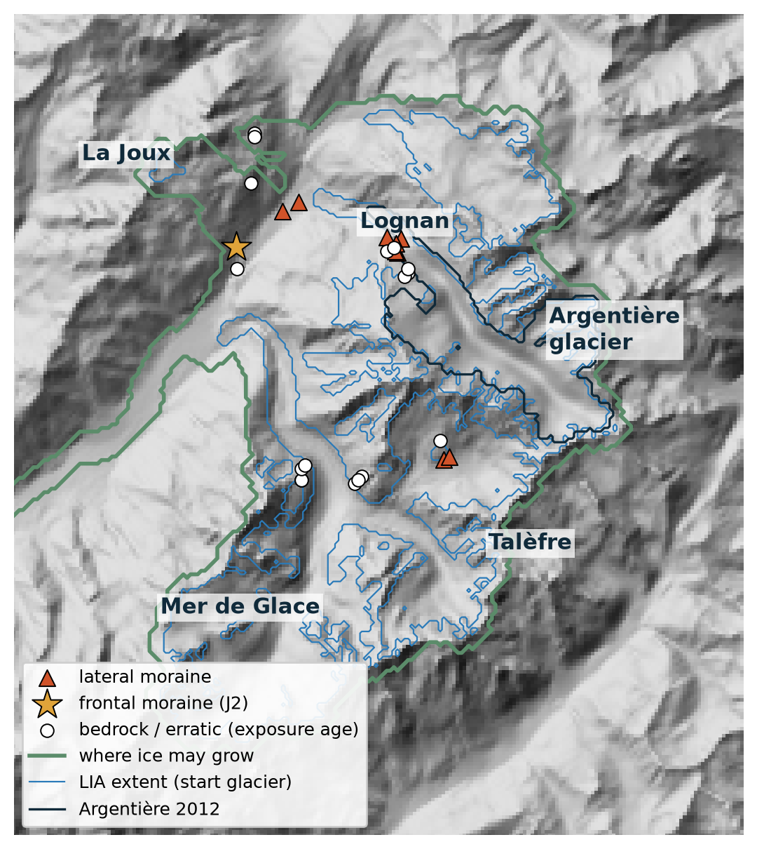
Younger Dryas temperature from the Argentière moraines
Inverting T(t), 13.6–9.0 ka, from dated landforms with a differentiable glacier model
Kejdi Lleshi · University of Lausanne
Notes:
Lateglacial window 13.6-9.0 ka; the target is the Younger Dryas temperature and how far we can trust it.

Slide 2






What made the Younger Dryas glacier?
Climate parameters (27)
Glacier parameters (2)
T(t), precipitation P, seasonality T_s, melt factor DDF
ice softness A (flow law) and basal sliding τ_ref
Goal: the values with which the glacier model reproduces the dated Younger Dryas landforms
Observations
Cheap first run · 200 m
T(t) inversion · 100 m
Joint inversion · 100 m
Invert T(t) only to get the prior. The rest of parameters from the literature
starts from the 200 m T(t) (S 9–11). Then we do a sensitivity analysis (S 10)
dated moraines and exposure ages, 13.6–9 ka
T(t) + P, T_s, DDF, A, τ_ref (slides 12–14)
27
35.3 → 25.9
→ 22.7
→ 13.4
landforms
loss
loss
loss
All results from here on are at 100 m spatial resolution; the 200 m run only provides the prior for T(t).
Notes:
What we look for: the climate (temperature history at 2000 m, precipitation, seasonality, melt factor) and the glacier parameters (ice softness, sliding) with which the IGM-emulator glacier model reproduces the dated Younger Dryas landforms of Argentiere, Mer de Glace and Talefre. Path: a cheap first inversion of T(t) alone at 200 m with literature parameters (loss 35.3 -> 25.9) gives the starting T(t); the 100 m inversion refines it (22.7, slides 9-11); the joint 100 m inversion then frees the five climate and glacier parameters together with T(t) (13.4, slides 12-14). Only 100 m results are shown.

Slide 3
Dated landforms record the Lateglacial glacier
landform | n | age (ka) | constrains
Frontal moraine J2 (La Joux) | 1 | 10.8 | terminus position
Lateral, dated: Lognan L1–L3, Talèfre T1–T2 | 5 | 11.9–10.3 | ice-surface height
Lateral, undated: La Joux, Lognan | 4 | 13.1–10.8 * | ice-surface height
Bedrock / erratic exposure ages | 17 | 19.1–9.8 | ice-free after exposure
* age window from morphostratigraphy
¹⁰Be ages: AlpIce-1 (Kamleitner et al. 2026); Protin et al. 2019, 2021; Lehmann et al. 2019, 2020
Start glacier: LIA extent and surface (Reinthaler & Paul 2025)
Grid: 100 m, 250 × 250 cells
Notes:
Three valleys: Argentière, Mer de Glace, Talèfre. One frontal moraine (J2), nine lateral moraines, 17 exposure-dated bedrock/erratic samples. The five samples exposed before 15.6 ka cannot constrain this window.

Slide 4

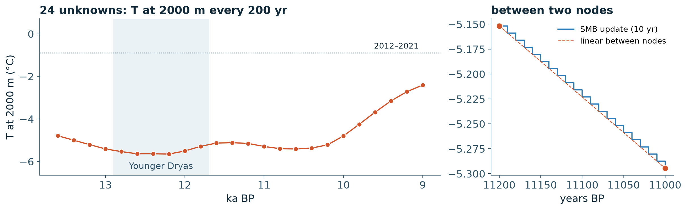
A forward run: from T(t) to a glacier
T(t) at 2000 m
T(x, y, t)
Mass balance
Ice flow
H(x, y, t)
Loss
24 nodes, the unknown
lapse rate
P, T_s, DDF, T_present
IGM emulator, fixed
saved every 100 yr
vs dated landforms
= parameters borrowed from the literature (next slide), tested for sensitivity at the end
Notes:
The only unknown is T at a fixed elevation (2000 m), 24 values every 200 years; linear in between; the mass balance is recomputed every 10 years. Everything else is fixed: these are the parameters on the next slide.

Slide 5
Fixed inputs, borrowed from the literature
parameter | value | what it does | source | tested range
P | 1.8 m/yr | precipitation; snow where T < 0 °C | Chamonix 1.28 (1042 m), Col du Dôme ~2.5 (4250 m) | 1.5 – 2.1
P scaling | +7 %/°C | Lateglacial P follows T(t) | Clausius–Clapeyron | ×0.75 – ×1.25
T_s | 9.4 °C | seasonal half-range of the year | Chamonix 1981–2010 (Jan −2.2, Jul 16.5 °C) | 7.9 – 10.9
lapse rate | 7 °C/km | T(z) from T at 2000 m | standard value | 6 – 8
DDF | 10 mm/K/d | melt per positive degree-day | upper literature bound | 8 – 12
T_present | −0.89 °C | 2012–2021 at 2000 m: anomaly reference | fitted to geodetic −0.66 m w.e./yr (Davaze 2020) | re-fitted
A (flow law) | 78 MPa⁻³/yr | ice softness | IGM | 52 – 117
τ_ref (sliding) | 0.215 MPa | basal sliding | IGM emulator | 0.15
speed cap | 600 m/yr | stability in the Lognan icefall | model choice | 1000
T bounds | envelope | keeps T(t) in the literature range | Protin 2019, Heiri 2015, Samartin 2012 | –
Check: P = 1.8 m/yr → 1.40 m w.e./yr accumulation vs 1.47 measured (Davaze et al. 2020)
Notes:
Every row here is a choice we did not invert. The last column is what the sensitivity analysis perturbs (slide 10). T_present is re-fitted to the geodetic balance whenever a mass-balance parameter changes, so the result stays an anomaly to today.

Slide 6
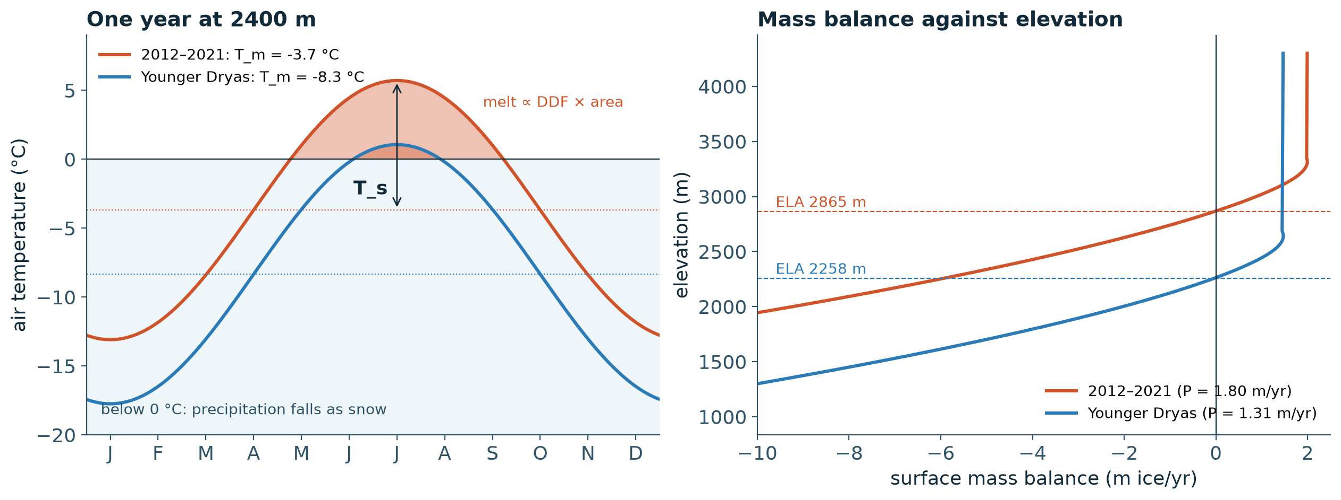
How T(t), T_s and P make the mass balance
T_m(z, t) = T(t) − 7 °C/km · (z − 2000 m)
T(τ) = T_m − T_s · cos 2πτ
SMB = P(t) · f(T < 0) − DDF · Σ max(T, 0)
T(t) shifts the whole field up or down
T_s sets how far summer rises above the mean
P(t) = 1.8 m/yr · 1.07^(T(t) − T_present)
Notes:
Left: the year at 2400 m. Today summer rises above 0 °C for ~4 months; in the Younger Dryas almost never. Right: the result is an ELA ~600 m lower (2865 → 2258 m), even though P is 27 % smaller (7 %/°C).

Slide 7
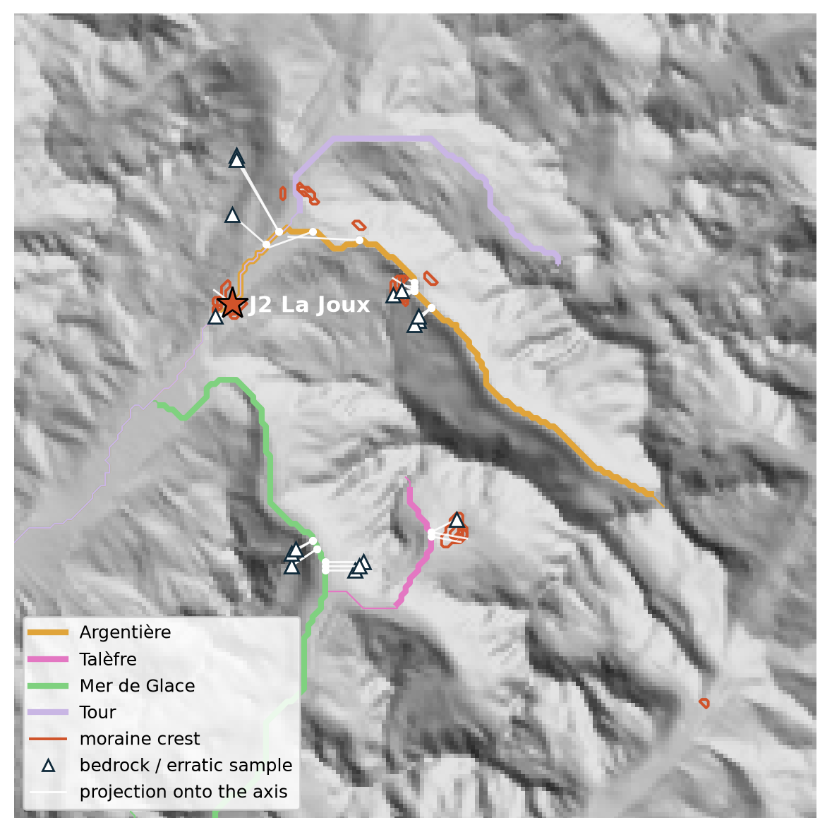
The loss: landforms read along their valley
landform | asks | σ
frontal moraine | terminus L = moraine, at some time in its age window | 300 m
lateral moraine | glacier reaches it, and axis surface = crest + 10 m, at some time in its window | 300 m, 60 m
bedrock, erratic | axis surface ≤ sample + 10 m at every time after exposure | 60 m
moraine preserved | no later advance overrides it | weight 0.5
J = Σ landforms w · Huber(misfit) + Σ (ΔΔT)²
Terminus L: soft maximum of ice along the flowline — defined and differentiable even when the glacier stops short
Each landform counts once; beyond 3σ it pulls linearly (Huber)
Second term: smoothness of the 24 nodes
Notes:
Map: one flowline per valley (thick part = where ice counts for the terminus). White lines: each landform is moved to its cross-section on the valley axis. Two quantities are measured there: the terminus position L along the flowline and the ice surface on the axis. The first version scored the ice at the landform's own cells: blind when the glacier stops short, and fooled by ice on valley sides and nunataks.

Slide 8
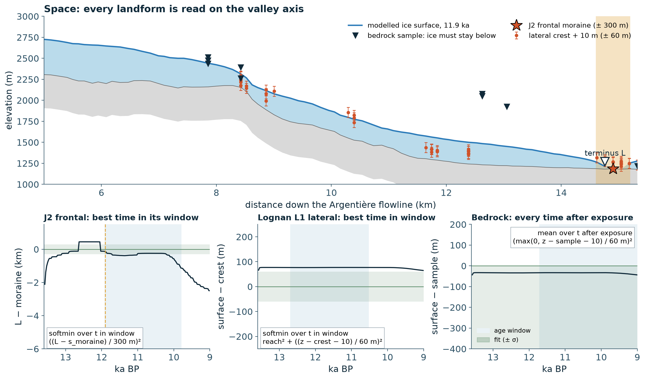



Scoring one forward run
Space
Each landform is moved to its cross-section of the valley axis.
Time
Moraines: the best time in their age window. Bedrock: every time after exposure.
Score
(distance / σ)², summed over landforms.
Notes:
Top: the best run at 11.9 ka along the Argentière flowline. Red: lateral crests (+10 m) with their 60 m σ; dark triangles: bedrock samples, ice must stay below them once they are exposed; star: J2 with its 300 m band; open triangle: the modelled terminus. Bottom: the same three kinds through time. J2 is met at 11.9 ka, the old end of its window. Lognan L1 sits ~76 m too high for the whole window, outside its σ. The bedrock sample stays ice-free.

Slide 9
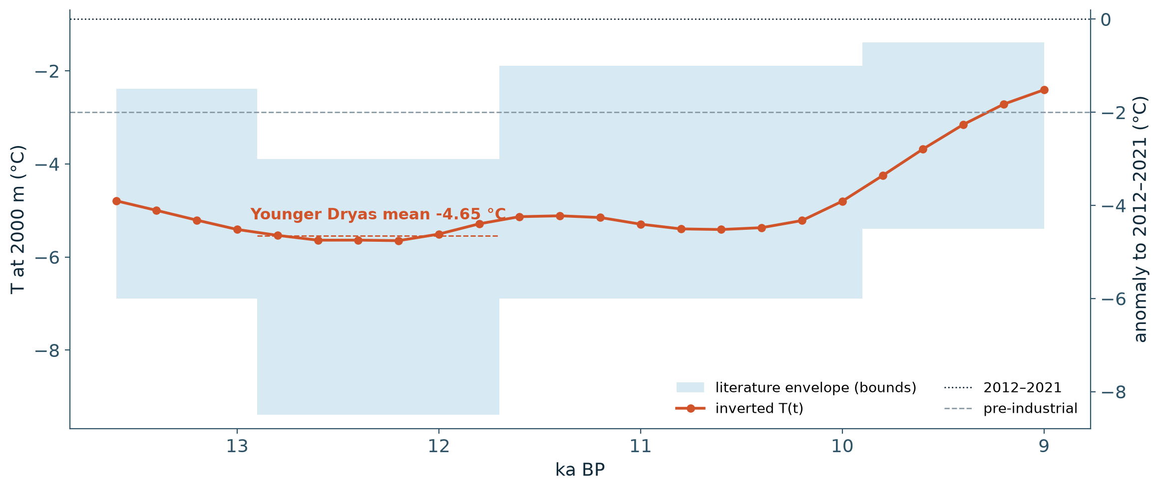
Younger Dryas: 4.65 °C colder than 2012–2021
−4.65 °C
YD mean vs 2012–2021
−2.65 °C
YD mean vs pre-industrial
−5.65 °C
coldest node, 12.2 ka (at 2000 m)
check | value
Protin et al. 2019 (summer, YD / early Holocene) | 3.0–5.5 °C below present
Loss over 30 iterations (from the 200 m result) | 23.66 → 22.74
Nodes on the envelope bounds | 0 of 24
Notes:
Warming from 10.2 ka to −2.41 °C at 2000 m by 9.0 ka. The YD value sits inside Protin et al. 2019 and no node is held by the envelope, so the data, not the bounds, set it. But: the 100 m run started from the 200 m optimum, so the 30 iterations only refine it (35.3 → 25.9 happened at 200 m).

Slide 10
Small temperature shifts, large changes in fit
parameter
low / high
change of the YD anomaly (°C)
loss
Loss at the best T shift
P
1.5
2.1 m/yr
−0.54
19.3
22.4
13.7
+0.47
25.5
DDF
8
12 mm/K/d
+0.34
20.3
−0.33
24.9
literature parameters
τ_ref 0.15 MPa (more sliding)
T_s
7.9
10.9 °C
−0.16
23.5
+0.08
22.4
A (flow law)
52
117
+0.01
28.0
YD moves ≤ 0.54 °C; the fit moves far more
−0.06
18.3
τ_ref (sliding)
0.15 MPa
−0.07
13.7
Still to come
upper: low end · lower: high end ■ better than base (22.4) ■ worse ■ data ±0.22 °C
Forward checks: Lateglacial P, lapse rate
First-order gradients were unreliable here (τ_ref: −0.80 predicted)
Joint inversion T(t) + P, T_s, DDF, A, τ_ref: slides 12–14
Forward runs, best uniform T shift relative to the base parameters; mass-balance cases re-fit T_present.
Notes:
Forward checks: for each parameter at an end of its literature range, the uniform shift of T(t) that minimises the loss (parabola through 3-6 forward runs), as a change of the YD anomaly to today relative to the base parameters' own best shift (-0.12 C). Mass-balance parameters re-fit T_present to the geodetic balance first. Upper bar: low end, lower bar: high end; green = better fit than the base (22.4), red = worse; number on the right = loss at that shift. Grey band: data-only uncertainty of the YD mean (+-0.22 C). All tested parameters move the YD anomaly by at most 0.54 C (P 1.5), but the fit changes a lot: more sliding gives 13.7, softer ice 18.3, less precipitation 19.3, a lower DDF 20.3. The first-order gradient estimates (previous version) were poor for the flow parameters. Pending: Lateglacial precipitation factor and lapse rate. Running: joint inversion of T(t) with P, T_s, DDF, A and tau_ref.

Slide 11
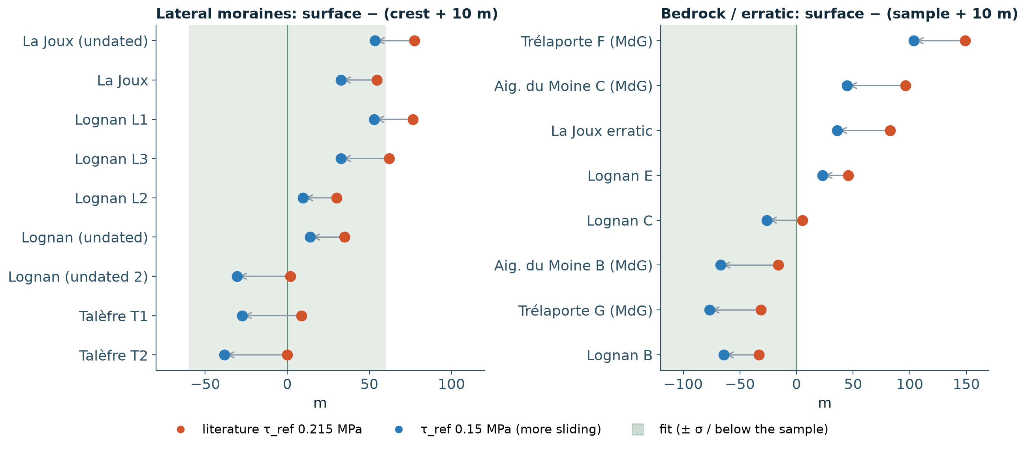
Best fit: more sliding, same temperature
−36 %
loss, without changing T(t)
20–50 m
thinner ice at the landforms, same length
−0.07 °C
YD anomaly at the new best shift
same T(t) | τ_ref 0.215 (literature) | τ_ref 0.15
loss | 22.7 | 14.5
landforms with misfit > 1 | 10 | 6
J2 terminus vs moraine | −129 m | −122 m
Softer ice (A 117) points the same way: loss 18.3
Notes:
Same T(t) as the inversion, only the sliding parameter changed (tau_ref 0.215 -> 0.15 MPa). Faster flow drains the glacier: the ice surface drops 20-50 m at every landform, the terminus stays put (J2 -129 -> -122 m). That is exactly the 'too thick for its length' misfit of the inversion. Lateral moraines at La Joux and Lognan L1/L3 come into or close to their 60 m sigma; the La Joux erratic and Aiguille du Moine C become ice-free or nearly; Talefre T1/T2 and Lognan (undated 2) now sit 30-40 m below their crests. Caveat: one parameter value, one uniform T shift, not a re-inversion; the joint inversion (slides 12-14) frees tau_ref, A and the mass-balance parameters together with T(t).

Slide 12


Why free the parameters too
Glacier too thick for its length
control | start | allowed range
T(t), 24 nodes | 100 m inversion | literature envelope
P | 1.8 m/yr | 1.0 – 1.8 m/yr
T_s | 9.4 °C | 7.9 – 10.9 °C
DDF | 10 mm/K/d | 8 – 12 mm/K/d
A (flow law) | 78 MPa⁻³/yr | 52 – 117
τ_ref (sliding) | 0.215 MPa | 0.10 – 0.25 MPa
Right length (J2 met), but ice 55–80 m above the La Joux and Lognan crests. T(t) moves length and thickness together.
Ice flow thins it, T barely moves
τ_ref 0.15 MPa: loss 22.4 → 13.7, YD anomaly −0.07 °C. Softer ice the same way.
Invert T(t) + five parameters
Equal weight
P, T_s, DDF, A, τ_ref (slide 5), with no control favoured.
Every control is a fraction of its range, 0 … 1
One Adam step size for all, no prior on the parameters
T_present re-fitted to the geodetic balance at each step
Notes:
The fixed-parameter inversion fits the length (J2) but not the thickness: lateral moraines and bedrock samples sit 50-150 m under modelled ice. A temperature change moves length and thickness together, so T(t) alone cannot fix that. The forward checks showed that more sliding (tau_ref 0.15) or softer ice (A 117) thins the glacier at the same length and barely moves the YD temperature. So the five bold parameters of slide 5 are inverted together with T(t). Equal weight: each control is optimized as a fraction of its allowed range with one Adam learning rate (Adam normalizes each control by its own gradient history), and there is no prior on the parameters; the only prior left is the smoothness of T(t). P range 1.0-1.8 m/yr. Gradients: adjoint for T(t), P, T_s, DDF; finite differences for A and tau_ref (their emulator gradient was unreliable). Run: results/argentiere_lg_100m_joint, 30 iterations of ~53 min.

Slide 13
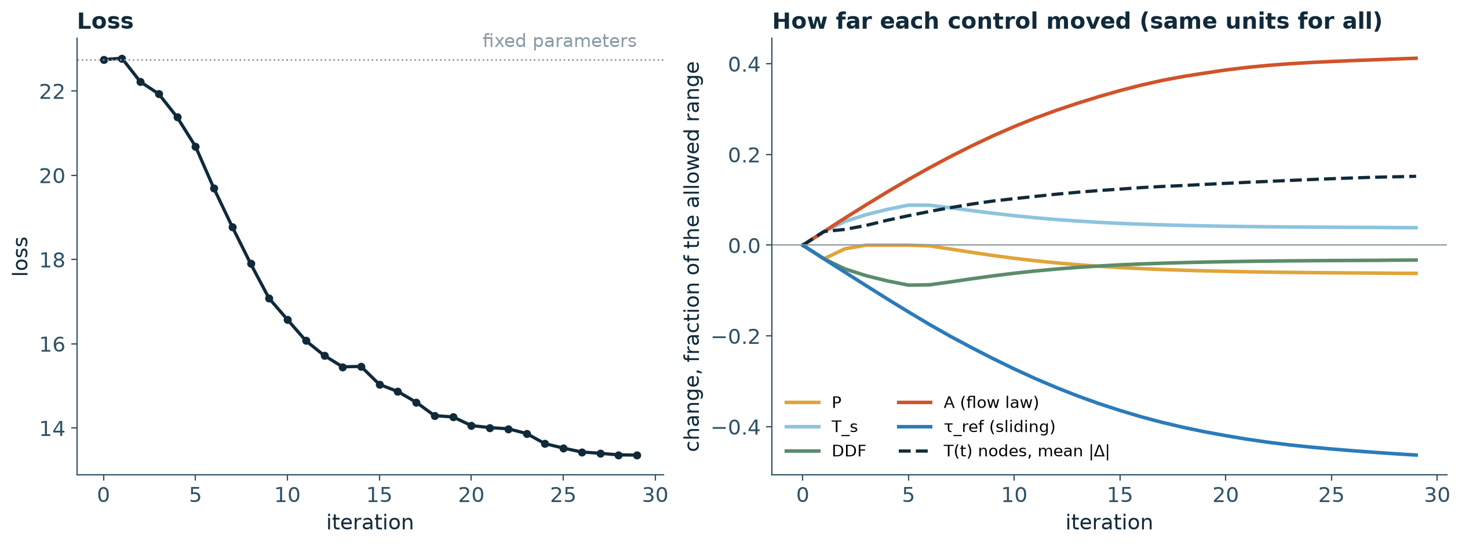
Ice flow does the work, not the temperature
−41 %
loss 22.7 → 13.4 in 30 iterations
0.215 → 0.146
τ_ref (MPa): more sliding
78 → 105
control | start | joint best | moved (fraction of range)
τ_ref (sliding) | 0.215 MPa | 0.146 MPa | 0.46
A (flow law) | 78 MPa⁻³/yr | 105 MPa⁻³/yr | 0.41
T(t), YD mean anomaly | −4.65 °C | −4.81 °C | 0.15 (all nodes, mean)
P | 1.80 m/yr | 1.75 m/yr | 0.06
T_s | 9.40 °C | 9.52 °C | 0.04
DDF | 10.0 mm/K/d | 9.87 mm/K/d | 0.03
A (MPa⁻³/yr): softer ice
Notes:
Left: loss per iteration, from the fixed-parameter optimum (22.74) to 13.36. Right: change of every control as a fraction of its allowed range, the units in which they are all treated alike. Table: every changed quantity, largest move first. Sliding and flow-law factor move furthest and steadily; the temperature nodes move 0.15 on average, P, T_s and DDF hardly. T_present is not a control: it is re-fitted to the 2012-2021 geodetic balance whenever P, T_s or DDF change. tau_ref and A were still drifting at iteration 30 (loss falling by ~0.05 per iteration), so the run is close to but not at convergence.

Slide 14
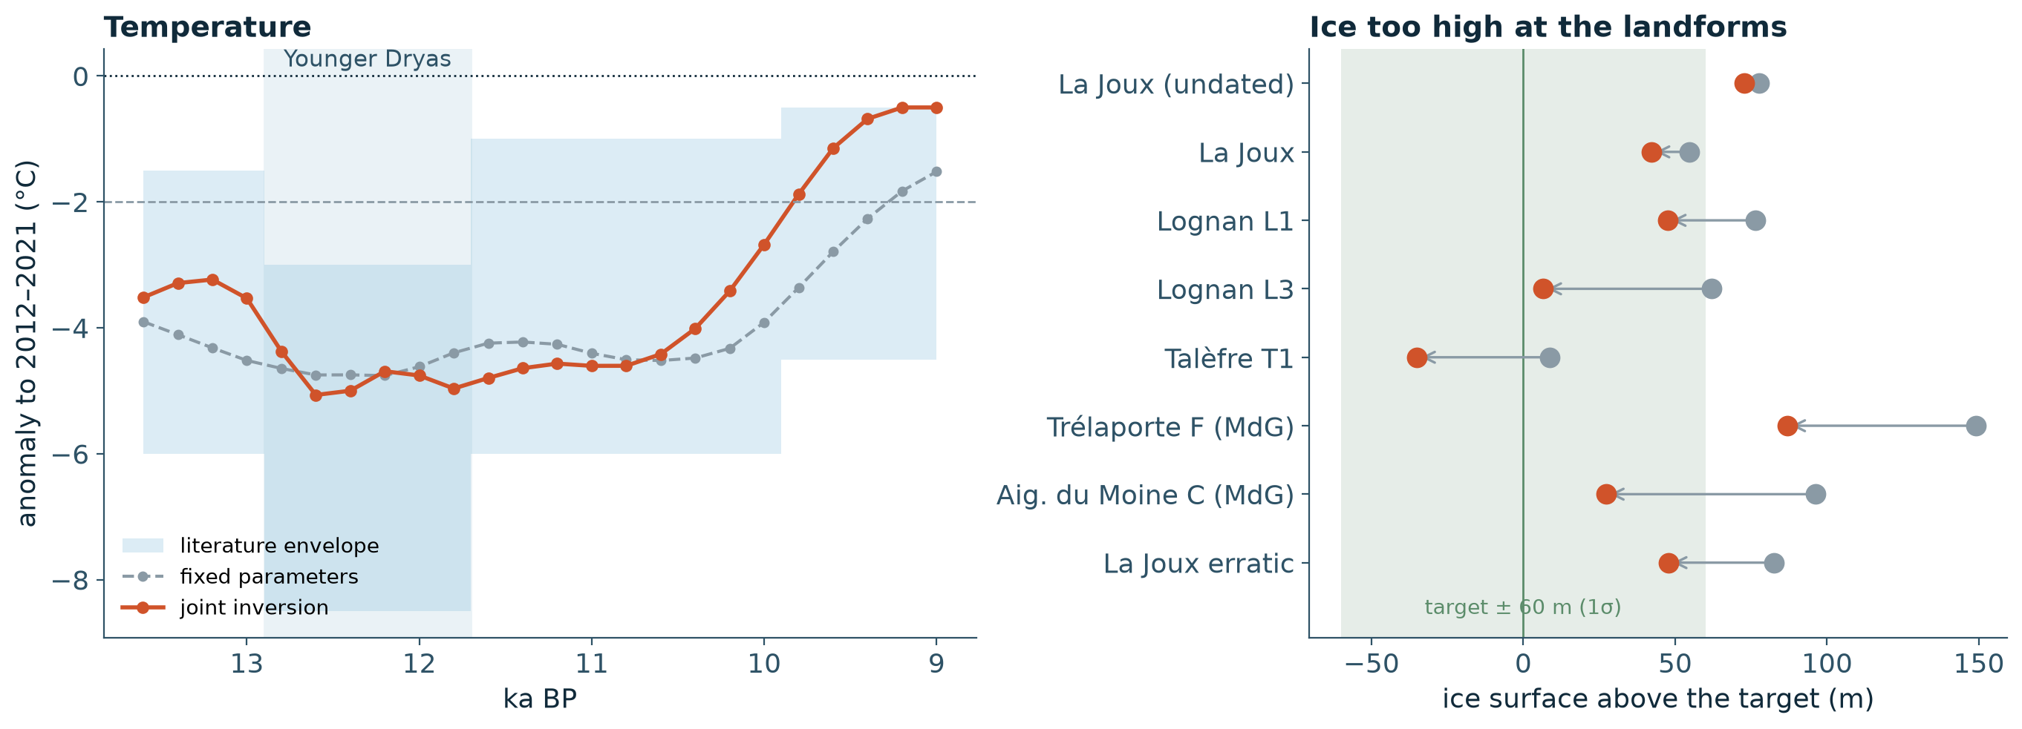
Same Younger Dryas, thinner glacier
−4.81 °C
4 → 3
Not yet converged: τ_ref, A still drifting. 9.2–9.0 ka on the warm bound; La Joux still 40–75 m too high
YD vs 2012–2021 (fixed parameters −4.65)
bedrock samples under > 10 m of ice
Notes:
Left: the YD anomaly is unchanged within its data uncertainty (-4.81 vs -4.65 C, sigma 0.22); the Allerod and 9.6-9.0 ka come out about 1 C warmer, and the last two nodes sit on the warm limit of the envelope. Right: modelled ice surface above each landform's target, fixed parameters (grey) to joint (red). Lognan L3 (62 -> 7 m), Aiguille du Moine C (96 -> 27 m), Trelaporte F (149 -> 87 m) and the La Joux erratic (83 -> 48 m) improve most; La Joux laterals still 40-75 m too high; Talefre T1/T2 now 35-44 m below their crests (within sigma). J2 stays met (0 m). Next: continue from this best point until tau_ref and A settle; widen the 9-10 ka warm limit; tau_ref is close to the lower end of the emulator's training range.

Slide 15
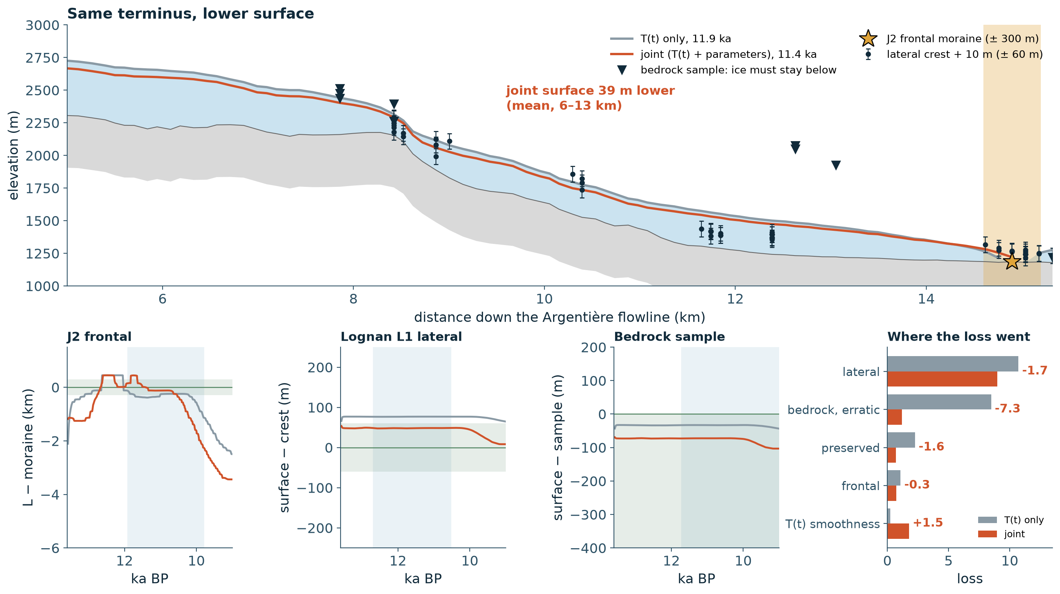




How the fit improved: same length, thinner ice
39 m thinner
Same J2 terminus, lower surface along the whole valley.
Faster flow
More sliding (τ_ref ↓) and softer ice (A ↑) carry the ice further with less thickness.
Bedrock −7.3
Most of the gain: samples no longer under ice. Laterals −1.7.
Cost +1.5
T(t) a bit rougher (smoothness term).
Notes:
Slide-8 figure with both runs. Grey: T(t) only (fixed parameters, loss 22.74). Red: joint inversion (13.36). Top: Argentiere flowline when each run meets J2 (11.9 ka and 11.4 ka); the joint surface is 39 m lower on average between 6 and 13 km, mean thickness 273 -> 233 m. Bottom: J2 is met by both; Lognan L1 drops from 77 to 48 m above its crest (inside sigma); the bedrock sample, already ice-free, gets a wider margin. Right: loss by landform type. Bedrock and erratics carry most of the gain (8.5 -> 1.2: Trelaporte F 149 -> 87 m, Lehmann C 96 -> 27 m, La Joux erratic 83 -> 48 m), laterals 10.7 -> 9.0, preservation 2.3 -> 0.7, frontal 1.1 -> 0.7. The price: the T(t) smoothness term rises 0.2 -> 1.8. Why: a T change moves length and thickness together; sliding and the flow law change the thickness for a given length.

