Slide 1
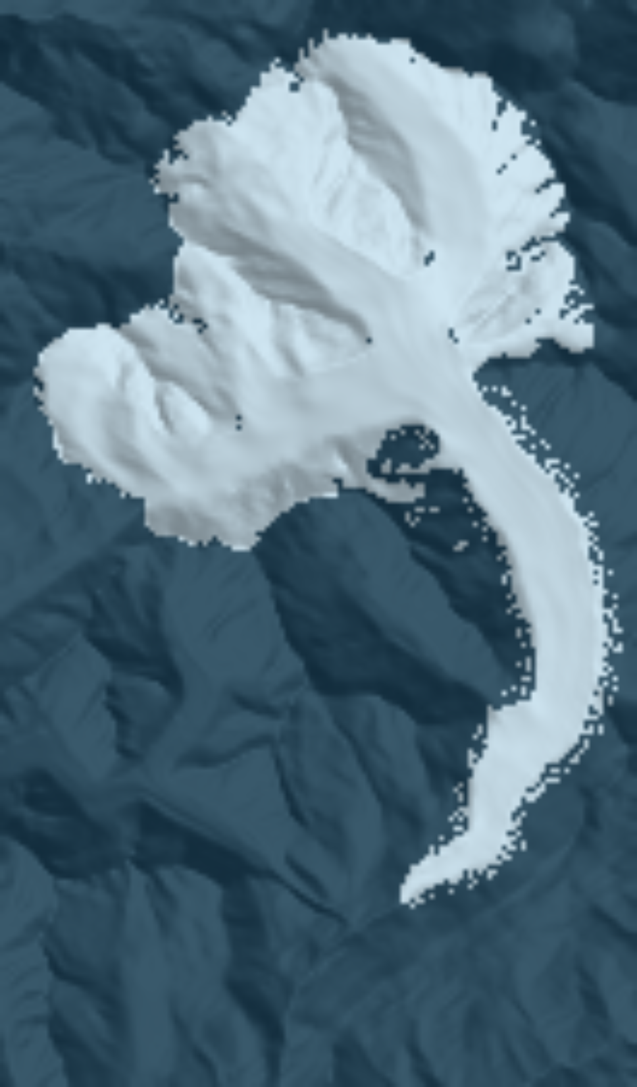
Inverting glacier history for past temperature
A differentiable glacier model applied to the Little Ice Age at the Great Aletsch Glacier
Kejdi Lleshi · University of Lausanne
Notes:
~0:45. Welcome. The question: what was the temperature in the Alps during the Little Ice Age, and how much can a single glacier tell us about it?
The image is the Great Aletsch Glacier today, from the model's own 100 m grid — it is the glacier we will invert at the end.

Slide 2




Past climate is heavily underconstrained
Temperature proxies are sparse, and most of them speak for a global or a hemisphere — not for regions where a glacier sits.
Ice cores
Speleothems
Instruments
Glaciers
Greenland, Antarctica
and lake sediments
Station network
Mapped extents, moraines
Footprint
Hemispheric, high-latitude
Time span
Millennia
Footprint
Regional; mixes temperature and moisture
Time span
Millennia
Footprint
Local
Time span
Only since the mid-1800s
Footprint
One valley
Time span
Centuries (moraines: millennia)
Glaciers are local and long-lived, and well documented — but they record climate through ice dynamics, so the record has to be inverted.
Notes:
~2:00. The problem. Paleo-temperature is severely underconstrained.
- Ice cores (e.g. Greenland) give a high-latitude, essentially hemispheric signal.
- Speleothems and lake sediments are regional, and mix temperature with moisture or seasonal signals.
- Instrumental series in the Alps only start in the mid-19th century — right at the end of the Little Ice Age.
So for a specific Alpine valley we usually borrow a temperature curve built for a much larger area.
Glaciers are the opposite: one valley, centuries of mapped extents, moraines going back millennia. The catch: a glacier is not a thermometer you can read directly.
[Add your preferred references here — e.g. PAGES 2k for regional reconstructions, Greenland ice-core temperature reconstructions.]

Slide 3



A glacier is a slow, indirect thermometer
forward model: well understood
Climate
Mass balance
Ice flow
Geometry
T(t), P(t)
accumulation, melt
deformation, sliding
extent, thickness, moraines
inverse problem: what we want
Lag
Distant forcing
Non-unique
The tongue responds to climate over 100–200 years, so today's extent reflects past climate.
Ensembles drive their parameters with distant records (North Atlantic, Greenland) that disagree with local observations.
Warmer melts like drier: temperature and precipitation trade off against each other.
Notes:
~1:30. Climate sets the mass balance, the mass balance feeds ice flow, and ice flow sets the geometry we observe. Running that forward is routine. We want the reverse arrow.
Three things make it hard: lag (Aletsch responds over a century or two); distant forcing — ensemble studies typically take the time evolution of their parameters from a North Atlantic / Greenland record, which comes from far away and does not agree with local observations; and non-uniqueness — a warmer climate can look like a drier one. Keep the last one in mind; it comes back in the sensitivity results.

Slide 4
Ensembles: cost grows with every parameter
The usual inverse: sample parameters, run the forward model many times, keep the runs that fit.
One-at-a-time sensitivity
≈ 2 forward runs per parameter, per perturbation size
Grids & Monte Carlo
cost multiplies with every added dimension
So climate gets compressed
into a few numbers: an offset, a step, a trend
And data get thinned
one observation type at a time, hand-tuned
100 forward runs
7 accepted — and that is only 2 parameters
11 temperature nodes × 5 values = 5¹¹ ≈ 49 million runs
Notes:
~1:30. How is this usually done? Ensembles: sample the unknowns, run the model many times, keep the runs that match the moraines or the mapped extents.
That is robust, and it gives a distribution — but every extra parameter multiplies the cost. In practice the climate history is collapsed to a few numbers (a constant offset, a step change), and observations are used one type at a time.
To make it concrete: a time-varying temperature with 11 nodes, sampled at only 5 values each, is 49 million forward runs. That is not a thing anyone does.

Slide 5



Our approach: a differentiable glacier model
repeated every time step · ~5,000 steps from 1500 to 2017
Temperature
Mass balance
Ice flow
Transport
Misfit J
T(t), 11 nodes
PDD scheme
IGM emulator (CNN)
flux-limited upwind
vs. dated extents
Backward pass: automatic differentiation carries ∂J/∂T(t) back through every time step
Real ice physics
Fits in memory
Gradients verified
PyTorch port of IGM's pretrained ice-flow emulator; matches the TensorFlow original to 2.4 × 10⁻⁶.
Gradient checkpointing recomputes each step on the way back, so 517 years run on one GPU.
With a fixed time step, the adjoint matches finite differences exactly.
Notes:
~2:15. Our approach: instead of sampling, we differentiate.
The forward model: a temperature history on 11 nodes drives a positive-degree-day mass balance; ice velocities come from IGM's pretrained CNN emulator; mass is transported with a flux-limited upwind scheme. That loop runs about 5,000 times between 1500 and 2017. At the end we compare simulated and observed extents.
Because every operation is in PyTorch, automatic differentiation gives the gradient of the misfit with respect to the whole temperature history in one backward pass, through all 5,000 steps.
Three ingredients make this work: the emulator port (agrees with IGM's TensorFlow model to 2.4e-6), checkpointing so the backward pass fits in memory, and gradients verified against finite differences.

Slide 6
One gradient gives every sensitivity
≈ 3.5
forward runs for one gradient: 173 s per forward + backward vs. ~50 s per forward (1500–2017, RTX 4090)
~3 h
60 iterations invert the full 11-node temperature history
≈ 9,000
ice-covered cells: a spatial field (e.g. sliding τ_ref) costs one gradient too, vs. ~5 GPU-days of runs
Notes:
~2:00. The key property: the cost of the gradient does not depend on the number of parameters.
A forward run from 1500 to 2017 takes about 50 s on an RTX 4090; forward + backward takes about 173 s, so one gradient costs ~3.5 forward runs — whether we ask about 1 parameter, the 11 temperature nodes, or a full 2D field.
Finite differences need N+1 runs. The lines cross at N≈3; beyond that the adjoint wins, and for a spatial field (~9,000 ice cells) it is ~3 minutes vs. ~5 GPU-days.
Honest caveat: a gradient is a local sensitivity. For full uncertainty you still want an ensemble — but a gradient-informed one can be much smaller.

Slide 7




Which observations can enter the loss?
J(T) = Σ_{k} w_{k} · misfit_{k}(model, observation_{k}) + λ · smoothness(T)
Dated extents
In use: 5 epochs
Historical maps and DEMs, compared through a soft (sigmoid) ice mask so the margin stays differentiable.
Surface elevation & moraine crests
Ready
Same DEMs (volume −34 % vs. area −6 %), and moraine crest heights, already built for the Younger Dryas.
Luminescence data → temperature?
To discuss
Could luminescence thermometry of exposed rock constrain past temperature?
Erosion rates → precipitation?
To discuss
Could catchment erosion rates constrain precipitation or ice flux? Exposure ages could date moraine stands.
Notes:
~1:30. Second advantage: any observation with a differentiable observation operator — "what would the model show here?" — becomes one more term in the loss.
In use today: dated extents, through a soft sigmoid mask. Ready: surface elevation from the same DEMs, and the moraine-crest operator built for the Younger Dryas.
Open for discussion: can luminescence data constrain temperature? Can erosion rates constrain precipitation or ice flux? Can exposure ages date moraine stands? For each: which data exist at Aletsch, and what would the observation operator be?

Slide 8
Little Ice Age temperature at the Great Aletsch Glacier, 1500–2017
APPLICATION
Notes:
~0:15. Now the real case: the Great Aletsch Glacier, the largest glacier in the Alps.

Slide 9
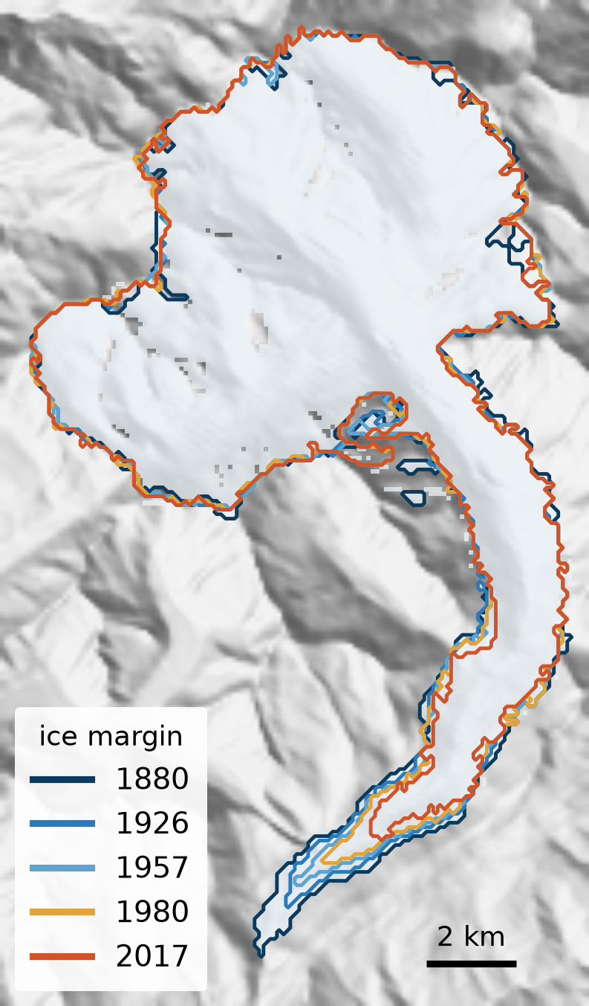
Aletsch: 140 years of dated surfaces
7
100 m
dated surface DEMs, 1880–2017 (5 used: 1880, 1926, 1957, 1980, 2017)
model grid, 225 × 132 cells; started from the 2017 geometry
−34 %
−6 %
ice volume, 1880 → 2017 (20.7 → 13.7 km³)
ice area over the same period (96 → 91 km²)
Aletsch thins far more than it shrinks. Extent is the information we are allowed to use, terminus-weighted signal — the inversion has to work from the tongue.
Notes:
~1:30. The data: seven dated surface DEMs from historical maps and modern surveys; I use five of them as extents. 100 m grid.
Important numbers: between 1880 and 2017 the glacier lost a third of its volume but only 6% of its area. It thins in a deep trough rather than narrowing. So an extent-only inversion relies mostly on the tongue — keep that in mind when reading the result.

Slide 10
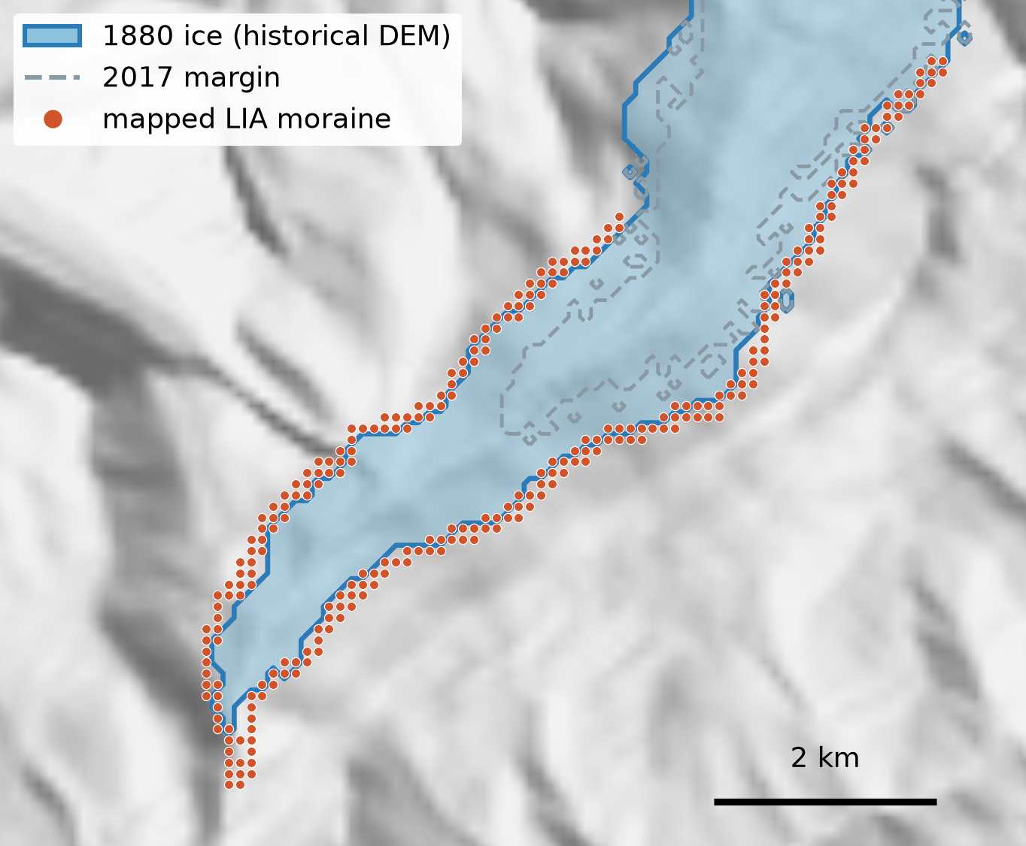
Independent check: LIA moraine = 1880 margin
100 m
median distance from the mapped LIA moraine to the 1880 ice margin — one grid cell
86 %
of moraine cells within 150 m of the 1880 margin
505 m
median distance to the 2017 margin — the offset grows with every later epoch
Two independent datasets agree: this validates the 1880 DEM and calibrates the moraine operator we will need for older, undated stands.
Notes:
~1:30. Before inverting, a data check. The field-mapped LIA moraine and the 1880 DEM margin are independent products. If both record the same stand, the moraine should sit on the 1880 margin.
It does: median offset 100 m — one cell — and 86% of moraine cells within 150 m. The distance grows monotonically for later epochs, the signature of a moraine dating one specific stand.
So the 1880 extent is trustworthy, and this is the calibration for the moraine operator for the Younger Dryas later.

Slide 11
Experiment: start from today, run 517 years
Spin-up from the 2017 geometry: 380 years to regrow the full 1880 volume
1500
1600
1700
1800
1900
2000
● 11 temperature nodes, every 50 years ◆ 5 observed extents: 1880, 1926, 1957, 1980, 2017
Control
Objective
Held fixed
Optimiser
T_lowest(t): mean annual temperature at the lowest grid point (799 m), lapse rate 7 °C/km
Soft-extent misfit, averaged over the 5 epochs, plus a smoothness penalty on T(t)
Melt factor 0.225, precipitation 1.8 m/yr, τ_ref 0.215 MPa, A = 78 MPa⁻³ yr⁻¹
Adam, learning rate 0.02, 60 iterations, one RTX 4090
Notes:
~1:45. Setup. We start from today's geometry and run forward from 1500 to 2017. Why 1500? I tested the spin-up: starting in 1700 undershoots the 1880 volume by 9% and leaves the terminus 1 km too short; 1500 recovers the full volume.
The control is the temperature at the lowest grid point, on 11 nodes every 50 years. The nodes before ~1700 have no data within a response time — they act as a warm-up.
Precipitation, melt factor and the flow parameters are fixed at values from an earlier calibration; the sensitivity slide shows what that costs.

Slide 12
Constant climate cannot explain the retreat
+1.36 °C warming implied by the terminus
Where the +1.36 °C comes from
1 Four runs at constant 6.5, 7.0, 7.5 and 8.0 °C. Each glacier settles at one equilibrium terminus (the flat lines).
2 Place each observed terminus on that curve and read off the temperature that would hold it there in equilibrium.
1880
6.14*
1926
6.64
1957
6.86
1980
7.14
2017
7.50
3 Difference, 2017 − 1880 (7.50 − 6.14):
* Extrapolated: the 1880 terminus lies 0.8 km beyond the coldest run. Each epoch is treated as if in equilibrium; the 2017 glacier lags its climate most, so the true warming is probably larger. A lower bound by argument, not by measurement.
Constant climate: the modelled tongue settles and stays put. Observed: 2.6 km of retreat.
Notes:
~2:00. First result, from a cheap scan with constant climate: whatever constant temperature you choose, the modelled terminus settles at its equilibrium length and stays there; the observed one retreats 2.6 km. So the data demand a time-varying climate.
Where the +1.36 °C comes from: (1) four runs from 1500 at constant 6.5, 7.0, 7.5 and 8.0 °C, each reaching an equilibrium terminus before 1880 — the flat lines; (2) for each epoch, place the observed terminus on that terminus-versus-temperature relation by linear interpolation: 1880 6.14, 1926 6.64, 1957 6.86, 1980 7.14, 2017 7.50 °C; (3) 7.50 − 6.14 = 1.36 °C. It is an independent target for the inversion, not an inversion result.
If asked: the 1880 value is extrapolated (its terminus lies 0.8 km beyond the 6.5 °C run; a 6.0 °C run would remove that); four runs on a 100 m grid give roughly ±0.05–0.1 °C per epoch; and "lower bound" is an argument — the 2017 glacier is furthest from equilibrium, so the true warming is probably larger. Code: implied_curve() in tools/plot_v2_diagnosis.py.

Slide 13
The inversion finds +0.9 °C of warming
+0.90 °C
from 1750 to 1950, recovered from extent alone
0.90 → 0.94
mean extent overlap (IoU) across the 5 epochs; loss down 47 %
T_lowest is a model parameter, not a station temperature: the trend is the interpretable quantity.
1500–1650: no observation within a response time — shaped by the smoothness prior only.
Notes:
~2:30. The main result. Starting from a flat 7 °C, the optimiser first raises the whole curve, and from about iteration 20 a trend develops. After 60 iterations (about 3 hours on one GPU) the history is flat near 7.3 °C until 1750, then warms to 8.15 °C by 1950–2000: +0.9 °C.
That is two thirds of the +1.36 °C the termini imply, and it was still growing — so read 0.9 °C as a lower bound from this run. Fit improves from IoU 0.90 to 0.94.
Two caveats: the early nodes are unconstrained; and absolute values are not station temperatures — T_lowest is a degree-day parameter at 799 m. The trend is what to interpret.

Slide 14
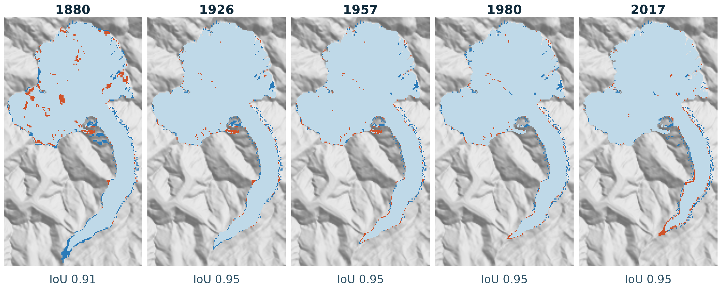
Simulated extents match all five epochs
Agree
Observed only
Simulated only
Residuals: a one-cell band at the terminus, and in 1880 thin ice on steep headwalls that the real glacier sheds by avalanching.
Open question: mask the steep headwalls (tested: removes 96 % of this misfit), and/or add pre-1880 terminus positions from historical reconstructions?
Notes:
~1:30. Spatially: grey-blue is agreement, blue is observed ice the model misses, orange is simulated ice that isn't observed. IoU 0.91–0.95.
The residuals have structure: a one-cell band at the terminus, which is the resolution limit, and in 1880 patches high in the basin — ice the model grows on steep headwalls where the real glacier avalanches it away. No temperature can remove that; it is model error, and it matters (next-but-one slide).
Open question for discussion. (a) Headwall ice: the V2 test masked bed above 3000 m, which keeps every cell the climate can affect and drops 96 % of the irreducible ones; the physical fix is avalanching / slope-limited accumulation in the model, which matters more for the Younger Dryas. (b) The 1880 tongue is also too short: real pre-1880 terminus positions from historical length reconstructions of the Aletsch would constrain the cold end directly, which synthetic observations cannot.

Slide 15
Mass balance, not ice flow, sets the answer
If a fixed parameter is off by this much, the inversion returns a temperature this far off to compensate.
0.2–0.4 °C
bias from a 10 % error in melt factor or precipitation
≤ 0.05 °C
from the same error in sliding (τ_ref): 5–15× smaller
Error bars on T(t) are set by the mass-balance priors. Melt and precipitation trade off, so extent constrains roughly their ratio.
Notes:
~2:00. How much does it matter that we fixed the other parameters? I perturbed each by ±10% and ±25% and converted the shift in terminus into an equivalent temperature bias.
Melt factor and precipitation dominate: 10% error ≈ 0.2–0.4 °C. Sliding is 5–15× smaller. Physically sensible: mass balance decides where the terminus ends up; dynamics mostly decide how fast it gets there. Note the melt-factor asymmetry (nonlinear PDD) and the melt–precipitation trade-off from slide 3.
Method note: this particular study was done the classical way — 16 perturbed forward runs. With the adjoint, one backward pass gives the same derivatives for all parameters at once, including spatial fields; that comparison is the next thing to run.

Slide 16


What we learned about the inverse problem
~20 iterations
36 %
< 0.01
Mean before trend
Structural model error
Extent is a weak signal
All 11 node gradients initially share one sign, so the optimiser fits the mean temperature before any trend emerges. Parameterising level and shape separately removes this delay.
of the extent misfit (60 % in 1880) lies on ~34° headwalls above every attainable ELA, where the real glacier loses ice by avalanching. No climate can remove it, yet it steers the gradient.
change in mean IoU per °C. Aletsch lost 34 % of its volume but only 6 % of its area since 1880, so many climate histories fit the outlines almost equally well.
Notes:
~1:30 (optional — skip if short on time). Three lessons about the inverse problem itself.
1. Mean before trend: with node values as parameters, all gradients initially share a sign, so the optimiser fits the mean first and the trend emerges only after ~20 iterations — stopping early would have suggested there is no trend. Separating level and shape removes the delay.
2. Structural error: about a third of the misfit is ice the model grows on steep headwalls where the real glacier avalanches it away. No climate can remove it, yet it biases the gradient, most strongly at 1880, the epoch that anchors the cold end.
3. Extent is weakly informative: mean IoU changes by less than 0.01 per °C (−0.006 per °C at 7 °C), because Aletsch thins far more than it shrinks. That is the case for adding surface elevation.

Slide 17


Conclusions and next steps
What we showed
Next
A differentiable glacier model inverts a 517-year temperature history from 5 dated extents in ~3 GPU-hours.
Aletsch needs warming: +0.9 °C between 1750 and 1950 recovered; ≥ +1.36 °C implied by the termini.
One gradient costs ~3.5 forward runs for any number of parameters: sensitivity without ensembles.
Mass balance matters 5–15× more than ice flow for the answer.
Add surface elevation
volume −34 % vs. area −6 %: far more signal than extent
Invert temperature and precipitation jointly
test how much of the trend is accumulation in disguise
Error bars
gradient-informed ensembles over the melt and precipitation priors
Younger Dryas
421 dated moraine cells (11.8–14.2 ka) already on the model grid
Notes:
~1:30. To conclude: the differentiable model inverts a 500-year temperature history from extents in a few GPU-hours; the Aletsch record requires warming of at least ~0.9 °C from the mid-18th to the mid-20th century in this run; gradients deliver sensitivities at a fixed cost, independent of the number of parameters; and mass balance, not dynamics, dominates.
Next: add surface elevation (much more information than extent), invert precipitation jointly, put error bars on T(t), and move to the Younger Dryas moraines, which are already prepared on the same grid.

Slide 18
Thank you — questions?
Kejdi Lleshi
University of Lausanne · kejdi.lleshi@unil.ch
Notes:
Questions. Backup material if asked: spin-up test (1500 vs 1600 vs 1700 start), the V2/V3 parameterisation experiments, and the flat-surface gradient fix.

