Slide 1
SiliconYOLO
We froze a neural network into silicon.
A pretrained YOLOv10n detector with its weights hard-wired into multiplier-less logic — real-time object detection at the milliwatt scale.
~51 FPS (FPGA)
up to ~200 FPS (ASIC)
0 DSP
~3.2 W
INT8
Two AI agents · one chip · orchestrated by Simular Sai
SiliconYOLO
UC Berkeley AI Hackathon 2026 (Cal Hacks)

Slide 2
◆ THE PROBLEM
01
Edge AI is stuck between a rock and the cloud
⚡
☁️
💸
Power-hungry
Cloud-dependent
Expensive at scale
GPUs and SoCs burn watts. Battery-powered vision is a non-starter at 15 W.
Round-trips add latency and cost — and your pixels leave the device.
Per-unit silicon + 3-year energy bills dominate fleet economics.
What if the model didn't need a processor at all — because the model IS the chip?
SiliconYOLO
Fixed-weight YOLOv10n · Kintex-7 (XC7K325T)

Slide 3
◆ THE IDEA
02
Freeze the weights into the silicon
A trained network is just a fixed set of numbers. So we bake those numbers directly into hardware — every weight becomes constant-coefficient logic, not a value fetched from memory.
THE MODEL = THE COMPUTER
Weights frozen as logic
✓
No weight SRAM, no DRAM — weights live in the gates themselves
▼
INT8 datapath CSD MAC array
✓
0 DSP blocks — multiplies become CSD shift-add logic
▼
Pixels in → detections out
✓
Deterministic latency — a pure feed-forward pipeline, every frame
SiliconYOLO
Fixed-weight YOLOv10n · Kintex-7 (XC7K325T)

Slide 4
◆ MODEL CHOICE
03
Why YOLOv10n: a whole block vanishes
OLDER DETECTORS (YOLOv5/v8)
2.3 M
6.7
Backbone → Neck → Head → Non-Max Suppression (NMS) NMS = sorting + IoU loops = an awkward, data-dependent block that fights an FPGA pipeline.
parameters
GFLOPs
NMS-free
640×640
YOLOv10n — NMS-FREE
Consistent dual-label training removes NMS entirely. What's left is a clean feed-forward graph that maps beautifully onto silicon.
architecture
80-class COCO
SiliconYOLO
Fixed-weight YOLOv10n · Kintex-7 (XC7K325T)

Slide 5
◆ THE PIPELINE
04
From pretrained model to metal — no retraining
→
→
→
→
1
2
3
4
5
Pretrained
INT8 PTQ
Freeze
CSD RTL
Kintex-7
YOLOv10n COCO weights
post-training quant
fixed weight contract
Cognichip generates HW
51 FPS on Genesys 2
Near-lossless: FP32 37.94 → INT8 37.62 mAP50-95 (−0.32 pt). No fine-tuning loops — a deterministic path from model to hardware.
SiliconYOLO
Fixed-weight YOLOv10n · Kintex-7 (XC7K325T)

Slide 6
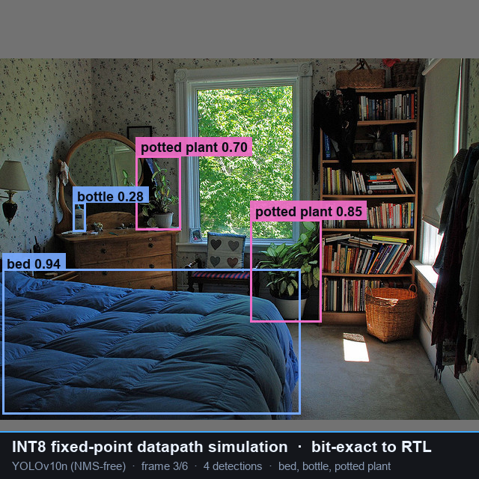
◆ RESULTS
05
Real-time detection, verified bit-exact
~51
0
~38K
~3.2 W
FPS @ 200 MHz
DSP blocks
LUTs (11.7%)
FPGA power
Kintex-7 · ~200 FPS as 28 nm ASIC
all CSD shift-add logic
+ ~483 BRAM (57.5%)
~0.2 W as 28 nm ASIC
BIT-EXACT VERIFICATION
INT8 fixed-point inference 1024 CSD MACs · ~255 FPS/W identical to the RTL, frame for frame
Every datapath checked against software golden vectors. 4 unit testbenches pass bit-exact (CSD MAC slice, SCE MAC array, requant, SiLU LUT). Top-level decoder honestly marked INCONCLUSIVE.
SiliconYOLO
Fixed-weight YOLOv10n · Kintex-7 (XC7K325T)

Slide 7
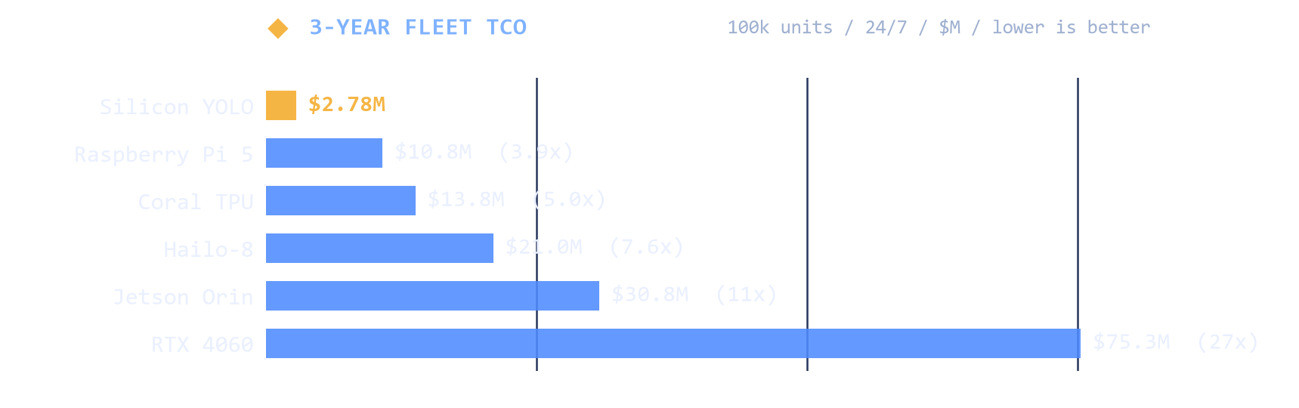
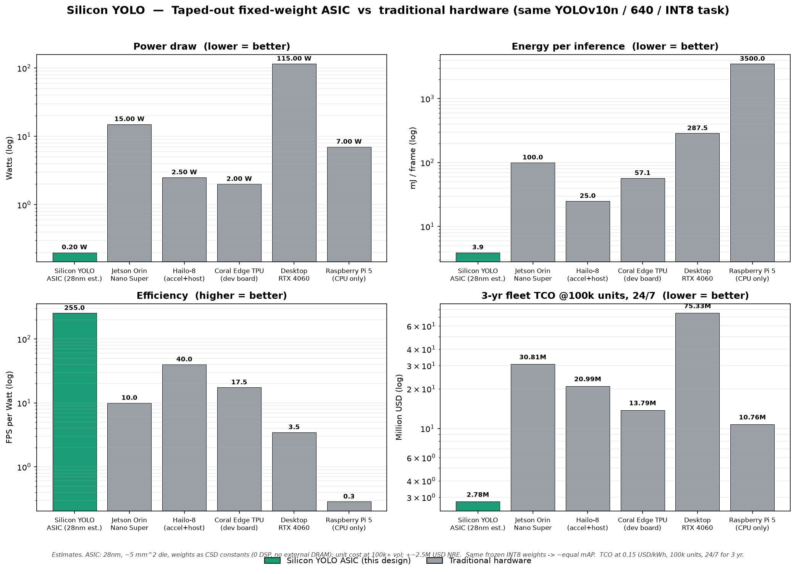
◆ COST & EFFICIENCY
06
Weights as silicon — the economics
~0.2 W
~$2
26×
~11×
power draw
per chip @ 100k
less energy / frame
lower 3-yr TCO
vs 15 W Jetson Orin Nano
vs $249 Jetson · ~$2.5M NRE
73× vs GPU · 6× vs Hailo-8
$2.78M vs $30.8M @100k 24/7
WHY IT WINS
255 FPS/W · no weight SRAM / no DRAM · 0 DSP ~37.6 mAP · deterministic ~20 ms latency — every frame, no jitter
Same netlist scales to
~800 MHz / ~200 FPS at constant 255 FPS/W
SiliconYOLO
Engineering estimates · docs/COST_COMPARISON.md

Slide 8
◆ THE BET
07
We bet against hard-coded LLMs
THE COMPARABLE
OUR BET
Taalas
Edge perception
$219M raised to hard-code small language models into silicon.
Proves the thesis: freezing a model into hardware is real, fundable, and powerful.
The biggest edge opportunity isn't language — it's vision.
Billions of cameras need to see in milliwatts, privately, on-device. Non-LLM perception is the larger, faster-growing layer — and almost nobody is freezing it into silicon.
SiliconYOLO
Fixed-weight YOLOv10n · Kintex-7 (XC7K325T)

Slide 9
◆ MARKET & INTEGRATION
08
A bigger TAM — and a drop-in block
MARKET (TAM)
MODULAR BY DESIGN
Non-LLM edge AI ~$20B (2024) → $100B+ by 2030 ~28% CAGR
AXI4-Lite — control / configuration
AXI4-Stream — pixels in / detections out
On-device LLM: ~$8B → ~$20B (~15–18% CAGR)
→ perception is a ~5× larger, faster-growing TAM.
Drops straight into any SoC
Sits next to a CPU, an image-signal processor, or a RISC-V core — no glue logic. The next wave of edge AI won't run on smaller software; it'll be the model itself, etched in silicon.
SiliconYOLO
Fixed-weight YOLOv10n · Kintex-7 (XC7K325T)

Slide 10
Two AI agents designed AI silicon —
and we kept them honest.
Claude Code
Cognichip
Simular Sai
Software track
Hardware track
Orchestration
pretrained → INT8 PTQ → freeze · golden vectors
architecture → CSD RTL → Kintex-7 synthesis
ran both agents · generated the demo video
SiliconYOLO · the model itself, etched in silicon — a drop-in vision brain for the next billion devices.
SiliconYOLO
github.com/kejiwuxian/SiliconYOLO

