Slide 1
Not Another COVID-19 Model
Kathryn Johnson
Notes:
Hi my name is Kathryn and I’m a data scientist. Today I’m going to be showing you the covid model I worked on this week.

Slide 2
Rationale:
Global interest
Personal interest
Inspiration from Kaggle
Notes:
So why did I choose covid? -
First – theres a lot of global interest , and lots of data to be used. It has been explored and modeled a lot, but this is all a fairly recent situation and there remains a lot to learn
- On a more personal level, my background prior to this program was in biology and health IT and I have a lot of interest in disparities in health related access and how that affects outcomes. which is something that’s been mentioned in COVID related reporting.
- So I found the idea for this from a data set shared in the discussion for the COVID forcasting competion on Kaggle. This data set was meant to model weather data for US counties but also included sociohealth data, and I thought it would be interesting to focus on those that part of it.

Slide 3
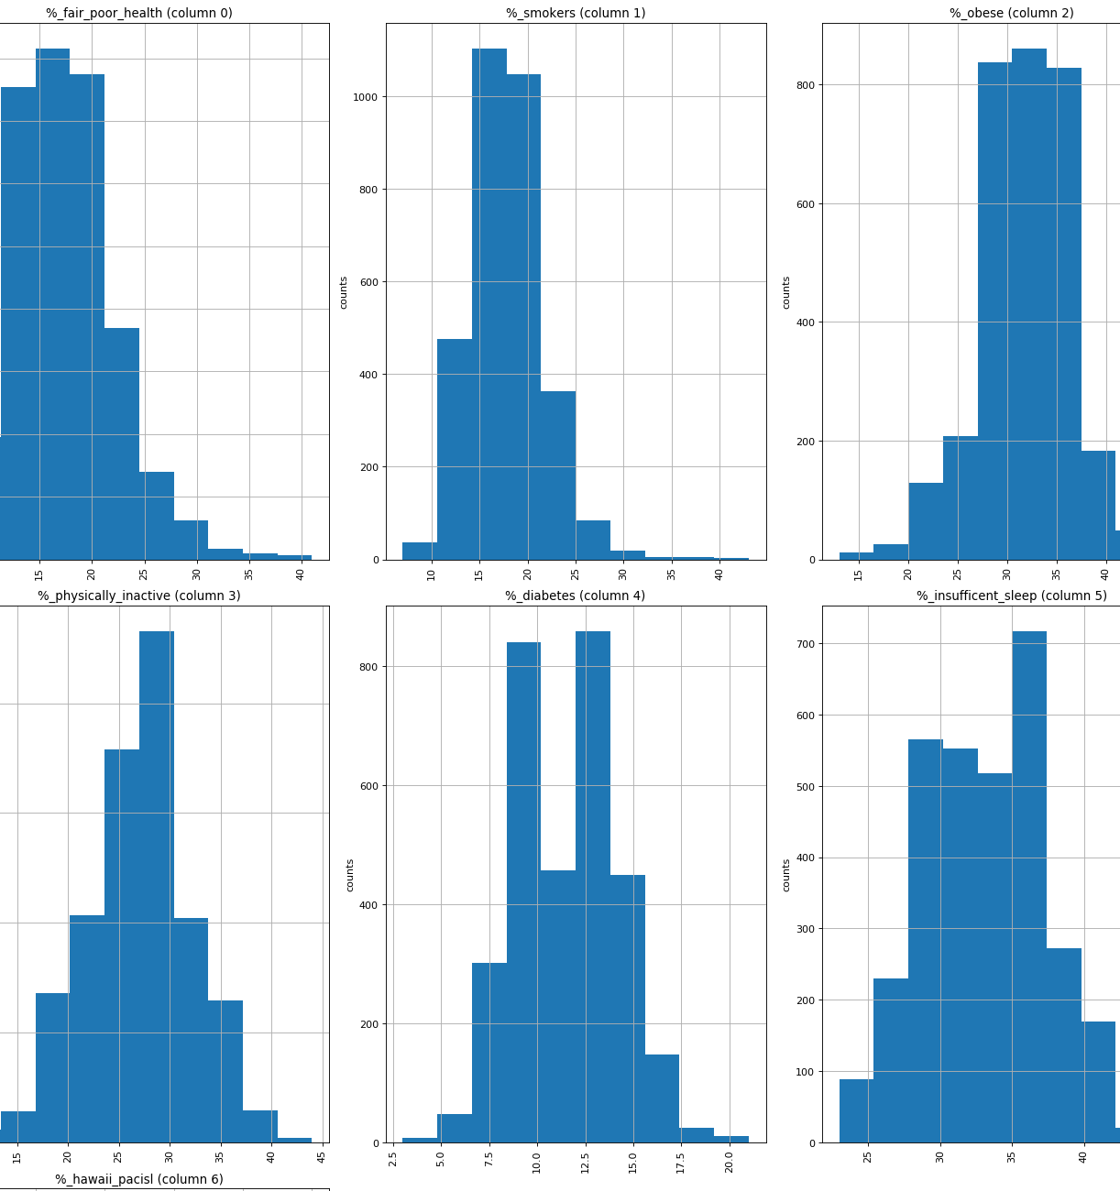
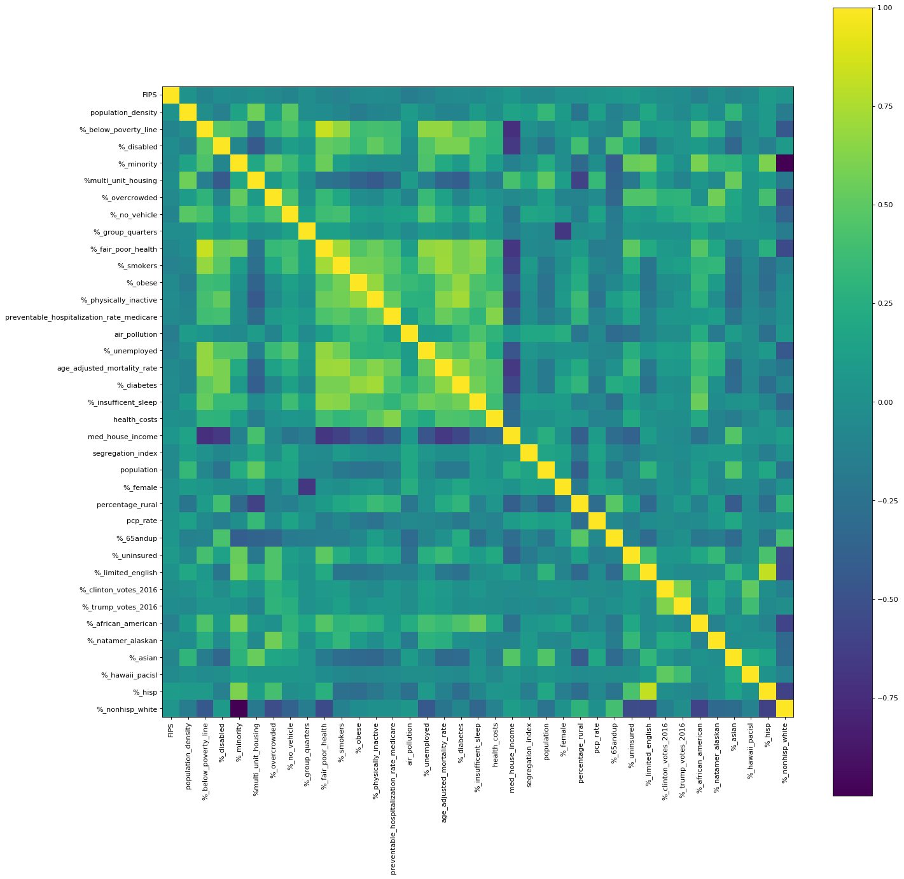
EDA & Cleaning
CDC Social Vulnerability Index, County Health Rankings, Politico
415 features -> 35 features
Features across several categories of interest
Representative selections
Remove duplicative data as much as possible
Notes:
Gathered data by county Using CDC, CHR, and Politico to create my own initial dataset to use.
The Originat combined sociolhealth dataset had over 400 features, so I knew I had to pare it down and clean it up quite a bit.
When I was looking through the features I could see that there seemed to be sortable into clear categories
My goal was to make representative selections across those categories of interest and remove duplicative data
I also have some examples of EDA here but the figures are pretty dense, probably too dense for this format

Slide 4
Model
FEATURES
Health
Prev. hospitalization rate
Age-adjusted mortality rate
% adults with diabetes
% obese
% fair/poor health
Demographic
Population
Population density
% each race
% minority
% over 65
% multi-unit housing
% rural
Access
PCP rate
Health cost
% insured
% no vehicle
% limited English
% disabled
Can sociohealth data be predictive of COVID-19 death rate?
Features and target
Random Forest Regression
Result : FAIL
Economic
Med Household Income
% below poverty line
% overcrowded
% unemployed
Behavioral
% smokers
% insufficient sleep
% physically inactive
Other
Segregation index
Air pollution
% Clinton
%Trump voters
TARGET
Ratio of deaths/cases
Notes:
Here are the features I chose
For my target I used data from the New York Times to calculate cumulative deaths divided by cumulative cases per county
I tried this model with a Random Forest Regressor a few ways but the score was always either negative or very small. A linear regression model performed slightly better but not by much.
- click
So I decided to take it as a lesson and pivot

Slide 5
Pivot
Feature Updates
Target Revisal
New model
Notes:
So I made some updates
For features – I pulled data for stay at home orders. So the dates they were announced, effective, lifted or scheduled to be lifted, and also the dates states started to reopen businesses. Used time deltas to featurize this data for the model. I also created some data sets from the johns Hopkins github which has case and death metadata posted daily. I wrote the code to pull from the github so that it would always update with the latest day available.
For Targets - I used some of the johns Hopkins data to create a new target, which was whether the active number of cases had increased since the day prior.
Because I changed my target, I was also able to also change my model from a random forest regressor to a random forest classifier

Slide 6
Model 2.0
I ran a Random Forest Classifier model using:
Scores:
Stay-home order features only
Stay-home features + select sociohealth features
Stay-home features + all sociohealth features
~ 67% accuracy
~78% accuracy
~78% accuracy
Notes:
Initially I ran the random forest classifier using just new feature data, to see a baseline for how it performed without any sociohealth data
The accuracy was running around 67%
When I added a few of the sociohealth features to the model, based of what I suspected to be most informative (both intuitively and based on feature importance in the first iteration of the model),
the accuracy improved by over 10%. I tested with different combinations of features, but the model accuracy mostly stayed pretty close to 78% accuracy (although precision and recall were more variable based on which feature I used).
I also tested how the model would perform if I threw in all the rest of the sociohealth features from the initial test, and
it remained at about 78% accuracy.

Slide 7
Confusion Matrix
Predicted
True Positives 254 | False Positives 76
False Negatives 95 | True Negatives 354
Actual
Accuracy: 78%
Precision: 80%
Recall: 68 %
Notes:
Here is a confusion matrix showing some a bit more granularity
Precision true positive/ everything that you predicted to be positive
Recall true positive/everything that was actually positive

Slide 8
Additional Takeaways
Initial model not predictive,
still informative
Feature importance ranking
gave unanticipated insight
Adding case trend data
=/=
Model improvement
Notes:
Initial model wasn’t great at predicting the death rate, but that in itself is still informative
I tried to see if I could improve the model beyond hyperparameter tuning, which wasn’t too consistently effective. Since I had months of time series data from johns Hopkins, I tested adding features for things like whether the previous day had seen an increase in active cases from the day prior to it, or whether there had been any new confirmed cases added for that county during the previous week. None of that data improved the model.
Third point here is that, I ran gini importance and permutation importance every time I ran my model, the rankings were mostly pretty inconsistent, which seemed to indicate a relatedness or redundancy of the features I was using. As a group they improve the model, but it’s not really necessary to use all of them.

Slide 9
Future Possibilities
Re-examine the initial project idea
Adding other features of interest
Google searches
Health technology adoption rates
Telemedicine readiness
Airport proximity
Weather data
Modeling time series data
Notes:
For the future
I still think the initial idea was interesting, or I wouldn’t have chosen it
I like the idea of adding more features
I think it would be interesting to see how certain google searches might be predictive of cases
Also I had some data that I had scraped but never included, like broadband access data from the fcc and ehr meaningful use data from Healthit.gov
With telemedicine readiness, prior to covid, telemedicine was only covered in certain regional situations, could be inteirestin to nfer how ready they were to accommodate a switch to telehealth
I theoretically had enough data to determine how far each county was from the closest airport, but I didn’t have the time budget to do that during this week
Weather data was a big part of the initial data set
Lastly I think it would be cool to use the time series data to predict the cases for the next day

Slide 10










Technology & Sources
explained.ai
Notes:
Here are the technologies I used, I mostly want to highlight that I found it beneficial to use both pandas and spark when I was trying to organize and clean the data. The dataset was large enough that it was nice having the speed and SQL functionality of spark.
Of course jupyter and python were used across this project
Add Johns Hopkins, NYT, Kaiser Family Foundation, CDC, CHR, Politico
Selenium
Pyspark/Pandas /numpy– things I like about both of them, initial dataset was large enough that using spark did allow me to explore it more efficiently
Sklearn/matplotlib/seaborn
Python and jupyter

Slide 11

Kathryn Johnson
Notes:
Any questions?

