Slide 1

Predicting Visual Brain Response using Convolutional Neural Networks
Awadh Kejriwal
Department of Electronics and Electrical Communication Engineering
IIT Kharagpur
Project Supervisor –
Dr. Debasis Samanta
Associate Professor
Department of Computer Science and Engineering
IIT Kharagpur
Project Mentor –
Mr. Subhrasankar Chaterjee
Research Scholar
Department of Computer Science and Engineering
IIT Kharagpur

Slide 2
Contents
Introduction
Background
Problem Statement
Work Done
Results and Analysis
Conclusion
References

Slide 3
INTRODUCTION

Slide 4
Introduction
Artificial Intelligence - Theory and development of computer systems that can perform tasks that normally require human intelligence.
Examples – Speech Recognition, Natural Language Processing, Decision Making, Visual Perception.
Human brain performs all these tasks very easily and efficiently.
Hence, we need to know about the working of the human brain and replicate the same to create artificial models.

Slide 5
Introduction (contd.) – Visual Perception
Computer Vision - field of artificial intelligence (AI) that enables computers and systems to derive meaningful information from digital images, videos and other visual inputs — and take actions or make recommendations based on that information.
Applications – Facial recognition, Self-driving cars, Text Recognition
Routine job for the Human Brain – Need to study the human brain’s visual perception technique.

Slide 6
Scope and Motivation
How does human brain process visual information?
Can we build an artificial model which replicates the human brain’s visual perception technique?
Can we use the model in high precision applications like self-driving cars, or facial recognition for security purposes?

Slide 7
BACKGROUND

Slide 8
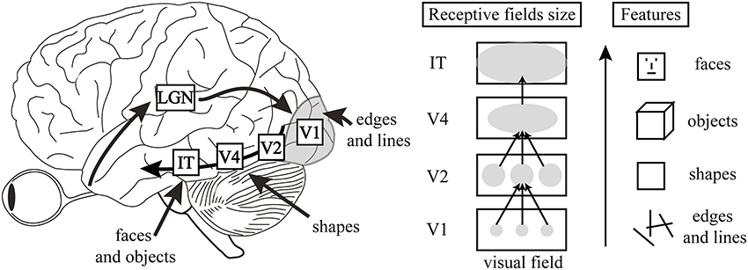
Visual Ventral Stream
Simple features are extracted earlier in the pathway
Complex features are extracted at a later stage

Slide 9
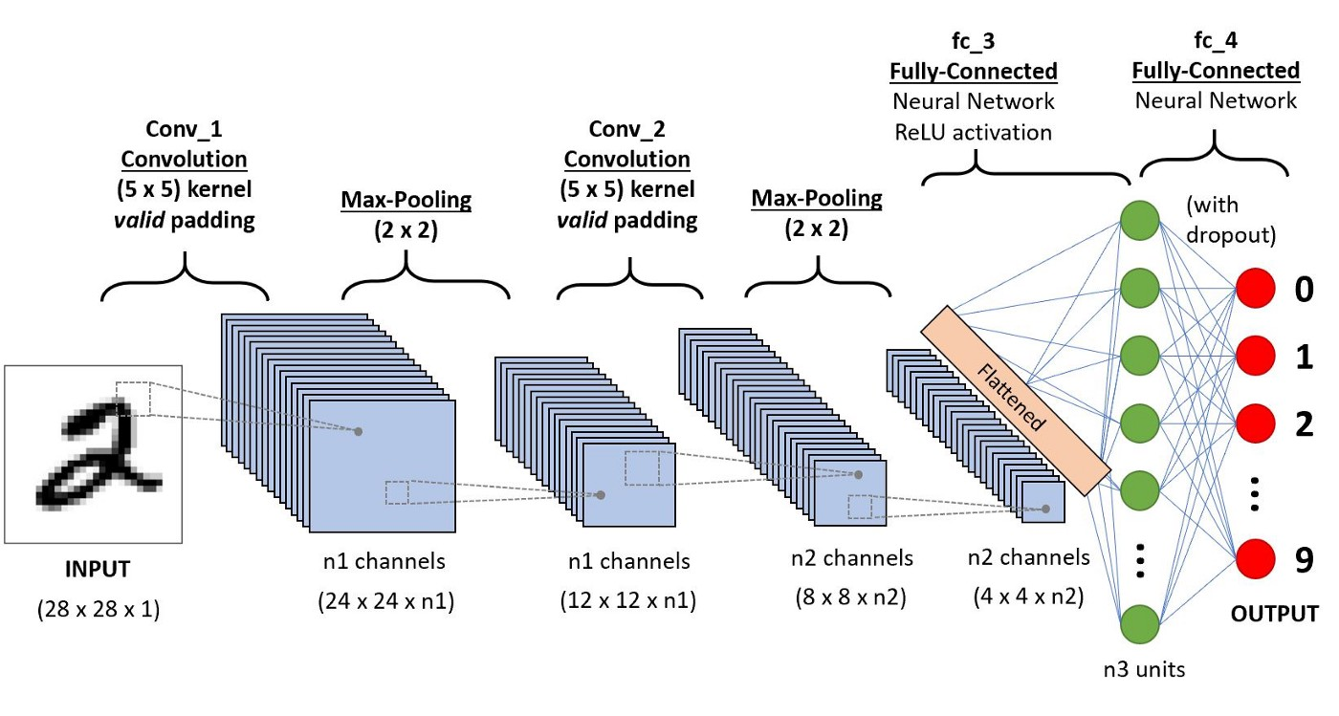
Convolutional Neural Networks
CNN - Deep Learning algorithm which can take in an input image, assign importance (learnable weights and biases) to various aspects/objects in the image and be able to differentiate one from the other.
Layered Structure resembles the brain’s hierarchical visual perception unit.

Slide 10
Previous Works with CNNs
Spampinato, C., Palazzo, S., Kavasidis, I., Giordano, D., Souly, N., Shah, M.: Deep learning human mind for automated visual classification. In: Proceedings of the IEEE Conference on Computer Vision and Pattern Recognition (CVPR). pp. 6809–6817 (2017) – EEG assisted Image Classification
Cudlenco N, Popescu N, Leordeanu M (2020) Reading into the mind’s eye: boosting automatic visual recognition with EEG signals. Neurocomputing 386:281–292 – EEG assisted Image Classification
Long Y., Kong W., Ling W., Yang C., Zhu J. (2019) Comparison of Facial Emotion Recognition Based on Image Visual Features and EEG Features. In: Sun F., Liu H., Hu D. (eds) Cognitive Systems and Signal Processing. ICCSIP 2018. Communications in Computer and Information Science, vol 1006. Springer, Singapore. https://doi.org/10.1007/978-981-13-7986-4_15 - EEG assisted Facial Emotion Recognition

Slide 11
PROBLEM STATEMENT

Slide 12
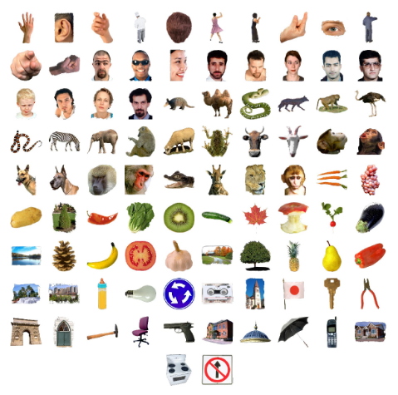
Problem Statement
Given –
a set of 92 images of different objects, scenes, etc.
Dissimilarity matrices of fMRI signals, which were recorded in response to viewing those 92 images, by 15 different subjects. The fMRI signal was collected from two regions of the brain, namely, early visual cortex (EVC) and inferior temporal cortex (IT) - in total 30 dissimilarity matrices
Task -
To generate features from the images so that the resulting dissimilarity matrix is closest to the given dissimilarity matrices

Slide 13
WORK DONE

Slide 14
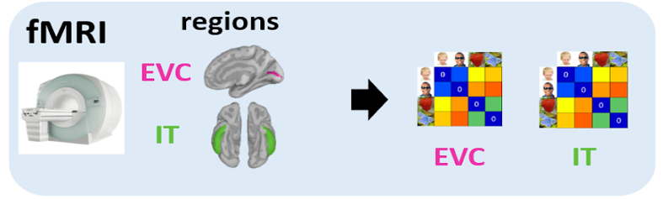
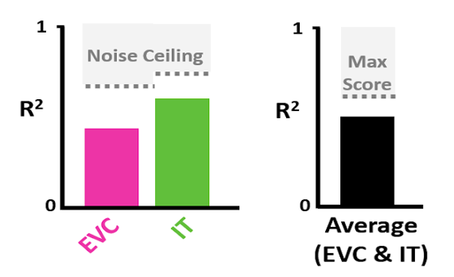

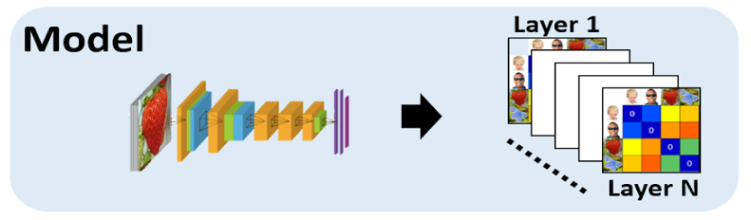
Workflow
Similarity Space (RDMs)
Compare RDM Similarity
Signal Space
Results
Final Score

Slide 15
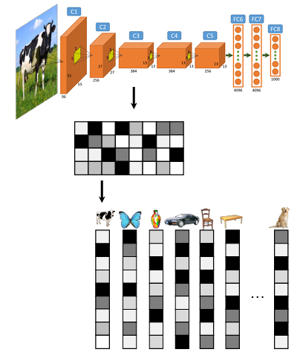
Feature Extraction
Some of the widely used Convolutional Neural Networks (CNNs) like AlexNet, VGG and Resnet50 were used for the purpose of feature extraction.
The images were pushed through the layers of these networks and the activations generated at some of the layers were used as features to create dissimilarity matrices.

Slide 16
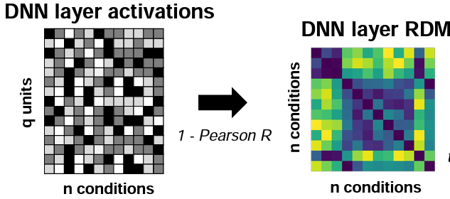
RDM Generation
Representational dissimilarity matrices (RDMs) were for the features obtained at various layers of the CNNs.
We used Pearson Correlation Coefficient (PCC) as a metric to compare two different activation vectors.
Suppose that the value of PCC for given pair of features is ‘r’, then the value filled in the RDM was 1-r.

Slide 17
Representational Similarity Analysis (RSA)
Why RSA – The RDMs obtained for different signal spaces have the same dimensions, and hence, are easy to compare. Also, computationally cheaper.
The RDMs can be compared by calculating their similarity using Spearman R.
The final score is obtained by squaring the result to R².
Normalization - To normalize the obtained score, we assume that the subject-averaged RDM is the best model (ideal) which we can obtain. Hence, we calculate the R² score value for the subject-averaged RDM, and consider it as the upper bound (noise ceiling) of the final score. Other R² values are normalized with respect to this noise ceiling, and hence the final normalized score is termed as Noise Normalized R^{2.}

Slide 18
RESULTS AND ANALYSIS

Slide 19
Correlation scores for different models and layers
Network | Layer | Noise Normalized R²
 |  | EVC | IT | Avg
AlexNet | conv1 | 6.844 | 1.253 | 3.157
AlexNet | conv2 | 16.793 | 7.106 | 10.406
AlexNet | conv3 | 17.853 | 7.136 | 10.787
AlexNet | conv4 | 13.983 | 10.662 | 11.793
AlexNet | conv5 | 8.029 | 4.344 | 5.600
ResNet | block1 | 8.588 | 1.533 | 3.937
ResNet | block2 | 10.803 | 1.281 | 4.525
ResNet | block3 | 7.448 | 1.552 | 3.561
ResNet | block4 | 12.449 | 10.018 | 10.846
VGG | maxpool1 | 7.235 | 1.403 | 3.390
VGG | maxpool2 | 10.029 | 1.916 | 4.680
VGG | maxpool3 | 14.333 | 4.758 | 8.020
VGG | maxpool4 | 15.746 | 7.478 | 10.295
VGG | maxpool5 | 9.503 | 5.034 | 6.556

Slide 20
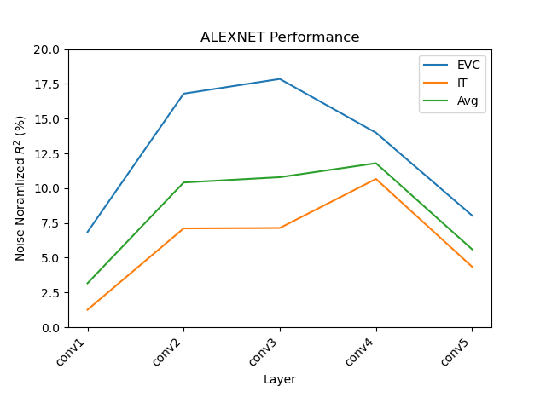
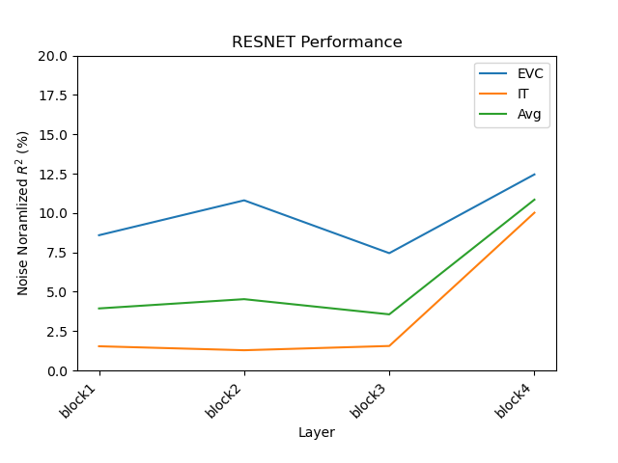
Correlation scores for different models and layers (contd.)

Slide 21
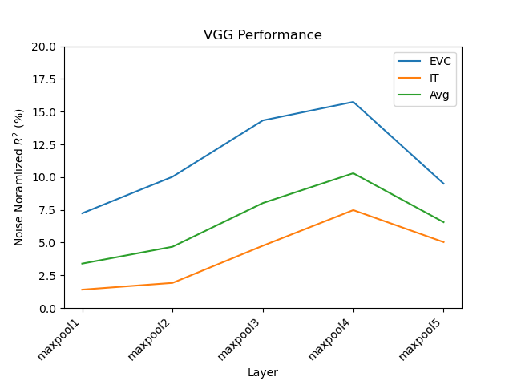
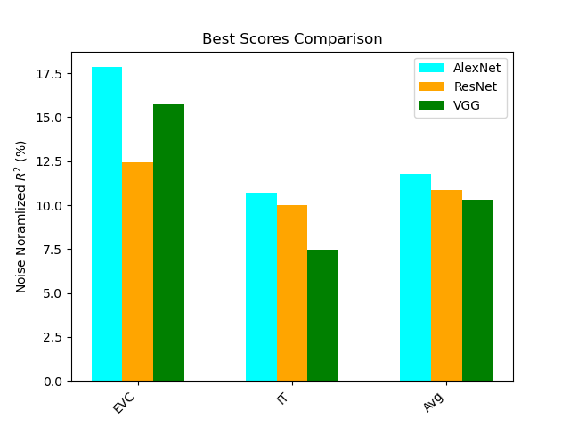
Correlation scores for different models and layers (contd.)

Slide 22
Analysis
AlexNet gave us the best results among the three CNNs.
We observe that mostly, as we move deeper into the neural networks, the predicted activities get more and more similar to the actual neural activities.
To analyse the results further, we plotted the dissimilarity matrix obtained for the 4th convolutional layer of AlexNet (as it gave us the best result) – shown in the next slide

Slide 23
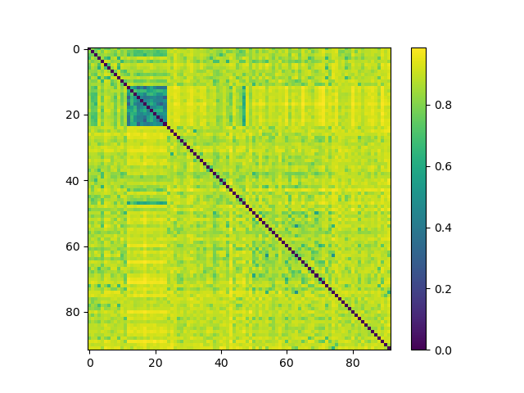
Analysis (contd.)
We observe that the matrix signifies high similarity among image numbers 12-25 (approx.). As per the dataset, theses images were those of human faces, and hence they had similar shapes. The objects belonging to other classes did not have similar shapes. Hence, we observe that the CNNs were not able to find as much similarity among different objects, as found by the fMRI signals.

Slide 24
CONCLUSION

Slide 25
Conclusion
We used some convolutional neural networks to model the hierarchical structure of the human brain visual system.
Even though the results were not very promising, but still they were enough to signify that after some fine tuning and further developments in the network architecture, these convolutional neural networks would be able to accurately predict the neural activities of human brain in response to visual stimuli.
To model the late visual cortex (or the inferior temporal cortex) we need some more advancements in the architecture of the networks.
These advancements would be highly beneficial for the field of computer vision and artificial intelligence, because CNNs would then be able to analyse and classify visual data in a similar way as the human brain does.

Slide 26
References
Abd ElGhany, Sameh et al. “Diagnosis of Various Skin Cancer Lesions Based on Fine-Tuned ResNet50 Deep Network.” Cmc-computers Materials & Continua 68 (2021): 117-135.
Agrawal, Aakash. “Dissimilarity learning via Siamese network predicts brain imaging data.” arXiv: Neurons and Cognition (2019): n. pag.
Hemmer, Martin & Khang, Huynh Van & Robbersmyr, Kjell & Waag, Tor & Meyer, Thomas. (2018). Fault Classification of Axial and Radial Roller Bearings Using Transfer Learning through a Pretrained Convolutional Neural Network. Designs. 2. 56. 10.3390/designs2040056.
Khaligh-Razavi S-M, Kriegeskorte N (2014) Deep Supervised, but Not Unsupervised, Models May Explain IT Cortical Representation. PLoS Comput Biol 10(11): e1003915.
Kriegeskorte, N. (2008). Representational similarity analysis connecting the branches of systems neuroscience. Frontiers in Systems Neuroscience, 2, 4.
Kriegeskorte, N., & Kievit, R. A. (2013). Representational geometry: integrating cognition, computation, and the brain. Trends in Cognitive Sciences, 17, 401-412.
Krizhevsky, A., Sutskever, I., & Hinton, G. E. (2012). Imagenet classification with deep convolutional neural networks. In F. Pereira, C. J. C. Burges, L. Bottou, & K. Q. Weinberger (Eds.), Advances in neural information processing systems 25 (p. 1097-1105).
Loukadakis, Manolis & Cano, José & O'Boyle, Michael. (2018). Accelerating Deep Neural Networks on Low Power Heterogeneous Architectures.

Slide 27
References (contd.)
Radoslaw Martin Cichy, Gemma Roig, Alex Andonian, Kshitij Dwivedi, Benjamin Lahner, Alex Lascelles, Yalda Mohsenzadeh, Kandan Ramakrishnan, and Aude Oliva. (2019). The Algonauts Project: A Platform for Communication between the Sciences of Biological and Artificial Intelligence. arXiv, arXiv:1905.05675.
Radoslaw M. Cichy, Dimitrios Pantazis and Aude Oliva. (2016). Similarity-Based Fusion of MEG and fMRI Reveals Spatio-Temporal Dynamics in Human Cortex During Visual Object Recognition. Cerebral Cortex, 26 (8): 3563-3579.
Yalda Mohsenzadeh, Caitlin Mullin, Benjamin Lahner, Radoslaw Martin Cichy, and Aude Oliva. (2019). Reliability and Generalizability of Similarity-Based Fusion of MEG and fMRI Data in Human Ventral and Dorsal Visual Streams. Vision, 3(1), 8.
Yamins DLK, Hong H, Cadieu CF, Solomon EA, Seibert D, et al. (2014) Performance-optimized hierarchical models predict neural responses in higher visual cortex. Proceedings of the National Academy of Sciences 111: 8619–8624.
http://algonauts.csail.mit.edu/2019/workshop.html
https://towardsdatascience.com/a-comprehensive-guide-to-convolutional-neural-networks-the-eli5-way-3bd2b1164a53

Slide 28
THANK YOU

