Slide 1
Side Channel Attack on Encrypted Traffic
Rahul Kejriwal, CS14B023 Code at: https://github.com/kejriwalrahul/TrafficLeak

Slide 2
Assumptions
Closed World Assumption
No interleaved browsing
Well demarcated request boundaries
Webpage-level fingerprinting
Caching Effects (assume hot pages)

Slide 3





Data Collection Methodology
Chose top ~79 popular webpages (Source: Wikipedia)
No highly similar webpages (Ex: google.com and google.co.in)
Caching effects (Collected hot traces)
SSH (Encrypted)
Unencrypted
Unencrypted

Slide 4
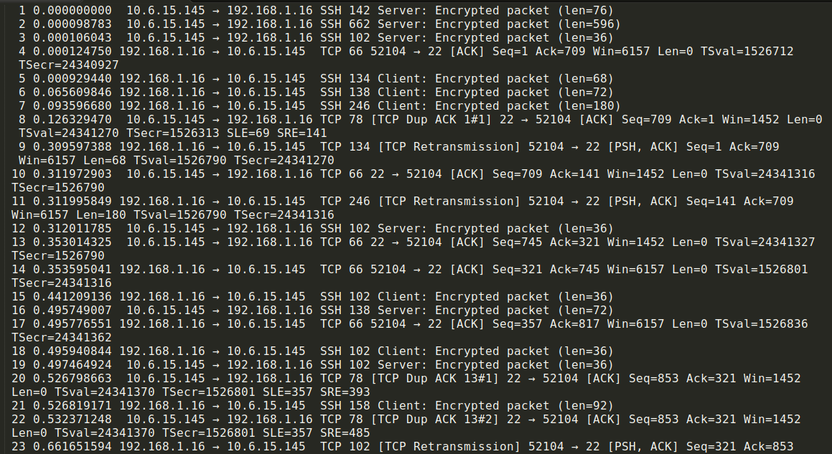
Sample Trace

Slide 5
Model 1: Ad-Hoc Model

Slide 6
Feature Extraction
Three major sources of information:
Packet size distribution (and direction)
Timing distribution (rate of transmission)
Ordering of packets
Features used:
Packet size distribution
# of packets (from client and server)
Avg Pkt Length (from client and server)
Std. Dev. of Pkt Lengths (from client and server)
# of full pkts (from client and server)
Timing distribution
Total Time
# of lag periods

Slide 7
Models
Sr. No. | Model (sklearn models) | Avg. Accuracy (after 4-fold cross validation)
1 | k-NN | 55.24%
2 | LDA | 60.02%
3 | Logistic Regression | 52.68%
4 | SVM (Linear Kernel) | 58.40%
5 | SVM (Poly Kernel) | 59.36%
6 | SVM (RBF Kernel) | 56.52%
7 | Decision Trees | 51.11%
8 | Random Forests | 66.05%
9 | ExtraTrees | 66.99%
10 | MLP | 40.01%
4-fold cross-validation on dataset
79 websites with 4 traces each = 316 training instances
Best accuracy of ~67% using ExtraTrees Classifier

Slide 8
Model 2: SVMs using Damerau-Levenshtein distance Model (Discretized Packet Size)
Src: Xiang et al. [2]

Slide 9


Strategy
Request packets are likely to get reordered, broken up and/or merged at different times.
Use Damerau-Levenshtein distance to measure edit-distance (similarity) between multiple traces. This captures insertion, deletion, substitution and transposition of requests. (Cost schemes are hyperparameters.)
Discretized packet size into 24 levels (hyperparameter) for computing DL distance.
Normalize DL distance:
Build kernel using DL distance for SVMs (𝛾 is hyperparameter):

Slide 10
Results & Discussion
Xiang et al. [2] unfortunately do not give us the complete cost schemes used for computing DL distance.
Avg. accuracy (after 4-fold cross-validation) was 75.26%.
Easily outperforms the ad-hoc models considered earlier.
Xiang et al. trained the model using 20-40 cold traces and got 80-85% accuracy.
We used only 4 hot traces/webpage.
Possible to improve our accuracy by increasing # of traces.
Advantages:
Unlike ad-hoc models, this one scales well with increasing # of websites.
Robust against many proposed traffic obfuscation based security measures.

Slide 11
Model 3: DLSVM Model (No packet size information)
Src: Xiang et al. [2]

Slide 12
Strategy & Results
Almost same model as previous one.
Only 1 level of packet size, sign gives direction.
This model uses only ordering information and ignores timing and size distribution present in the trace.
Avg. accuracy (after 4-fold cross-validation) was 53.96%
On-par with most ad-hoc models considered earlier.
Still performs quite well (as good as many ad-hoc models)
Order of requests contains lot of information ignored by previous work

Slide 13
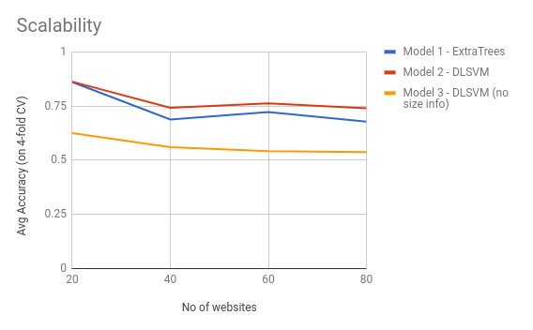

Slide 14
Differences wrt Xiang et al.

Slide 15
Procedural Differences
Worked on hot traces rather than cold traces which is more difficult to distinguish.
Used only SSH packets for experiments. Xiang et al. also use TCP level packets.
Used much lesser training instances (4 per website as compared to 20-40 per website).
Used different cost schemes for DL distance and different hyperparameter configurations.

Slide 16
Possible Further Work

Slide 17
Relook at some Assumptions
Closed World Assumption: Larger # of negative instances needed for training the model.
Webpage-level fingerprinting: Xiang et al.[2] have given a strategy to extend this webpage fingerprinting to create fingerprints for websites using HMM models
Caching Effects (assumed hot pages): Cold pages are actually easier to distinguish due to the larger # of differing requests.

Slide 18
Security Counter-Measures

Slide 19
Some Counter-Measures
Obfuscation based techniques to prevent side-channel attacks:
Reorder, merge, split requests
Make dummy requests
Add dummy data in headers
Proposed & Used Techniques:
Randomized Pipelining over Tor
HTTPOS
Cover Traffic
Traffic morphing
Xiang et al. showed that such schemes are not very secure against DLSVM based attacks.

Slide 20
References
Cai, Xiang, et al. "Touching from a distance: Website fingerprinting attacks and defenses." Proceedings of the 2012 ACM conference on Computer and communications security. ACM, 2012.
Herrmann, Dominik, Rolf Wendolsky, and Hannes Federrath. "Website fingerprinting: attacking popular privacy enhancing technologies with the multinomial naïve-bayes classifier." Proceedings of the 2009 ACM workshop on Cloud computing security. ACM, 2009.
Perry, Mike. “A Critique of Website Traffic Fingerprinting Attacks.” Tor Blog, Tor Blog, 7 Nov. 2013, blog.torproject.org/critique-website-traffic-fingerprinting-attacks.

