Slide 1
Memory
Prof. Hakim Weatherspoon
CS 3410
Computer Science
Cornell University
[Weatherspoon, Bala, Bracy, and Sirer]

Slide 2
Announcements
Make sure you are
Registered for class, can access CMS
Have a Section you can go to.
Lab Sections are required.
“Make up” lab sections only Friday 11:40am or 1:25pm
Bring laptop to Labs
Project partners are required for projects starting w/ project 2
Project partners will be assigned (from the same lab section, if possible)

Slide 3
Announcements
Make sure to go to your Lab Section this week
Completed Proj1 due Friday, Feb 15th
Note, a Design Document is due when you submit Proj1 final circuit
Work alone
BUT use your resources
Lab Section, Piazza.com, Office Hours
Class notes, book, Sections, CSUGLab

Slide 4
Announcements
Check online syllabus/schedule
http://www.cs.cornell.edu/Courses/CS3410/2019sp/schedule
Slides and Reading for lectures
Office Hours
Pictures of all TAs
Project and Reading Assignments
Dates to keep in Mind
Prelims: Tue Mar 5th and Thur May 2nd
Proj 1: Due next Friday, Feb 15th
Proj3: Due before Spring break
Final Project: May 16th
Schedule is subject to change

Slide 5
Announcements
Level Up (optional enrichment)
Teaches CS students tools and skills needed in their coursework as well as their career, such as Git, Bash Programming, study strategies, ethics in CS, and even applying to graduate school.
Thursdays at 7-8pm in 310 Gates Hall, starting this week
http://www.cs.cornell.edu/courses/cs3110/2019sp/levelup/

Slide 6
Goals for today
Memory
CPU: Register Files (i.e. Memory w/in the CPU)
Scaling Memory: Tri-state devices
Cache: SRAM (Static RAM—random access memory)
Memory: DRAM (Dynamic RAM)

Slide 7
Last time: How do we store one bit
D
Q
clk
D Flip Flop stores 1 bit
Notes:
Put a matching box around both

Slide 8
Goal for today
How do we store results from ALU computations?

Slide 9
Big Picture: Building a Processor
memory
register file
inst
alu
+4
+4
addr
=?
PC
d_{in}
d_{out}
control
cmp
offset
memory
new pc
target
imm
extend
A Single cycle processor

Slide 10
Big Picture: Building a Processor
memory
register file
inst
alu
+4
+4
addr
=?
PC
d_{in}
d_{out}
control
cmp
offset
memory
new pc
target
imm
extend
A Single cycle processor

Slide 11
Goal for today
How do we store results from ALU computations?
How do we use stored results in subsequent operations?
Register File
How does a Register File work? How do we design it?

Slide 12
Register File
Register File
N read/write registers
Indexed by register number
Dual-Read-Port Single-Write-Port
32 x 32 Register File
Q_{A}
D_{W}
32
32
Q_{B}
32
W
R_{W}
R_{A}
R_{B}
1
5
5
5

Slide 13
Register File
D0
Recall: Register
D flip-flops in parallel
shared clock
extra clocked inputs: write_enable, reset, …
D1
D2
D3
4-bit
reg
4
4
clk
clk

Slide 14
Register File
D0
Recall: Register
D flip-flops in parallel
shared clock
extra clocked inputs: write_enable, reset, …
D1
D2
D3
32-bit
reg
32
32
clk
clk

Slide 15
Register File
Register File
N read/write registers
Indexed by register number
How to write to one register in the register file?
Need a decoder
32
D
Reg 0
Reg 1
….
5-to-32
decoder
Reg 30
Reg 31
addi x1, x0, 10
5
R_{W}
W
00001
Notes:
Ask class to describe/design a decoder?
How to distinguish a wrote from a read?

Slide 16
Aside: 3-to-8 decoder truth table & circuit
i2 | i1 | i0 | o0 | o1 | o2 | o3 | o4 | o5 | o6 | o7
0 | 0 | 0
0 | 0 | 1
0 | 1 | 0
0 | 1 | 1
1 | 0 | 0
1 | 0 | 1
1 | 1 | 0
1 | 1 | 1
3-to-8
decoder
…
001
3
R_{W}
Notes:
Ask class to describe/design a decoder?
How to distinguish a wrote from a read?

Slide 17
Aside: 3-to-8 decoder truth table & circuit
i2 | i1 | i0 | o0 | o1 | o2 | o3 | o4 | o5 | o6 | o7
0 | 0 | 0 | 1
0 | 0 | 1 |  | 1
0 | 1 | 0 |  |  | 1
0 | 1 | 1 |  |  |  | 1
1 | 0 | 0 |  |  |  |  | 1
1 | 0 | 1 |  |  |  |  |  | 1
1 | 1 | 0 |  |  |  |  |  |  | 1
1 | 1 | 1 |  |  |  |  |  |  |  | 1
3-to-8
decoder
…
001
3
R_{W}
i2
i1
i0
o0
i2
i1
i0
o5
Notes:
Ask class to describe/design a decoder?
How to distinguish a wrote from a read?

Slide 18
Register File
Register File
N read/write registers
Indexed by register number
How to read from two registers?
Need a multiplexor
32
Reg 0
Reg 1
M
U
X
32
….
….
Q_{A}
Reg 30
Reg 31
add x1, x0, x5
M
U
X
32
….
Q_{B}
5
5
R_{A}
R_{B}
Notes:
Ask class how do we select a register to read?
Ask class to describe/design a multiplexor?

Slide 19
Register File
Register File
N read/write registers
Indexed by register number
Implementation:
D flip flops to store bits
Decoder for each write port
Mux for each read port
32
D
32
Reg 0
Reg 1
M
U
X
32
….
….
Q_{A}
5-to-32
decoder
Reg 30
Reg 31
M
U
X
….
32
Q_{B}
5
5
5
W
R_{W}
R_{A}
R_{B}
Notes:
Is this a good clicker question

Slide 20
Register File
Register File
N read/write registers
Indexed by register number
Implementation:
D flip flops to store bits
Decoder for each write port
Mux for each read port
Dual-Read-Port Single-Write-Port
32 x 32 Register File
Q_{A}
D_{W}
32
32
Q_{B}
32
W
R_{W}
R_{A}
R_{B}
1
5
5
5

Slide 21
Register File
Register File
N read/write registers
Indexed by register number
Implementation:
D flip flops to store bits
Decoder for each write port
Mux for each read port
What happens if same register read and written during same clock cycle?

Slide 22
Tradeoffs
8-to-1 mux
a
Register File tradeoffs
+ Very fast (a few gate delays for
both read and write)
+ Adding extra ports is
straightforward
– Doesn’t scale
e.g. 32Mb register file with
32 bit registers
Need 32x 1M-to-1 multiplexor
and 32x 20-to-1M decoder
How many logic gates/transistors?
b
c
d
e
f
g
h
s₂
s₁
s₀
Notes:
Need two transistors per input of a logic gate
How does a n-input Mux grow in transistors? 2n + 4 transistors per input.
e.g. 2^20 input Mux will have 2x20+4=44 transistors per input, so 44M total transistors.
2⁰ = 1024 = 1k
2²⁰ = 1M
2³⁰ = 1G
2⁴⁰ = 1T

Slide 23
Takeway
Register files are very fast storage (only a few gate delays), but does not scale to large memory sizes.

Slide 24
Goals for today
Memory
CPU: Register Files (i.e. Memory w/in the CPU)
Scaling Memory: Tri-state devices
Cache: SRAM (Static RAM—random access memory)
Memory: DRAM (Dynamic RAM)

Slide 25
Next Goal
How do we scale/build larger memories?

Slide 26
Building Large Memories
Need a shared bus (or shared bit line)
Many FlipFlops/outputs/etc. connected to single wire
Only one output drives the bus at a time
How do we build such a device?
D₀
S₀
D₁
S₁
D₂
S₂
D₃
S₃
D₁₀₂₃
S₁₀₂₃
shared line

Slide 27
Tri-State Devices
Tri-State Buffers
If enabled (E=1), then Q = D
Otherwise, Q is not connected (z = high impedance)
E
D
Q
E | D | Q
0 | 0 | z
0 | 1 | z
1 | 0 | 0
1 | 1 | 1
Notes:
z, z 0, 1

Slide 28
Tri-State Devices
Tri-State Buffers
If enabled (E=1), then Q = D
Otherwise, Q is not connected (z = high impedance)
E
V_{supply}
D
Q
E | D | Q
0 | 0 | z
0 | 1 | z
1 | 0 | 0
1 | 1 | 1
D
Q
Gnd

Slide 29
Tri-State Devices
Tri-State Buffers
If enabled (E=1), then Q = D
Otherwise, Q is not connected (z = high impedance)
E
E
V_{supply}
D
Q
D
E | D | Q
0 | 0 | z
0 | 1 | z
1 | 0 | 0
1 | 1 | 1
Q
Gnd

Slide 30
Tri-State Devices
Tri-State Buffers
If enabled (E=1), then Q = D
Otherwise, Q is not connected (z = high impedance)
E
E
V_{supply}
D
Q
0
1
D
off
E | D | Q
0 | 0 | z
0 | 1 | z
1 | 0 | 0
1 | 1 | 1
Q
z
0
0
off
A | B | AND | NAND
0 | 0 | 0 | 1
0 | 1 | 0 | 1
1 | 0 | 0 | 1
1 | 1 | 1 | 0
A | B | OR | NOR
0 | 0 | 0 | 1
0 | 1 | 1 | 0
1 | 0 | 1 | 0
1 | 1 | 1 | 0
Gnd

Slide 31
Tri-State Devices
Tri-State Buffers
If enabled (E=1), then Q = D
Otherwise, Q is not connected (z = high impedance)
E
E
V_{supply}
D
Q
1
1
D
off
0
E | D | Q
0 | 0 | z
0 | 1 | z
1 | 0 | 0
1 | 1 | 1
0
Q
0
1
1
on
0
A | B | AND | NAND
0 | 0 | 0 | 1
0 | 1 | 0 | 1
1 | 0 | 0 | 1
1 | 1 | 1 | 0
A | B | OR | NOR
0 | 0 | 0 | 1
0 | 1 | 1 | 0
1 | 0 | 1 | 0
1 | 1 | 1 | 0
Gnd

Slide 32
Tri-State Devices
Tri-State Buffers
If enabled (E=1), then Q = D
Otherwise, Q is not connected (z = high impedance)
E
E
V_{supply}
D
Q
1
0
D
on
1
E | D | Q
0 | 0 | z
0 | 1 | z
1 | 0 | 0
1 | 1 | 1
1
Q
1
1
0
off
1
A | B | AND | NAND
0 | 0 | 0 | 1
0 | 1 | 0 | 1
1 | 0 | 0 | 1
1 | 1 | 1 | 0
A | B | OR | NOR
0 | 0 | 0 | 1
0 | 1 | 1 | 0
1 | 0 | 1 | 0
1 | 1 | 1 | 0
Gnd

Slide 33
Shared Bus
D₀
S₀
D₁
S₁
D₂
S₂
D₃
S₃
D₁₀₂₃
S₁₀₂₃
shared line

Slide 34
Takeway
Register files are very fast storage (only a few gate delays), but does not scale to large memory sizes.
Tri-state Buffers allow scaling since multiple registers can be connected to a single output, while only one register actually drives the output.

Slide 35
Goals for today
Memory
CPU: Register Files (i.e. Memory w/in the CPU)
Scaling Memory: Tri-state devices
Cache: SRAM (Static RAM—random access memory)
Memory: DRAM (Dynamic RAM)

Slide 36
Next Goal
How do we build large memories?
Use similar designs as Tri-state Buffers to connect multiple registers to output line. Only one register will drive output line.
Notes:
Tri-State buffers, plus we need denser designs.

Slide 37
Memory
Storage Cells + bus
Inputs: Address, Data (for writes)
Outputs: Data (for reads)
Also need R/W signal (not shown)
N address bits → 2^{N} words total
M data bits → each word M bits
N
Address
M
Data
Notes:
How many address bits are necessary for a 4M x 8 SRAM module? (i.e. 4M word lines that are each 8 bits wide)?

Slide 38
Memory
Storage Cells + bus
Decoder selects a word line
R/W selector determines access type
Word line is then coupled to the data lines
Data
Address
Decoder
R/W
Notes:
Essentially just D-Latches plus Tri-State Buffers
A decoder selects which line of memory to access
(i.e. word line)
A R/W selector determines the
type of access
That line is then coupled to
the data lines

Slide 39
Memory
Storage Cells + bus
Decoder selects a word line
R/W selector determines access type
Word line is then coupled to the data lines
22
Address
Memory
4M x 8
8
8
D_{in}
D_{out}
Chip Select
Write Enable
Output Enable
Notes:
How many address bits are necessary for a 4M x 8 SRAM module? (i.e. 4M word lines that are each 8 bits wide)?

Slide 40
Memory
D_{in}[1]
D_{in}[2]
E.g. How do we design
a 4 x 2 Memory Module?
(i.e. 4 word lines that are
each 2 bits wide)?
D
Q
D
Q
enable
enable
0
2-to-4
decoder
D
Q
D
Q
enable
enable
1
2
Address
4 x 2 SRAM
D
Q
D
Q
enable
enable
2
D
Q
D
Q
enable
enable
3
Write Enable
Output Enable
D_{out}[1]
D_{out}[2]
Notes:
How many address bits are necessary for a 4 x 2 SRAM module? (i.e. 4 word lines that are each 2 bits wide)?

Slide 41
Memory
D_{in}[1]
D_{in}[2]
E.g. How do we design
a 4 x 2 Memory Module?
(i.e. 4 word lines that are
each 2 bits wide)?
D
Q
D
Q
enable
enable
0
2-to-4
decoder
D
Q
D
Q
enable
enable
1
2
Address
D
Q
D
Q
enable
enable
2
D
Q
D
Q
enable
enable
3
Write Enable
Output Enable
D_{out}[1]
D_{out}[2]
Notes:
How do we design a 4 x 2 SRAM Module?
Caption on A.9.1 is incorrect
Output enable is useful for connecting multiple memories to a single-output bus and using Output enable to determine which memory drives the bus.

Slide 42
Register File
Register File
N read/write registers
Indexed by register number
How to write to one register in the register file?
Need a decoder
32
D
Reg 0
Reg 1
….
5-to-32
decoder
Reg 30
Reg 31
addi x1, x0, 10
5
R_{W}
W
00001
Notes:
Ask class to describe/design a decoder?
How to distinguish a wrote from a read?

Slide 43
Memory
D_{in}[1]
D_{in}[2]
E.g. How do we design
a 4 x 2 Memory Module?
(i.e. 4 word lines that are
each 2 bits wide)?
D
Q
D
Q
enable
enable
0
2-to-4
decoder
D
Q
D
Q
enable
enable
1
2
Address
D
Q
D
Q
enable
enable
Word lines
2
D
Q
D
Q
enable
enable
3
Write Enable
Output Enable
D_{out}[1]
D_{out}[2]
Notes:
How do we design a 4 x 2 SRAM Module?
Caption on A.9.1 is incorrect
Output enable is useful for connecting multiple memories to a single-output bus and using Output enable to determine which memory drives the bus.

Slide 44
Memory
D_{in}[1]
D_{in}[2]
E.g. How do we design
a 4 x 2 Memory Module?
(i.e. 4 word lines that are
each 2 bits wide)?
D
Q
D
Q
enable
enable
0
2-to-4
decoder
D
Q
D
Q
enable
enable
1
2
Address
D
Q
D
Q
enable
enable
Bit lines
2
D
Q
D
Q
enable
enable
3
Write Enable
Output Enable
D_{out}[1]
D_{out}[2]
Notes:
How do we design a 4 x 2 SRAM Module?
Caption on A.9.1 is incorrect
Output enable is useful for connecting multiple memories to a single-output bus and using Output enable to determine which memory drives the bus.

Slide 45
iClicker Question
What’s your familiarity with memory (SRAM, DRAM)?
I’ve never heard of any of this.
I’ve heard the words SRAM and DRAM, but I have no idea what they are.
I know that DRAM means main memory.
I know the difference between SRAM and DRAM and where they are used in a computer system.

Slide 46

SRAM Cell
bit line
Typical SRAM Cell
Pass-Through
Transistors
word line
$$\overline{B}$$
B
Each cell stores one bit, and requires 4 – 8 transistors (6 is typical)
Notes:
Typical
read access times for SRAMs in 2004 varied from about 2–4 ns for the fastest CMOS
parts, which tend to be somewhat smaller and narrower, to 8–20 ns for the typical
largest parts, which in 2004 had more than 32 million bits of data.

Slide 47
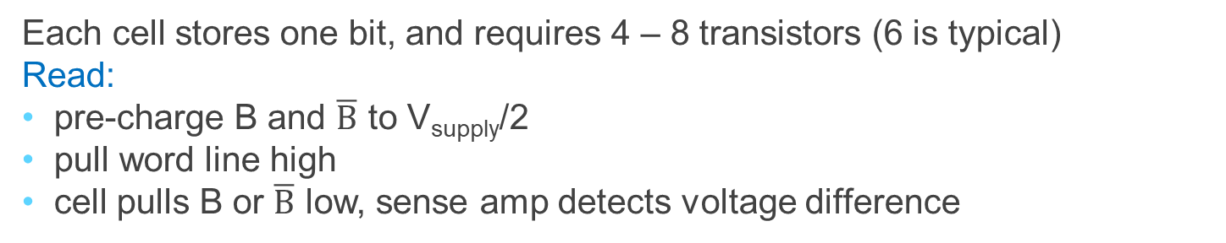
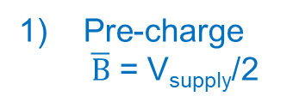
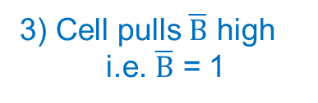
SRAM Cell
bit line
Typical SRAM Cell
2) Enable (wordline = 1)
word line
Disable (wordline = 0)
1
0
Pre-charge
$\overline{B}$ = V_{supply}/2
Pre-charge
B = V_{supply}/2
3) Cell pulls $\overline{B}$ high
i.e. $\overline{B}$ = 1
on
on
3) Cell pulls B low
i.e. B = 0
off
off
$$\overline{B}$$
B
Each cell stores one bit, and requires 4 – 8 transistors (6 is typical)
Read:
pre-charge B and $\overline{B}$ to V_{supply}/2
pull word line high
cell pulls B or $\overline{B}$ low, sense amp detects voltage difference

Slide 48
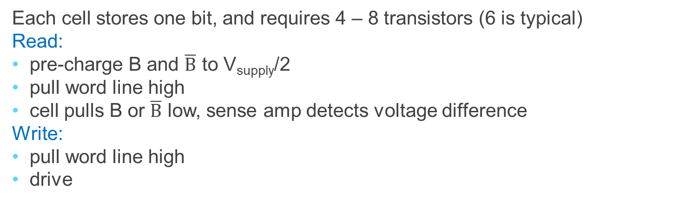
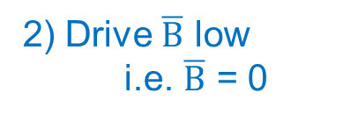
SRAM Cell
bit line
Typical SRAM Cell
1) Enable (wordline = 1)
Disabled (wordline = 0)
word line
1
→
0
0
→
1
2) Drive $\overline{B}$ low
i.e. $\overline{B}$ = 0
off
off
2) Drive B high
i.e. B = 1
on
on
$$\overline{B}$$
B
Each cell stores one bit, and requires 4 – 8 transistors (6 is typical)
Read:
pre-charge B and $\overline{B}$ to V_{supply}/2
pull word line high
cell pulls B or $\overline{B}$ low, sense amp detects voltage difference
Write:
pull word line high
drive B and $\overline{B}$ to flip cell

Slide 49
SRAM
Bit Line
D_{in}[1]
D_{in}[2]
E.g. How do we design
a 4 x 2 SRAM Module?
(i.e. 4 word lines that are
each 2 bits wide)?
D
Q
D
Q
enable
enable
0
2-to-4
decoder
D
Q
D
Q
enable
enable
1
2
Address
D
Q
D
Q
enable
enable
Word lines
2
D
Q
D
Q
enable
enable
3
Write Enable
Output Enable
D_{out}[1]
D_{out}[2]
Notes:
How do we design a 4 x 2 SRAM Module?
Caption on A.9.1 is incorrect
Output enable is useful for connecting multiple memories to a single-output bus and using Output enable to determine which memory drives the bus.

Slide 50
SRAM
D_{in}[1]
D_{in}[2]
E.g. How do we design
a 4 x 2 SRAM Module?
(i.e. 4 word lines that are
each 2 bits wide)?
D
Q
D
Q
enable
enable
0
2-to-4
decoder
D
Q
D
Q
enable
enable
1
2
Address
4 x 2 SRAM
D
Q
D
Q
enable
enable
2
D
Q
D
Q
enable
enable
3
Write Enable
Output Enable
D_{out}[1]
D_{out}[2]
Notes:
Caption on A.9.1 is incorrect
Output enable is useful for connecting multiple memories to a single-output bus and using Output enable to determine which memory drives the bus.

Slide 51
SRAM
D_{in}
8
E.g. How do we design
a 4M x 8 SRAM Module?
(i.e. 4M word lines that
are each 8 bits wide)?
22
Address
4M x 8 SRAM
Chip Select
Write Enable
Output Enable
8
D_{out}
Notes:
Caption on A.9.1 is incorrect
Output enable is useful for connecting multiple memories to a single-output bus and using Output enable to determine which memory drives the bus.

Slide 52
SRAM
E.g. How do we design
a 4M x 8 SRAM Module?
4M x 8 SRAM
12 x
4096
decoder
4k x
1024
SRAM
4k x
1024
SRAM
4k x
1024
SRAM
4k x
1024
SRAM
4k x
1024
SRAM
4k x
1024
SRAM
4k x
1024
SRAM
4k x
1024
SRAM
12
Address [21-10]
10
1024
1024
1024
1024
1024
1024
1024
1024
Address [9-0]
mux
mux
mux
mux
mux
mux
mux
mux
1
1
1
1
1
1
1
1
D_{out}[7]
D_{out}[6]
D_{out}[5]
D_{out}[4]
D_{out}[3]
D_{out}[2]
D_{out}[1]
D_{out}[0]
Notes:
Caption on A.9.1 is incorrect
Output enable is useful for connecting multiple memories to a single-output bus and using Output enable to determine which memory drives the bus.

Slide 53
SRAM
E.g. How do we design
a 4M x 8 SRAM Module?
4M x 8 SRAM
row
decoder
4k x
1024
SRAM
4k x
1024
SRAM
4k x
1024
SRAM
4k x
1024
SRAM
4k x
1024
SRAM
4k x
1024
SRAM
4k x
1024
SRAM
4k x
1024
SRAM
12
Address [21-10]
10
1024
1024
1024
1024
1024
1024
1024
1024
Address [9-0]
column selector, sense amp, and I/O circuits
Chip Select (CS)
R/W Enable
8
Shared Data Bus
Notes:
Caption on A.9.1 is incorrect
Output enable is useful for connecting multiple memories to a single-output bus and using Output enable to determine which memory drives the bus.

Slide 54
SRAM Modules and Arrays
R/W
4M x 8 SRAM
4M x 8 SRAM
4M x 8 SRAM
4M x 8 SRAM
A₂₁₋₀
CS
msb
lsb
CS
Bank 2
CS
Bank 3
CS
Bank 4
Notes:
2, 3, or more step address decode
The first decoder generates the addresses for eight 4M x 4 arrays; then a set of multiplexors is used to select 1 bit from each 4-bit-wide array. This is a much easier design than a single-level decode that would need either an enormous decoder or a gigantic multiplexor. In practice, a modern SRAM of
this size would probably use an even larger number of blocks, each somewhat smaller.

Slide 55
SRAM Summary
SRAM
A few transistors (~6) per cell
Used for working memory (caches)
But for even higher density…

Slide 56
Dynamic RAM: DRAM
bit line
Dynamic-RAM (DRAM)
Data values require constant refresh
word line
Capacitor
Gnd
Each cell stores one bit, and requires 1 transistors
Notes:
value kept in a cell is stored as a charge in a capacitor
To refresh the cell, we merely read its contents and write it back.
Because DRAMs store the charge on a capacitor, it cannot be kept indefinitely and must periodically be refreshed. That is why this memory structure is called dynamic, as opposed to the static storage in an SRAM cell.
The pass transistor acts like a switch: when the signal on the word line is asserted, the switch is closed, connecting the capacitor to the bit line. If the operation is a write, then the value to be written is placed on the bit line. If the value is a 1, the capacitor will be charged. If the value is a 0, then the capacitor will be discharged. Reading is slightly more complex, since the DRAM must detect a very small charge stored in the capacitor. Before activating the word line for a read, the bit line is charged to the voltage that is halfway between the low and high voltage. Then, by activating the word line, the charge on the capacitor is read out onto the bit line. This causes the bit line to move slightly toward the high or low direction, and this change is detected with a sense amplifier, which can detect small changes in voltage.

Slide 57
Dynamic RAM: DRAM
Pass-Through
Transistors
bit line
Dynamic-RAM (DRAM)
Data values require constant refresh
word line
Capacitor
Gnd
Each cell stores one bit, and requires 1 transistors
Notes:
value kept in a cell is stored as a charge in a capacitor
To refresh the cell, we merely read its contents and write it back.
Because DRAMs store the charge on a capacitor, it cannot be kept indefinitely and must periodically be refreshed. That is why this memory structure is called dynamic, as opposed to the static storage in an SRAM cell.
The pass transistor acts like a switch: when the signal on the word line is asserted, the switch is closed, connecting the capacitor to the bit line. If the operation is a write, then the value to be written is placed on the bit line. If the value is a 1, the capacitor will be charged. If the value is a 0, then the capacitor will be discharged. Reading is slightly more complex, since the DRAM must detect a very small charge stored in the capacitor. Before activating the word line for a read, the bit line is charged to the voltage that is halfway between the low and high voltage. Then, by activating the word line, the charge on the capacitor is read out onto the bit line. This causes the bit line to move slightly toward the high or low direction, and this change is detected with a sense amplifier, which can detect small changes in voltage.

Slide 58
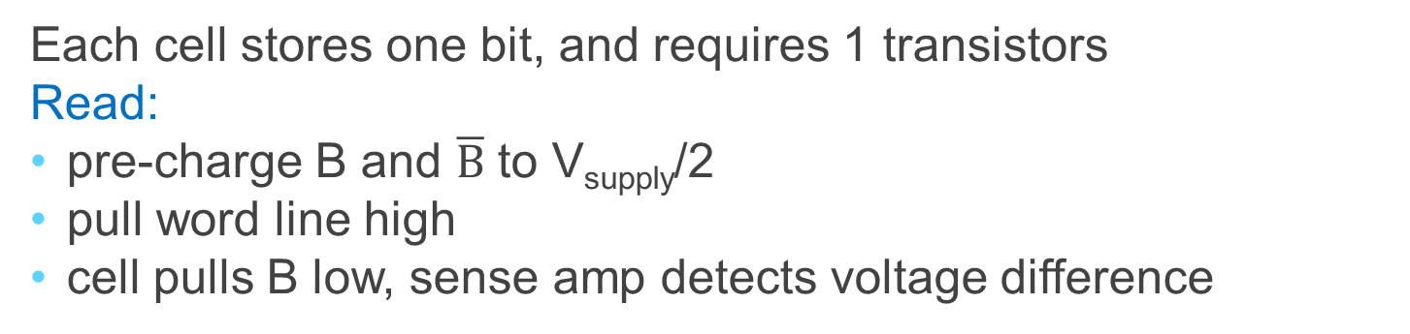
Dynamic RAM: DRAM
bit line
Dynamic-RAM (DRAM)
2) Enable (wordline = 1)
word line
Disable (wordline = 0)
0
Pre-charge
B = V_{supply}/2
Capacitor
on
3) Cell pulls B low
i.e. B = 0
off
Gnd
Each cell stores one bit, and requires 1 transistors
Read:
pre-charge B and $\overline{B}$ to V_{supply}/2
pull word line high
cell pulls B low, sense amp detects voltage difference
Notes:
value kept in a cell is stored as a charge in a capacitor
To refresh the cell, we merely read its contents and write it back.
Because DRAMs store the charge on a capacitor, it cannot be kept indefinitely and must periodically be refreshed. That is why this memory structure is called dynamic, as opposed to the static storage in an SRAM cell.
The pass transistor acts like a switch: when the signal on the word line is asserted, the switch is closed, connecting the capacitor to the bit line. If the operation is a write, then the value to be written is placed on the bit line. If the value is a 1, the capacitor will be charged. If the value is a 0, then the capacitor will be discharged. Reading is slightly more complex, since the DRAM must detect a very small charge stored in the capacitor. Before activating the word line for a read, the bit line is charged to the voltage that is halfway between the low and high voltage. Then, by activating the word line, the charge on the capacitor is read out onto the bit line. This causes the bit line to move slightly toward the high or low direction, and this change is detected with a sense amplifier, which can detect small changes in voltage.

Slide 59
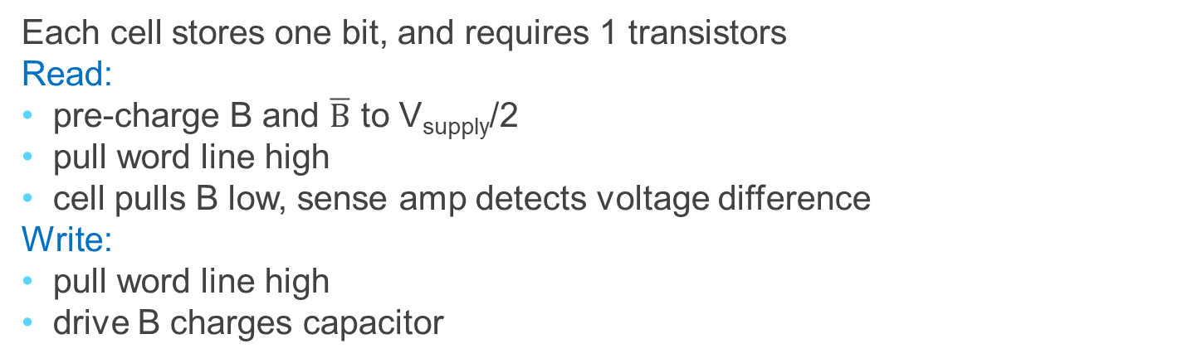
Dynamic RAM: DRAM
bit line
Dynamic-RAM (DRAM)
1) Enable (wordline = 1)
word line
Disable (wordline = 0)
→
1
0
Capacitor
on
2) Drive B high
i.e. B = 1
Charges capacitor
off
Gnd
Each cell stores one bit, and requires 1 transistors
Read:
pre-charge B and $\overline{B}$ to V_{supply}/2
pull word line high
cell pulls B low, sense amp detects voltage difference
Write:
pull word line high
drive B charges capacitor
Notes:
value kept in a cell is stored as a charge in a capacitor
To refresh the cell, we merely read its contents and write it back.
Because DRAMs store the charge on a capacitor, it cannot be kept indefinitely and must periodically be refreshed. That is why this memory structure is called dynamic, as opposed to the static storage in an SRAM cell.
The pass transistor acts like a switch: when the signal on the word line is asserted, the switch is closed, connecting the capacitor to the bit line. If the operation is a write, then the value to be written is placed on the bit line. If the value is a 1, the capacitor will be charged. If the value is a 0, then the capacitor will be discharged. Reading is slightly more complex, since the DRAM must detect a very small charge stored in the capacitor. Before activating the word line for a read, the bit line is charged to the voltage that is halfway between the low and high voltage. Then, by activating the word line, the charge on the capacitor is read out onto the bit line. This causes the bit line to move slightly toward the high or low direction, and this change is detected with a sense amplifier, which can detect small changes in voltage.

Slide 60
DRAM vs. SRAM
Single transistor vs. many gates
Denser, cheaper ($30/1GB vs. $30/2MB)
But more complicated, and has analog sensing
Also needs refresh
Read and write back…
…every few milliseconds
Organized in 2D grid, so can do rows at a time
Chip can do refresh internally
Hence… slower and energy inefficient

Slide 61
Memory
Register File tradeoffs
+ Very fast (a few gate delays for both read and write)
+ Adding extra ports is straightforward
– Expensive, doesn’t scale
– Volatile
Volatile Memory alternatives: SRAM, DRAM, …
– Slower
+ Cheaper, and scales well
– Volatile
Non-Volatile Memory (NV-RAM): Flash, EEPROM, …
+ Scales well
– Limited lifetime; degrades after 100000 to 1M writes

Slide 62
Summary
We now have enough building blocks to build machines that can perform non-trivial computational tasks
Register File: Tens of words of working memory
SRAM: Millions of words of working memory
DRAM: Billions of words of working memory
NVRAM: long term storage (usb fob, solid state disks, BIOS, …)
Next time we will build a simple processor!

