Slide 1
Introduction to C
CS 3410

Slide 2
Basics of C
Developed by Dennis Ritchie in the 1970s.
Maps very easily to machine instructions.
Even allows inline assembly!
Unlike Java or Python, the programmer is in charge of memory management.
There is no garbage collector.
Not Object Oriented!
No inheritance or interfaces.

Slide 3
Terminology
Compiler: The program that converts source code into object code (assembly/machine code)
You will be using GCC to compile your source before you can run it.
Debugger: The program that allows you to inspect a program while it is running.
You will be using GDB.
A good alternative is to use print statements everywhere!
Header: File of function and variable declarations
If you want to use functions defined in other files, you must include a corresponding header (.h) file.

Slide 4
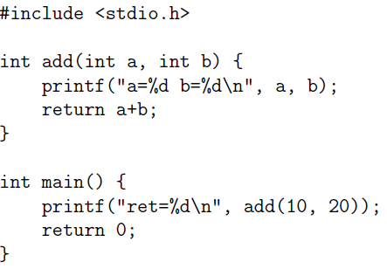
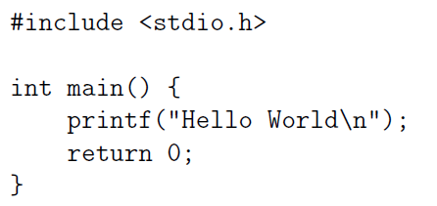
Structure of a C Program
Which lines are preprocessor directives? Function declarations?

Slide 5
Name of array (Note that all elements of this array have the same name, c)
Arrays
Array
Group of consecutive memory locations
Same name and type
To refer to an element, specify
Array name
Position number
Format:
arrayname[ position number ]
First element at position 0
n element array named c:
c[ 0 ], c[ 1 ]...c[ n – 1 ]
c[0]
-45
c[1]
6
c[2]
0
c[3]
72
c[4]
1543
c[5]
-89
c[6]
0
c[7]
62
c[8]
-3
c[9]
1
c[10]
6453
c[11]
78
Position number of the element within array c

Slide 6
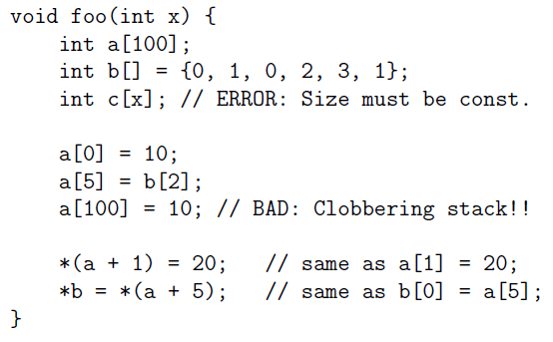
Arrays
declaration
initialization

Slide 7
Common Array Mistakes
C has no array-bound checks. You won’t even get a warning! At best you’ll get a segfault when you try to run it.
Do not use sizeof(array), it will return the size of one single element, not the underlying memory size.
SEGFAULT

Slide 8
Strings in C…
Just null terminated char arrays!
For example: “CS3410” is equivalent to:
char str[] = {‘C’,‘S’,‘3’,‘4’,‘1’,‘0’,‘\0’};
Things to note:
<string.h> has common string functions:
strlen(s) does not include the terminal character. Be careful when using memory operations which does include the character!

Slide 9
Pointers
A pointer is a bit-pattern (generally a number) that represents a memory location.
To access the data in the memory that the pointer points to, you dereference the pointer.
The type of a pointer tells the compiler what kind of object to expect when it is dereferenced.
A “double*” is a pointer representing the memory location of a double.
A pointer does not actually create the data it points to. For the pointer to contain data, some other function must create the data it will point to.
This is typically a call to malloc.

Slide 10
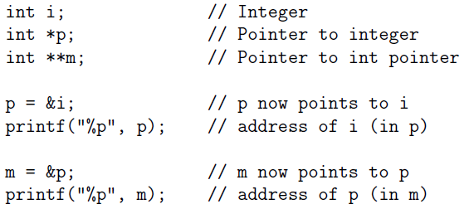
Pointers

Slide 11
Pointers: A visual representation
char* d1;
d1 = “CS3410”;
Memory
char* d2;
Stack
d2 = d1+1;
Address | Value
0x07 | ‘\0’
0x06 | ‘0’
0x05 | ‘1’
0x04 | ‘4’
0x03 | ‘3’
0x02 | ‘S’
0x01 | ‘C’
//d2[0]==‘S’;
char* d1
char* d2
d2[6]=?

Slide 12
Pointers: A visual representation
int* d1;
d1 = {3,4,1,0,9,8,7};
Memory
int* d2;
Stack
d2 = d1+1;
Address | Value
0x18 | 7
0x14 | 8
0x10 | 9
0x0c | 0
0x08 | 1
0x04 | 4
0x00 | 3
//d2[0]==4;
int* d1
int* d2
d2[6]=?

Slide 13
Pointers to stack variables
float* d1;
float local = 42.42;
d1 = &local;
Stack
*d1 = 25;
float* d1
local = 25
local = 42.42

