Slide 1
INFO 5871-001: Data Science / Info Science
Robin burke, Fall 2019

Slide 2
centrality 1
Week 15, Part 1

Slide 3
Centrality
What are the most important nodes?
No single answer
depends on the kind of network

Slide 4
Different ideas of centrality
Different measures capture different ideas of what makes a node important
Here X > Y by different measures
indegree
outdegree
betweenness
closeness

Slide 5
Degree centrality
We’ve talked a lot about degree
Degree centrality
is normalized degree
Undirected network
d / max(d) = d / n-1
Directed network
d_{in} / max(d) = d_{in} / n-1
d_{out} / max(d) = d_{out} / n-1

Slide 6
Normalization
Dividing by the maximum degree
Let’s us compare between networks
degree of 5 means something different
network of size 6
degree centrality = 1
network of size 600
degree centrality = 0.0083

Slide 7
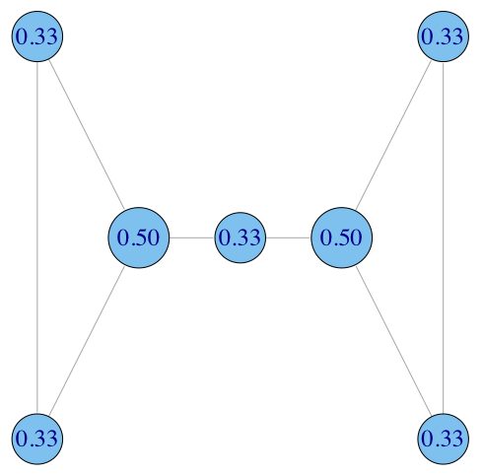
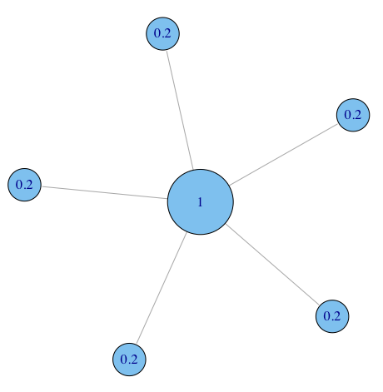

Normalizations of degree

Slide 8
Interpretation
High relative degree centrality
means that a node has many neighbors
Is this node important?
depends on the kind of network

Slide 9
Anti-Examples
Email network
maybe this is the administrative assistant
sending everyone meeting reminders
Criminal network
maybe this is the street dealer
lots of drug buyers
Web pages
maybe a page is designed to have high in-degree
part of a spam network

Slide 10
Examples
Financial network
weighted in-degree of transaction flow is a very informative
in-degree by itself maybe not
Advice network
in-degree reflects how trusted an individual is
Political donations
an individual or group with high weighted out-degree
is potentially influencing many candidates

Slide 11
In NetworkX
nx.degree_centrality(g)

Slide 12
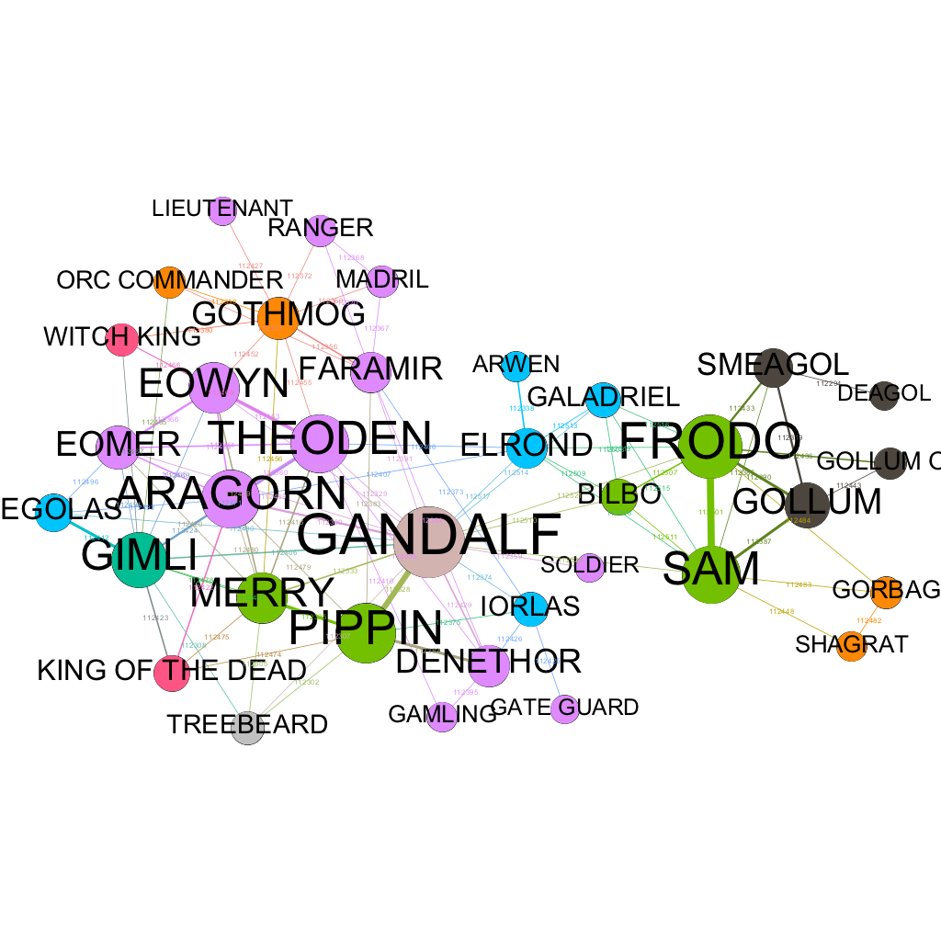
Example: LOTR1 network

Slide 13
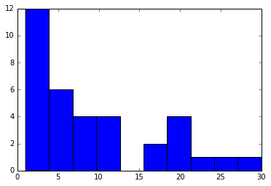
Weighted degree distribution

Slide 14
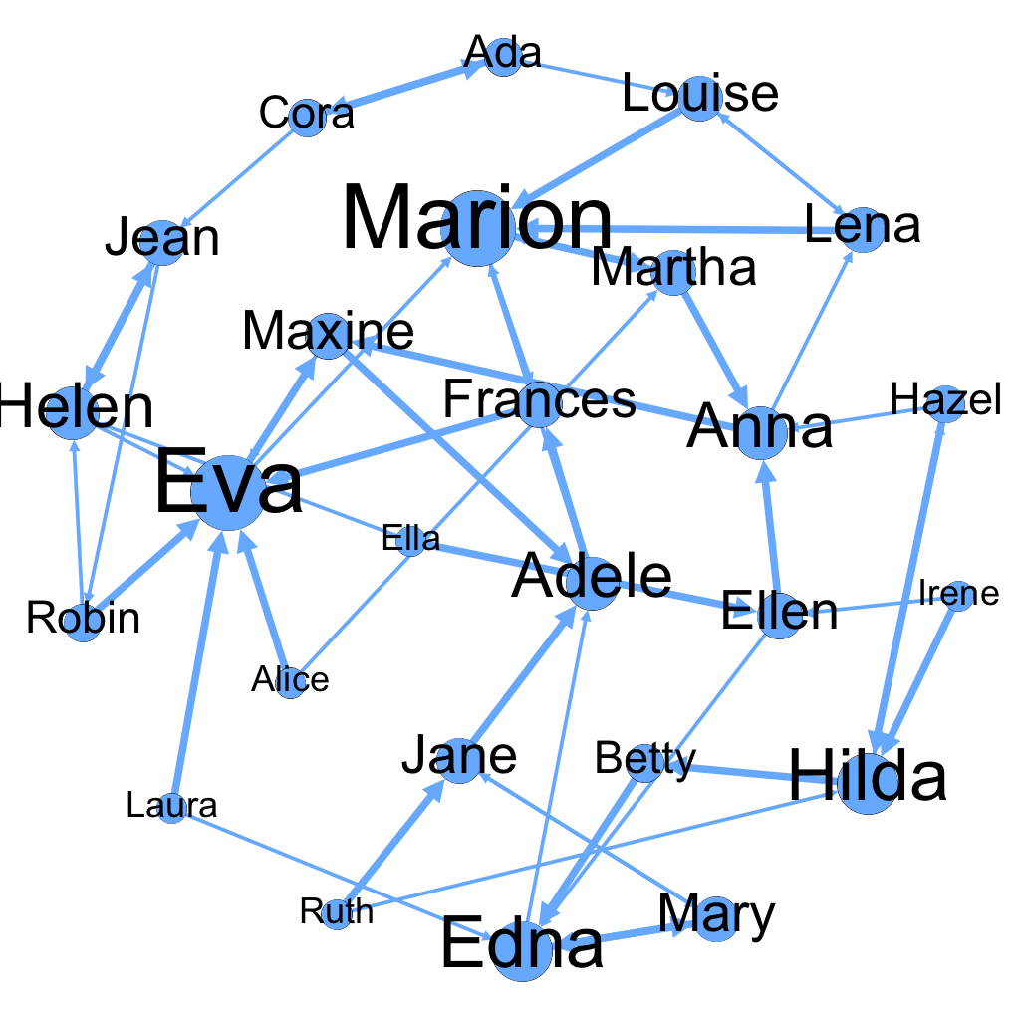
In-degree centrality

Slide 15

Degree centrality
High degree makes a node important IF
immediate connections are important
each neighbor equally valuable
Many variants
weighted
in-degree
out-degree
more exotic extensions

Slide 16
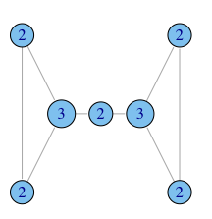
Brokerage
Not captured by degree

Slide 17
Brokerage
The extent to which one individual is an intermediary between different groups
who otherwise lack direct connections

Slide 18
Constraint / Structural holes
My dog ate it!
No homework today!
Teachers
Parents

Slide 19
Betweeness: capturing brokerage
Intuition: how many pairs of individuals would have to go through you
in order to reach one another in the minimum number of hops?

Slide 20

Betweenness examples
A
B
C
D
E
A lies between no two other vertices
B lies between A and 3 other vertices: C, D, and E
C lies between 4 pairs of vertices (A,D),(A,E),(B,D),(B,E)
note that there are no alternate paths for these pairs to take, so C gets full credit

Slide 21
But
A
B
C
E
D
How to account for multiple shortest paths?
C and D “share”
divide by the number of shortest paths

Slide 22
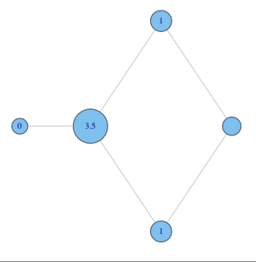
Betweenness examples
why do C and D each have betweenness 1?
They are both on shortest paths for pairs (A,E), and (B,E), and so must share credit:
½+½ = 1
C
A
B
E
D

Slide 23
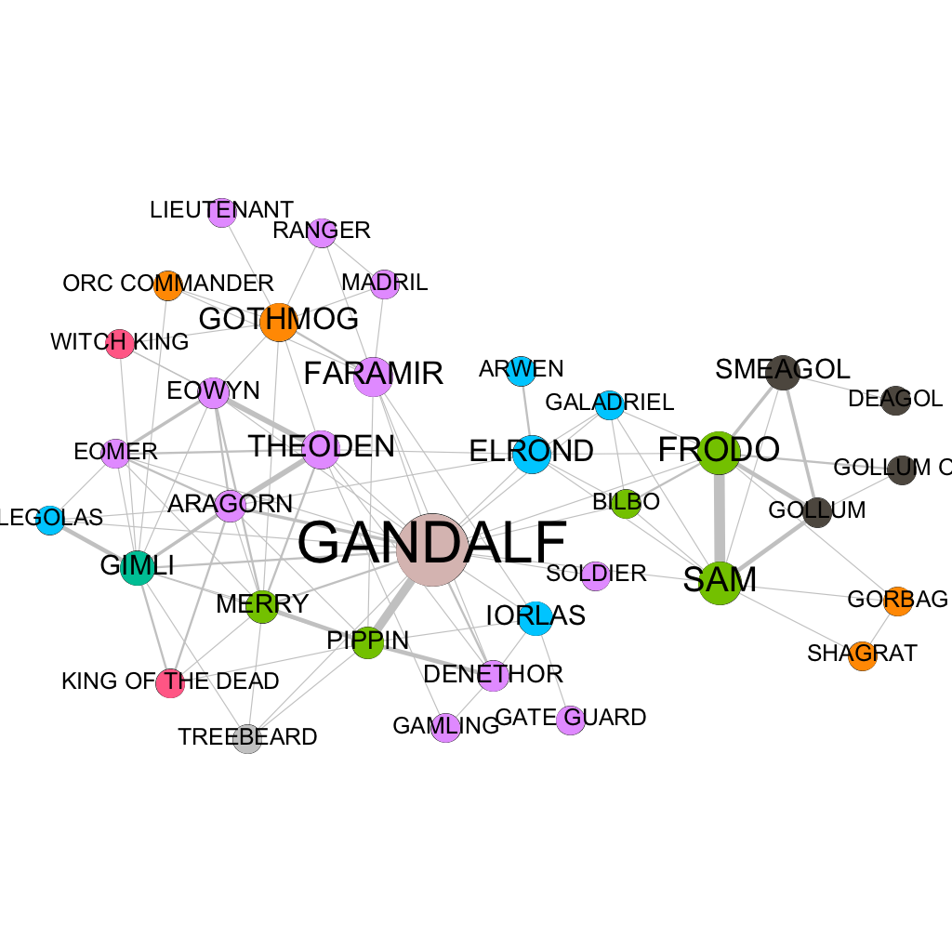
LOTR3 Network
Lower degree but higher betweenness

Slide 24
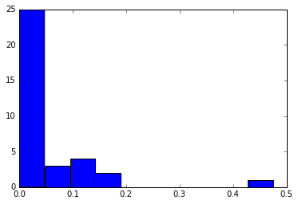
Betweenness distribution

Slide 25
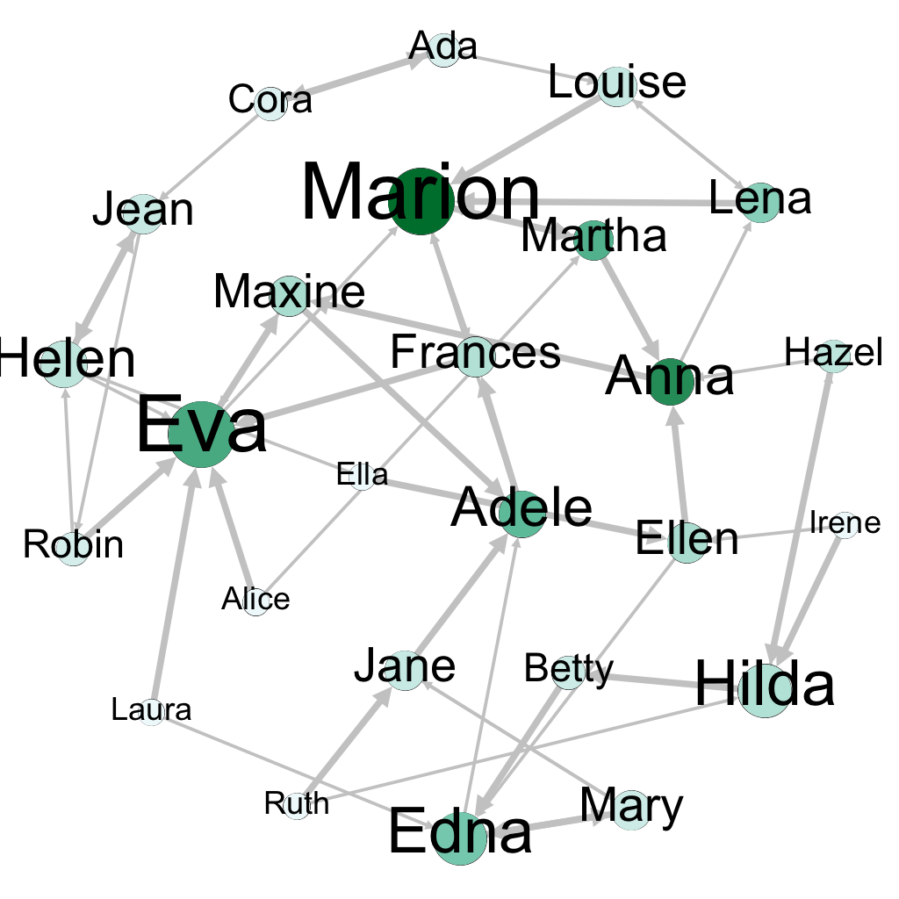
Dining network

Slide 26
Computation
Betweenness is kind of slow to compute
especially if you do it in a naive way
O(n³)
We have to count every path between every pair of nodes
best algorithm is O(n²)
Compare degree = O(n)
With very large networks
might not be able to compute this
might prefer measures of lower complexity

Slide 27
Approximations
Only use paths of length k
becomes linear but has a hard cut-off
may miss important non-proximal effects
Sample k nodes
can tune k to the desired trade-off between accuracy and time
implemented in NetworkX
nx.betweenness(G, k)

Slide 28
Betweenness
A node with high betweenness is important IF
the purpose of the network is communication or the flow of things
and the person benefits from the flow

Slide 29
Closeness
What if it’s not so important to have many direct friends?
Or be “between” others
But one still wants to be in the “middle” of things, not too far from the center

Slide 30
Importance without brokerage

Slide 31
Closeness
Average distance to other nodes
This gives a strange result
smaller is more important
So to match other metrics
1 / (average distance)
Now the range is 0 to 1
close to zero means far from most nodes

Slide 32

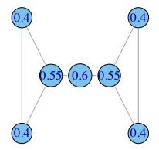
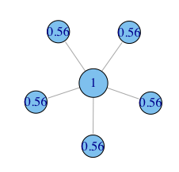
Closeness examples
A
B
C
D
E

Slide 33
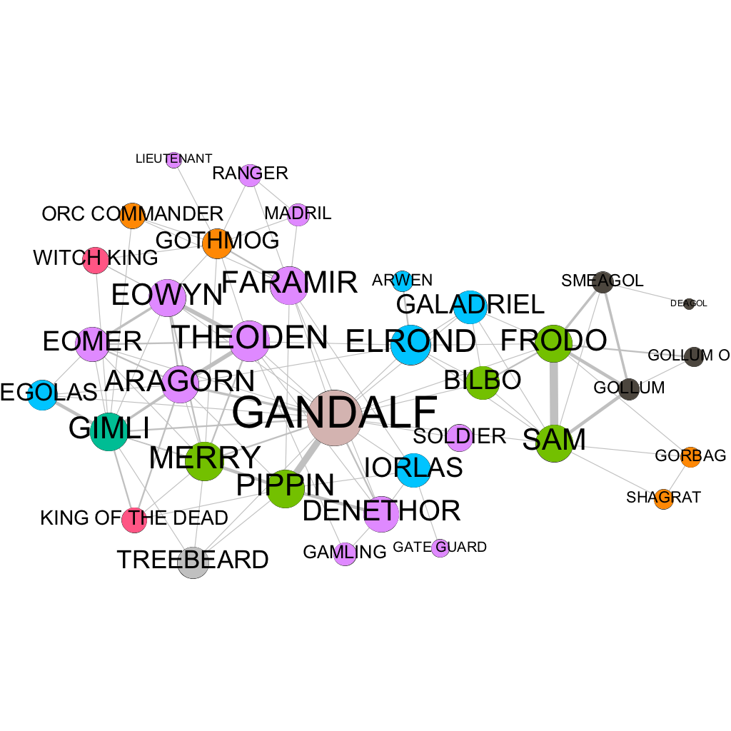
LOTR 3 Network

Slide 34
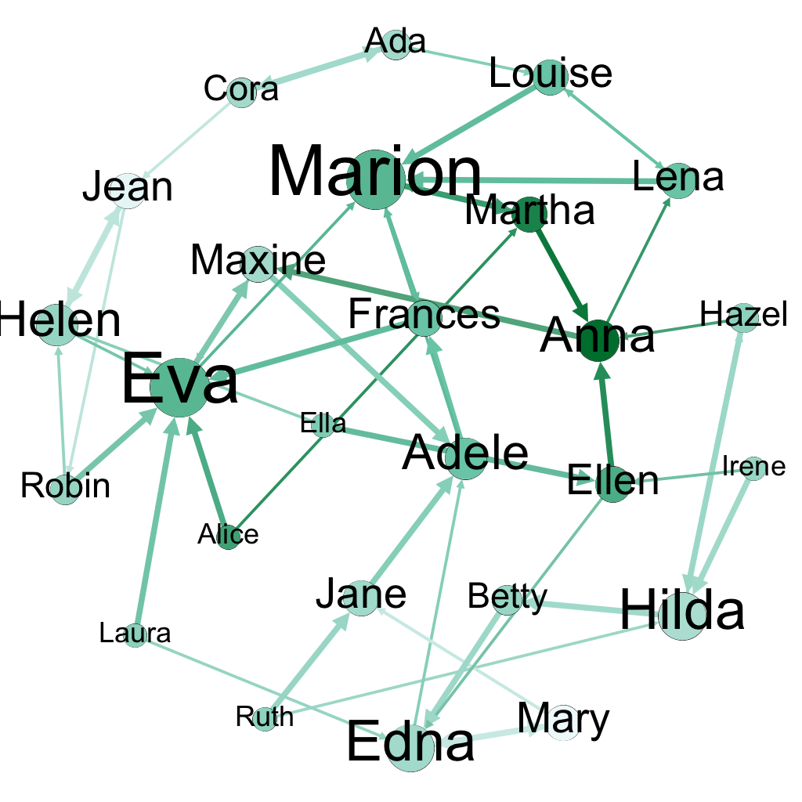
Dining network

Slide 35
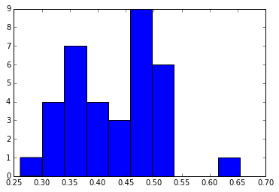
Closeness distribution

Slide 36
Closeness
A node with high closeness is important IF
reaching others in a small number of steps is important

Slide 37
Centrality correlation
Normally centrality values are correlated
high degree nodes living the middle of the network
But not always

Slide 38
Low degree / High closeness
 | Low degree | Low closeness | Low betweenness
High degree | ✖
High closeness | ✔ | ✖
High betweenness |  |  | ✖

Slide 39
Low degree / High betweenness
 | Low degree | Low closeness | Low betweenness
High degree | ✖
High closeness |  | ✖
High betweenness | ✔ |  | ✖

Slide 40
Low closeness / High degree
 | Low degree | Low closeness | Low betweenness
High degree | ✖ | ✔
High closeness |  | ✖
High betweenness |  |  | ✖

Slide 41
Low closeness / High betweenness
 | Low degree | Low closeness | Low betweenness
High degree | ✖
High closeness |  | ✖
High betweenness |  | ✔ | ✖

Slide 42
High degree / Low betweenness
 | Low degree | Low closeness | Low betweenness
High degree | ✖ |  | ✔
High closeness |  | ✖
High betweenness |  |  | ✖

Slide 43
High closeness / Low betweenness
 | Low degree | Low closeness | Low betweenness
High degree | ✖
High closeness |  | ✖ | ✔
High betweenness |  |  | ✖

Slide 44
Centrality correlation
Important nodes are usually important
no matter how you measure
But
sometimes they are not
those differences can be interesting

