Slide 1
INFO 5871-001: Data Science / Info Science
Robin burke, Fall 2019

Slide 2
centrality 2
Week 15, Part 3

Slide 3
Eigenvector centrality
What if your centrality depends on your neighbor’s centrality?
Centrality as a relational concept
having to do with being associated with other central individuals

Slide 4
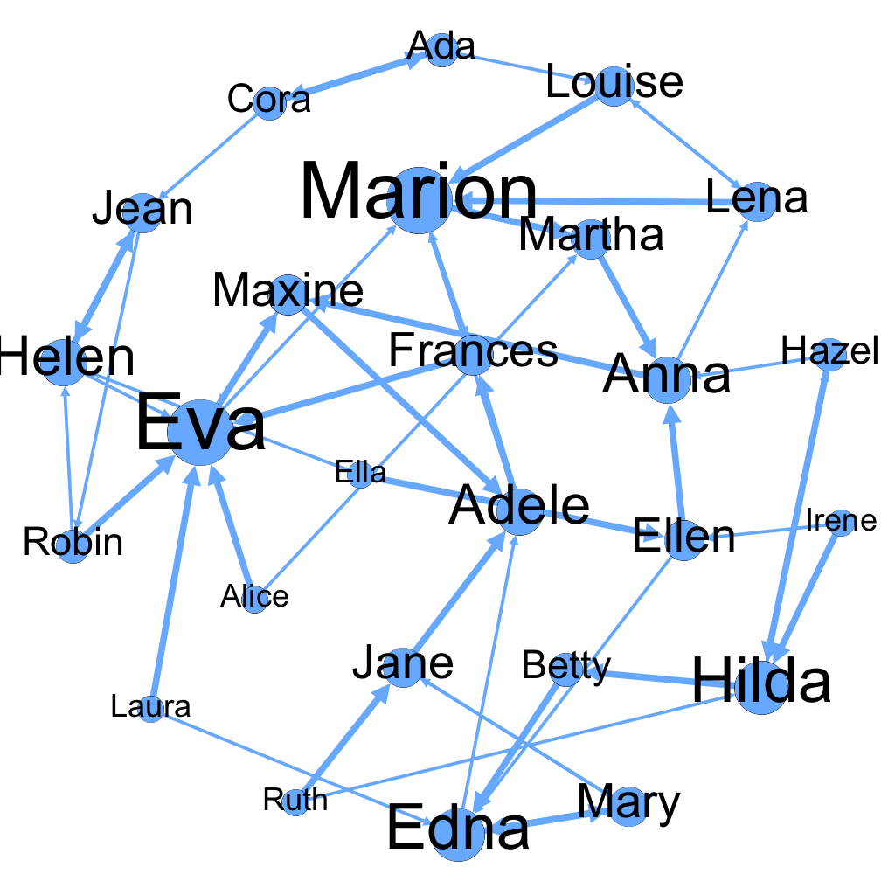
Example
Maxine has low in-degree (2) but her in-links come from Eva (6) and Anna (3)
Ellen has the same in-degree (2) but her in-links come from two zero-degree nodes.

Slide 5
Basic idea
Extend the notion of degree centrality
Degree
each neighbor adds 1 to your centrality
What if
each neighbor adds their centrality to your centrality?
Having influential friends is better
Definition is circular, though...

Slide 6
Treat as an update rule
Centrality of user i is the sum of all centralities of its neighbors
c_{i}’ = sum of c_{j} if edge(i,j)
In terms of the adjacency matrix M
C’ = M C
Is there a point where the process converges?
C’ = C

Slide 7
Eigenvector centrality
Matrix eigenvector is a vector such that
M c = λ c
multiple eigenvectors c
each with its own eigenvalue λ
Eigenvector centrality
largest eigenvalue solution to
M c = λ c

Slide 8
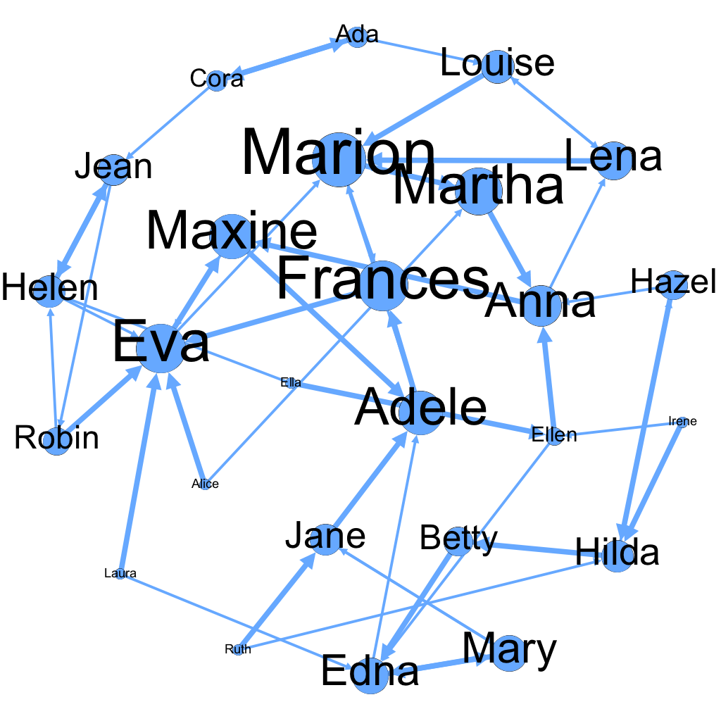
Dining network again
NOTE: Square root transformation used
to reduce skew in sizes

Slide 9
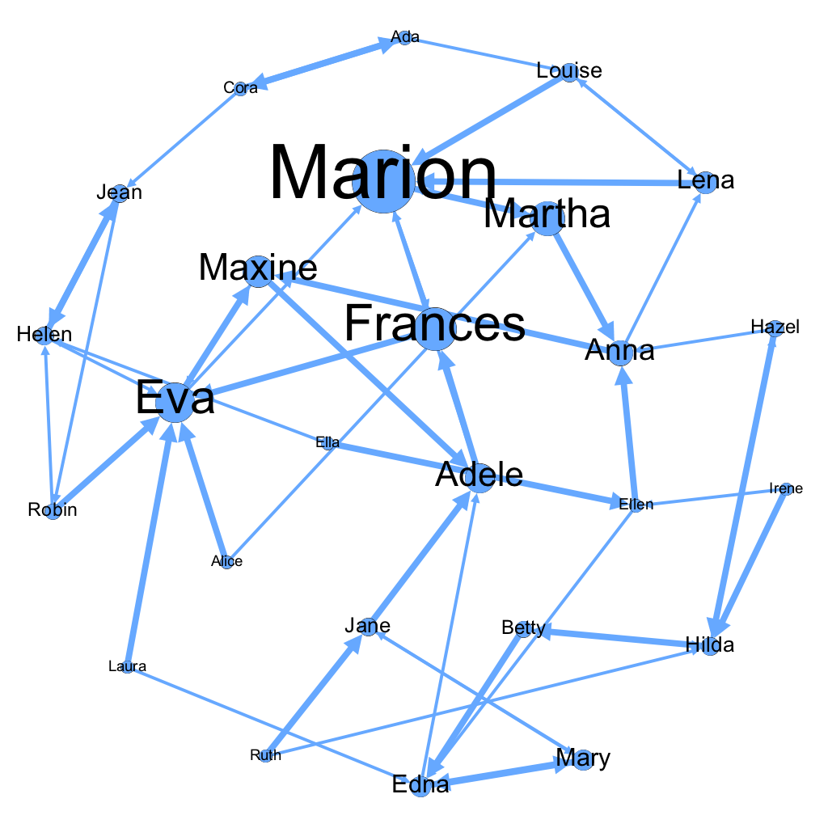
Dining network with skew

Slide 10
Uses for eigenvector centrality
If importance is relative
“it’s who you know”
assumes no dilution effect
all outbound edges get full weight
In NetworkX
nx.eigenvector_centrality(G)
“power iteration”

Slide 11
Break
10 minutes break plus
10 minutes to do the FCQs
Lab: Gephi

