Slide 1
INFO 5871-001: Data Science / Info Science
Robin burke, Fall 2019

Slide 2
Networks
Week 14, Part 2

Slide 3
Social networks
“Social phenomena should be primarily conceived and investigated through the properties of relations between and within units, instead of the properties of these units themselves.”
- Wikipedia
“Social network analysis”

Slide 4
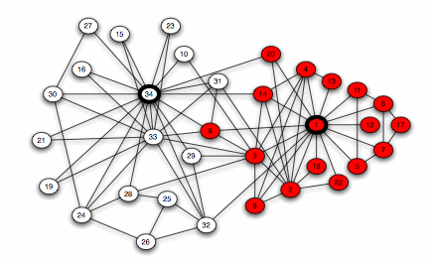
Interpersonal Networks
Groups of People
Express friendships or other social relationships
Looking at power within the network
Looking at connectivity

Slide 5
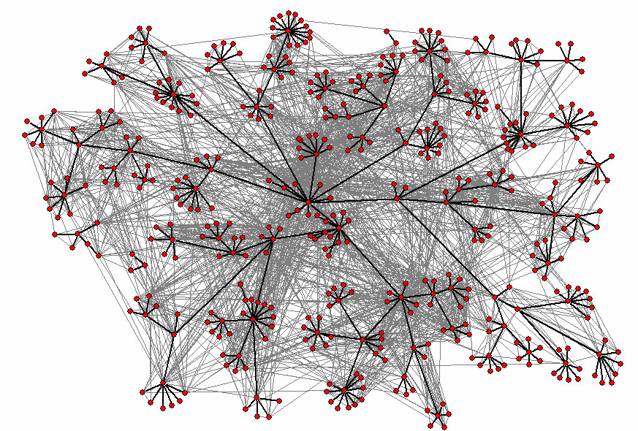
Communication Networks
Who talks to whom
Who works for who?
Understand organizational behavior
http://www-personal.umich.edu/~ladamic/img/hplabsemailhierarchy.jpg

Slide 6
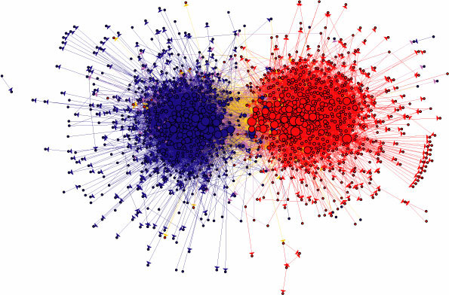
Information Networks
Links on web pages
Political Blogs
Papers / References
How is information organized?
http://www-personal.umich.edu/~ladamic/img/politicalblogs.jpg

Slide 7
Social network analysis
Questions
who are important individuals in the network?
what properties of individuals explain the network structure?
can the network be divided into coherent parts?
can we predict new / missing edges?

Slide 8
Graphs
Models of Networks
Vertices and Edges
We can use graphs to represent many different structures
Vertices = People
Edges = Friends
Also
Vertices = Companies
Edges = Purchases

Slide 9
Formalizing
A network is a set of nodes
connected by a set of edges
node
“Network” ≡ “Graph”
points | lines
vertices | edges, arcs | math
nodes | links | computer science
sites | bonds | physics
actors | ties, relations | sociology
edge

Slide 10
Vertices
These are usually the “actors” in the network
Vertices may
form connections
send messages
exert influence
exchange resources
etc.
Vertices are (usually) the fixed points in the graph
edges may be less stable

Slide 11
Vertices
May have a variety of attributes
associated data
Individuals
age
sex
race
etc.
Companies
business sector
location
market capitalization
etc.

Slide 12
Vertex types
Sometimes networks have nodes of different types
Example
LinkedIn
Types
Individuals
Companies
Universities
Interest groups
etc.
We will see many examples of networks with two types
bipartite networks

Slide 13
Edges
These are the connections in the network
Edges are the means by which vertices connect / exchange / exert influence, etc.
Implicit idea
the network is not “complete”
everyone is not connected directly to everyone else

Slide 14
Edge attributes
Edges can also have attributes
In a communication network
how much communication over this edge?
In a friendship network
how much time do they spend together?
Many other possibilities
historical: when was the edge created?
valence: like or dislike? degree of trust

Slide 15
Direction
Most important edge attribute
defines the whole graph
Do the edges have direction?
directed edges
Or are they mutual
undirected edges
Undirected edges imply agreement
both nodes must accept the connection
Graph in NetworkX
Directed implies asymmetry
connection can be initiated by one side
DiGraph in NetworkX

Slide 16
Weight
Also important edge attribute
More heavily weighted edge is
more significant
more trafficked
Sometimes weight = distance
then low weight = closer

Slide 17
Graphs
Directed
all directed edges
also digraph
Undirected
all undirected edges
Weighted
edges have weight
Simple
no parallel edges
no self-loops

Slide 18
NetworkX
A Graph is two collections
list of nodes
plus dictionary of node attributes
list of edges
plus dictionary of edge attributes
Directed graph
separate type DiGraph

Slide 19
Visualizations
Not one of the strengths of NetworkX
Sometimes show visualizations done with Gephi 0.9.1
open-source Java-based interactive graph visualization
gephi.org

Slide 20
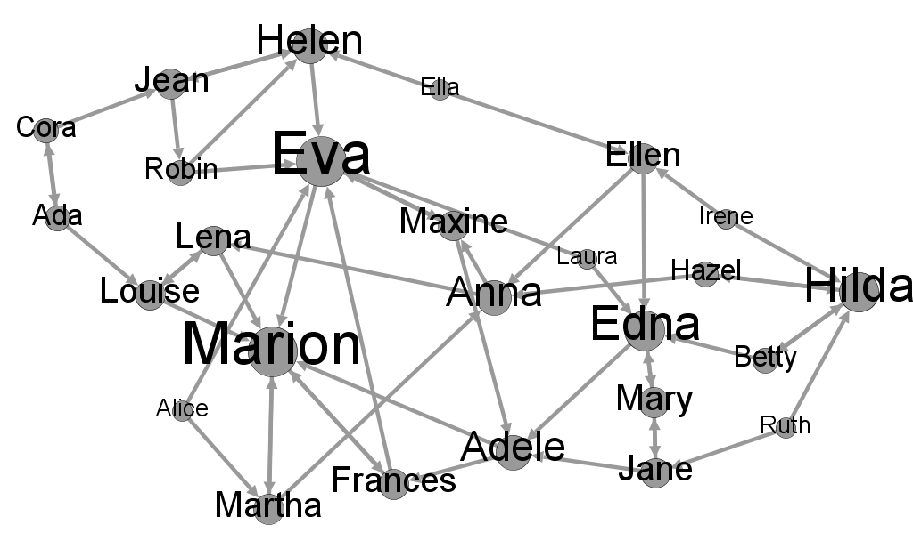
Directed networks
girls’ school dormitory dining-table partners, 1st and 2nd choices (Moreno, The sociometry reader, 1960)

Slide 21
Network representation
Pictures are nice!
easy for humans to examine at a glance
A picture is just one representation of a network
not necessarily the best one for all purposes
Computers are not so good at looking at pictures

Slide 22
Adjacency Matrix
Most important graph representation is the adjacency matrix
also “sociomatrix”
Square marix with an entry for each pair of nodes
non-zero entry if the nodes are connected

Slide 23
Matrix
A
B
C
D
E

Slide 24
Directed graph?
A
B
C
D
E

Slide 25
Matrix
Great for graph computing
Matrix multiplication = path traversal
Must handle sparsity
most entries zero
in NetworkX sparse matrix classes in numpy are used

Slide 26
Paths
A path is a sequence of edges going from one node to another
no repeated nodes
allow repeated nodes = “walk”
A simple path has no repeated edges
No reason today to use non-simple paths
“Path” will mean “simple path”

Slide 27
Geodesic = shortest path
The length of a path is the number of edges in it
unless it is a weighted graph, in which case the length could be the sum of the weights
A geodesic is the shortest path between two nodes
there can be more than one shortest path
Usually we are not interested in detours
often “path” means “shortest path”

Slide 28
Diameter
Diameter = longest shortest path
how far apart are the farthest nodes?
In geometry
the diameter of a circle is the maximum distance two points can be from each other

Slide 29
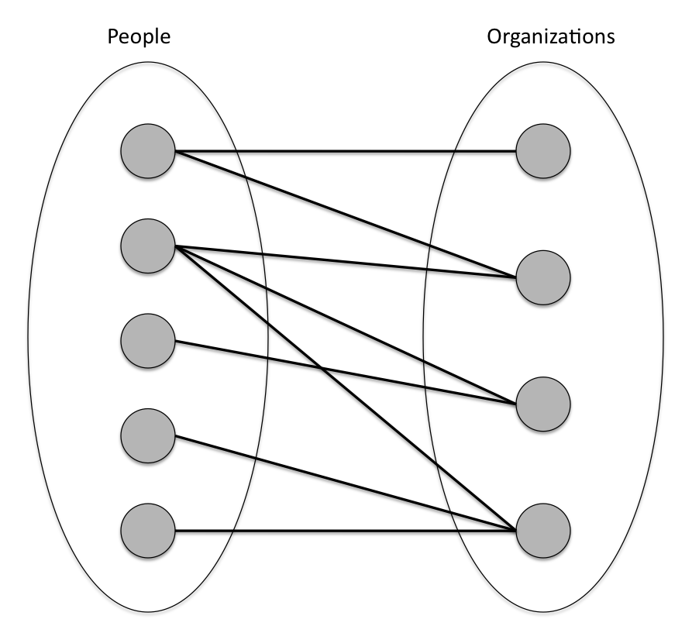
Networks with multiple node types
Bipartite graphs have two node types that do not have connections within the type
E.g. no people connected to one another
Graphs can have multiple node types and not be bipartite

Slide 30
Multimodal
This idea extends to networks with more types
Example: a social tagging system
Last.fm lets users tag web pages related to music

Slide 31
Tagging network
psychedelic
Alice
FlamingLips
A1
A2
Bob
alternative
MassiveAttack
A3

Slide 32
Bipartite networks
Show up in many social media contexts
users are connected because they interact with the same resource
But they have special properties
cannot be directly compared to user-user networks
most useful analysis is done with projections
Part 4

Slide 33
Components
A graph can be disconnected
no way to get from one set of nodes to another
Straightforward in an undirected graph
A
B
C
E
H
D
F
I
G
J

Slide 34
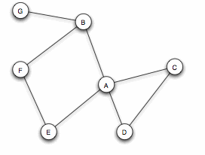
Components in a directed graph
How many components?
must be able to get from any node to any other

Slide 35
Giant component
Usually a large network has a “giant component”
to which most of the nodes belong
even true when the network is random
As many as 90% of the nodes will be in the giant component

Slide 36
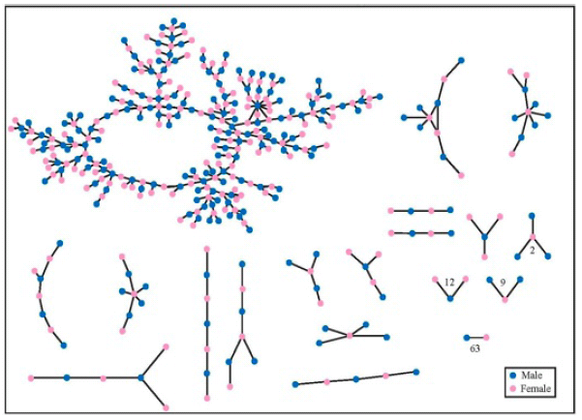
Social network with a giant component

