Slide 1
INFO 5871-001: Data Science / Info Science
Robin burke, Fall 2019

Slide 2
Degree
Week 14, Part 3

Slide 3
Degree
Most basic notion of popularity
How “connected” is each node?
High degree nodes have many neighbors
more potential for exchange

Slide 4
Types of degree
in degree
how many directed edges are incident (coming in)?
out degree
how many directed edges originate (go out)?
degree
number of edges connected to a node
usually applied for undirected networks
indegree=3
outdegree=2
degree=5

Slide 5
Weighted degree
If edges have weight,
might make sense to take this into account
In NetworkX
Can pass the name for the weight attribute to include in calculation
Example: communication network
if weight = # of emails
degree = # of contacts
weighted degree = total amount of email

Slide 6
In-degree vs out-degree
These measure very different things
Which one I care about
depends on my question
Do I want to know about importers or exporters?
In social networks
in-degree is often associated with prestige
people want to connect to you

Slide 7
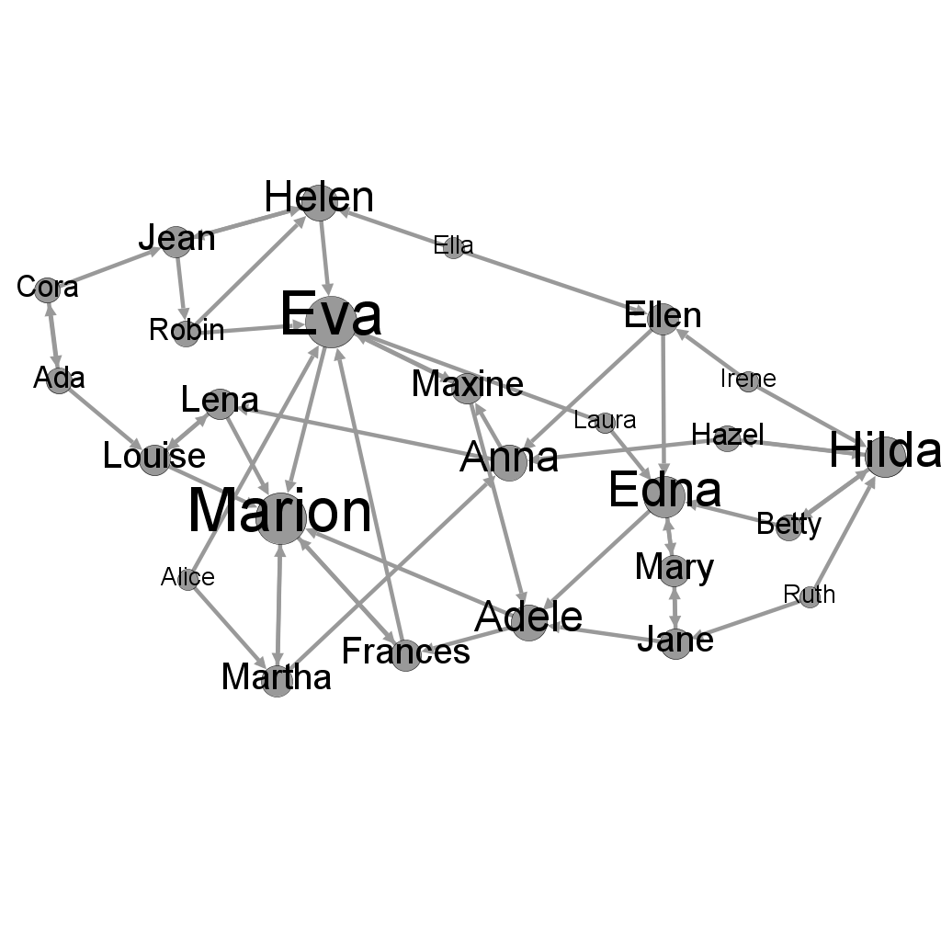
Dining network

Slide 8
In NetworkX
g.degree(node)
returns the degree of that node
g.degree(g)
returns the degree of all the nodes
as a dictionary
{'Andre': 9, 'Beverly': 2, 'Carol': 2, 'Diane': 3, 'Ed': 3, 'Fernando': 2, 'Garth': 2, 'Heather': 2, 'Ike': 9, 'Jane': 2}
g.degree(g).values()
returns just the values as a list

Slide 9
For directed graphs
dg.in_degree(dg)
returns the in-degrees of all the nodes as a dictionary
dg.out_degree(dg)
returns the out-degrees of all the nodes as a dictionary

Slide 10
Average degree
We can calculate the average degree over the network
kind of like measuring the number of edges (density)
But also captures the extent of concentration of edges
But average degree is not that practically useful in many cases

Slide 11
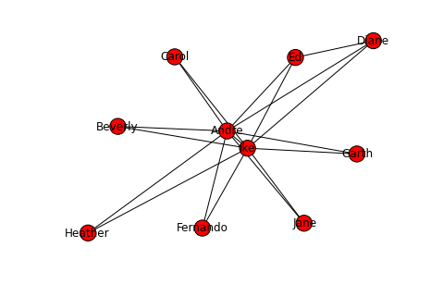
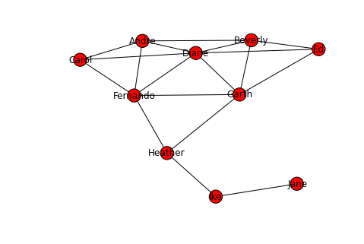
Same average degree
3.6

Slide 12
Distribution
Looks at how the value is spread over the nodes
Count how many nodes have each degree value
discrete distribution
histogram

Slide 13
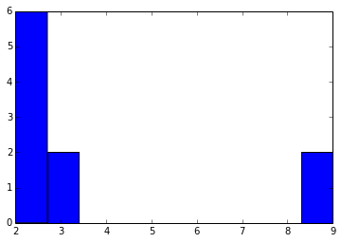
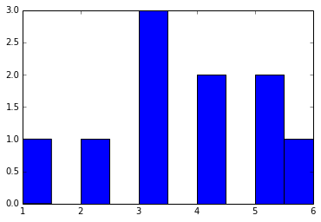
question a) left degree distribution matches left network b) left degree distribution matches right network

Slide 14
Degree distribution
Average degree
tells us where the graph overall has few or many connections in it, but
We want a sense of how a value is distributed over all of the nodes
Are all the nodes more or less the same?
Are some nodes WAY more popular than others?

Slide 15
question
In the Dining network
if a node has high in-degree, it means
a. The individual eats a lot
b. Nothing in particular
c. The individual is desirable as a dinner companion
d. The individual is more senior
e. This can’t happen in this network

Slide 16
question
In the Dining network
if a node has high out-degree, it means
a. The individual eats a lot
b. Nothing in particular
c. The individual is desirable as a dinner companion
d. The individual is more senior
e. This can’t happen in this network

Slide 17
Summing up
Network =
set of nodes +
edges connecting them
plus attributes
Paths
connect nodes
diameter = length of longest shortest paths
Components
chunks of the network
Degree
# of incident edges
degree distribution characterizes network as a whole

