Slide 1
INFO 5871-001: Data Science / Info Science
Robin burke, Fall 2019

Slide 2
Class Organization
Week 1, Part 2

Slide 3
Outline
Class structure
Weekly outline
Assignments
Readings
Tools
Policies

Slide 4
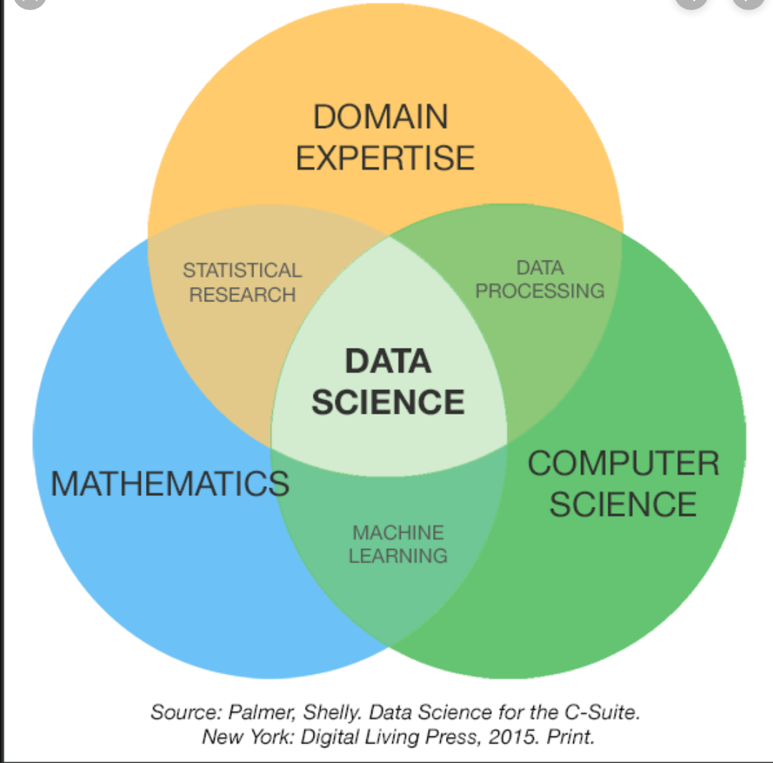
Class structure
Assuming you have / will develop this part of the picture

Slide 5
Class time
1st half+ (5:00 – 6:15)
Mostly math / stats material
Break (6:15 – 6:30)
2nd half- (6:30 – 7:30)
Mostly Python / CS material
Balance between ”halves” may shift week to week

Slide 6
Weekly topics
Week 1 (8/26), Introduction / Python & Jupyter
Week 2 (9/2), No Class
Week 3 (9/9), Probability / Python Data Structures
Week 4 (9/16), Distributions / Pandas Intro Guest Instructor
Week 5 (9/23), Visualization / Matplotlib
Week 6 (9/30), Statistical Inference / Data Preparation
Week 7 (10/7), Midterm Presentations
Week 8 (10/14), Inference For Categorical Data / Data Shaping
Week 9 (10/21), Inference For Numerical Data / Group Operations
Week 10 (10/28), Linear Regression / Time Series Data
Week 11, (11/4), Multiple And Logistic Regression / Sql
Week 12 (11/11), Text Data / Web Scraping And Apis
Week 13 (11/18), Text Modeling / Gensim
Week 14 (11/25), Thanksgiving Break, No Class
Week 15 (12/2), Relational Data / Networkx
Week 16 (12/9), Social Network Analysis / Gephi
Finals Week (12/16), Final Presentations (7:30 Pm)

Slide 7
Assignments
Homework
Due every week
Mostly Python/Jupyter notebook work
Embedded questions to test understanding of math concepts
Projects
Midterm project
Data set as assigned
Results in class on 10/7
Final project
Data set own choice
Results in class on 12/16
Also final report

Slide 8
Grading
Participation: 10%
Includes in-class and Slack contributions
Assignments: 40%
12 homeworks (more or less weekly)
Midterm project: 20%
Presentation
Final project: 30%
Presentation + Report

Slide 9
Questions
What questions do you have about the course organization?

Slide 10
Readings
Diez, Çetinkaya-Rundel, Barr. OpenIntro Statistics (4th ed). OpenIntro.org. 2019.
Free download at openintro.org/os
Grus. Data Science from Scratch: First Principles with Python (2nd ed). O’Reilly. 2019.
Free access through the CU library
McKinney, Python for Data Analysis (2nd ed). 2017.
Free access through the CU library.
But then you knew this already because you did tonight’s reading 👍
Many outside resources you might want to access
KDNuggets is an important mailing list on data science and machine learning topics
Many blogs and sites (informationisbeautiful)

Slide 11
Tools
JupyterLab (more later tonight)
Anaconda distribution
Campus cloud installation
Canvas
Submitting homework
Lecture notes
Other documents
Slack
Course discussion
Let me know if you didn’t get an invite

Slide 12
Policies
Late policy
4 late days over the semester
Can be used on any assignment (not project assignments)
Once you’ve used these four, late assignments not accepted
Without accommodation documentation
Honor code
Assignments are meant to be individual work
General help on programming / math concepts is welcome esp. on Slack
Not specific answers, though
Example
👍 “How do you compute the maximum of a Series? Is it max(x) or x.max()?”
❌ “My answer to Step 6b is max(tuition) but I’m getting an error. Anybody have a different solution?”

Slide 13
activity
Setup: groups of three or four
Activity: Sketch one or two personas for students who might take this class
Persona: “A persona is a user archetype used to help guide decisions about product features, navigation, interactions, and even visual design” (Wikipedia)
Who is this person?
What is their background?
How does the course fit into their academic career?
What specifically do they want to get out of the class?
What might they be concerned about?
Time: 15 min
Reconvene and discuss

