Slide 1
INFO 5871-001: Data Science / Info Science
Robin burke, Fall 2019

Slide 2
Working with Data
Week 1, Part 3
Thanks to Brian Keegan for some materials

Slide 3
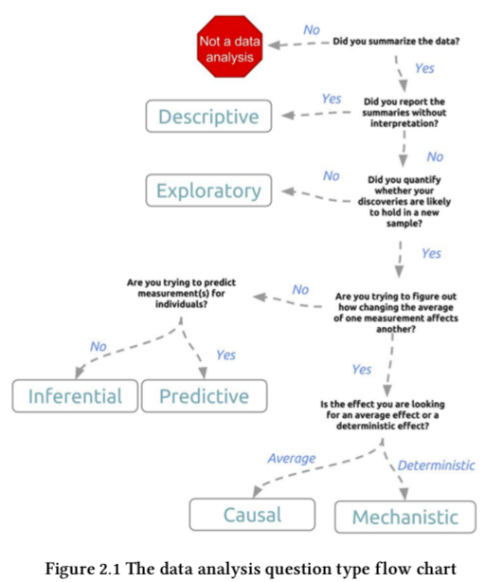
What are we trying to learn?
Different objectives for analyzing data
I can report on the average tuition at US universities
Descriptive – here is a way to describe the data in summary
I can report on the differences between private and public university tuition
Exploratory – I’m interpreting the average in terms of these different types of entities
I can try to predict next year’s tuition rates
Inferential – if this is an aggregate prediction (next year’s average)
Predictive – if I’m trying to predict each university’s rate
I’m trying to determine how consumer-price inflation drives changes in tuition rates
Causal – I’m trying to find a general trend
Mechanistic – I’m trying to derive a mathematical law (scientific theory)
Figure 2.1 from Leek (2015) The Elements of Data Analytic Style

Slide 4
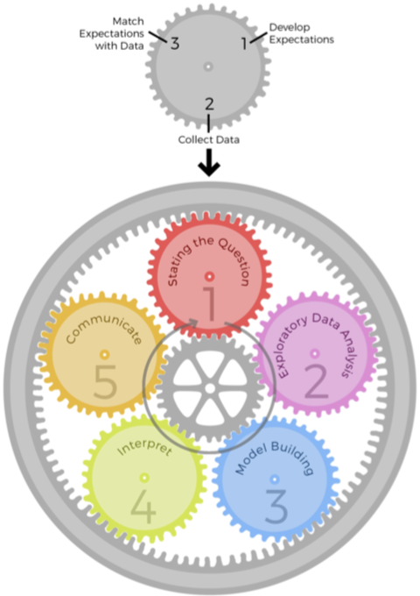
Epicycles of Analysis
Setting expectations
A priori knowledge: what should happen?
Collecting information
Review literature and ask experts about question
Identify and retrieve relevant data
If you have to conduct experiments to get the data
That’s science, not data science
Revising expectations or fixing data to create a match
Compare expectations and data
Update expectations or find alternative data
Although…
From Peng & Matsui (2018). The Art of Data Science.

Slide 5
Epicycles of Analysis
 | Set expectations | Collect information | Revise expectations
Question | Question is of interest to audience | Survey literature and experts | Sharpen question
EDA | Data are appropriate for question | Make exploratory plots of data | Refine question or collect more data
Modeling | Primary model answers question | Fit secondary models, sensitivity analyses | Revise model to include other predictors
Interpretation | Specific and meaningful answer to question | Focus on effect sizes, uncertainty | Revise analysis to provide meaningful answers
Communication | Results are understood and meaningful to audience | Seek feedback | Revise analyses of approach to presentation
From Peng & Matsui (2018). The Art of Data Science.

Slide 6
What are we looking for?
Common data analysis patterns
Differences or patterns across time
Differences or patterns across space/geography
Differences or patterns across categories/contexts
Differences or patterns in relationships

Slide 7
Activity
Setup: same groups as before
Activity: Derive analysis questions
I have a data set of tuition costs at US universities for the year 2016
What questions might I ask?
Time
Space
Categories (other than private/public)
Relationships
Free to make assumptions about what the data set contains
Time: 10 min
Reconvene and discuss

Slide 8
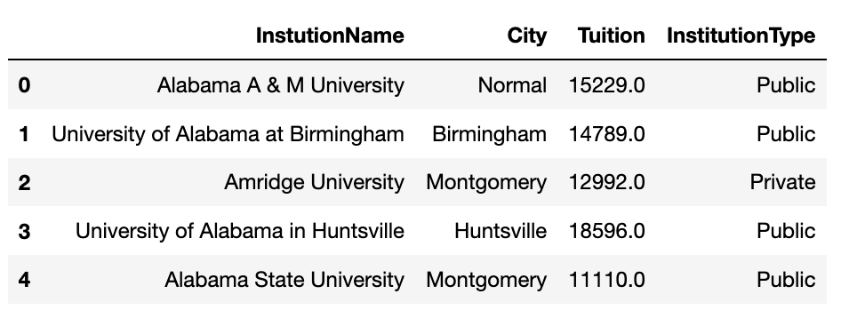
Types of Data sets
Good old-fashioned tabular data
Observations (rows)
Variables (columns)
Each observation has value for each variable
Not the only kind of data
Value might be complex (a long document, an image, etc.)
Value might represent a relationship to other observations (example: a friendship network)

Slide 9
Data Set questions
How to interpret the columns?
Units
How gathered
What categories mean
How to interpret the rows?
Is this a complete set? A sample of possible observations?
Other issues
Does the way the data gathered impact potential analyses?
Are there missing/ambiguous values?
Are appropriate distinctions captured?

Slide 10
Types of Variables: Numerical
Continuous
Variable that can (theoretically) take on any value in a numeric range.
Example: temperature
Typical format: floating point value, 85.3
Discrete
Variable that can take on only a fixed number of values in a numeric range
Example: age in years
Typical format: integer value, 26

Slide 11
Types of Variables: Categorical & COMPLEX
Categorical
Nominal
Variable that is drawn from a set of descriptors
Example: publication type
Typical format: short string value, “book”
Ordinal
Variable that is drawn from an ordered set of descriptors
Example: degree of agreement
Typical format: short string value, “Strongly agree”
Free
A categorical label drawn from an unlimited vocabulary
Example: user-generated hash tag
Typical format: short string value, “#nevertrump”
Complex
Many possibilities: images, text, audio
Think of a electronic medical record

Slide 12
Ordinal as Discrete
We often treat ordinal values as discrete
For example, Likert scale
Strongly disagree
Disagree
Neither agree nor disagree
Agree
Strongly agree
Treat as identical to a discrete scale {1, 2, 3, 4, 5}
BUT
Discrete scales have the guarantee that all elements are equidistant from neighbors
Really true of Likert? Neutral -> Agree same as Agree -> Strongly agree?
How would we know?

Slide 13
Activity
Set up: same groups as before
Activity: Label variable types
Continuous, discrete, nominal, ordinal, free, complex, or ”Need more information”
Come up with a category for each variable / column
Time: 15 min
Reconvene and discuss after break

Slide 14
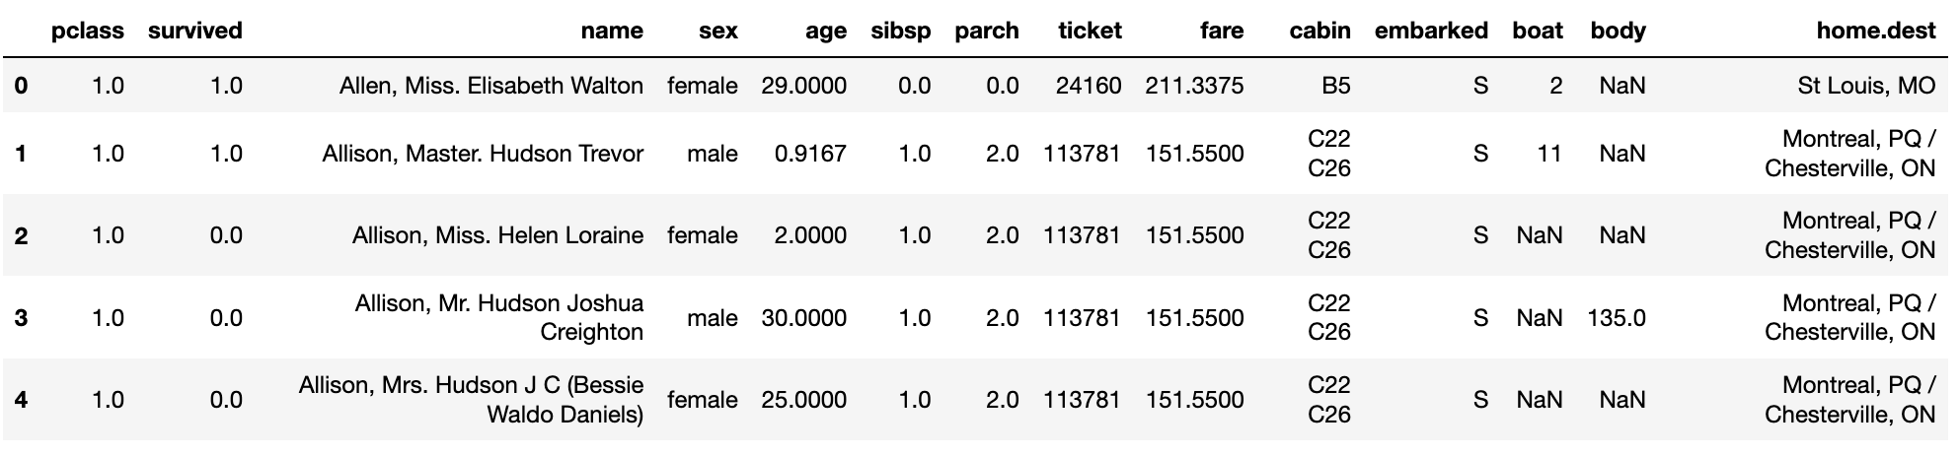
Passenger Class (first, second, third)
Survived
Name
Sex
Age
# of siblings / spouses aboard
# of parents aboard
Ticket number
Fare paid
Cabin
Port of embarkation
Lifeboat
Recovered body number
Home

Slide 15
Break (15 min)

