Slide 1
INFO 5871-001: Data Science / Info Science
Robin burke, Fall 2019

Slide 2
Announcement: Office hours
I'm moving my office hours
Originally 11 – noon on Tuesdays
Moving to 1 – 2 pm on Tuesdays
Always by appointment if this time doesn't work

Slide 3
Outline
Probability
Conditional probability
Continuous distributions
Break
Lab

Slide 4
Probability
Week 3, Part 1

Slide 5
Probability / statistics
Probability
Theory
(Mathematical model)
Data
(Observations)
Statistics

Slide 6
Probability question
What is the probability that it will rain tomorrow?
A number and a reason why
Discuss in groups of 3 or 4
Time: 10 minutes

Slide 7
How do we think about probability?
P(Weather=Rain) = ?
outcome
Probability value
random variable

Slide 8
Understanding the definition
What is the universe of outcomes?
What possible values can "Weather" take on?
How do we precisely define each condition?
What is "Rain" vs "Scattered showers" etc.

Slide 9
What does the value mean?
Frequentist answer: How often the outcome tends to occur
But people state probabilities of unique events all the time (election outcomes, for example)
Bayesian answer: Measure of expectation / belief
What outcomes we think are likely in the circumstances (but purely subjective)
Is anything really random? Or maybe everything is random?
NB: Spinoza, Heisenberg

Slide 10
Distribution
Let X be our random variable ("Weather")
X is drawn from U
The universe of possible outcomes
Assume that U
Is complete (we have a name for everything that can happen)
Has members x that are disjoint (meaning the only one observation is possible at a time)
No "Sunny / Cloudy", must be a distinct outcome "Partly cloudy"
Then we can talk about a distribution
For all x in U, P(X=x) has some value
Usually, just say P(x)

Slide 11
Some Outcomes
Take a coin
Flip five times and record outcomes
"T H H T T" for example

Slide 12
Report (Empirical distribution)
Universe 1: Value of the first throw (H, T)
Universe 2: Number of heads (0, 1, 2, 3, 4, 5)
Universe 3: First and last throws were the same (True, False)
Universe 4: Number of longest consecutive run of heads: (0, 1, 2, 3, 4, 5)
Universe 5: Number of heads greater than or equal to (0, 1, 2, 3, 4, 5)
non-disjoint outcomes

Slide 13
UNIFORM Distribution
In theory, a fair coin has a uniform distribution between heads and tails
A bar chart with equal bars
What about Universe 2 (First and last throws were the same)?

Slide 14
Non-uniform distribution
Number of heads thrown
Is 5 (all heads) likely?
Is 1 as likely as 2?
What should this look like?
Key method = counting possibilities
More later

Slide 15
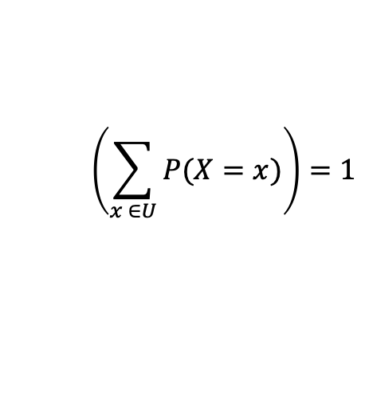
Laws of probability
1 >= P(X=x) >= 0
No negative probabilities
No probabilities above 1
Often we talk about %
For all x in U, there is a complement of x (~x)
Meaning the outcome where x doesn't happen
P(X=~x) = 1 – P(X=x)
Sometimes it is easier to compute P(~x) than P(x)
For all x in U, P(X=x) must add up to 1
Some outcome must happen
$$\left(\sum_{x ∈U}{P(X=x)}\right)=1$$

Slide 16
Expected value
Game: You flip a coin 5 times
Reward: I give you a dollar for every head
How much should you expect to earn?
Add up the value for each outcome X the probability of that outcome
$0 * P(0) + $1 * P(1) + … + $5 * P(5)
Need the probabilities…

Slide 17
Binomial Distribution
Number of successes out of some number of trials
More next week
Points to note
P(0) = P(5) because switching heads and tail shouldn't change our probability
Similarly P(1) = P(4) and P(2) = P(3)
P(0) + P(1) + P(2) + P(3) + P(4) + P(5) = 1, because those are all the possibilities
P(0) and P(5) should be less likely because there fewer ways to make this happen

Slide 18
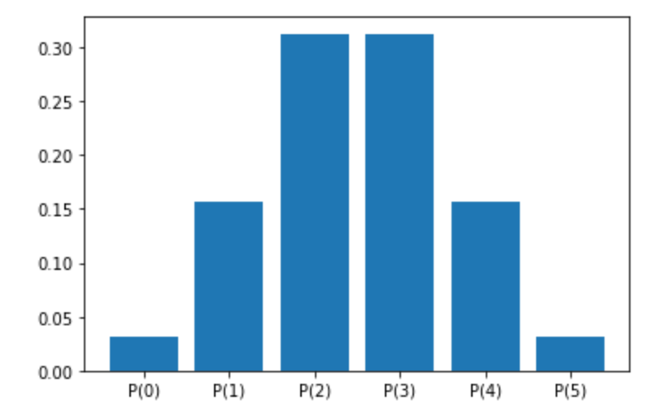
Theoretical Distribution
P(0) = P(5) = 1/32 = 0.031
P(1) = P(4) = 15/96 = 0.16
P(2) = P(3) = 5/16 = 0.31

Slide 19
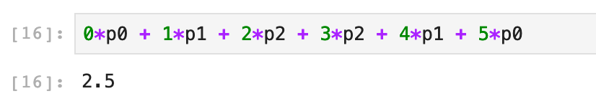
Expected value
E(game) = 2.5
This makes sense because $0/$5 are equally likely
And $1/$4 are equally likely
And $2/$3 are equally likely
So the payoff should be balanced between the outcomes of 0 and 5
If you played this game 1000 times
You would likely earn $2500

