Slide 1
INFO 5871-001: Data Science / Info Science
Robin burke, Fall 2019

Slide 2
CONTINUOUS DISTRIBUTIONS
Week 3, Part 3

Slide 3
DISCRETE DISTRIBUTION
Outcomes are individual events
  it rained
  coin came up heads
  etc.
Each outcome can have a specific probability

Slide 4
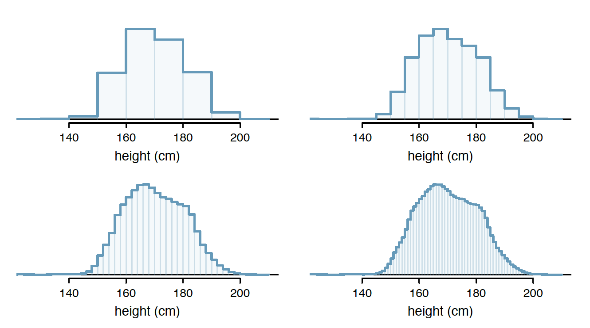
continuous distribution
Quantity of rainfall
Profit in a given year
Patient temperature

Slide 5
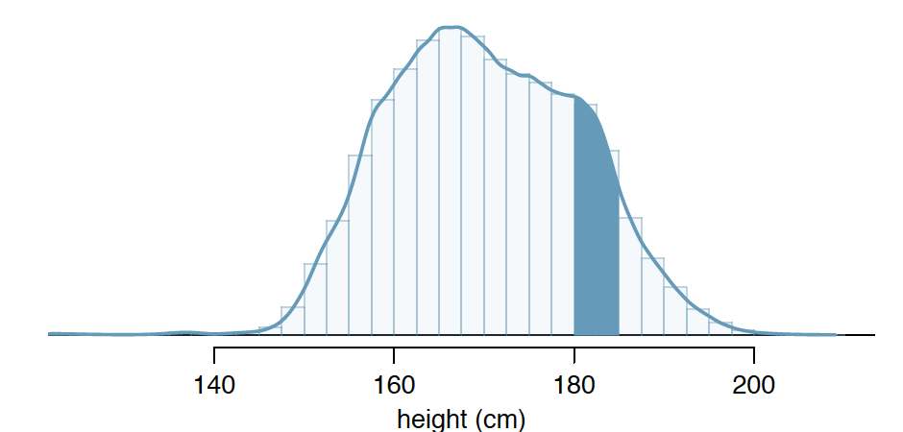
Probability density function
Different kind of PDF – not the Adobe document
Maps from values to probabilities BUT
  probability of any given value is actually mathematically 0
We can only sensibly talk about the probability of a range
  P(0 and 0.5" of rain)
Total area under PDF = 1.0
  otherwise it wouldn't be a probability
Notes:
We are talking about a range instead of a particular point
Define the begin + end point of the range

Slide 6
Continuous random variables
All of the same rules apply
  Independence
  Conditional probability, etc.
  Bayes rule
  Etc.
Distributions work differently
Important to know what kind of variable you have

