Slide 1
INFO 5871-001: Data Science / Info Science
Robin burke, Fall 2019

Slide 2
Who am I?
[TODO Nasim]
[Put something about yourself here!]

Slide 3
Outline
Normal distribution
Binomial distribution
Break
Lab

Slide 4
NORMAL DISTRIBUTION
Week 4, Part 1

Slide 5
statistics TOPIC
Probability
Theory
(Mathematical model)
Data
(Observations)
Statistics
Notes:
Meaning that we are going to be working from data to mathematical descriptions of the distributions of the data. A topic for the rest of the class.

Slide 6
Heights of males
Distribution of heights (empirical)
Distribution of heights (theoretical)
“The male heights on OkCupid very nearly follow the expected normal distribution – except the whole thing is shifted to the right of where it should be. Almost universally guys like to add a couple inches.”
“You can also see a more subtle vanity at work: starting at roughly 5’ 8”, the top of the dotted curve tilts even further rightward. This means that guys as they get closer to six feet round up a bit more than usual, stretching for that coveted psychological benchmark.”
http:// blog.okcupid.com/ index.php/ the-biggest-lies-in-online-dating/
Notes:
Note what is happening in this discussion. We look at an empirical distribution (heights that users supply to OKCupid in their profiles). Then we calculate the theoretical normal distribution that these observations imply and then we compare this with another theoretical curve as derived from the US population as a whole.

Slide 7
comparative parametric methodology
1. Start with two data sets (ex. US population vs OKCupid)
2. Using a particular model (ex. normal distribution) derive the parameters of the model that fit the two data sets
3. Compare the parameters and draw conclusions about the data
Model
Data
Fitting
Parameters

Slide 8
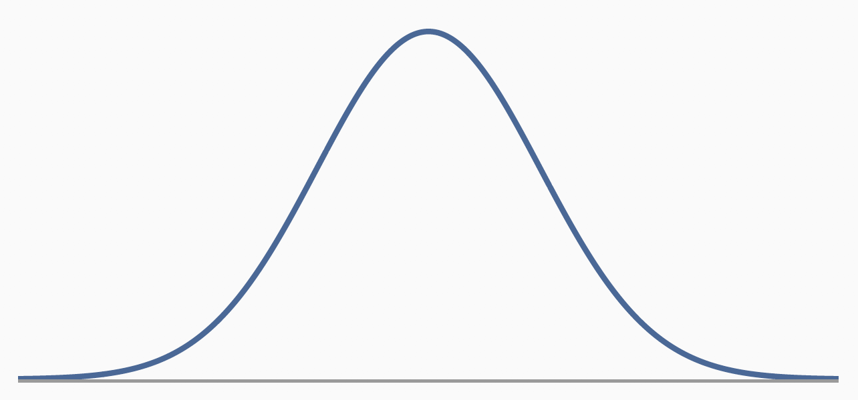
Normal distribution
Unimodel (one hump)
Symmetric (around a central value)
Bell-shaped
Theoretical idea
no observed variable is going to be perfectly normal in its distributionm
N(𝜇, 𝜎) where 𝜇 is the mean and 𝜎 is the standard deviation
𝜇, 𝜎 are the parameters of the distribution

Slide 9

mathematical description
We typically won't have any need to know this
Software keeps track
Why is it so ugly?
Need to sum to 1 under the curve
Need to have symmetric decay from a central point
Need to "spread" based on 𝜎
Need to be centerd on 𝜇: (x- 𝜇)
pdf = $\frac{1}{\sqrt{2πσ^{2}}}e^{−\frac{{(x−μ)}^{2}}{2σ^{2}}}$

Slide 10
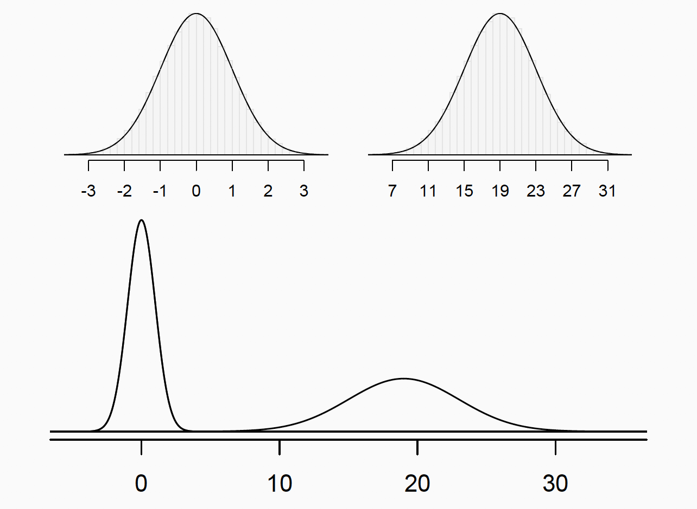
different parameters = different curves
N(𝜇=0, 𝜎=1)
standardized
N(𝜇=19, 𝜎=4)
shifted from 0 (𝜇= 19)
spread out more (𝜎=4)
Notes:
The curves look the same as plotted, but on the same axis, you can see that one is much more "peaked" and one is flatter. The area under both curves is still 1. Must be because otherwise it wouldn't be a probability distribution.

Slide 11
z score
The normal distribution gives us a way to compare points from different distributions
Question: how far are we from the mean?
Express answer in terms of standard deviation (SD) units.

Slide 12
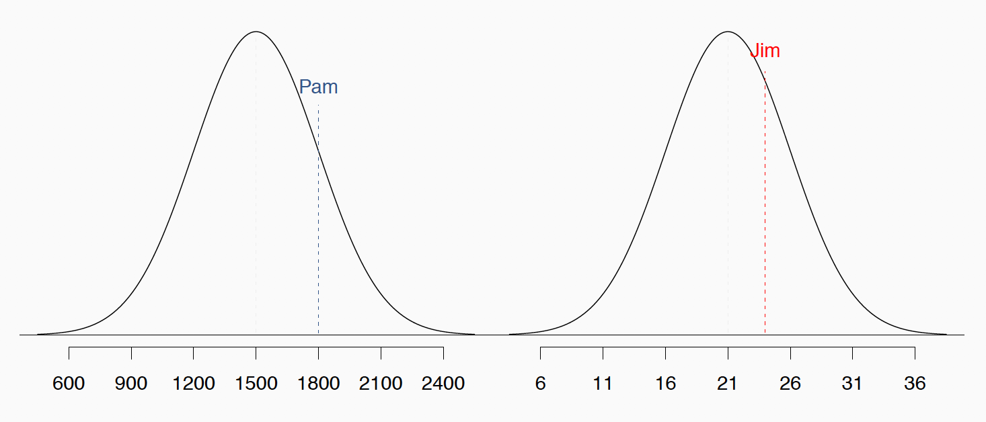
Example: compare test takers
Different test scores have different scales
Standardized tests are questionable – yes!
Did Pam do better relative to other test-takers than Jim did?
Compute with Z-score

Slide 13
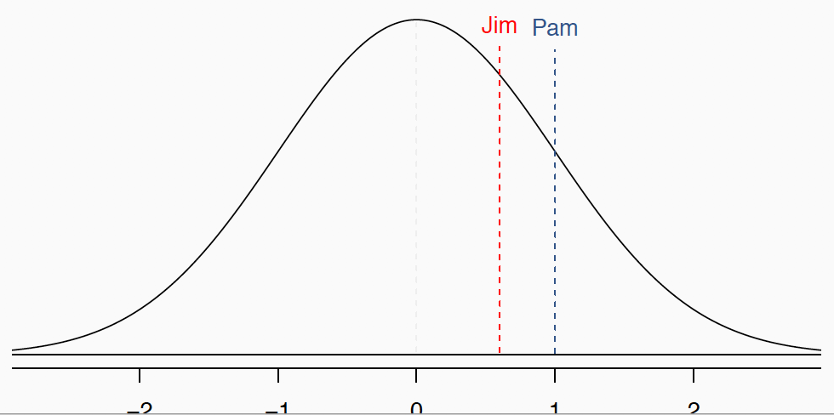
EXAMPLE: Z-SCORE
Pam’s score is (1800-1500) / 300 = 1 standard deviation above the mean.
Jim’s score is (24-21)/5 = 0:6 standard deviations above the mean.
Pam did "better"
on the test relative to the peers taking it

Slide 14
Z-SCORE
Z = (val – mean) / SD
Also called a standardized score
Rule of thumb
observation that is more than 2 SD from mean is unusual / unexpected
later we will quantify this

Slide 15
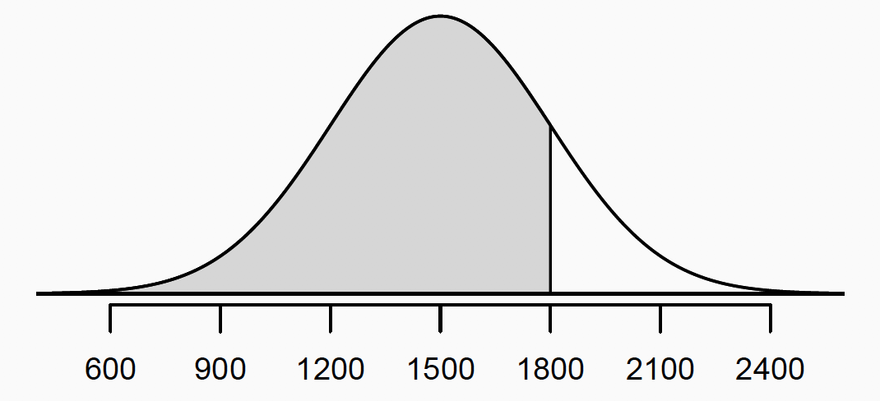
Percentile
This is the proportion of observations that lie below a given data point in the distribution
We can also think of this as the area to the left of the data point

Slide 16
cumulative density function
We can think of this as the probability that an observation will be less than some value
P(X < w) = percentile of w
This is considered a distribution of its own
always goes up (monotonically increasing)
because you can't lose any probability as w increases
Picture
starts at 0, low probability this far to the left
When we get to 0 (mean), the probability is 0.5
which makes sense, probability of being less than the mean = ½
ends at 1 as we get far to the right
probability of the value below this is 100%

Slide 17
In Python
We can create a normally distributed random variable by specified mean and standard deviation.
import scipy.stats as st
rv = st.norm(score_mean, score_std)
Once we have the variable, we can do various computations
CDF
rv.cdf(val)
Tells us the percentile of this value
PPF = percentile point function
inverse of CDF: what value lies at the given percentile
rv.ppf(ptle)

Slide 18
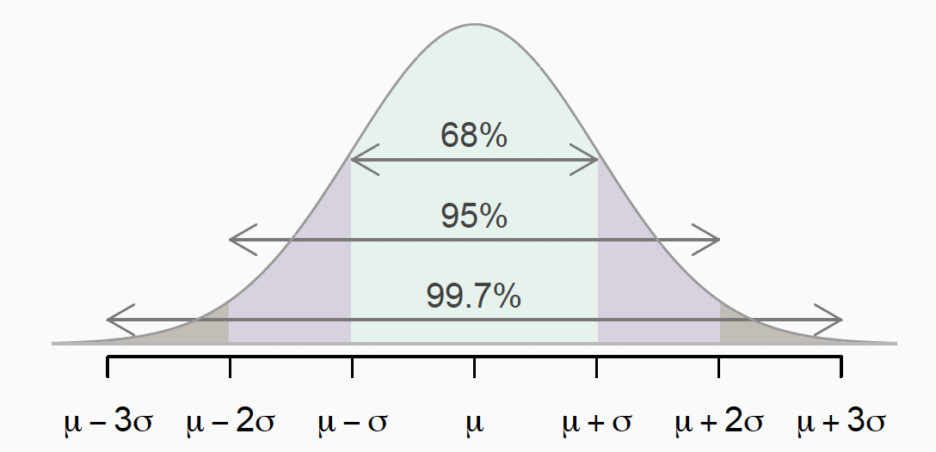
68-95-99.7 Rule
Using Z-scores, we can compute the region around the mean containing most of the observations
68% of observations are within 1 SD of the mean (+/-)
95% of observations are within 2 SD of the mean
99.7% of observations are within 3 SD of the mean

Slide 19
2 SD outlier rule
Why are observations more than 2 SD from the mean considered outliers?
Because they are outside of where 95% of the data lies
They are very unlikely as representatives of the central tendency of the data
This is just a rule of thumb
Certainly you will want to investigate such points to try to understand them better
Often you will find typos, coding errors, etc.
Other times these are legitimate data points, but they suggest that your model is not correct
Maybe there are really multiple populations or multiple effects at work

Slide 20
Is my data normal?
Probably not
But is it close enough that you can use this as an approximation?
The normal probability plot is a test for normality
Question that it asks:
How does the quantiles of the data compare to what the theory would predict?
Places special emphasis on the "tails" of the distribution: left (lower values) and right (higher values)
Heavy-tailed = more values here than normally distributed data would have
Light-tailed = fewer values that normally distributed data would have
Red diagonal is the theoretical distribution

Slide 21
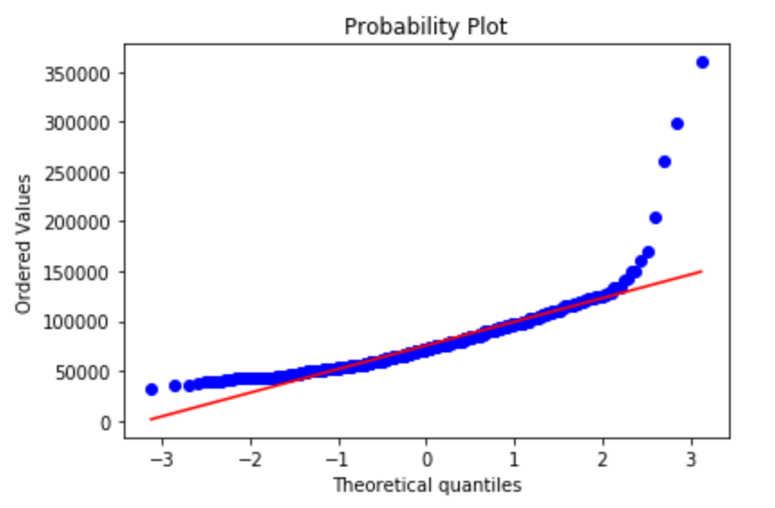
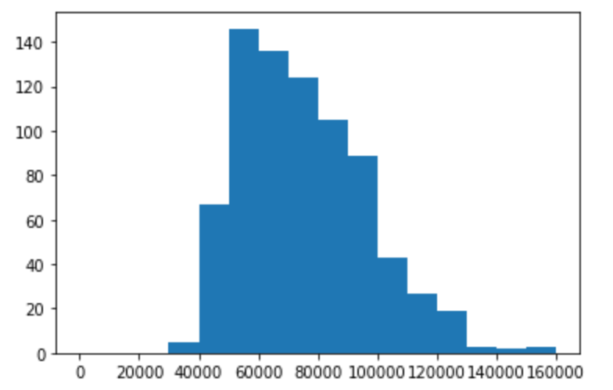
Example: (from exercise)
Too many high values
Peaks too early
Not enough low values

Slide 22
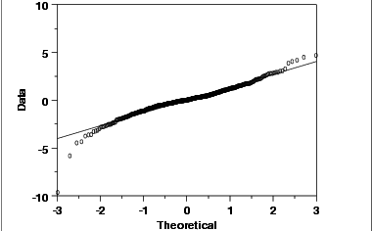
Exercise
What can we say about this distribution?
Left tail?
Right tail?

