Slide 1
INFO 5871-001: Data Science / Info Science
Robin burke, Fall 2019

Slide 2
binomial DISTRIBUTION
Week 4, Part 2

Slide 3
Bernoulli random variable
A Bernoulli random variable
two outcomes: Success / Failure
Some fixed probability p of success
Coin flip
p = 0.5
Bet "red" on a double-zero roulette wheel
p = 18/38 = 0.474
Many other random distributions are built on top of Bernoulli RVs

Slide 4
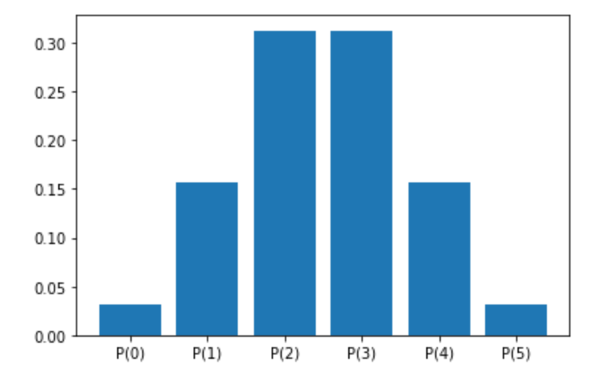
Binomial distribution
How many successes in k independent trials?
This is a distribution with k+1 outcomes
We looked at the number of heads in 5 coin flips in week 3
Certain properties
symmetrical
uni-modal
Independence is important
trial i not influenced by the outcome of trial i-1
also called a "memory-free" process

Slide 5
computing the distribution
Each outcome (0-k) successes has some number of "ways" of happening
particular sequence of outcomes
0 successes = only 1 way
k successes = only 1 way
1 success
HTTTT / THTTT / TTHTT / TTTHT / TTTH = 5 ways
Each sequence has probability 0.5 * 0.5 * 0.5 * 0.5 * 0.5 = (1/2)⁵=1/32
1 success = 5/32
more generally p^{k}(1-p)^{n-k}
because we have to have k positive results and therefore n-k negative ones
Counting up sequences is slow and error-prone

Slide 6
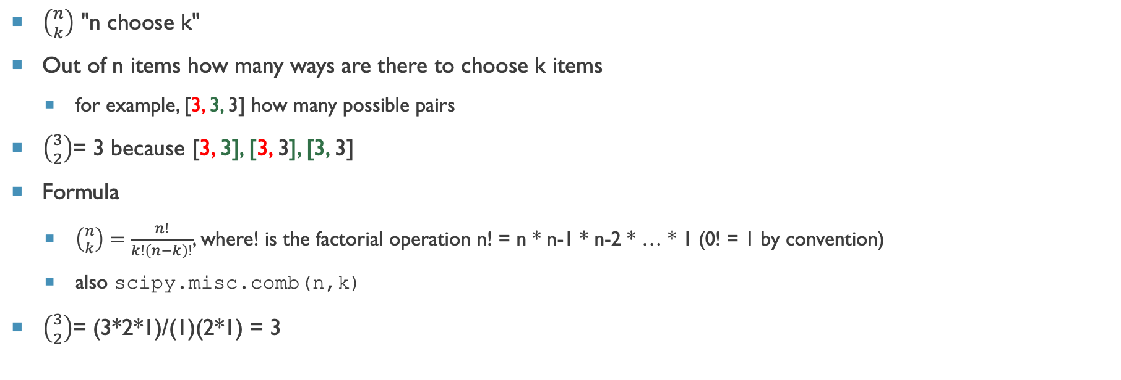
Choose function
$\left({n \atop k}\right)$ "n choose k"
Out of n items how many ways are there to choose k items
for example, [3, 3, 3] how many possible pairs
$\left({3 \atop 2}\right)$= 3 because [3, 3], [3, 3], [3, 3]
Formula
$\left({n \atop k}\right)=\frac{n!}{k!\left(n−k\right)!}$, where! is the factorial operation n! = n * n-1 * n-2 * … * 1 (0! = 1 by convention)
also scipy.misc.comb(n,k)
$\left({3 \atop 2}\right)$= (3*2*1)/(1)(2*1) = 3

Slide 7
Exercise
How many pairs in n items?
giving you k = 2
Notes:
n * n-1 * … * 1 / (2) (n-2)! = n*(n-1)/2 because the rest cancels out

Slide 8
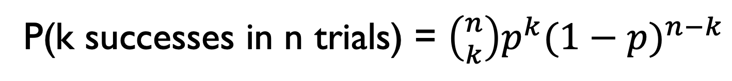
binomial distribution
P(k successes in n trials) = $\left({n \atop k}\right)p^{k}{(1−p)}^{n−k}$
# of ways to get k successes
probability of k successes
probability of n-k failures

Slide 9
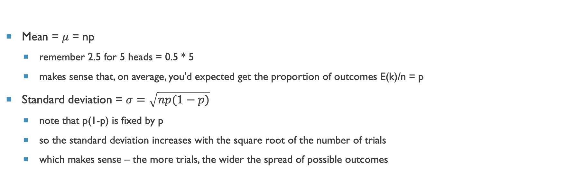
Binomial Distribution properties
Mean = 𝜇 = np
remember 2.5 for 5 heads = 0.5 * 5
makes sense that, on average, you'd expected get the proportion of outcomes E(k)/n = p
Standard deviation = $σ=\sqrt{np(1−p)}$
note that p(1-p) is fixed by p
so the standard deviation increases with the square root of the number of trials
which makes sense – the more trials, the wider the spread of possible outcomes

Slide 10
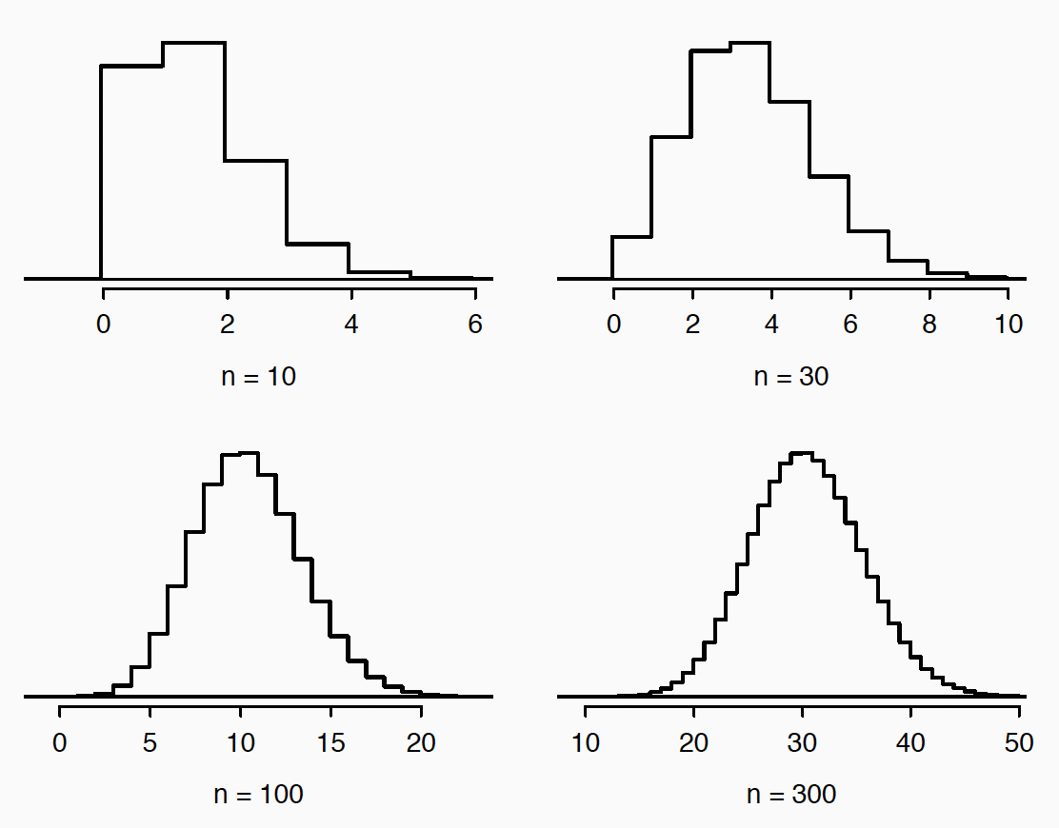
Distribution with increasing n
p = 0.10
n increases from 10 to 300

Slide 11
Normal approximation
When n is "large enough", you can approximate it with the normal distribution
using the mean and std from previous slide
"Large enough" rule of thumb
np >= 10, n(1-p) >= 10

Slide 12
Poisson distribution

Slide 13
Poisson
Not the "poison" distribution
Discrete distribution
like binomial
This is also about counting
about the occurrence of events
How many customers arrive in a business during an hour?
might be zero
might be 50 is a busy period
Counts have special properties
0 minimum
can't have negative counts
But 0 is often a frequent value

Slide 14
conditions
k = number of times the event occurs
events are independent
the average rate is constant over time
binomial distribution could apply
BUT events are fairly rare n>>k

Slide 15
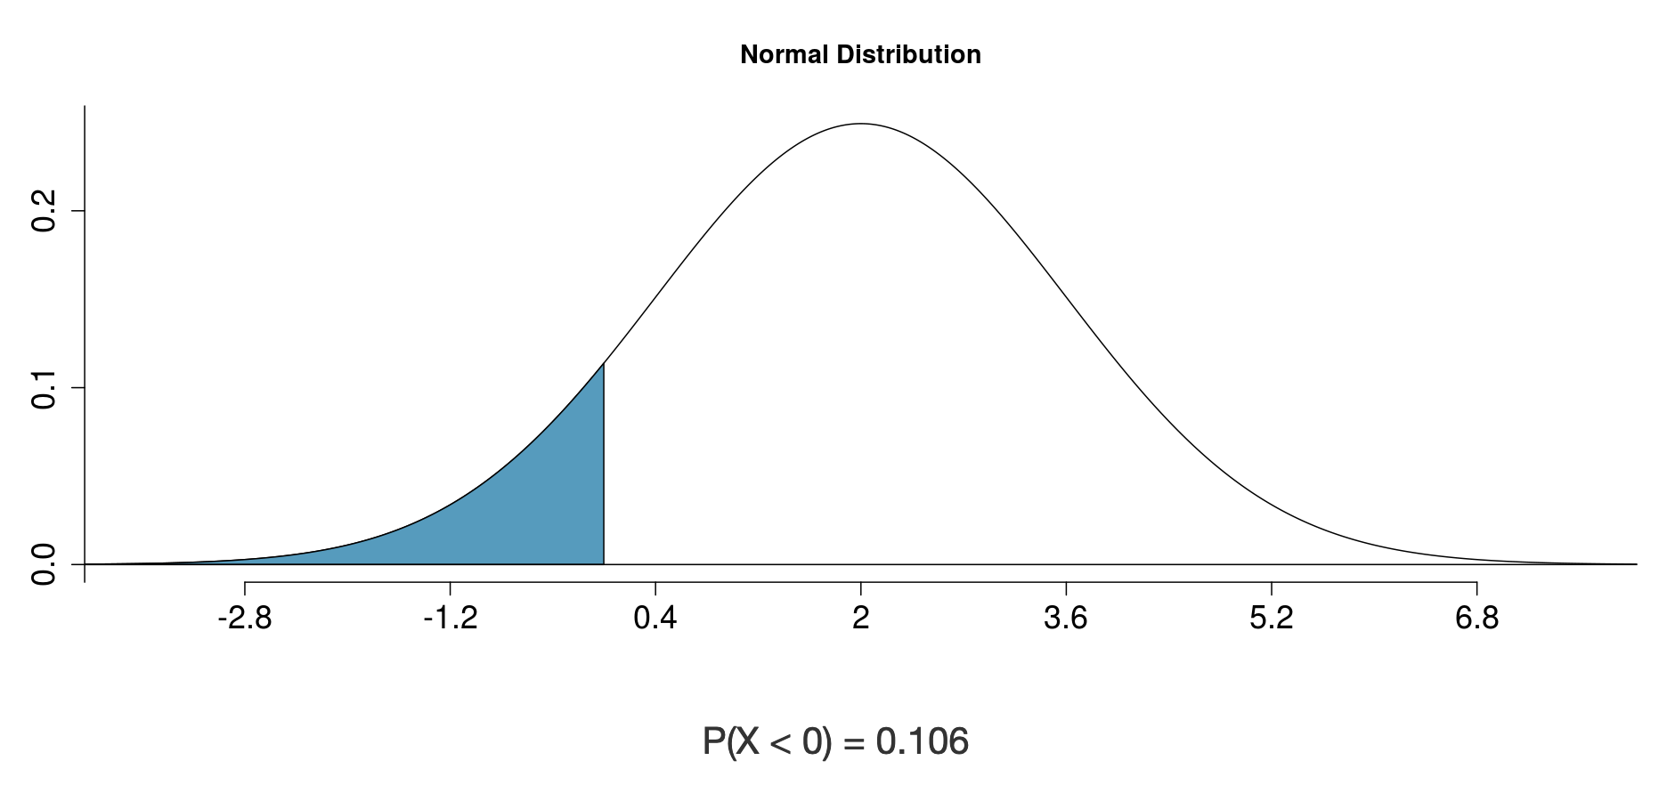
Example
Goals in a World Cup soccer match
P(k goals)
Average = 2.5
0 goals fairly common
SD = 1.58
Normal distribution doesn't make sense
10% of games have a negative score
We can't just cut off at zero!
then area doesn't add up to 1
Binomial distribution could apply
but it is hard to say how many "trials" in a game

Slide 16
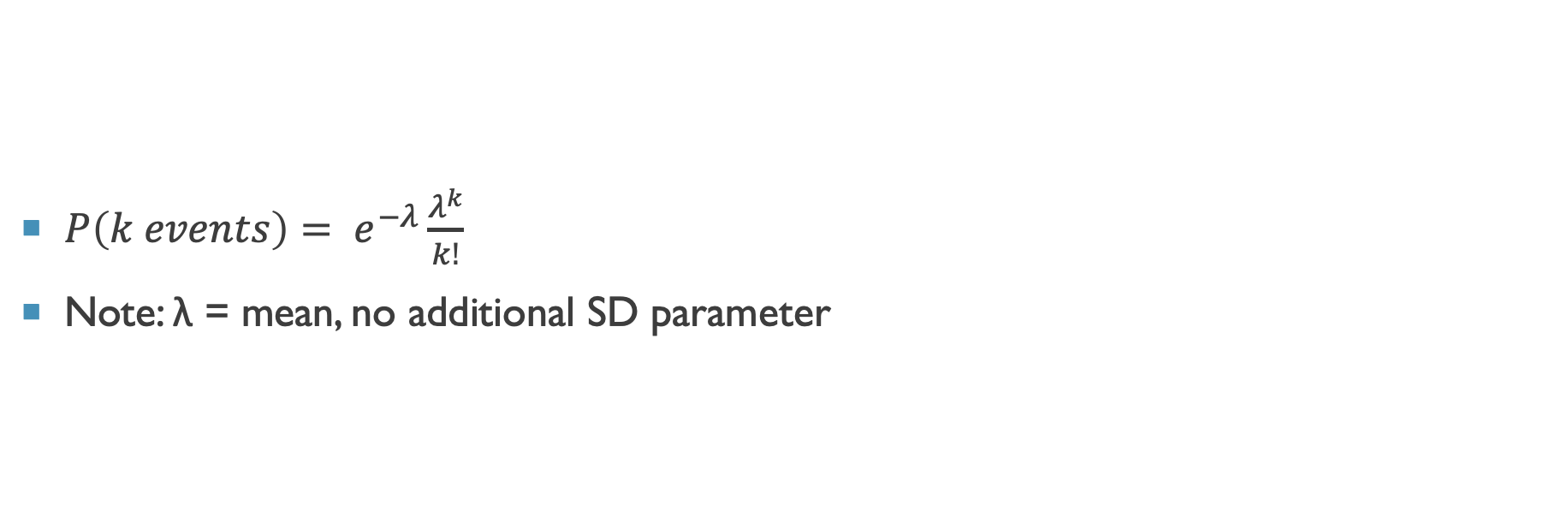
POISSON PDF
$P\left(k events\right)= e^{−λ}\frac{λ^{k}}{k!}$
Note: λ = mean, no additional SD parameter

Slide 17
In Python
Create random variable
import scipy.stats as st
rv = st.poisson(mean)
Then you can access various aspects of the distribution as before

