Slide 1
INFO 5871-001: Data Science / Info Science
Robin burke, Fall 2019

Slide 2
Sampling and point estimates
Some parts based on material by Mine Çetinkaya-Rundel of OpenIntro
under the CC BY-SA license
Week 6, Part 2

Slide 3
CNN Poll: Democrats knotted in Nevada while Biden leads South Carolina
Biden tops Warren by 21 points in South Carolina -- 37% of likely voters back the former vice president, 16% Warren and 11% Sanders. In Nevada, there is no clear leader, with Biden and Sanders tied at 22% of likely caucusgoers with 18% for Warren, all within the poll's margin of sampling error. In neither state does any other candidate reach double-digits.
...
The CNN polls in Nevada and South Carolina were conducted by telephone among random samples of adults in each state. In Nevada, results among the 1,203 adults have a margin of sampling error of plus or minus 3.6 percentage points, it is 7.1 points for results among the 324 likely Democratic caucusgoers. In South Carolina, results among 1,200 adults carry an error margin of 3.4 percentage points, while those among the 406 likely Democratic primary voters have an error margin of 5.9 points.
CNN 9/29/2019

Slide 4
three key points
Sampling
They didn't interview every voter in South Carolina
How could that even be possible?
Result
Is a "point estimate": 37% of voters back Biden in SC
We are intended to see this as representative of what all voters think
Error
In SC, 3.4% margin of error

Slide 5
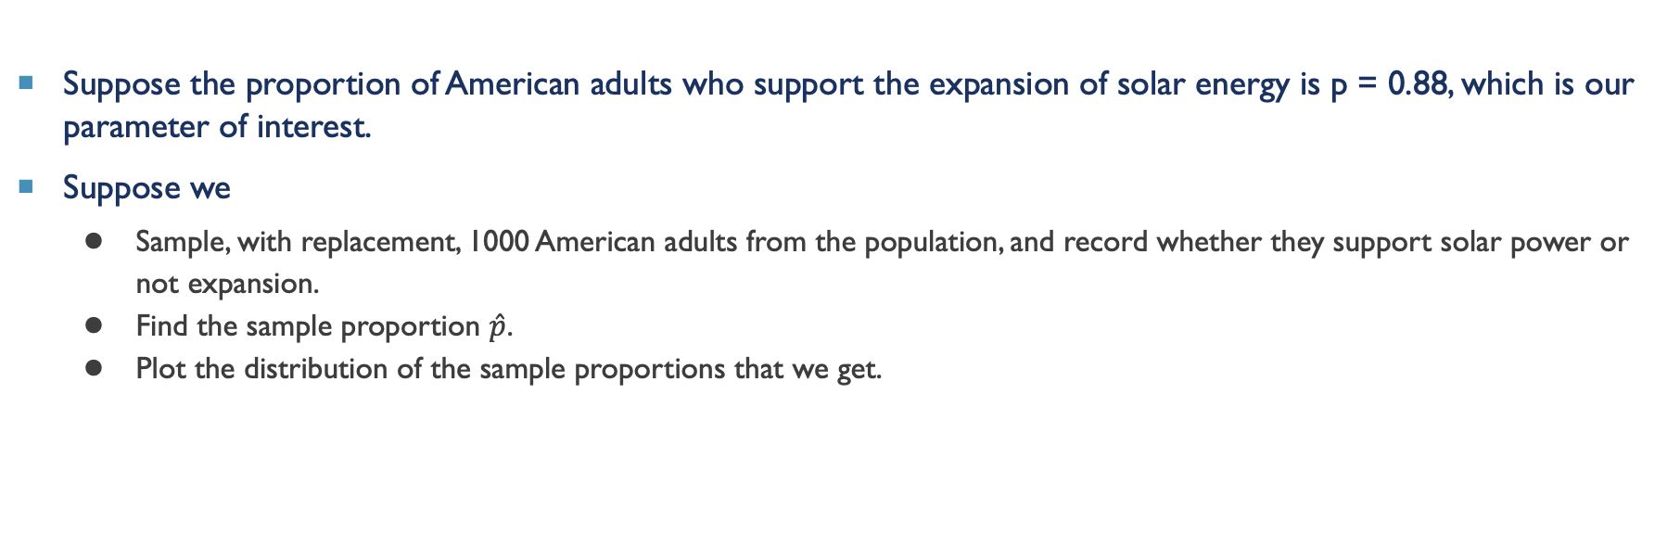
another example
Suppose the proportion of American adults who support the expansion of solar energy is p = 0.88, which is our parameter of interest.
Suppose we
Sample, with replacement, 1000 American adults from the population, and record whether they support solar power or not expansion.
Find the sample proportion $\hat{p}$.
Plot the distribution of the sample proportions that we get.

Slide 6
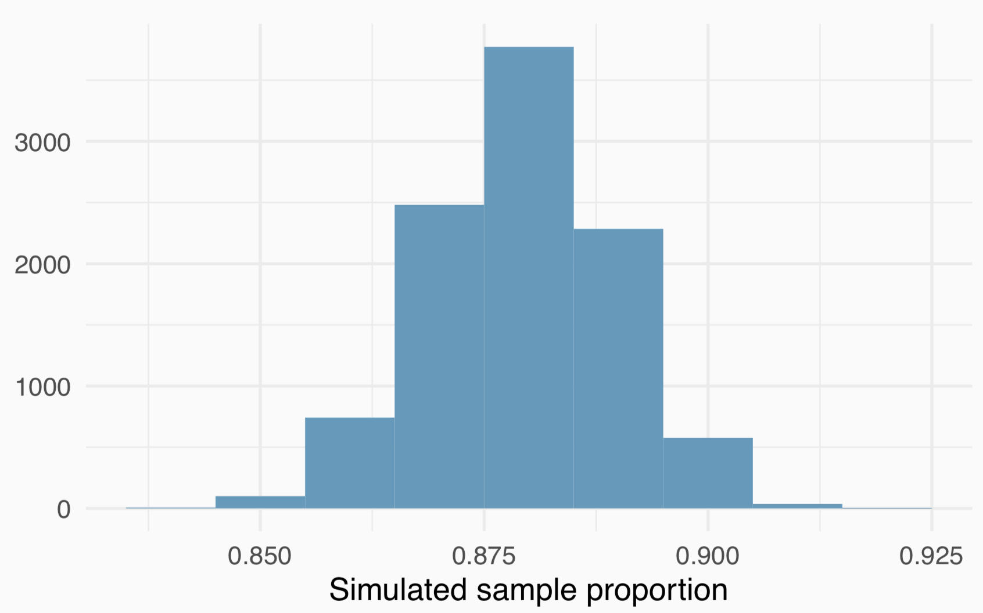
Sampling distribution

Slide 7
Sampling distribution
What can we say about this distribution?
Centered around 88%
Symmetric, bell-shaped
Looks like a normal distribution

Slide 8
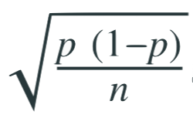
Central limit theorem
Sample proportions will be nearly normally distributed with mean equal to the population proportion, p, and standard error equal to
The error is inversely related to sqrt(1/n). The more samples, the less error in our estimate
It doesn't matter what the proportion is
we can get an estimate of the mean by sampling individuals
and we can make the estimate as accurate as we want by sampling more
and once we have the estimate we know how much error there is in our result

Slide 9
central limit theorem - conditions
Independence
Sampled observations must be independent. This is difficult to verify, but is more likely if
random sampling/assignment is used, and
if sampling without replacement, n < 10% of the population
Suppose we only sampled people who live in big cities in South Carolina?
Would we still be confident about the result?
Sample size
There should be at least 10 expected successes and 10 expected failures in the observed sample.
This is difficult to verify if you don’t know the population proportion (or can’t assume a value for it). In those cases we look for the number of observed successes and failures to be at least 10.

Slide 10
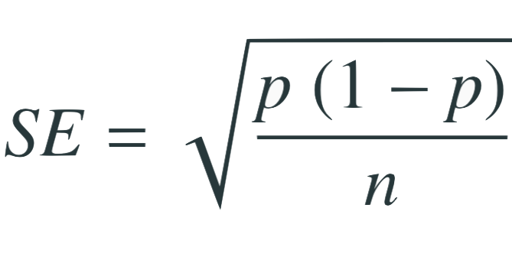
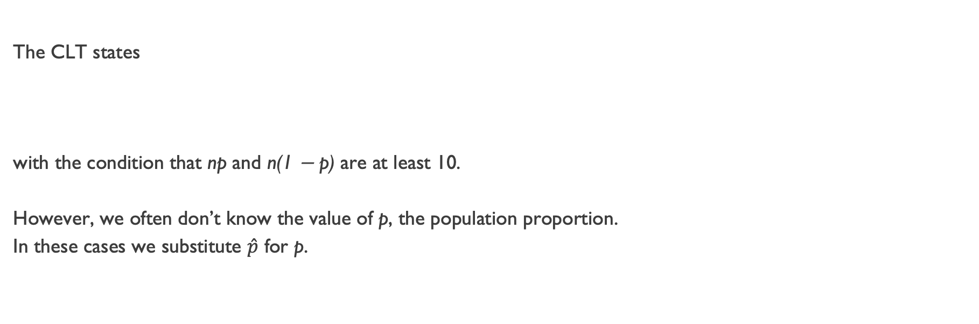
when 𝘱 is unknown
The CLT states
with the condition that np and n(1 − p) are at least 10.
However, we often don’t know the value of p, the population proportion.
In these cases we substitute $\hat{p}$ for p.
The sample proportion
(our estimate)

Slide 11
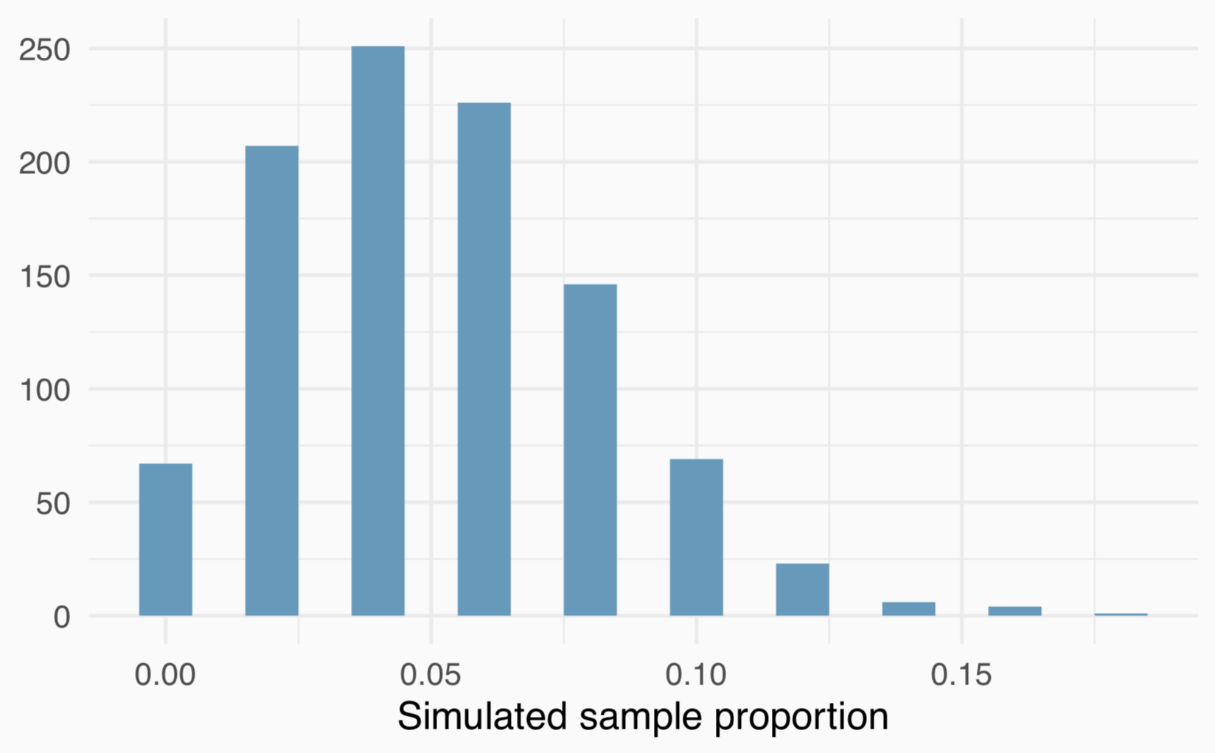
Small numbers don't work
Suppose the true population proportion is p = 0.05,
Samples of size n = 50 from this population.
Would you expect this distribution to be nearly normal? Why, or why not?
Success-failure condition is not met (50 x 0.05 = 2.5),
the sampling distribution may not be nearly normal.

Slide 12
Small numbers don't work
Suppose the true population proportion is p = 0.05,
Samples of size n = 50 from this population.
Would you expect this distribution to be nearly normal? Why, or why not?
Why isn't this normal?
Success-failure condition is not met (50 x 0.05 = 2.5),
the sampling distribution may not be nearly normal.

