Slide 1
INFO 5871-001: Data Science / Info Science
Robin burke, Fall 2019

Slide 2
CONFIDENCE interval
Some parts based on material by Mine Çetinkaya-Rundel of OpenIntro
under the CC BY-SA license
Week 6, Part 3

Slide 3
CNN Poll: Democrats knotted in Nevada while Biden leads South Carolina
Biden tops Warren by 21 points in South Carolina -- 37% of likely voters back the former vice president, 16% Warren and 11% Sanders. In Nevada, there is no clear leader, with Biden and Sanders tied at 22% of likely caucusgoers with 18% for Warren, all within the poll's margin of sampling error. In neither state does any other candidate reach double-digits.
South Carolina: 1,200 voters
Nevada: 1,203 voters

Slide 4
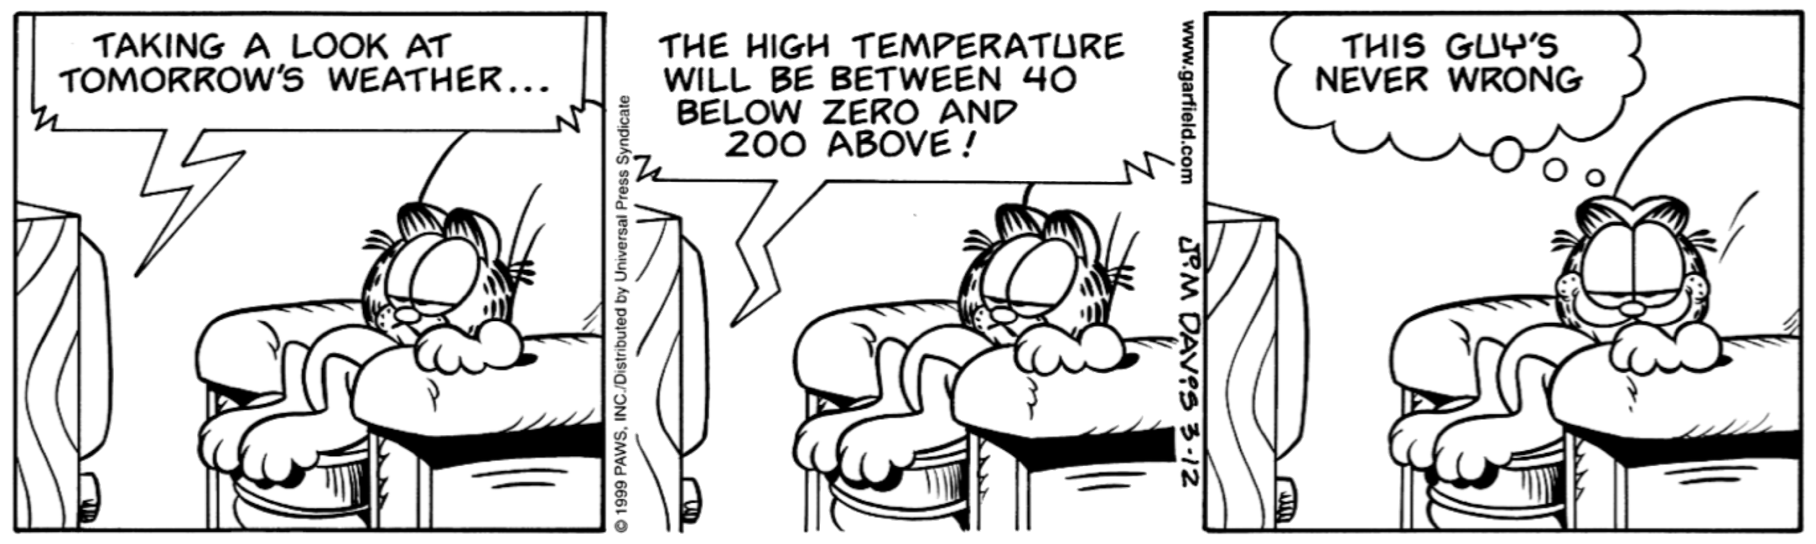
Confidence interval
Large interval says "I'm fairly ignorant about the true value"
Small interval says "I have gathered enough data to be pretty sure that the value is correct."

Slide 5
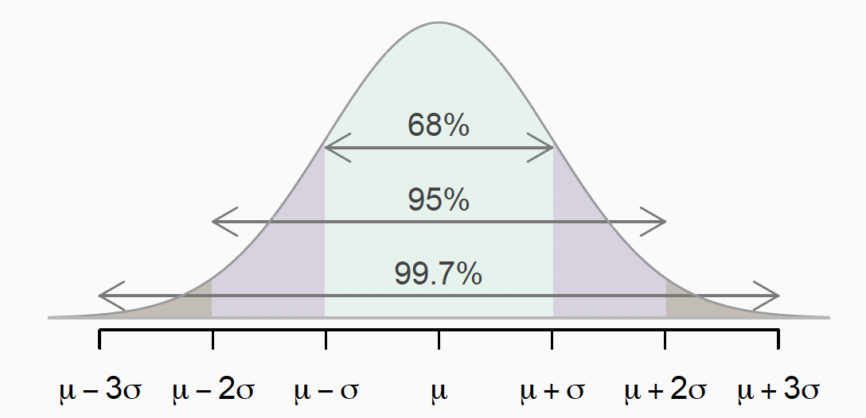
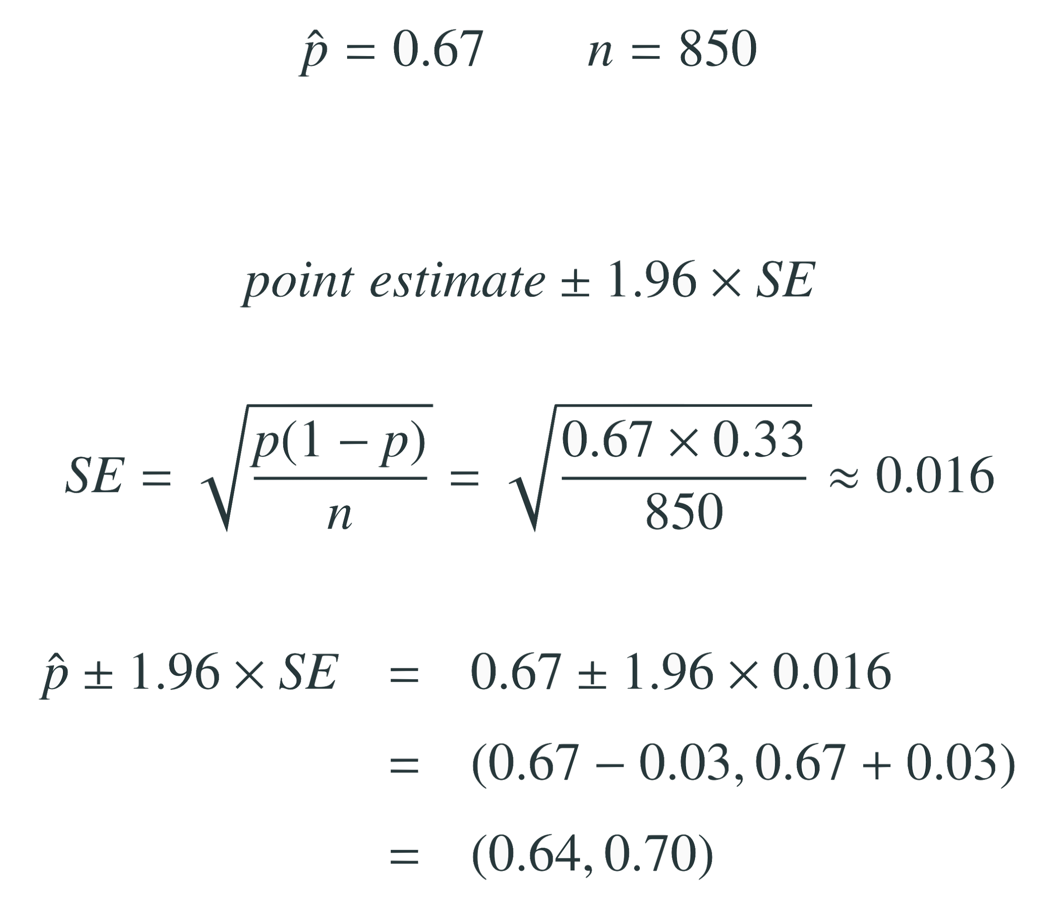
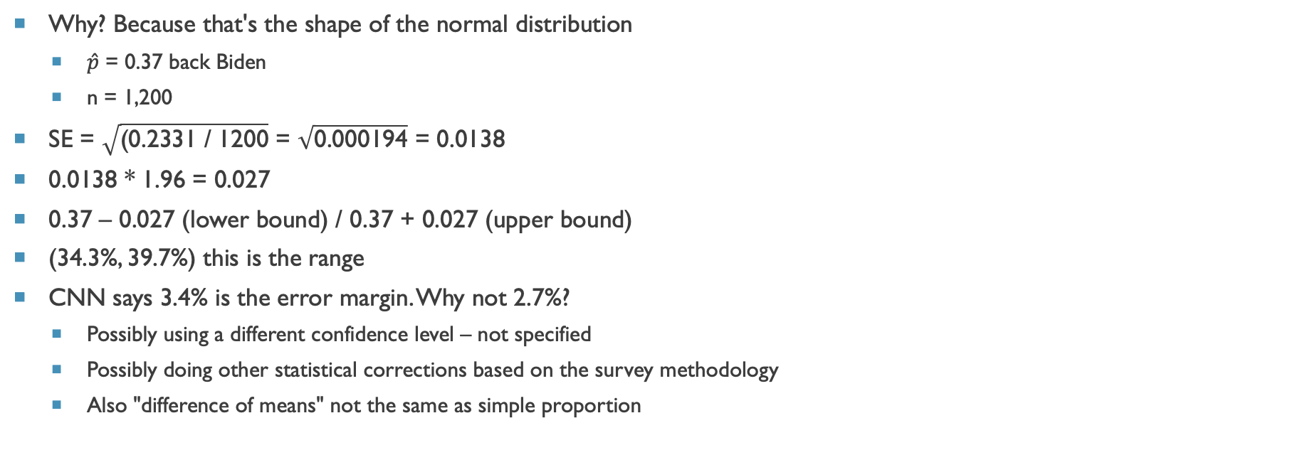
95% confidence = 1.96 * standard error +/-
Why? Because that's the shape of the normal distribution
$\hat{p}$ = 0.37 back Biden
n = 1,200
SE = $\sqrt{\text{(}\text{0}\text{.2331 / 1200}}$ = $\sqrt{\text{0.000194}}$ = 0.0138
0.0138 * 1.96 = 0.027
0.37 – 0.027 (lower bound) / 0.37 + 0.027 (upper bound)
(34.3%, 39.7%) this is the range
CNN says 3.4% is the error margin. Why not 2.7%?
Possibly using a different confidence level – not specified
Possibly doing other statistical corrections based on the survey methodology
Also "difference of means" not the same as simple proportion

Slide 6
Interpretation
Which of the following is the correct interpretation of this confidence interval? We are 95% confident that...
34.3% to 39.7% of South Carolina voters in this sample would choose Biden.
34.3% to 39.7% of all South Carolina voters would choose Biden
there is a 34.3% to 39.7% chance that a randomly chosen South Carolina voter would choose Biden.
there is a 34.3% to 39.7% chance that 95% of South Carolina voters would choose Biden.

Slide 7
Key point
Suppose we took many samples and built a confidence interval from each sample using the equation
point estimate ± 1.96 × SE
Then about 95% of those intervals would contain the true population proportion (p).
5% would not

Slide 8
levels of confidence
We can pick any level of confidence
95% corresponds to z* = 1.96
98% corresponds to z* = 2.33

Slide 9
Confidence intervals
always about the population
are not probability statements
only about population parameters, not individual observations
only reliable if the sample statistic they’re based on is an unbiased estimator of the population parameter
true for the mean

