Slide 1
INFO 5871-001: Data Science / Info Science
Robin burke, Fall 2019

Slide 2
hypothesis testing
Some parts based on material by Mine Çetinkaya-Rundel of OpenIntro
under the CC BY-SA license
Week 6, Part 4

Slide 3
Hypothesis
Joe Biden is ahead of Elizabeth Warren in public opinion in South Carolina
Biden 37%, Warren 16%
Could this difference have arisen by chance?
If we took another sample, maybe it would be
Biden 28%, Warren 30%
Statistical hypothesis testing for questions like this
How sure are we that the effect we see (Biden > Warren) is "real"
Rather than an artifact of a particular sample
Notes:
Quantify our confidence

Slide 4
Another example
I sample 1,000 tweets about UK politics
I sort them into pro-Brexit, anti-Brexit and neither categories
10% of the pro-Brexit tweets have the combination of negative sentiment and words referring to immigrants
Only in 1% of the anti-Brexit tweets
Can I conclude that pro-Brexit posters have a more negative view of immigrant than anti-Brexit users?
Maybe if I took another 1,000 tweets the numbers would be 5%/5%

Slide 5
Starting point: Null Hypothesis
The null hypothesis is the claim that there is no effect
Biden? Warren? No difference
Brexit / immigrant-bashing. Not connected
Indicated H₀
The claim we are making is H_{A}
We are trying to determine if there is enough evidence to reject the null hypothesis in favor of H_{A}
And we want to know how confident we can be that this is the right decision
Notes:
H0: no difference -> reject
Ha: some difference

Slide 6
Decision errors
Hypothesis tests are not flawless.
In the court system innocent people are sometimes wrongly convicted, and the guilty sometimes walk free.
Similarly, we can make a wrong decision in statistical hypothesis tests as well.
The difference is that we have the tools necessary to quantify how often we make errors in statistics.

Slide 7
Decision errors (cont.)
There are two competing hypotheses: the null and the alternative. In a hypothesis test, we make a decision about which might be true, but our choice might be incorrect.

Slide 8
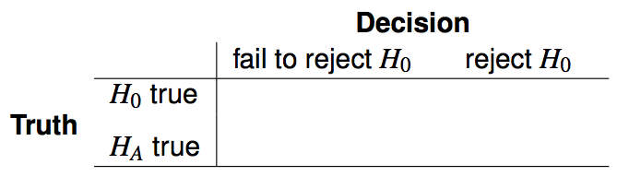
Decision errors (cont.)
There are two competing hypotheses: the null and the alternative. In a hypothesis test, we make a decision about which might be true, but our choice might be incorrect.

Slide 9
Decision errors (cont.)
There are two competing hypotheses: the null and the alternative. In a hypothesis test, we make a decision about which might be true, but our choice might be incorrect.

Slide 10
Decision errors (cont.)
There are two competing hypotheses: the null and the alternative. In a hypothesis test, we make a decision about which might be true, but our choice might be incorrect.

Slide 11

Decision errors (cont.)
There are two competing hypotheses: the null and the alternative. In a hypothesis test, we make a decision about which might be true, but our choice might be incorrect.
A Type 1 Error is rejecting the null hypothesis when H₀ is true.

Slide 12

Decision errors (cont.)
There are two competing hypotheses: the null and the alternative. In a hypothesis test, we make a decision about which might be true, but our choice might be incorrect.
A Type 1 Error is rejecting the null hypothesis when H₀ is true.
A Type 2 Error is failing to reject the null hypothesis when H_{A} is true.

Slide 13
Hypothesis Test as a trial
If we again think of a hypothesis test as a criminal trial then it makes sense to frame the verdict in terms of the null and alternative hypotheses:
H₀: Defendant is innocent
H_{A}: Defendant is guilty
Which type of error is being committed in the following circumstances?
Declaring the defendant innocent when they are actually guilty
Declaring the defendant guilty when they are actually innocent

Slide 14
How do we think about this in the US legal system?
“better that ten guilty persons escape than that one innocent suffer” - William Blackstone
Type 2 errors are better than Type 1 errors
Value individual liberty

Slide 15
Type 1 error rate
As a general rule we reject H₀ when the p-value is less than 0.05, i.e. we use a significance level of 0.05, α = 0.05.
This means that, for those cases where H₀ is actually true, we do not want to incorrectly reject it more than 5% of those times.
In other words, when using a 5% significance level there is about 5% chance of making a Type 1 error if the null hypothesis is true. P(Type 1 error | H₀ true) = α
This is why we prefer small values of α -- increasing α increases the Type 1 error rate.

Slide 16
Facebook interest categories
A survey asked 850 respondents how comfortable they are with Facebook creating a list of categories for them instead of identifying their own interests. 41% of the respondents said they are comfortable. Do these data provide convincing evidence that the proportion of American Facebook users are comfortable with Facebook creating a list of interest categories for them is different than 50%?
https://www.pewinternet.org/2019/01/16/facebook-algorithms-and-personal-data/

Slide 17
Facebook interest categories
A survey asked 850 respondents how comfortable they are with Facebook creating a list of categories for them instead of identifying their own interests. 41% of the respondents said they are comfortable. Do these data provide convincing evidence that the proportion of American Facebook users are comfortable with Facebook creating a list of interest categories for them is different than 50%?
Setting the hypotheses The parameter of interest is the proportion of all American Facebook users who are comfortable with Facebook creating categories of interests for them.
There may be two explanations why our sample proportion is lower than 0.50 (minority).
The true population proportion is different than 0.50.
The true population mean is 0.50, and the difference between the true population proportion and the sample proportion is simply due to natural sampling variability.

Slide 18
Facebook interest categories
A survey asked 850 respondents how comfortable they are with Facebook creating a list of categories for them instead of identifying their own interests. 41% of the respondents said they are comfortable. Do these data provide convincing evidence that the proportion of American Facebook users are comfortable with Facebook creating a list of interest categories for them is different than 50%?
https://www.pewinternet.org/2019/01/16/facebook-algorithms-and-personal-data/
Setting the hypotheses We start with the assumption that 50% of American Facebook users are comfortable with Facebook creating categories of interests for them
H₀: p = 0.50
We test the claim that the proportion of American Facebook users who are comfortable with Facebook creating categories of interests for them is different than 50%.
H_{A}: p ≠ 0.50

Slide 19
Facebook interest categories - conditions
Which of the following is not a condition that needs to be met to proceed with this hypothesis test?
Respondents in the sample should be independent of each other with respect to whether or not they feel comfortable with their interests being categorized by Facebook.
Sampling should have been done randomly.
The sample size should be less than 10% of the population of all American Facebook users.
There should be at least 30 respondents in the sample.
There should be at least 10 expected successes and 10 expected failure.
Notes:
10% -> make this a restricted sampling process -> the distribution is

Slide 20
Facebook interest categories - conditions
Which of the following is not a condition that needs to be met to proceed with this hypothesis test?
Respondents in the sample should be independent of each other with respect to whether or not they feel comfortable with their interests being categorized by Facebook.
Sampling should have been done randomly.
The sample size should be less than 10% of the population of all American Facebook users.
There should be at least 30 respondents in the sample.
There should be at least 10 expected successes and 10 expected failure.
Notes:
Significant level -> sample size (formula)
Survey -> sample without replacement – never ask the same person twice

Slide 21
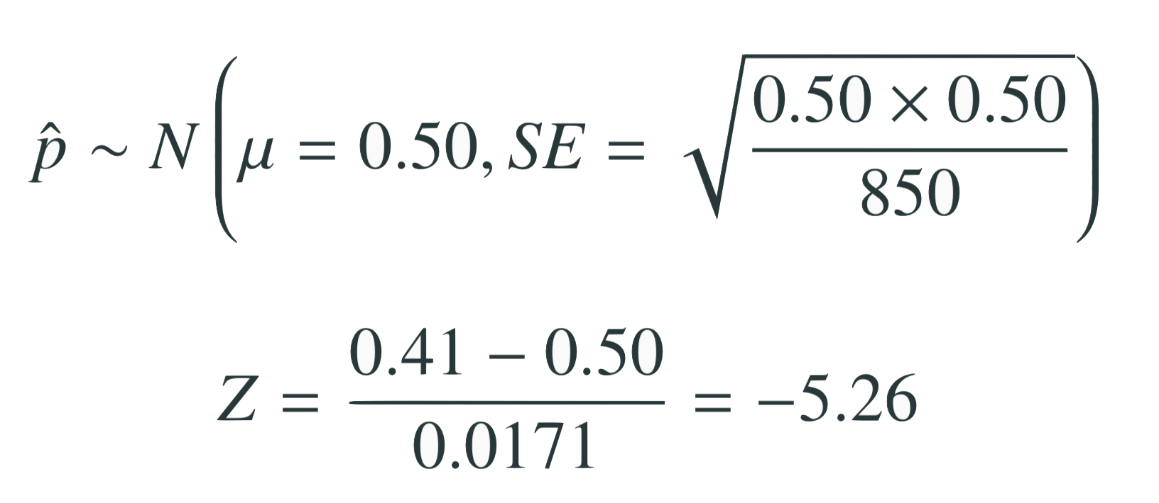
Test statistic
In order to evaluate if the observed sample mean is unusual for the hypothesized sampling distribution, we determine how many standard errors away from the null it is, which is also called the test statistic.
The sample proportion is 5.26 standard errors away from the hypothesized value. Is this considered unusually low? That is, is the result statistically significant?
Yes, and we can quantify how unusual it is using a p-value.

Slide 22
p-values
We then use this test statistic to calculate the p-value, the probability of observing data at least as favorable to the alternative hypothesis as our current data set, if the null hypothesis were true.
If the p-value is low (lower than the significance level, α, which is usually 5%) we say that it would be very unlikely to observe the data if the null hypothesis were true, and hence reject H₀.
If the p-value is high (higher than α) we say that it is likely to observe the data even if the null hypothesis were true, and hence do not reject H₀.

Slide 23
Facebook interest categories - p-value
p-value: probability of observing data at least as favorable to H_{A} as our current data set (a sample proportion lower than 0.41), if in fact H₀ were true (the true population proportion was 0.50).

Slide 24
Facebook interest categories - Making a decision
p-value < 0.0001
If 50% of all American Facebook users are comfortable with Facebook creating these interest categories, there is less than a 0.01% chance of observing a random sample of 850 American Facebook users where 41% or fewer or 59% of higher feel comfortable with it.
This is a pretty low probability for us to think that the observed sample proportion, or something more extreme, is likely to happen simply by chance.
Since p-value is low (lower than 5%) we reject H₀.
The data provide convincing evidence that the proportion of American Facebook users who are comfortable with Facebook creating a list of interest categories for them is different than 50%.
The difference between the null value of 0.50 and observed sample proportion of 0.41 is not due to chance or sampling variability.

Slide 25
Choosing a significance level
Choosing a significance level for a test is important in many contexts, and the traditional level is 0.05. However, it is often helpful to adjust the significance level based on the application.
We may select a level that is smaller or larger than 0.05 depending on the consequences of any conclusions reached from the test.
If making a Type 1 Error is dangerous or especially costly, we should choose a small significance level (e.g. 0.01). Under this scenario we want to be very cautious about rejecting the null hypothesis, so we demand very strong evidence favoring H_{A} before we would reject H₀.
If a Type 2 Error is relatively more dangerous or much more costly than a Type 1 Error, then we should choose a higher significance level (e.g. 0.10). Here we want to be cautious about failing to reject H₀ when the null is actually false.

Slide 26
One vs. two sided hypothesis tests
In two sided hypothesis tests we are interested in whether p is either above or below some null value p₀: H_{A} : p ≠ p₀.
In one sided hypothesis tests we are interested in p differing from the null value p₀ in one direction (and not the other):
If there is only value in detecting if population parameter is less than p₀, then H_{A}: p < p₀.
If there is only value in detecting if population parameter is greater than p₀, then H_{A} : p > p₀.
Two-sided tests are often more appropriate as we often want to detect if the data goes clearly in the opposite direction of a hypothesis direction as well.

Slide 27
p-hacking
p-hacking is the unscientific practice of conducting multiple tests, hoping that something will rise to significance
With α=0.05, you have a 1/20 chance of a Type 1, reject the null hypothesis when we shouldn't
Do 100 tests, some of them will come up significant
Write up your result
https://xkcd.com/882/
Prediction con

Slide 28
Break

