Slide 1
INFO 5871-001: Data Science / Info Science
Robin burke, Fall 2019

Slide 2
Difference of proportions
Some parts based on material by
Mine Çetinkaya-Rundel of OpenIntro
under the CC BY-SA license
Week 7, Part 1

Slide 3
Part of Homework 5

Slide 4
Melting ice cap
Scientists predict that global warming may have big effects on the polar regions within the next 100 years. One of the possible effects is that the northern ice cap may completely melt. Would this bother you a great deal, some, a little, or not at all if it actually happened?
A great deal
Some
A little
Not at all

Slide 5
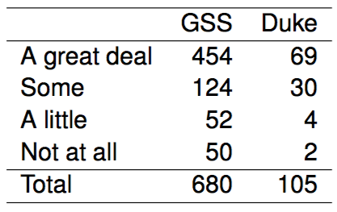
Results from the
US General Social Survey
The GSS asks the same question, below are the distributions of responses from the 2010 GSS as well as from a group of introductory statistics students at Duke University:

Slide 6
Parameter and point estimate
Parameter of interest: Difference between the proportions of all Duke students and all Americans who would be bothered a great deal by the northern ice cap completely melting.
p_{Duke} - p_{US}

Slide 7
Parameter and point estimate
Parameter of interest: Difference between the proportions of all Duke students and all Americans who would be bothered a great deal by the northern ice cap completely melting.
p_{Duke} - p_{US}
Point estimate: Difference between the proportions of sampled Duke students and sampled Americans who would be bothered a great deal by the northern ice cap completely melting.
p̂_{Duke} - p̂_{US}

Slide 8
Inference for comparing proportions
The details are the same as before…

Slide 9
Inference for comparing proportions
The details are the same as before…
CI: point estimate ± margin of error

Slide 10
Inference for comparing proportions
The details are the same as before…
CI: point estimate ± margin of error
HT: Use Z = (point estimate - null value) / SE to find appropriate p-value.

Slide 11

Inference for comparing proportions
The details are the same as before…
CI: point estimate ± margin of error
HT: Use Z = (point estimate - null value) / SE to find appropriate p-value.
We just need the appropriate standard error of the point estimate , which is the only new concept.

Slide 12

Inference for comparing proportions
The details are the same as before…
CI: point estimate ± margin of error
HT: Use Z = (point estimate - null value) / SE to find appropriate p-value.
We just need the appropriate standard error of the point estimate , which is the only new concept.
Standard error of the difference between two sample proportions

Slide 13
Conditions for CI for difference of proportions
Independence within groups:
  The US group is sampled randomly and we're assuming that the Duke group represents a random sample as well.

Slide 14
Conditions for CI for difference of proportions
Independence within groups:
  The US group is sampled randomly and we're assuming that the Duke group represents a random sample as well.
n_{Duke} < 10% of all Duke students and 680 < 10% of all Americans.

Slide 15
Conditions for CI for difference of proportions
Independence within groups:
  The US group is sampled randomly and we're assuming that the Duke group represents a random sample as well.
n_{Duke} < 10% of all Duke students and 680 < 10% of all Americans.
We can assume that the attitudes of Duke students in the sample are independent of each other, and attitudes of US residents in the sample are independent of each other as well.

Slide 16
Conditions for CI for difference of proportions
Independence within groups:
  The US group is sampled randomly and we're assuming that the Duke group represents a random sample as well.
n_{Duke} < 10% of all Duke students and 680 < 10% of all Americans.
We can assume that the attitudes of Duke students in the sample are independent of each other, and attitudes of US residents in the sample are independent of each other as well.
Independence between groups:
The sampled Duke students and the US residents are independent of each other.

Slide 17
Conditions for CI for difference of proportions
Independence within groups:
  The US group is sampled randomly and we're assuming that the Duke group represents a random sample as well.
n_{Duke} < 10% of all Duke students and 680 < 10% of all Americans.
We can assume that the attitudes of Duke students in the sample are independent of each other, and attitudes of US residents in the sample are independent of each other as well.
Independence between groups:
The sampled Duke students and the US residents are independent of each other.
Success-failure:
At least 10 observed successes and 10 observed failures in the two groups.

Slide 18
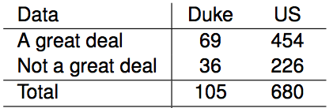
Sample proportions are also nearly normally distributed
Construct a 95% confidence interval for the difference between the proportions of Duke students and Americans who would be bothered a great deal by the melting of the northern ice cap (p_{Duke} - p_{US}).

Slide 19
Sample proportions are also nearly normally distributed
Construct a 95% confidence interval for the difference between the proportions of Duke students and Americans who would be bothered a great deal by the melting of the northern ice cap (p_{Duke} - p_{US}).

Slide 20

Sample proportions are also nearly normally distributed
Construct a 95% confidence interval for the difference between the proportions of Duke students and Americans who would be bothered a great deal by the melting of the northern ice cap (p_{Duke} - p_{US}).

Slide 21

Sample proportions are also nearly normally distributed
Construct a 95% confidence interval for the difference between the proportions of Duke students and Americans who would be bothered a great deal by the melting of the northern ice cap (p_{Duke} - p_{US}).

Slide 22
Sample proportions are also nearly normally distributed
Construct a 95% confidence interval for the difference between the proportions of Duke students and Americans who would be bothered a great deal by the melting of the northern ice cap (p_{Duke} - p_{US}).

Slide 23
Sample proportions are also nearly normally distributed
Construct a 95% confidence interval for the difference between the proportions of Duke students and Americans who would be bothered a great deal by the melting of the northern ice cap (p_{Duke} - p_{US}).

Slide 24
Sample proportions are also nearly normally distributed
Construct a 95% confidence interval for the difference between the proportions of Duke students and Americans who would be bothered a great deal by the melting of the northern ice cap (p_{Duke} - p_{US}).

Slide 25


Sample proportions are also nearly normally distributed
Construct a 95% confidence interval for the difference between the proportions of Duke students and Americans who would be bothered a great deal by the melting of the northern ice cap (p_{Duke} - p_{US}).

Slide 26
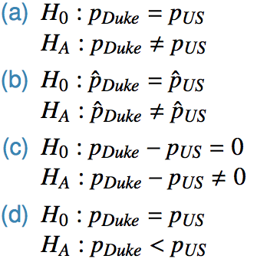
Practice
Which of the following is the correct set of hypotheses for testing if the proportion of all Duke students who would be bothered a great deal by the melting of the northern ice cap differs from the proportion of all Americans who do?

Slide 27
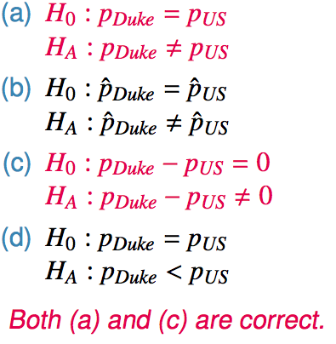
Practice
Which of the following is the correct set of hypotheses for testing if the proportion of all Duke students who would be bothered a great deal by the melting of the northern ice cap differs from the proportion of all Americans who do?

Slide 28
one proportion
When constructing a confidence interval for a population proportion, we check if the observed number of successes and failures are at least 10.
np̂ ≥ 10 n * (1 - p̂) ≥10

Slide 29
Pooled estimate of a proportion
In the case of comparing two proportions where H₀: p₁ = p₂, there isn't a given null value we can use to calculated the expected number of successes and failures in each sample.

Slide 30
Pooled estimate of a proportion
In the case of comparing two proportions where H₀: p₁ = p₂, there isn't a given null value we can use to calculated the expected number of successes and failures in each sample.
Therefore, we need to first find a common (pooled) proportion for the two groups, and use that in our analysis.

Slide 31

Pooled estimate of a proportion
In the case of comparing two proportions where H₀: p₁ = p₂, there isn't a given null value we can use to calculated the expected number of successes and failures in each sample.
Therefore, we need to first find a common (pooled) proportion for the two groups, and use that in our analysis.
This simply means finding the proportion of total successes among the total number of observations.
Pooled estimate of a proportion

Slide 32
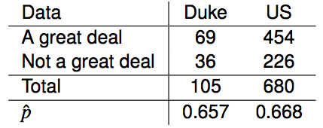
CI vs. HT for proportions
Do these data suggest that the proportion of all Duke students who would be bothered a great deal by the melting of the northern ice cap differs from the proportion of all Americans who do? Calculate the test statistic, the p-value, and interpret your conclusion in context of the data.

Slide 33
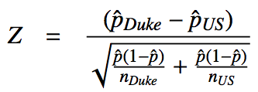
CI vs. HT for proportions
Do these data suggest that the proportion of all Duke students who would be bothered a great deal by the melting of the northern ice cap differs from the proportion of all Americans who do? Calculate the test statistic, the p-value, and interpret your conclusion in context of the data.

Slide 34
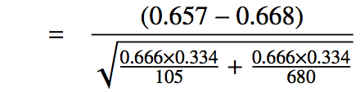
CI vs. HT for proportions
Do these data suggest that the proportion of all Duke students who would be bothered a great deal by the melting of the northern ice cap differs from the proportion of all Americans who do? Calculate the test statistic, the p-value, and interpret your conclusion in context of the data.

Slide 35
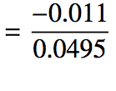
CI vs. HT for proportions
Do these data suggest that the proportion of all Duke students who would be bothered a great deal by the melting of the northern ice cap differs from the proportion of all Americans who do? Calculate the test statistic, the p-value, and interpret your conclusion in context of the data.

Slide 36
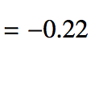
CI vs. HT for proportions
Do these data suggest that the proportion of all Duke students who would be bothered a great deal by the melting of the northern ice cap differs from the proportion of all Americans who do? Calculate the test statistic, the p-value, and interpret your conclusion in context of the data.

Slide 37
CI vs. HT for proportions
Do these data suggest that the proportion of all Duke students who would be bothered a great deal by the melting of the northern ice cap differs from the proportion of all Americans who do? Calculate the test statistic, the p-value, and interpret your conclusion in context of the data.

Slide 38
Recap - comparing two proportions
Population parameter: (p₁ - p₂), point estimate: (p̂₁ - p̂₂)

Slide 39
Recap - comparing two proportions
Population parameter: (p₁ - p₂), point estimate: (p̂₁ - p̂₂)
Conditions:

Slide 40
Recap - comparing two proportions
Population parameter: (p₁ - p₂), point estimate: (p̂₁ - p̂₂)
Conditions:
independence within groups
- random sample and 10% condition met for both groups
independence between groups
at least 10 successes and failures in each group
- if not → randomization (Section 6.4)

Slide 41


Recap - comparing two proportions
Population parameter: (p₁ - p₂), point estimate: (p̂₁ - p̂₂)
Conditions:
independence within groups
- random sample and 10% condition met for both groups
independence between groups
at least 10 successes and failures in each group
- if not → randomization (Section 6.4)
for CI: use p̂₁ and p̂₂
for HT:
  when H₀: p₁ = p₂: use
  when H₀: p₁ - p₂ = (some value other than 0): use p̂₁ and p̂₂
  - this is pretty rare

