Slide 1
INFO 5871-001: Data Science / Info Science
Robin burke, Fall 2019

Slide 2
CHI-Square Test for Counts
Some parts based on material by Mine Çetinkaya-Rundel of OpenIntro
under the CC BY-SA license
Week 7, Part 1

Slide 3
Question
Do observed counts match an expected distribution?

Slide 4
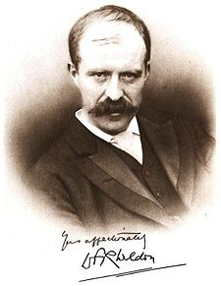
Weldon's dice
Walter Frank Raphael Weldon (1860 - 1906), was an English evolutionary biologist and a founder of biometry. He was the joint founding editor of Biometrika, with Francis Galton and Karl Pearson.
In 1894, he rolled 12 dice 26,306 times, and recorded the number of 5s or 6s (which he considered to be a success).
It was observed that 5s or 6s occurred more often than expected, and Pearson hypothesized that this was probably due to the construction of the dice. Most inexpensive dice have hollowed-out pips, and since opposite sides add to 7, the face with 6 pips is lighter than its opposing face, which has only 1 pip.

Slide 5
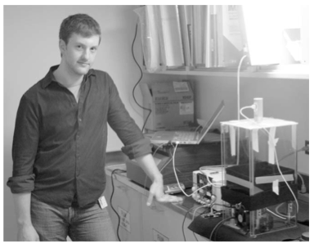
Labby's dice
In 2009, Zacariah Labby (U of Chicago), repeated Weldon's experiment using a homemade dice-throwing, pip counting machine.
www.youtube.com/watch?v=95EErdouO2w
The rolling-imaging process took about 20 seconds per roll.
Each day there were ~150 images to process manually.
At this rate Weldon's experiment was repeated in a little more than six full days.

Slide 6
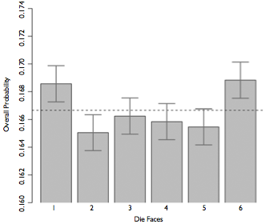
Labby's dice (cont.)
Labby did not actually observe the same phenomenon that Weldon observed (higher frequency of 5s and 6s).
Automation allowed Labby to collect more data than Weldon did in 1894, instead of recording "successes" and "failures", Labby recorded the individual number of pips on each die.

Slide 7
Expected counts
Labby rolled 12 dice 26,306 times. If each side is equally likely to come up, how many 1s, 2s, ..., 6s would he expect to have observed?
1/6
12/6
26,306 / 6
12 x 26,306 / 6

Slide 8
Expected counts
Labby rolled 12 dice 26,306 times. If each side is equally likely to come up, how many 1s, 2s, ..., 6s would he expect to have observed?
1/6
12 / 6
26,306 / 6
12 x 26,306 / 6 = 52,612

Slide 9
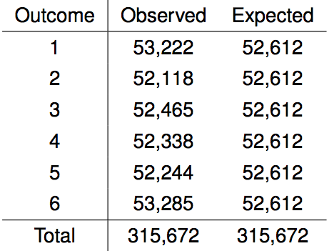
Summarizing Labby's results
The table below shows the observed and expected counts from Labby's experiment.

Slide 10
Summarizing Labby's results
The table below shows the observed and expected counts from Labby's experiment.
Why are the expected counts the same for all outcomes but the observed counts are different? At a first glance, does there appear to be an inconsistency between the observed and expected counts?

Slide 11
Setting the hypotheses
Do these data provide convincing evidence of an inconsistency between the observed and expected counts?

Slide 12
Setting the hypotheses
Do these data provide convincing evidence of an inconsistency between the observed and expected counts?
H₀: There is no inconsistency between the observed and the expected counts. The observed counts follow the same distribution as the expected counts.

Slide 13
Setting the hypotheses
Do these data provide convincing evidence of an inconsistency between the observed and expected counts?
H₀: There is no inconsistency between the observed and the expected counts. The observed counts follow the same distribution as the expected counts.
H_{A}: There is an inconsistency between the observed and the expected counts. The observed counts do not follow the same distribution as the expected counts. There is a bias in which side comes up on the roll of a die.

Slide 14
Evaluating the hypotheses
To evaluate these hypotheses, we quantify how different the observed counts are from the expected counts.

Slide 15
Evaluating the hypotheses
To evaluate these hypotheses, we quantify how different the observed counts are from the expected counts.
Large deviations from what would be expected based on sampling variation (chance) alone provide strong evidence for the alternative hypothesis.

Slide 16
Evaluating the hypotheses
To evaluate these hypotheses, we quantify how different the observed counts are from the expected counts.
Large deviations from what would be expected based on sampling variation (chance) alone provide strong evidence for the alternative hypothesis.
This is called a goodness of fit test since we're evaluating how well the observed data fit the expected distribution.

Slide 17

Anatomy of a test statistic
The general form of a test statistic is

Slide 18
Anatomy of a test statistic
The general form of a test statistic is
This construction is based on
identifying the difference between a point estimate and an expected value if the null hypothesis was true, and
standardizing that difference using the standard error of the point estimate.

Slide 19
Anatomy of a test statistic
The general form of a test statistic is
This construction is based on
identifying the difference between a point estimate and an expected value if the null hypothesis was true, and
standardizing that difference using the standard error of the point estimate.
These two ideas will help in the construction of an appropriate test statistic for count data.

Slide 20
Chi-square statistic
When dealing with counts and investigating how far the observed counts are from the expected counts, we use a new test statistic called the chi-square (χ²) statistic.

Slide 21
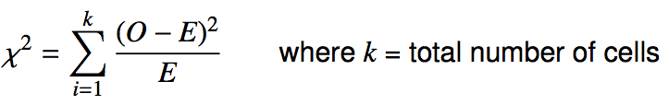
Chi-square statistic
When dealing with counts and investigating how far the observed counts are from the expected counts, we use a new test statistic called the chi-square (χ²) statistic.
χ² statistic

Slide 22
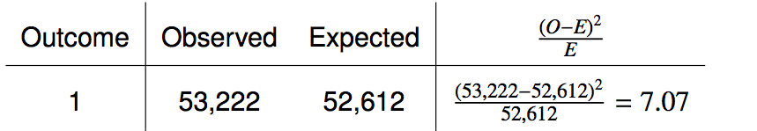
Calculating the chi-square statistic

Slide 23
Calculating the chi-square statistic

Slide 24
Calculating the chi-square statistic

Slide 25

Calculating the chi-square statistic

Slide 26
Calculating the chi-square statistic

Slide 27
Calculating the chi-square statistic

Slide 28

Calculating the chi-square statistic

Slide 29
Why square?
Squaring the difference between the observed and the expected outcome does two things:

Slide 30
Why square?
Squaring the difference between the observed and the expected outcome does two things:
Any standardized difference that is squared will now be positive.

Slide 31
Why square?
Squaring the difference between the observed and the expected outcome does two things:
Any standardized difference that is squared will now be positive.
Differences that already looked unusual will become much larger after being squared.

Slide 32
Why square?
Squaring the difference between the observed and the expected outcome does two things:
Any standardized difference that is squared will now be positive.
Differences that already looked unusual will become much larger after being squared.
When have we seen this before?

Slide 33
The chi-square distribution
In order to determine if the χ² statistic we calculated is considered unusually high or not we need to first describe its distribution.

Slide 34
The chi-square distribution
In order to determine if the χ² statistic we calculated is considered unusually high or not we need to first describe its distribution.
The chi-square distribution has just one parameter called degrees of freedom (df), which influences the shape, center, and spread of the distribution.

Slide 35
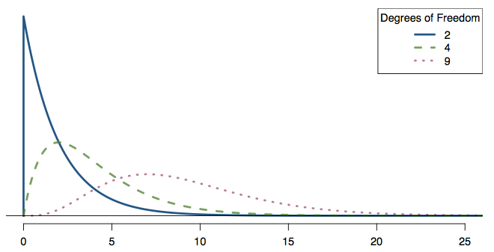
The chi-square distribution
In order to determine if the χ² statistic we calculated is considered unusually high or not we need to first describe its distribution.
The chi-square distribution has just one parameter called degrees of freedom (df), which influences the shape, center, and spread of the distribution.

Slide 36
Finding areas under the chi-square curve
p-value = tail area under the chi-square distribution (as usual)
In Python, scipy.stats.chisquare
st.chisquare(f_obs=observations, f_exp=expected)
Returns a "PowerDivergenceResult" (don't ask)
res.statistic is the χ² value
res.pvalue is the associated area under the curve
The smaller the statistic
the closer the value to 0
the more area under the curve
the greater the p-value
the more likely that the divergence is due to chance

Slide 37
Back to Labby's dice
The research question was: Do these data provide convincing evidence of an inconsistency between the observed and expected counts?

Slide 38
Back to Labby's dice
The research question was: Do these data provide convincing evidence of an inconsistency between the observed and expected counts?
The hypotheses were:
H₀: There is no inconsistency between the observed and the expected counts. The observed counts follow the same distribution as the expected counts.
H_{A}: There is an inconsistency between the observed and the expected counts. The observed counts do not follow the same distribution as the expected counts. There is a bias in which side comes up on the roll of a die.

Slide 39
Back to Labby's dice
The research question was: Do these data provide convincing evidence of an inconsistency between the observed and expected counts?
The hypotheses were:
H₀: There is no inconsistency between the observed and the expected counts. The observed counts follow the same distribution as the expected counts.
H_{A}: There is an inconsistency between the observed and the expected counts. The observed counts do not follow the same distribution as the expected counts. There is a bias in which side comes up on the roll of a die.
We had calculated a test statistic of χ² = 24.67.

Slide 40
Back to Labby's dice
The research question was: Do these data provide convincing evidence of an inconsistency between the observed and expected counts?
The hypotheses were:
H₀: There is no inconsistency between the observed and the expected counts. The observed counts follow the same distribution as the expected counts.
H_{A}: There is an inconsistency between the observed and the expected counts. The observed counts do not follow the same distribution as the expected counts. There is a bias in which side comes up on the roll of a die.
We had calculated a test statistic of χ² = 24.67.
All we need is the df and we can calculate the tail area (the p-value) and make a decision on the hypotheses.

Slide 41
Degrees of freedom
When conducting a goodness of fit test to evaluate how well the observed data follow an expected distribution, the degrees of freedom are calculated as the number of cells (k) minus 1. df = k - 1

Slide 42
Degrees of freedom
When conducting a goodness of fit test to evaluate how well the observed data follow an expected distribution, the degrees of freedom are calculated as the number of cells (k) minus 1. df = k - 1
For dice outcomes, k = 6, therefore df = 6 - 1 = 5

Slide 43
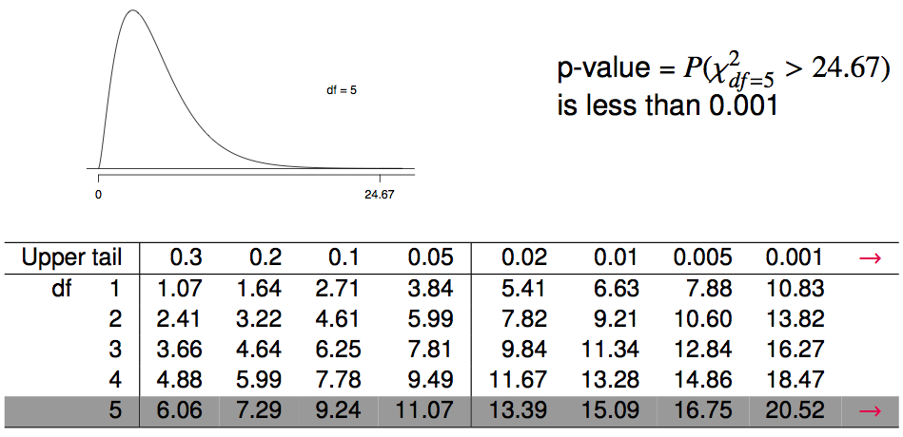
Finding a p-value
The p-value for a chi-square test is defined as the tail area above the calculated test statistic.

Slide 44
Conclusion
We calculated a p-value less than 0.001. At 5% significance level, what is the conclusion of the hypothesis test?
Reject H₀, the data provide convincing evidence that the dice are fair.
Reject H₀, the data provide convincing evidence that the dice are biased.
Fail to reject H₀, the data provide convincing evidence that the dice are fair.
Fail to reject H₀, the data provide convincing evidence that the dice are biased.

Slide 45
Conclusion
We calculated a p-value less than 0.001. At 5% significance level, what is the conclusion of the hypothesis test?
Reject H₀, the data provide convincing evidence that the dice are fair.
Reject H₀, the data provide convincing evidence that the dice are biased.
Fail to reject H₀, the data provide convincing evidence that the dice are fair.
Fail to reject H₀, the data provide convincing evidence that the dice are biased.

Slide 46
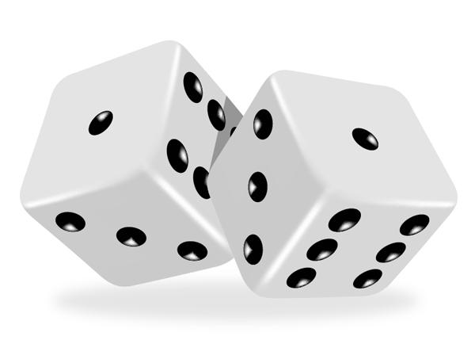
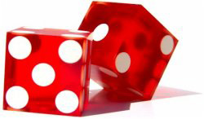
Turns out...
The 1-6 axis is consistently shorter than the other two (2-5 and 3-4), thereby supporting the hypothesis that the faces with one and six pips are lighter than the other faces.
Pearson's claim that 5s and 6s appear more often due to the carved-out pips is not supported by these data.
Dice used in casinos have flush faces, where the pips are filled in with a plastic of the same density as the surrounding material and are more precisely shaped.

Slide 47
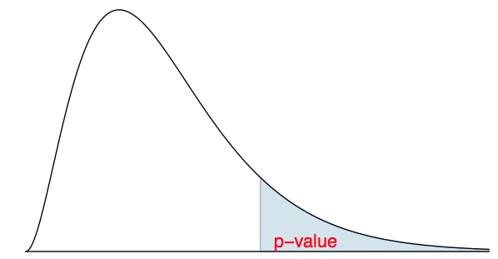
Recap: p-value for a chi-square test
The p-value for a chi-square test is defined as the tail area above the calculated test statistic.
This is because the test statistic is always positive, and a higher test statistic means a stronger deviation from the null hypothesis.

Slide 48
Conditions for the chi-square test
Independence: Each case that contributes a count to the table must be independent of all the other cases in the table.

Slide 49
Conditions for the chi-square test
Independence: Each case that contributes a count to the table must be independent of all the other cases in the table.
Sample size: Each particular scenario (i.e. cell) must have at least 5 expected cases.

Slide 50
Conditions for the chi-square test
Independence: Each case that contributes a count to the table must be independent of all the other cases in the table.
Sample size: Each particular scenario (i.e. cell) must have at least 5 expected cases.
df > 1: Degrees of freedom must be greater than 1.

Slide 51
Conditions for the chi-square test
Independence: Each case that contributes a count to the table must be independent of all the other cases in the table.
Sample size: Each particular scenario (i.e. cell) must have at least 5 expected cases.
df > 1: Degrees of freedom must be greater than 1.
Failing to check conditions may unintentionally affect the test's error rates.

