Slide 1
INFO 5871-001: Data Science / Info Science
Robin burke, Fall 2019

Slide 2
independence in contingencY tables
Some parts based on material by Mine Çetinkaya-Rundel of OpenIntro
under the CC BY-SA license
Week 7, Part 4

Slide 3
Question
Do the conditions in the table interact (have an effect) or are they independent?

Slide 4
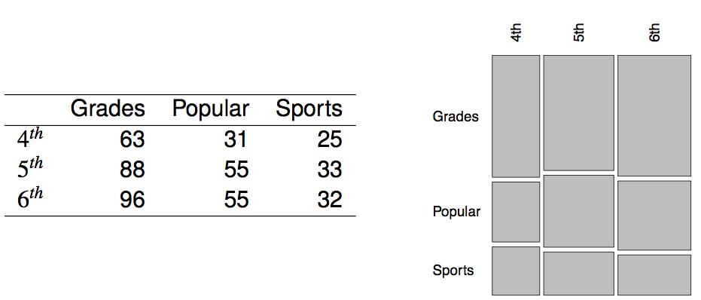
Popular kids
In the dataset popular, students in grades 4-6 were asked whether good grades, athletic ability, or popularity was most important to them. A two-way table separating the students by grade and by choice of most important factor is shown below. Do these data provide evidence to suggest that goals vary by grade?

Slide 5
Chi-square test of independence
The hypotheses are:
H₀: Grade and goals are independent. Goals do not vary by grade.
H_{A}: Grade and goals are dependent. Goals vary by grade.

Slide 6
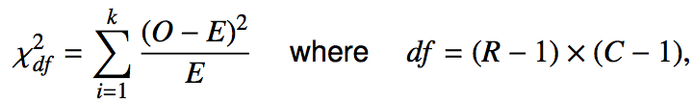
Chi-square test of independence
The hypotheses are:
H₀: Grade and goals are independent. Goals do not vary by grade.
H_{A}: Grade and goals are dependent. Goals vary by grade.
The test statistic is calculated as
where k is the number of cells, R is the number of rows, and C is the number of columns.
_______________
Note: we calculate df differently for one-way and two-way tables.

Slide 7
Chi-square test of independence
The hypotheses are:
H₀: Grade and goals are independent. Goals do not vary by grade.
H_{A}: Grade and goals are dependent. Goals vary by grade.
The test statistic is calculated as
where k is the number of cells, R is the number of rows, and C is the number of columns.
_______________
Note: we calculate df differently for one-way and two-way tables.
The p-value is the area under the χ²_{df} curve, above the calculated test statistic.

Slide 8

Expected counts in two-way tables

Slide 9
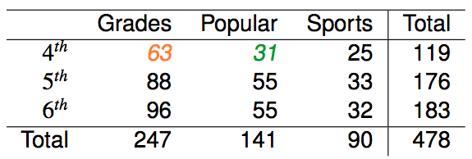
Expected counts in two-way tables

Slide 10

Expected counts in two-way tables

Slide 11

Expected counts in two-way tables

Slide 12
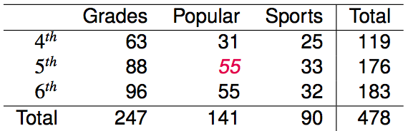
Expected counts in two-way tables
What is the expected count for the highlighted cell?
176 x 141 / 478
119 x 141 / 478
176 x 247 / 478
176 x 478 / 478

Slide 13
Expected counts in two-way tables
What is the expected count for the highlighted cell?
176 x 141 / 478
119 x 141 / 478
176 x 247 / 478
176 x 478 / 478
→ 52
more than expected # of 5th graders
have a goal of being popular

Slide 14
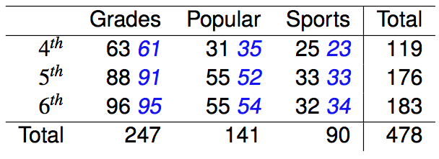
Calculating the test statistic
Expected counts are shown in blue next to the observed counts.

Slide 15

Calculating the test statistic
Expected counts are shown in blue next to the observed counts.

Slide 16
Calculating the test statistic
Expected counts are shown in blue next to the observed counts.

Slide 17
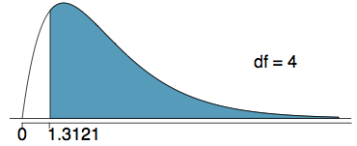
Calculating the p-value
Which of the following is the correct p-value for this hypothesis test?
χ²_{df} = 1.3121 df = 4
more than 0.3
between 0.3 and 0.2
between 0.2 and 0.1
between 0.1 and 0.05
less than 0.001

Slide 18
Calculating the p-value
Which of the following is the correct p-value for this hypothesis test?
χ²_{df} = 1.3121 df = 4
more than 0.3
between 0.3 and 0.2
between 0.2 and 0.1
between 0.1 and 0.05
less than 0.001

Slide 19
Conclusion
Do these data provide evidence to suggest that goals vary by grade?
H₀: Grade and goals are independent. Goals do not vary by grade.
H_{A}: Grade and goals are dependent. Goals vary by grade.

