Slide 1
INFO 5871-001: Data Science / Info Science
Robin burke, Fall 2019

Slide 2
Confidence intervals for means
Some parts based on material by Mine Çetinkaya-Rundel of OpenIntro
under the CC BY-SA license
Week 8, Part 2

Slide 3
so far
We have looked at confidence intervals for proportions
useful for categorical data
Much more often we have numerical data
we want to say something about its distribution
Introduce a new distribution – the t distribution

Slide 4
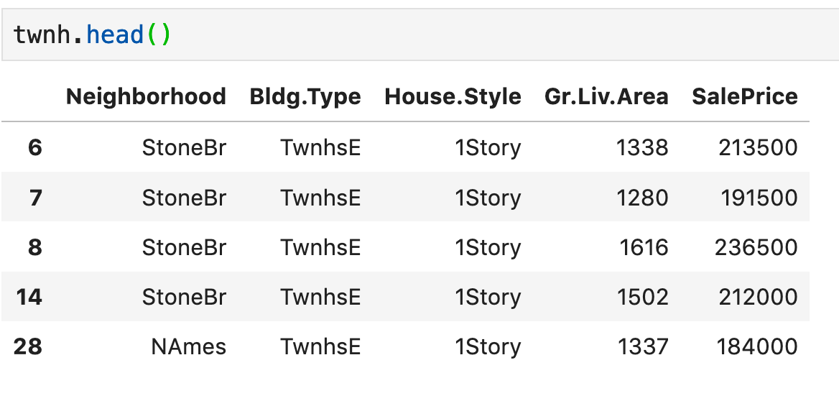
Problem
From the Ames housing data set
these are the Townhouses
The mean is
$175,263
Taking this dataset as a sample of housing values
what is the 95% confidence interval for this value?

Slide 5
New distribution: T distribution
Needed to account for uncertainty in the population variance
especially if we have a small number of samples
the standard deviation from a sample might not be a good estimate
Why does this matter most when n is small?
Larger n, we can rely on the CLT → sampling distribution is approximately normal
Can't guarantee this for smaller n
Solution
a distribution that takes into account "degrees of freedom"
how much data do you have?
the more data, the closer to a normal distribution it is

Slide 6
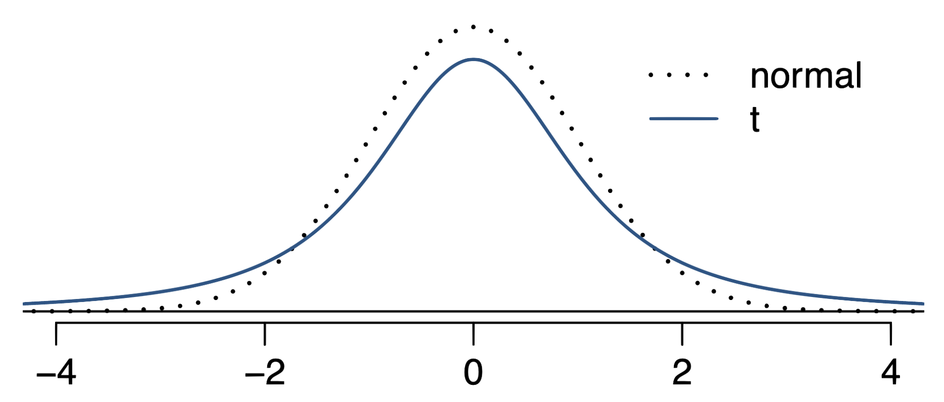
The 𝒕 distribution
When the population standard deviation is unknown (almost always), the uncertainty of the standard error estimate is addressed by using a new distribution: the 𝒕 distribution.
This distribution also has a bell shape, but its tails are thicker than the normal model’s.
Therefore observations are more likely to fall beyond two SDs from the mean than under the normal distribution
These extra thick tails are helpful for resolving our problem with a less reliable estimate the standard error (since n is small)

Slide 7
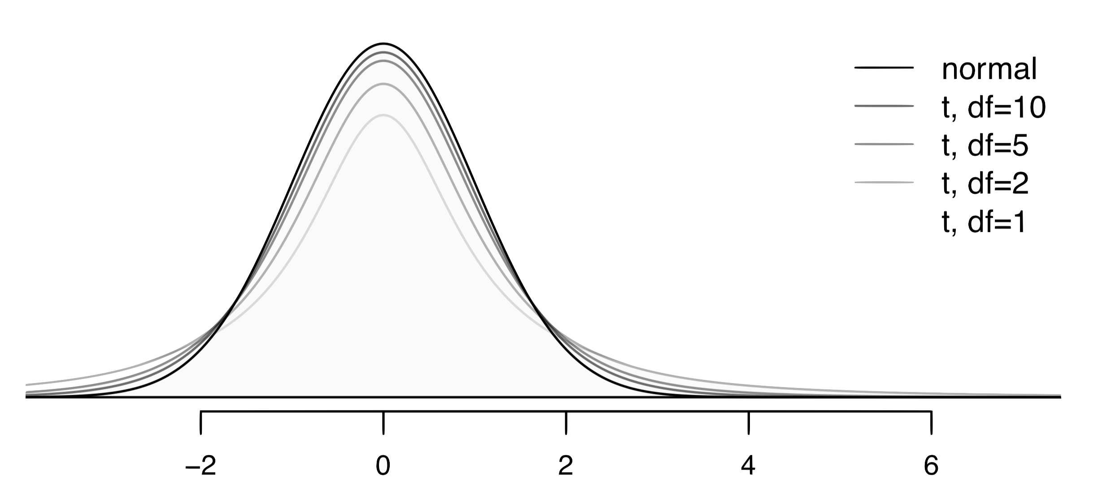
The 𝒕 distribution (cont.)
Always centered at zero, like the standard normal (𝓏) distribution
Has a single parameter: degrees of freedom (df).

Slide 8


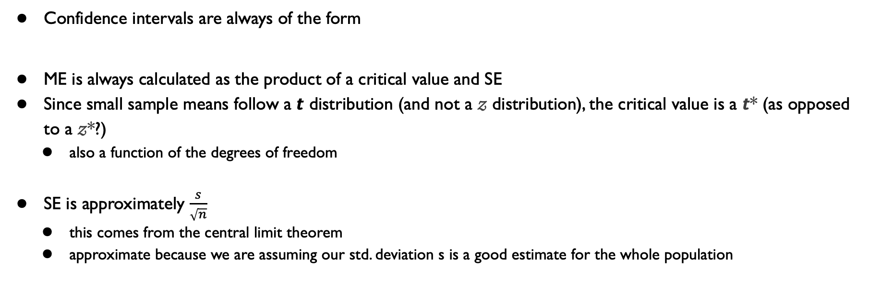
Confidence interval
Confidence intervals are always of the form
ME is always calculated as the product of a critical value and SE
Since small sample means follow a 𝙩 distribution (and not a 𝓏 distribution), the critical value is a 𝙩* (as opposed to a 𝓏*?)
also a function of the degrees of freedom
SE is approximately $\frac{s}{\sqrt{n}}$
this comes from the central limit theorem
approximate because we are assuming our std. deviation s is a good estimate for the whole population

Slide 9
Critical value
Need the T distribution critical value for 0.975 (why not 0.95?)
At what value of T does the area to the left contain 97.5% of the area?
st.t.ppf(0.975, 333)
1.967
degrees of freedom
t distribution
percentage point function
critical value

Slide 10
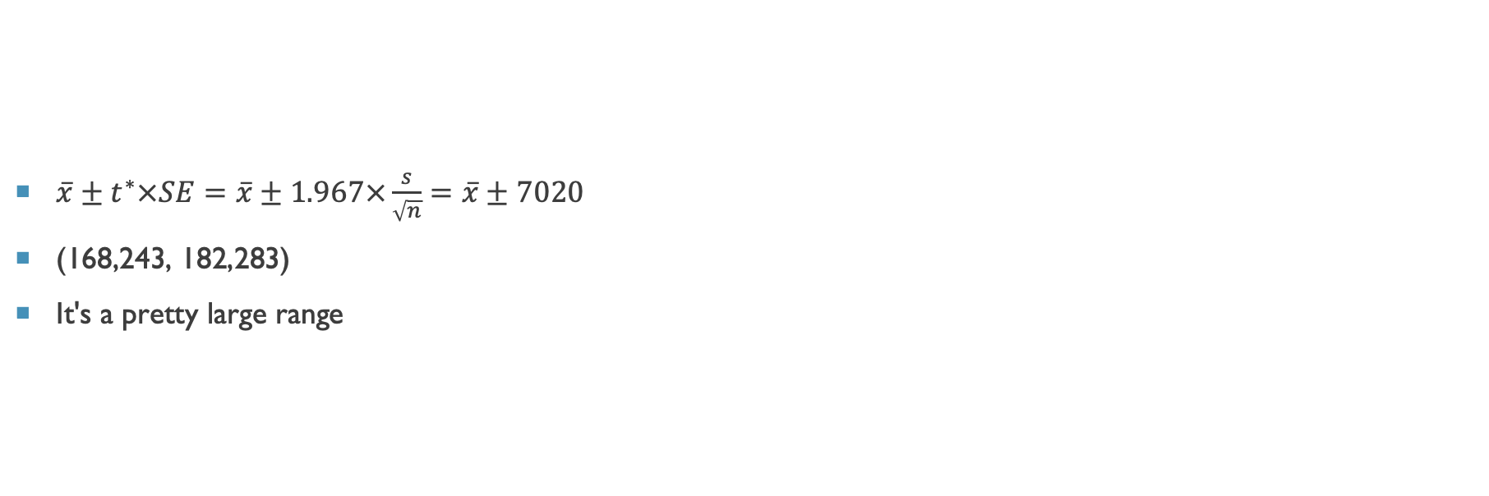
Confidence interval
$\overline{x}±t^{∗}×SE=\overline{x}±1.967×\frac{s}{\sqrt{n}}=\overline{x}±7020$
(168,243, 182,283)
It's a pretty large range

Slide 11
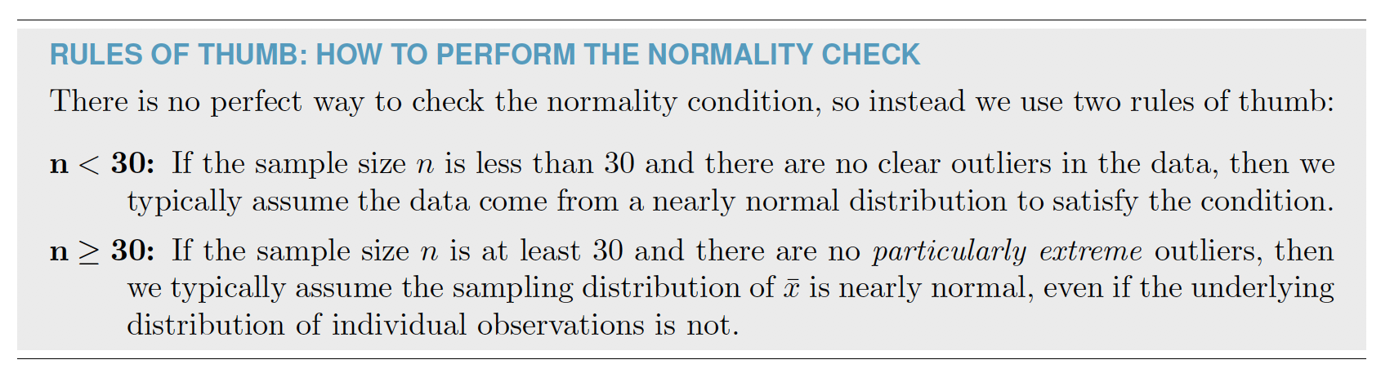
Conditions
Good to check that the conditions for this test apply
Independence
Hmm. It could be that the houses that people choose to sell are systematically different than the houses people keep
This would mean that home sales are not a good random sample of home values
The value of the house is not independent of its inclusion in the sample
Treat this as an assumption
Normality

Slide 12
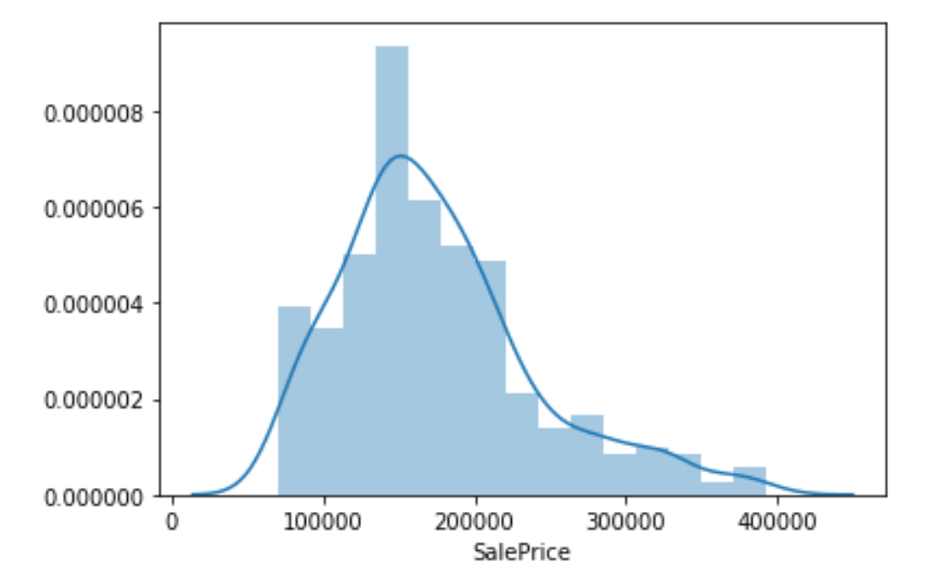
distplot
There is a heavy tail to the right
But no extreme outliers
so we will say the normality condition is met

Slide 13
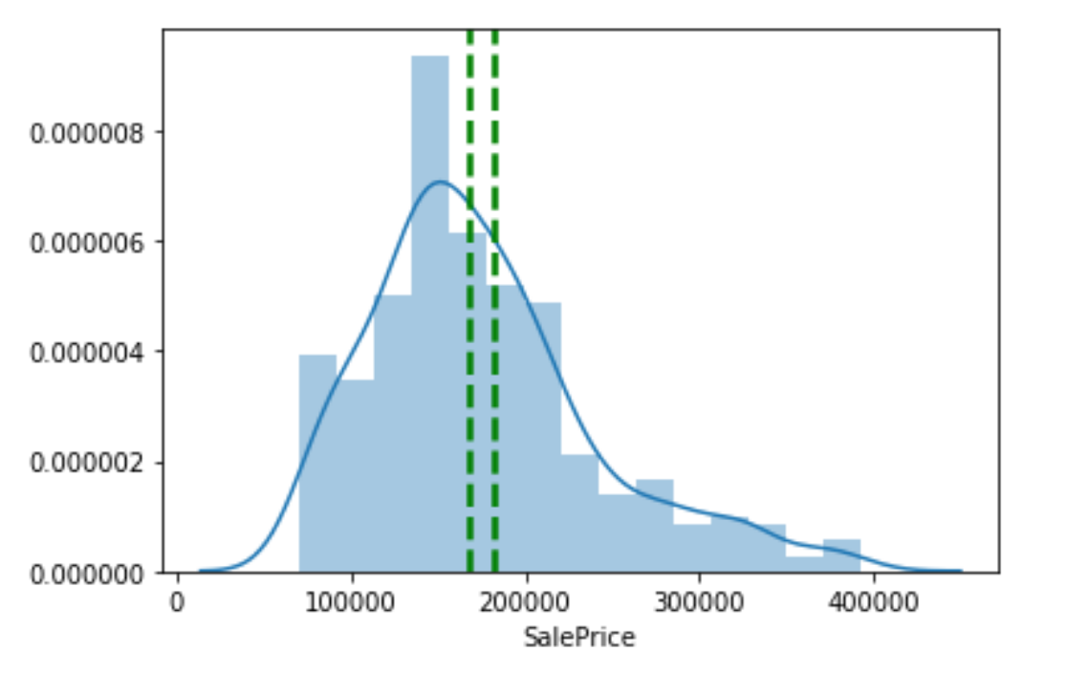
With confidence interval
Seems too small
But remember this is the confidence interval of the mean
it is not the range where 95% of the values lie
It represents our belief that if we took another sample of house values
the mean would be in this range

