Slide 1
INFO 5871-001: Data Science / Info Science
Robin burke, Fall 2019

Slide 2
Difference of means
Week 8, Part 3

Slide 3
Difference of means
This is often what we want to know
Does the average for group A differ from the average for group B?
Is this difference significant?

Slide 4
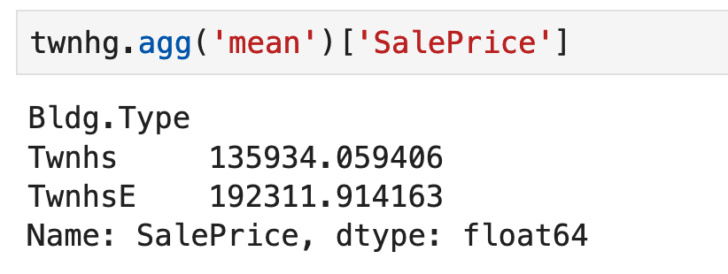
Problem
Townhouses that are middle units are cheaper than end units
Is this difference significant?

Slide 5
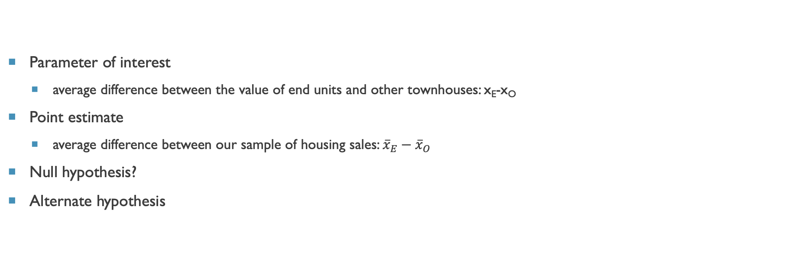
Defining our terms
Parameter of interest
average difference between the value of end units and other townhouses: x_{E}-x_{O}
Point estimate
average difference between our sample of housing sales: ${\overline{x}}_{E}−{\overline{x}}_{O}$
Null hypothesis?
Alternate hypothesis

Slide 6
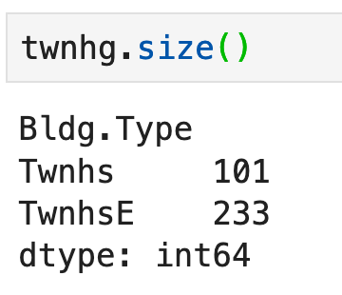
Conditions
Independence:
Same caveat as before: possible not a random sample
Interaction between the groups?
doesn't seem like it
but it is possible that developers put new units on the market at the same time
Normality
More than 30 in each condition?
Extreme outliers?

Slide 7
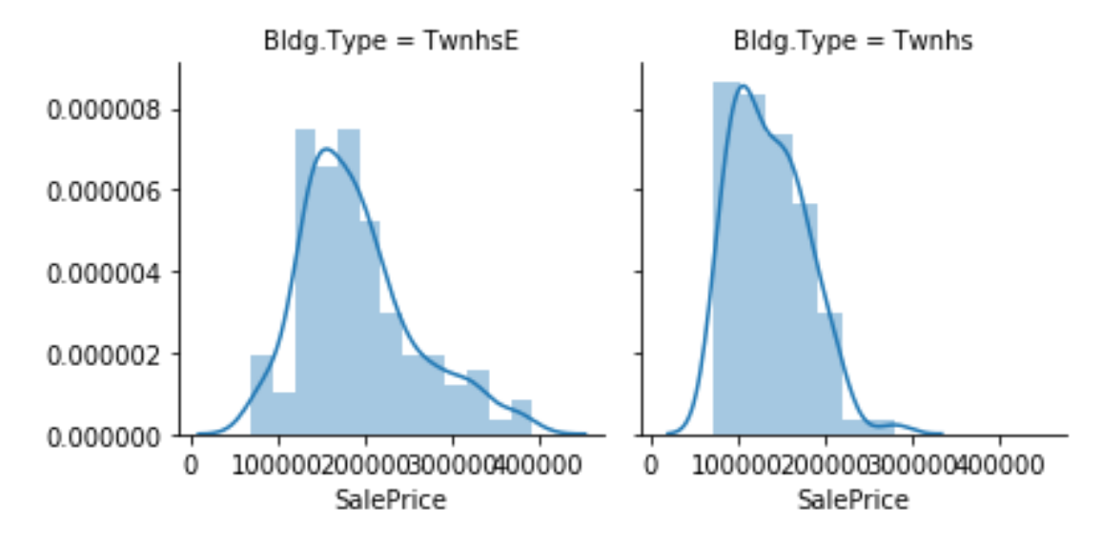
No extreme outliers
Seems OK?

Slide 8
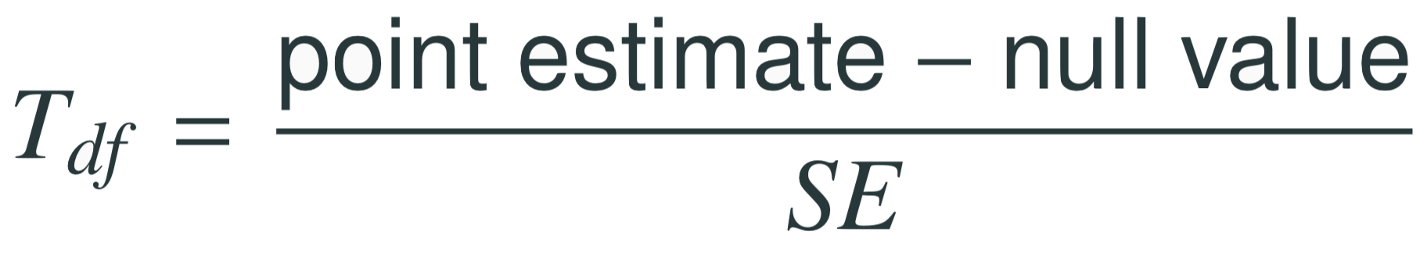
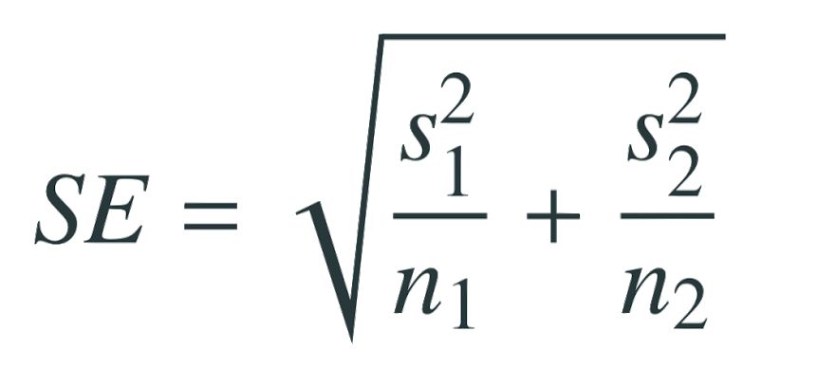
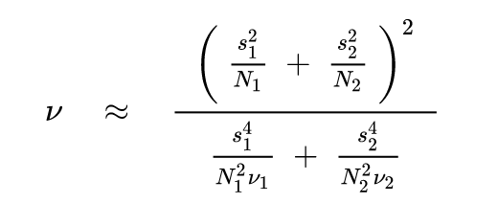
The test statistic
This is the T statistic
note that it is relative to a particular degree of freedom value
SE is similar to the two-proportion case from last week
degrees of freedom calculation is complex
that's why we have software

Slide 9
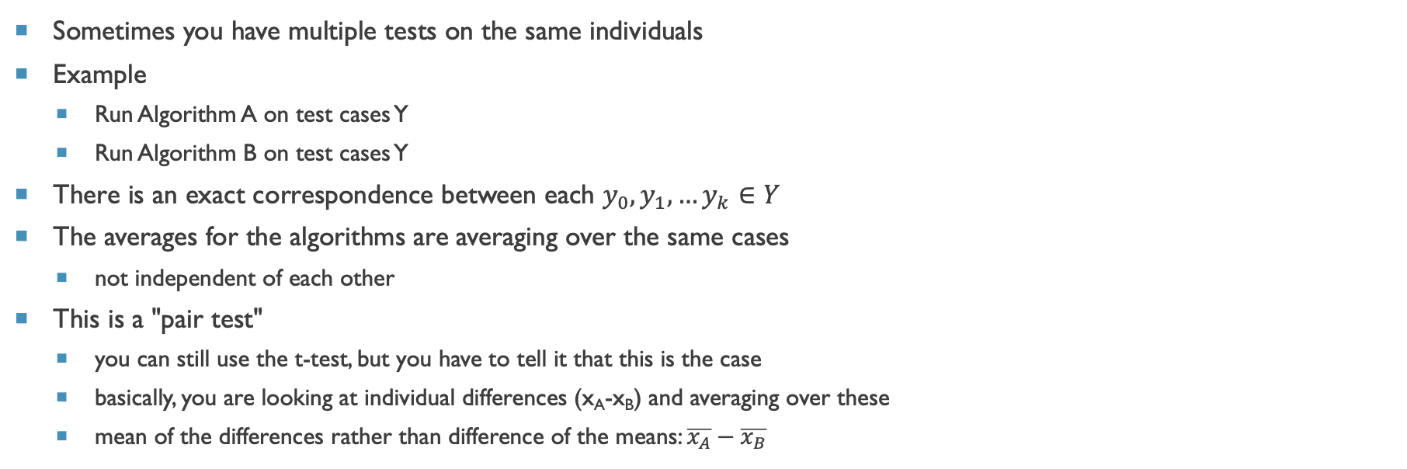
paired vs unpaired tests
Sometimes you have multiple tests on the same individuals
Example
Run Algorithm A on test cases Y
Run Algorithm B on test cases Y
There is an exact correspondence between each $y_{0},y_{1}, …y_{k}∈Y$
The averages for the algorithms are averaging over the same cases
not independent of each other
This is a "pair test"
you can still use the t-test, but you have to tell it that this is the case
basically, you are looking at individual differences (x_{A}-x_{B}) and averaging over these
mean of the differences rather than difference of the means: $\overline{x_{A}}−\overline{x_{B}}$

Slide 10
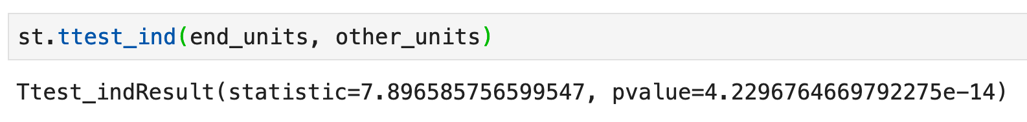
In SCIPY
Use the function ttest_ind
it would be ttest_dep for paired tests
Note the p value is very small
reject the null hypothesis
end units are very different from other units in this market
we know from our distribution that the end units have a heavier right tail = more expensive units

