Slide 1
INFO 5871-001: Data Science / Info Science
Robin burke, Fall 2019

Slide 2
Multiple means with ANOVA
Week 8, Part 5

Slide 3
What if I have more than two groups?
Null hypothesis = the means are all the same
Alternative hypothesis = some means are different

Slide 4
You could
Just look at all pairs of groups
But now we are testing over and over
increases our false positive rate for the overall assessment
(We will come back to this idea)

Slide 5
ANOVA to the rescue
Analysis Of Variance
Yet another distribution
the F distribution

Slide 6
ANOVA
ANOVA is used to assess whether the mean of the outcome variable is different for different levels of a categorical variable
H₀ : The mean outcome is the same across all categories,
𝜇₁ = 𝜇₂ = … = 𝜇_{k},
where 𝜇_{i} represents the mean of the outcome for observations in category i
H_{A} : At least one mean is different than others

Slide 7
Conditions
The observations should be independent within and between groups
If the data are a simple random sample from less than 10% of the population, this condition is satisfied
Carefully consider whether the data may be independent (e.g. no pairing)
Always important, but sometimes difficult to check
The observations within each group should be nearly normal
Especially important when the sample sizes are small
How do we check for normality?
The variability across the groups should be about equal
Especially important when the sample sizes differ between groups
How can we check this condition?

Slide 8
z/𝘵 test vs. ANOVA - Purpose
z/𝘵 test
Compare means from two groups to see whether they are so far apart that the observed difference cannot reasonably be attributed to sampling variability
H₀ : 𝜇₁ = 𝜇₂
ANOVA
Compare the means from two or more groups to see whether they are so far apart that the observed differences cannot all reasonably be attributed to sampling variability
H₀ : 𝜇₁ = 𝜇₂ = … = 𝜇_{k}

Slide 9


z/𝘵 test vs. ANOVA - Method
z/𝘵 test
Compute a test statistic (a ratio)
ANOVA
Compute a test statistic (a ratio)
Large test statistics lead to small p-values
If the p-value is small enough H₀ is rejected, we conclude that the population means are not equal

Slide 10
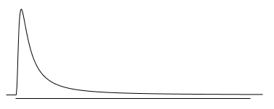
𝑭 distribution and p-value
In order to be able to reject H₀, we need a small p-value, which requires a large F statistic
In order to obtain a large F statistic, variability between sample means needs to be greater than variability within sample means

Slide 11
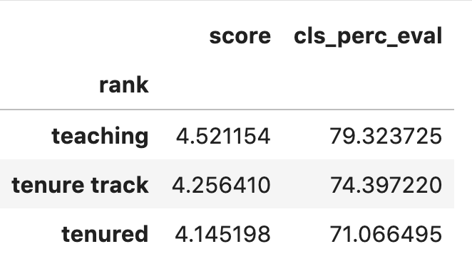
Example
We think that male tenured professors don't care if their students do teaching evaluations or not
and so the response rate will be different in this group
Seems like this might be the case from the data
note: not true for the female professors in the sample

Slide 12
conditions
Want to test for normality and variability
we will do this in lab

Slide 13
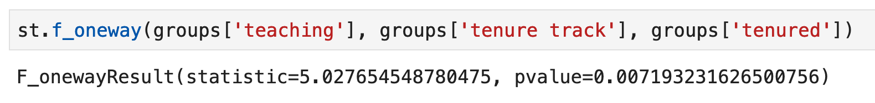
IN Python
Use the f_oneway function
Kind of unsatisfying
Yes, there's a difference
Doesn't tell you where it is

Slide 14
If the ANOVA yields a positive result
Then you can move on to multi-comparison testing
Crucial point
You have to adjust the p-value to account for the number of tests you are making
The most conservative correction: Bonferroni correction
α/k where k is the number of tests
Three groups = 3 pairwise tests
If you want an overall 95% confidence, then you use α'=0.0167 for each test
there are a number of alternative proposals for how to do this

Slide 15
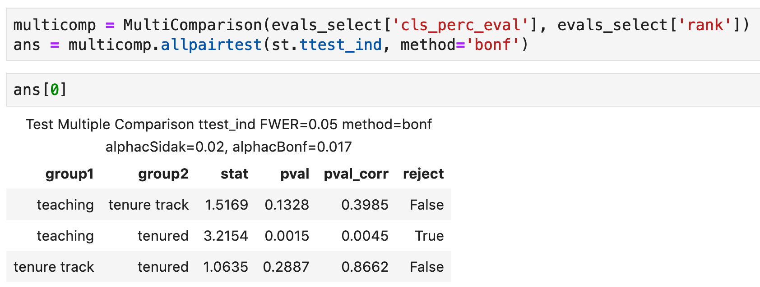
Python will do this for you
Bonferroni correction
Expected this
Thought this would also be true

