Slide 1
INFO 5871-001: Data Science / Info Science
Robin burke, Fall 2019

Slide 2
Indicator variables
Some parts based on material by Mine Çetinkaya-Rundel of OpenIntro
under the CC BY-SA license
Week 11, Part 2

Slide 3
Dummy variables
What do we do with a variable that looks like this?
Region
Northwest
Northeast
Northwest
Southeath
Midwest
etc.
Can we do regression on a categorical variable?

Slide 4
answer: sort of
The trick is to use "dummy variables"
Replace single categorical variable with many binary ones

Slide 5
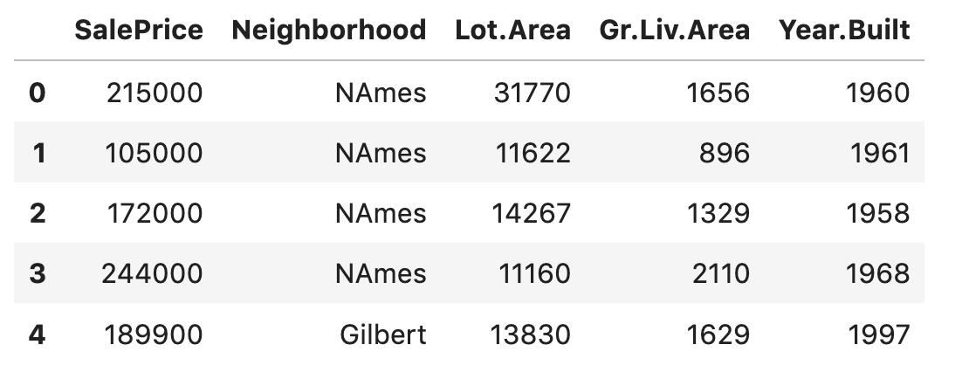
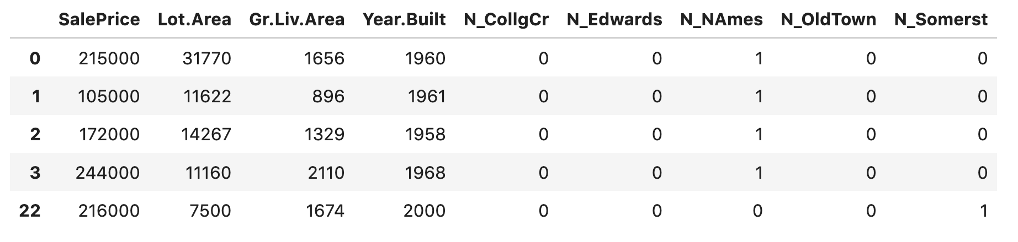
Example
Ames houses

Slide 6
In pandas
get_dummies() function does this
You can apply it to multiple columns at once.

Slide 7
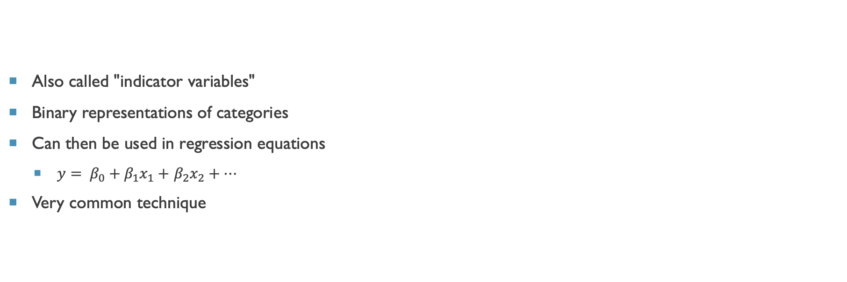
Dummy Variables
Also called "indicator variables"
Binary representations of categories
Can then be used in regression equations
$y= β_{0}+β_{1}x_{1}+$ $β_{2}x_{2}+…$
Very common technique
If x_{i} can only be either 0 or 1,
then 𝛽i represents a "shift" of the whole regression line

Slide 8
In regression
The fitting procedure will typically do this for you
if you have categorical variables in the data
You can't include all the indicator variables
because k categories have k-1 degrees of freedom
If a property isn't A, B, or C, then it must be D if there are no other options
The omitted indicator level
is the "reference" level
this is what must be true if all the other values are 0

Slide 9
MULTIPLE REGression

Slide 10
Multiple regression
Simple linear regression: Bivariate - two variables: y and x
Multiple linear regression: Multiple variables: y and x₁, x₂, · · ·
2

Slide 11
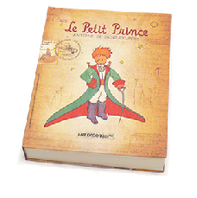
Weights of books
 | weight (g) | volume (cm³) | cover
1 | 800 | 885 | hc
2 | 950 | 1016 | hc
3 | 1050 | 1125 | hc
4 | 350 | 239 | hc
5 | 750 | 701 | hc
6 | 600 | 641 | hc
7 | 1075 | 1228 | hc
8 | 250 | 412 | pb
9 | 700 | 953 | pb
10 | 650 | 929 | pb
11 | 975 | 1492 | pb
12 | 350 | 419 | pb
13 | 950 | 1010 | pb
14 | 425 | 595 | pb
15 | 725 | 1034 | pb
l
h
w
3

Slide 12
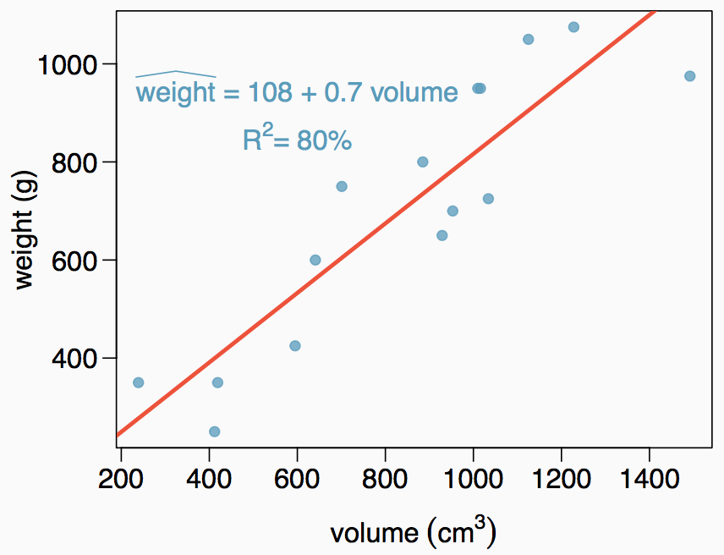
Weights of books (cont.)
The scatterplot shows the relationship between weights and volumes of books as well as the regression output. Which of the below is correct?
Weights of 80% of the books can be predicted accurately using this model.
Books that are 10 cm³ over average are expected to weigh 7g over average.
The correlation between weight and volume is R = 0.80² = 0.64.
The model underestimates the weight of the book with the highest volume.
4

Slide 13
Weights of books (cont.)
The scatterplot shows the relationship between weights and volumes of books as well as the regression output. Which of the below is correct?
Weights of 80% of the books can be predicted accurately using this model.
Books that are 10 cm³ over average are expected to weigh 7g over average.
The correlation between weight and volume is R = 0.80² = 0.64.
The model underestimates the weight of the book with the highest volume.
4

Slide 14
Modeling weights of books using volume
somewhat abbreviated output...
Coefficients:
Estimate Std. Error t value Pr(>|t|)
(Intercept) 107.67931 88.37758 1.218 0.245
Volume 0.70864 0.09746 7.271 6.26e-06
Residual standard error: 123.9 on 13 degrees of freedom Multiple R-squared: 0.8026, Adjusted R-squared: 0.7875
F-statistic: 52.87 on 1 and 13 DF, p-value: 6.262e-06

Slide 15
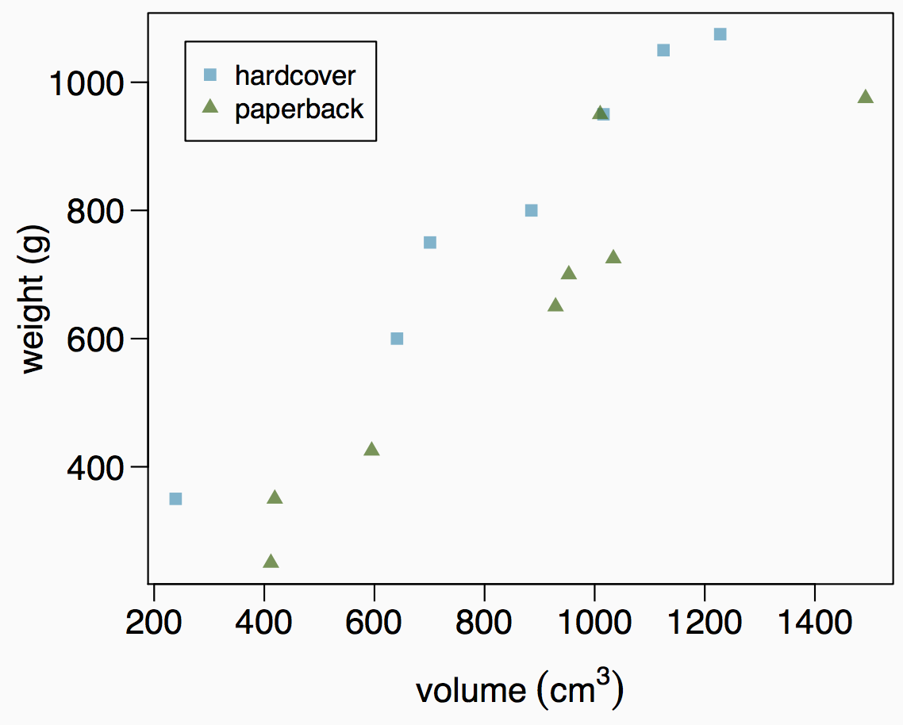
Weights of hardcover and paperback books
Can you identify a trend in the relationship between volume and weight of hardcover and paperback books?

Slide 16
Weights of hardcover and paperback books
Can you identify a trend in the relationship between volume and weight of hardcover and paperback books?
Paperbacks generally weigh less than hardcover books after controlling for the book's volume.

Slide 17
Modeling weights of books using volume and cover type
Coefficients:
 | Estimate | Std. Error | t value | Pr(>|t|)
(Intercept) | 197.96284 | 59.19274 | 3.344 | 0.005841 | **
volume | 0.71795 | 0.06153 | 11.669 | 6.6e-08 | ***
cover:pb | -184.04727 | 40.49420 | -4.545 | 0.000672 | ***
Residual standard error: 78.2 on 12 degrees of freedom Multiple R-squared: 0.9275,Adjusted R-squared: 0.9154 F-statistic: 76.73 on 2 and 12 DF, p-value: 1.455e-07

Slide 18
Modeling weights of books using volume and cover type
Coefficients:
 | Estimate | Std. Error | t value | Pr(>|t|)
(Intercept) | 197.96284 | 59.19274 | 3.344 | 0.005841 | **
volume | 0.71795 | 0.06153 | 11.669 | 6.6e-08 | ***
cover:pb | -184.04727 | 40.49420 | -4.545 | 0.000672 | ***
Based on the regression output below, which level of cover is the reference level? Note that pb: paperback.
paperback
hardcover

Slide 19
Modeling weights of books using volume and cover type
Coefficients:
 | Estimate | Std. Error | t value | Pr(>|t|)
(Intercept) | 197.96284 | 59.19274 | 3.344 | 0.005841 | **
volume | 0.71795 | 0.06153 | 11.669 | 6.6e-08 | ***
cover:pb | -184.04727 | 40.49420 | -4.545 | 0.000672 | ***
Based on the regression output below, which level of cover is the reference level? Note that pb: paperback.
paperback
hardcover

Slide 20
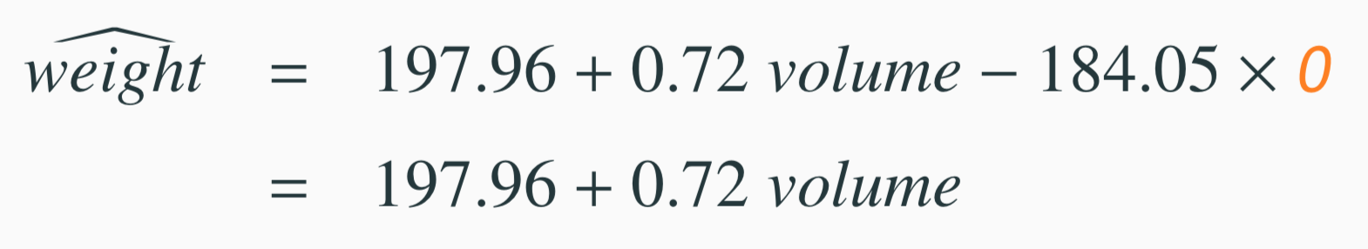
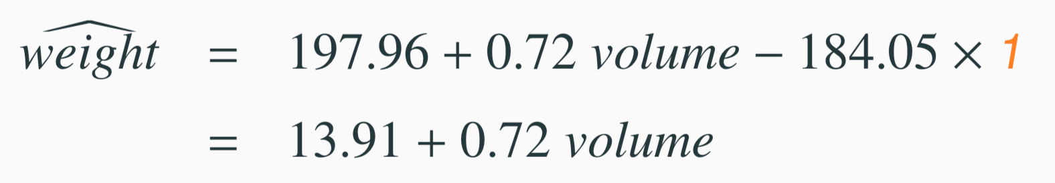
Linear Model
Estimate Std. Error t value Pr(>|t|)
(Intercept) | 197.96 | 59.19 | 3.34 | 0.01
volume | 0.72 | 0.06 | 11.67 | 0.00
cover:pb | -184.05 | 40.49 | -4.55 | 0.00
1. For hardcover books: plug in 0 for cover
2. For paperback books: plug in 1 for cover
12

Slide 21
Visualising the linear model
1000
hardcover paperback
800
600
400
weight (g)
200 400 600 800 1000 1200 1400
volume (cm³)

Slide 22
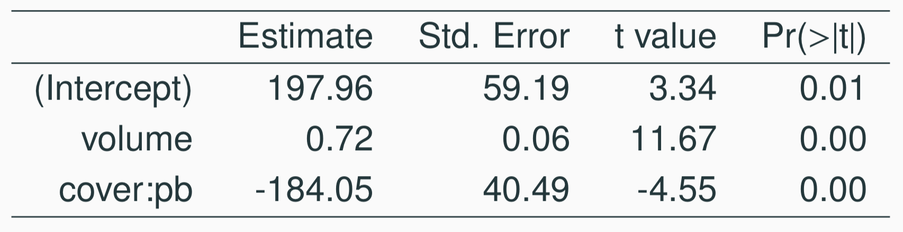
Linear model
Slope of volume: All else held constant, books that are 1 more cubic centimeter in volume tend to weigh about 0.72 grams more.
Slope of cover: All else held constant, the model predicts that paperback books weigh 184 grams lower than hardcover books.
Intercept: Hardcover books with no volume are expected on average to weigh 198 grams.
Obviously, the intercept does not make sense in context. It only serves to adjust the height of the line.
10

Slide 23
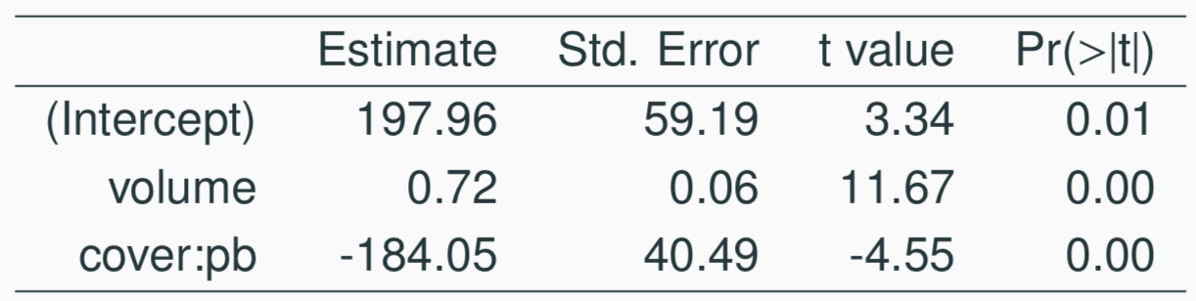
Prediction
Which of the following is the correct calculation for the predicted weight of a paperback book that is 600 cm³?
(a) 197.96 + 0.72 * 600 - 184.05 * 1
(b) 184.05 + 0.72 * 600 - 197.96 * 1
(c) 197.96 + 0.72 * 600 - 184.05 * 0
(d) 197.96 + 0.72 * 1 - 184.05 * 600
13

Slide 24
Prediction
Which of the following is the correct calculation for the predicted weight of a paperback book that is 600 cm³?
(a) 197.96 + 0.72 * 600 - 184.05 * 1
(b) 184.05 + 0.72 * 600 - 197.96 * 1
(c) 197.96 + 0.72 * 600 - 184.05 * 0
(d) 197.96 + 0.72 * 1 - 184.05 * 600
13

Slide 25
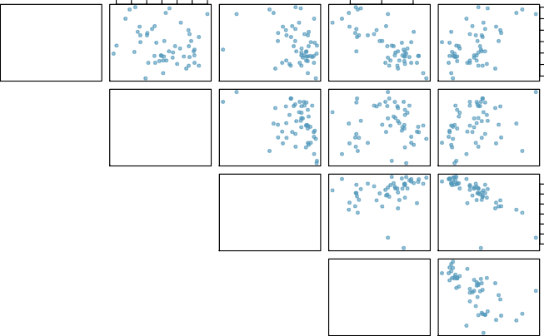
Modeling poverty
40 50 60 70 80 90 100
80
85
90
poverty
6 8 10 14 18
100
80
metro_res
60
−0.20
40
−0.31
−0.34
white
30 50 70 90
90
0.018
0.24
85
−0.75
hs_grad
80
0.30
−0.61
0.53
−0.75
female_house
8 10 14 18
6 8 10 12 14 16 18
30 50 70 90
8 10 12 14 16 18

Slide 26
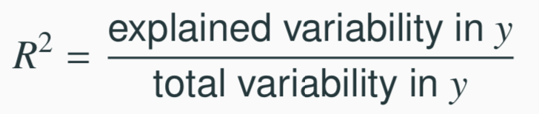
Another look at R²
R² can be calculated in three ways:
square the correlation coefficient of x and y (how we have been calculating it)
square the correlation coefficient of y and ŷ
based on definition:
Using ANOVA we can calculate the explained variability and total variability in y.
20

Slide 27
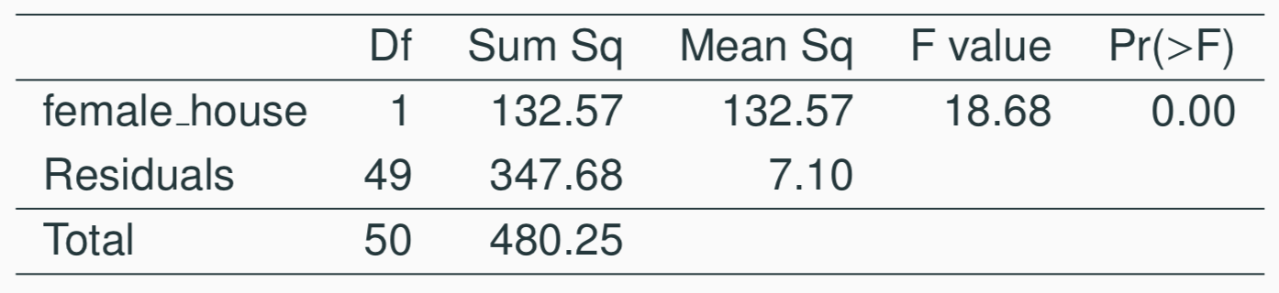
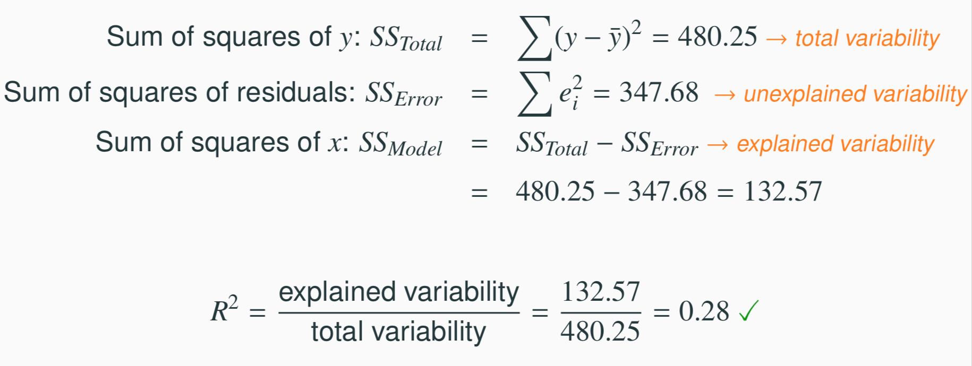
Sum of squares
21

Slide 28
Why bother?
Why bother with another approach for calculating R² when we had a perfectly good way to calculate it as the correlation coefficient squared?
In multiple linear regression, we can’t calculate R² as the square of the correlation between x and y because we have multiple xs.
And next we’ll learn another measure of explained variability, adjusted R², that requires the use of the third approach, ratio of explained and unexplained variability.
22

Slide 29
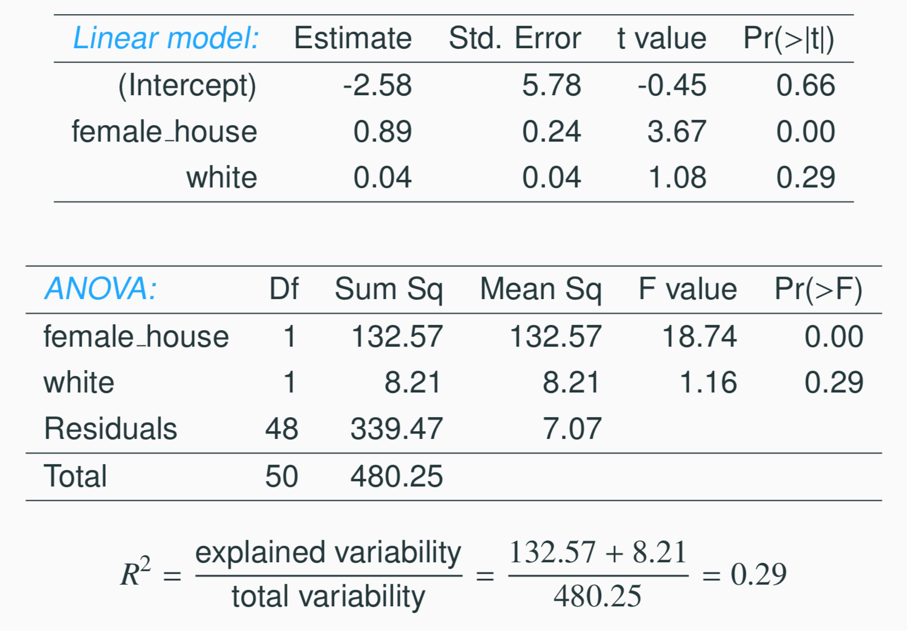
Predicting poverty using % female hh + % white
23

Slide 30
Predicting poverty using % female hh + % white
23

Slide 31
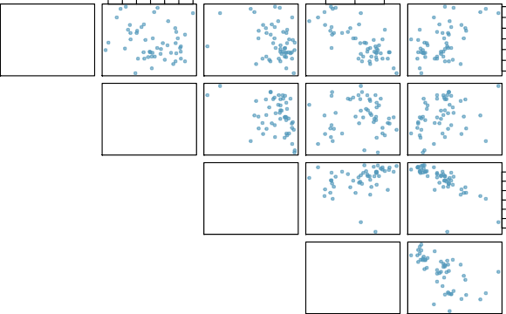
Does adding the variable white to the model add valuable information that wasn’t provided by female_house?
40 50 60 70 80 90 100
80
85
90
poverty
6 8 10 14 18
100
−0.20
80
metro_res
60
40
−0.31
−0.34
white
30 50 70 90
90
−0.75
0.018
0.24
85
hs_grad
80
0.30
−0.61
0.53
−0.75
30 50 70 90
female_house
8 10 14 18
6 8 10 12 14 16 18
8 10 12 14 16 18

Slide 32
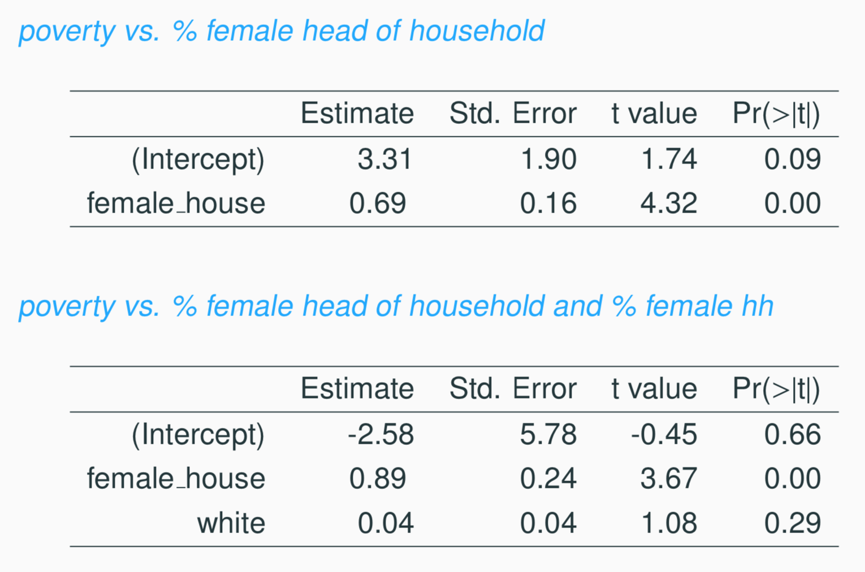
Collinearity between explanatory variables
25

Slide 33
Collinearity between explanatory variables (cont.)
Two predictor variables are said to be collinear when they are correlated, and this collinearity complicates model estimation. Ideally, predictors are independent of each other.
We don’t like adding predictors that are associated with each other to the model, because no new information is added.
Prefer the simplest best model, i.e. parsimonious model.
Experiments are usually designed to prevent correlation among predictors
Or collinear features can be dropped
26

Slide 34
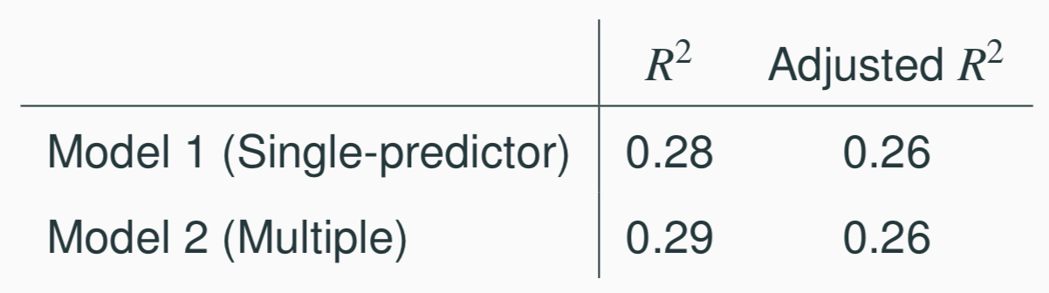
R² vs. adjusted R²
When any variable is added to the model R² increases.
But if the added variable doesn’t really provide any new information, or is completely unrelated, adjusted R² does not increase.
27

Slide 35
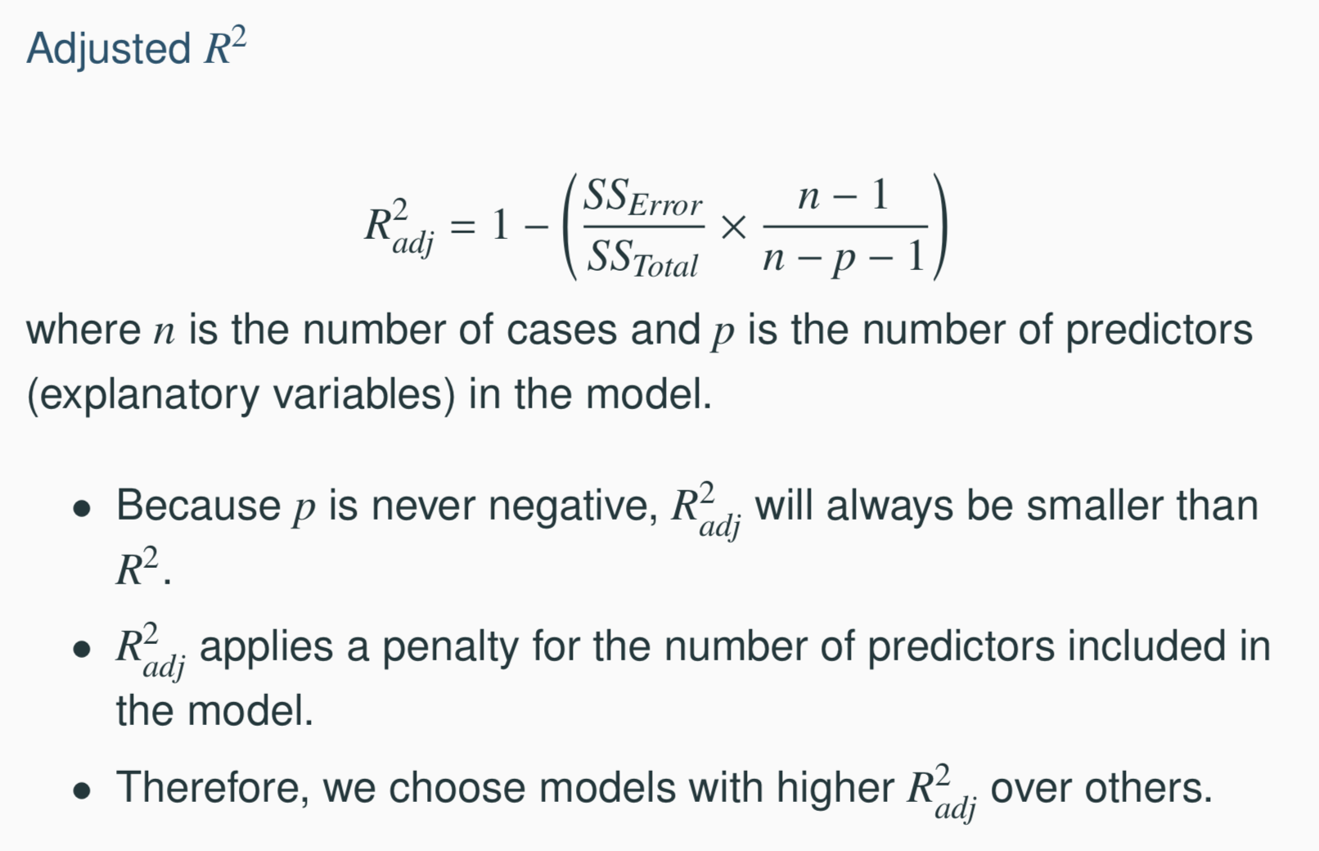
R² vs. adjusted R²
27

Slide 36
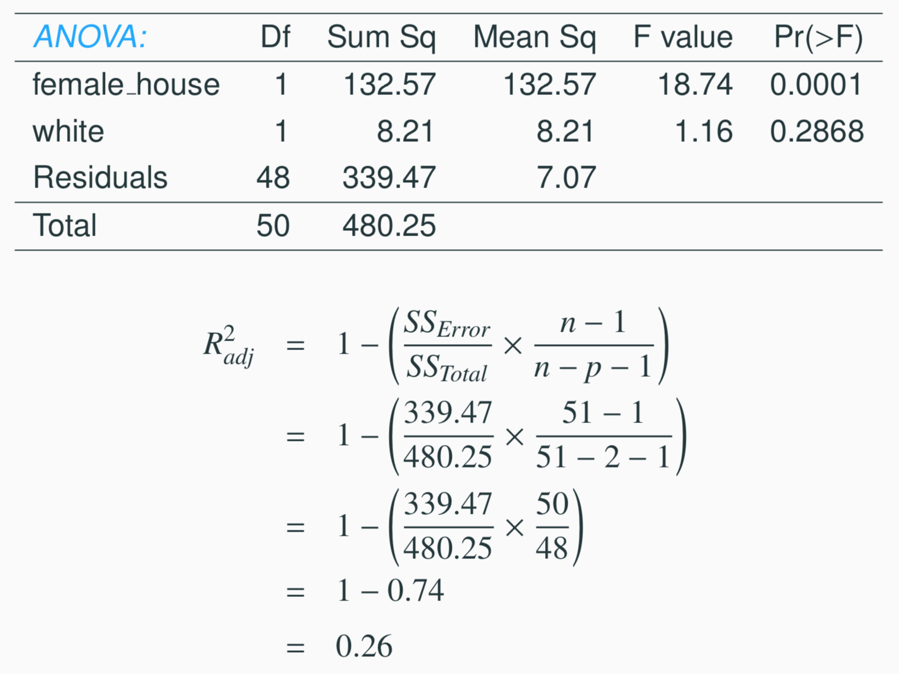
Calculate adjusted R²
27

