Slide 1
INFO 5871-001: Data Science / Info Science
Robin burke, Fall 2019

Slide 2
Checking model conditions
Week 11, Part 4

Slide 3
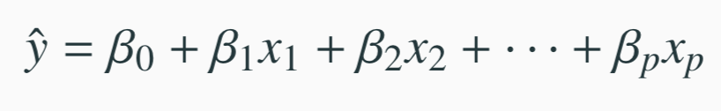
Modeling conditions
The model depends on the following conditions
residuals are nearly normal (less important for larger data sets)
residuals have constant variability
residuals are independent
each variable is linearly related to the outcome
We often use graphical methods to check the validity of these conditions, which we will go through in detail in the following slides.
27

Slide 4
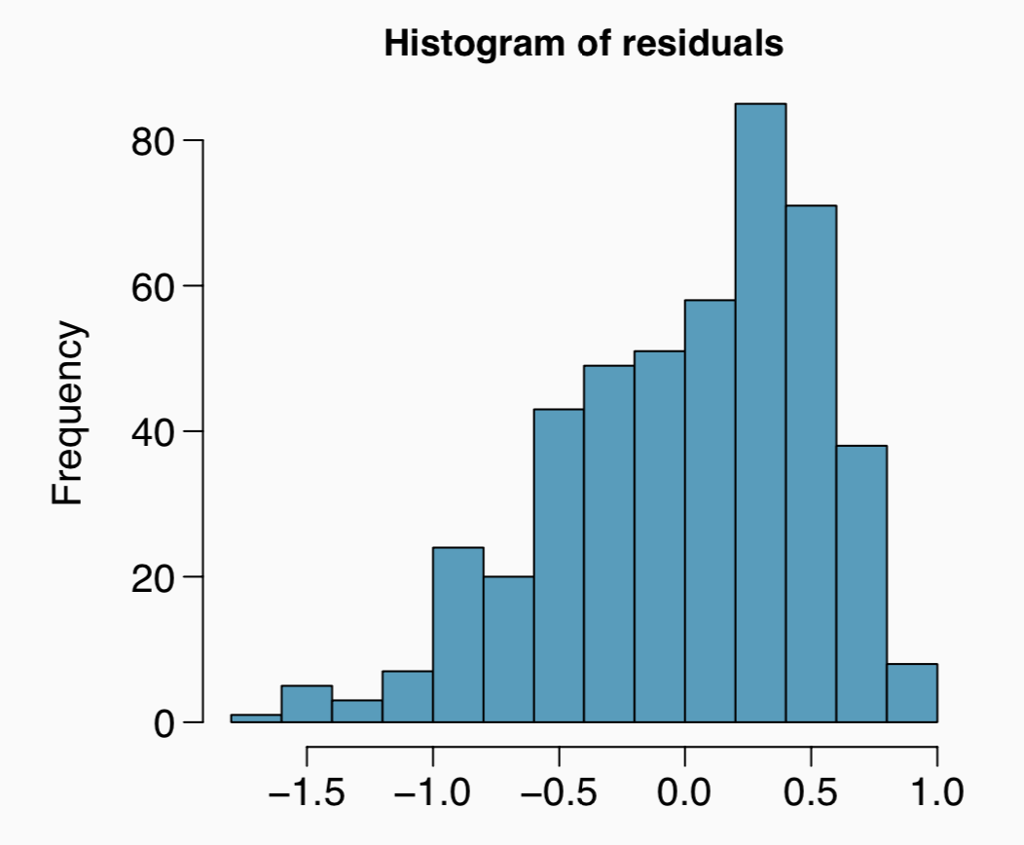
(1) nearly normal residuals
Histogram of the residuals.
Does this condition appear to be satisfied?
27

Slide 5
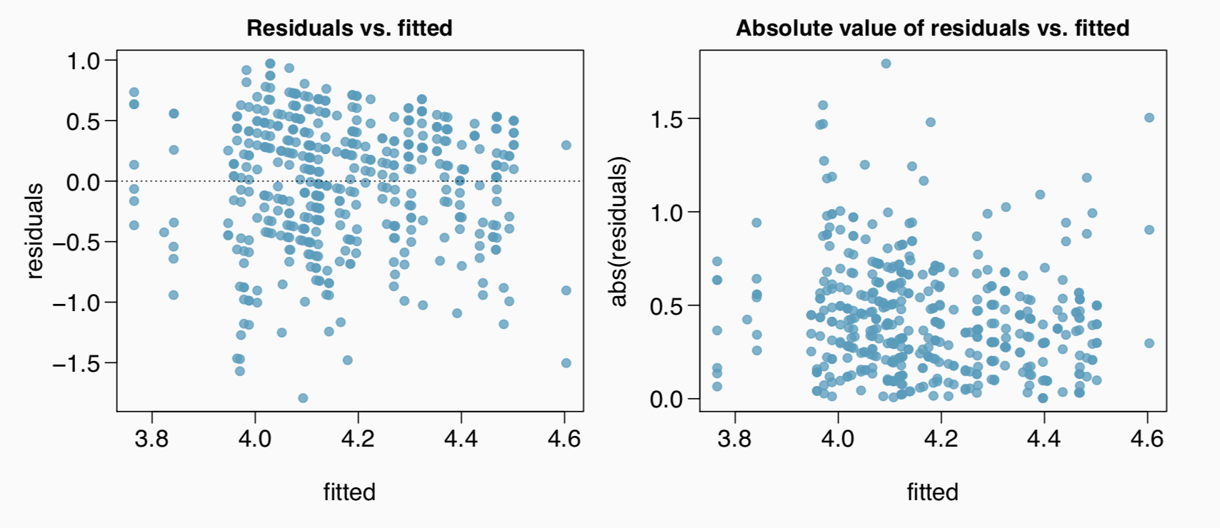
(2) constant variability in residuals
Scatterplot of residuals and/or absolute value of residuals vs. fitted (predicted).
Does this condition appear to be satisfied?
27

Slide 6
Checking constant variance - recap
When we did simple linear regression (one explanatory variable) we checked the constant variance condition using a plot of residuals vs. x.
With multiple linear regression (2+ explanatory variables) we checked the constant variance condition using a plot of residuals vs. fitted.
Why are we using different plots?
In multiple linear regression there are many explanatory variables, so a plot of residuals vs. one of them wouldn’t give us the complete picture.
We can look at them one at a time to check
52

Slide 7
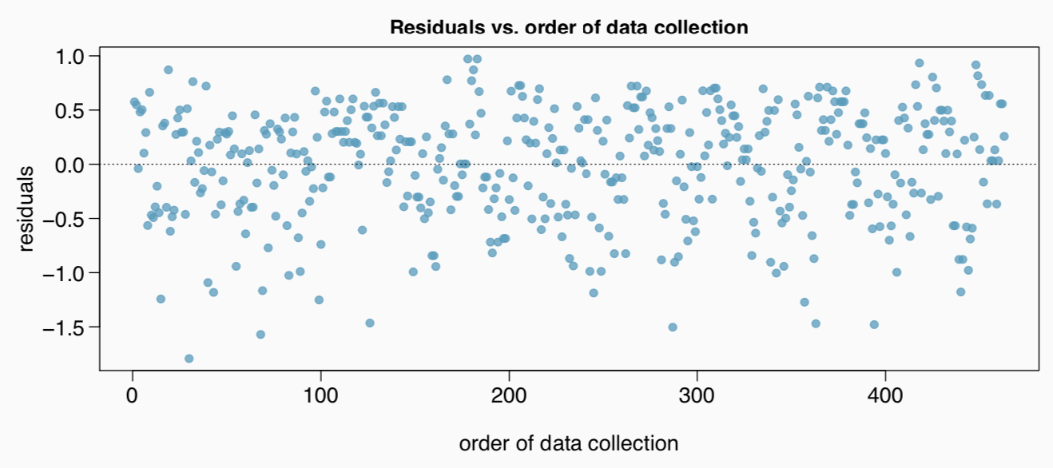
(3) independent residuals
Scatterplot of residuals vs. order of data collection.
Does this condition appear to be satisfied?
27

Slide 8
More on the condition of independent residuals
Checking for independent residuals allows us to indirectly check for independent observations.
If observations and residuals are independent, we would not expect to see an increasing or decreasing trend in the scatterplot of residuals vs. order of data collection.
This condition is often violated when we have time series data. Such data require more advanced time series regression techniques for proper analysis.
27

Slide 9
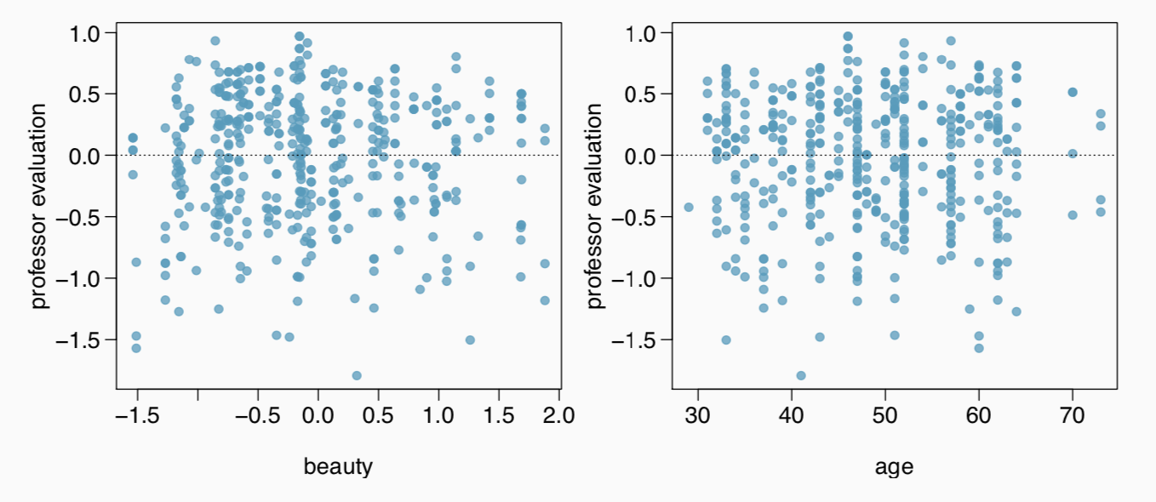
(4) linear relationships
Scatterplot of residuals vs. each (numerical) explanatory variable.
Does this condition appear to be satisfied?
Note: We use residuals instead of the predictors on the y-axis so that we can still check for linearity without worrying about other possible violations like collinearity between the predictors.
27

Slide 10
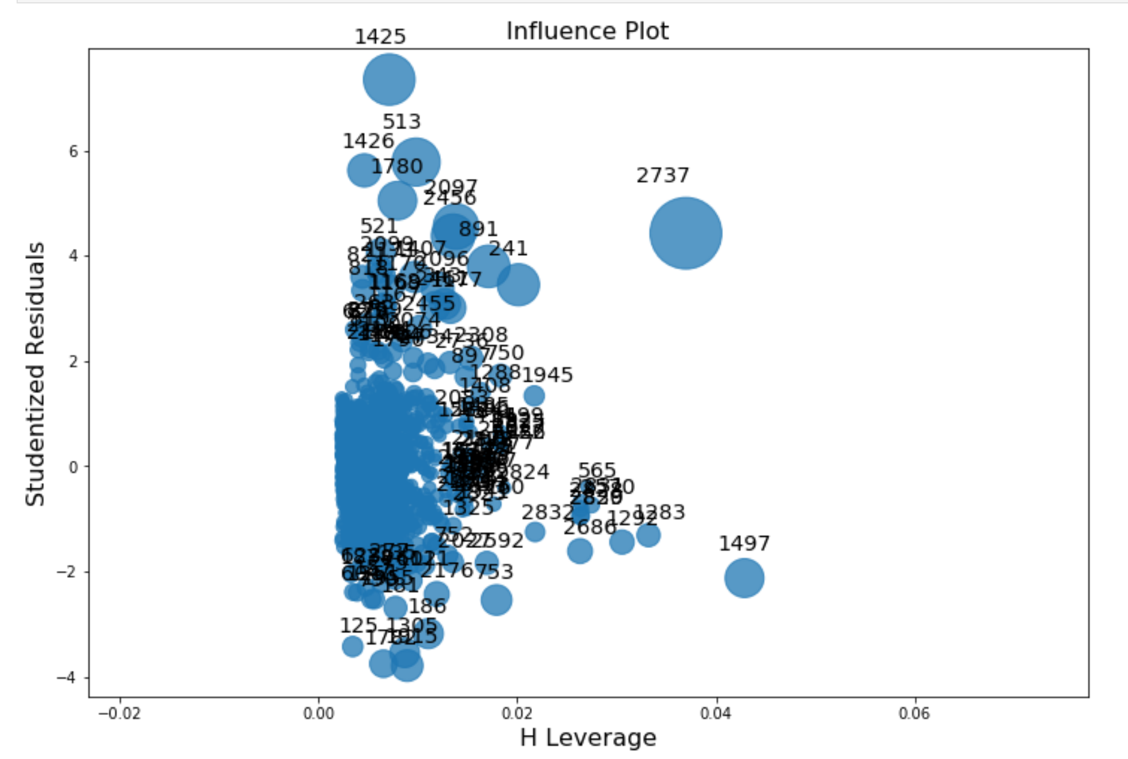
Python INFLUENCE PLOTS
Residuals normalized
vs Leverage
high leverage = the potential to change the answer
Dot size = Cook's distance
measures the effect of deleting the observation
we talked about eyeballing this
Tells us if there are outliers with big influence on the findings

Slide 11
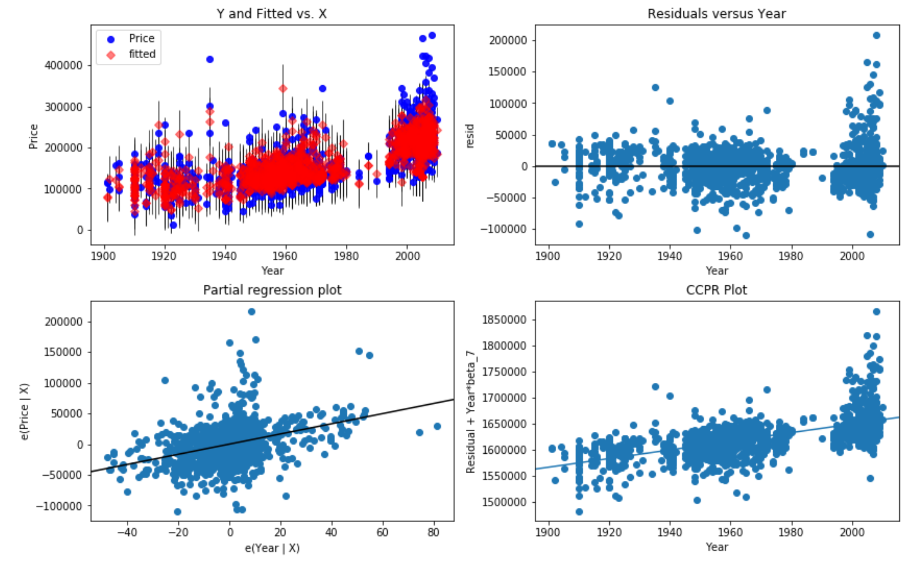
Python SINGLE-VARIABLE PLOTS
#1: Actual vs predicted against VAR
#2: Residuals vs VAR
#3: Partial regression
what are the residuals without VAR?
plot residuals with VAR and without
#4: Component / Component plus Residual
plots the residuals + regression term
like #2 but including the slope due to VAR

Slide 12
Several options for improving a model
Transforming variables
Seeking out additional variables to fill model gaps
Using more advanced methods that would account for challenges around inconsistent variability or nonlinear relationships between predictors and the outcome
27

Slide 13
Transformations
If the concern with the model is non-linear relationships between the explanatory variable(s) and the response variable, transforming the response variable can be helpful.
Log transformation (log y)
Square root transformation (sqrt(y))
Inverse transformation (1/y)
Truncation (cap the max value possible)
It is also possible to apply transformations to the explanatory variable(s), however such transformations tend to make the model coefficients even harder to interpret.
27

Slide 14
Models can be wrong, but useful
All models are wrong, but some are useful.
- George Box
No model is perfect, but even imperfect models can be useful, as long as we are clear and report the model’s shortcomings.
If conditions are grossly violated, we should not report the model results, but instead consider a new model, even if it means learning more statistical methods or finding someone who can help.
Note: Applied math has the LISA program for statistical consulting
27

