Slide 1
INFO 5871-001: Data Science / Info Science
Robin burke, Fall 2019

Slide 2
Logistic regression
Week 11, Part 5

Slide 3
Regression so far ...
At this point we have covered:
Simple linear regression
Relationship between numerical response and a numerical or categorical predictor
Multiple regression
Relationship between numerical response and multiple numerical and/or categorical predictors
What we haven’t seen is what to do when the predictors are weird (nonlinear, complicated dependence structure, etc.) or when the response is weird (categorical, count data, etc.)
27

Slide 4
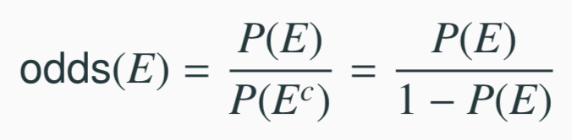
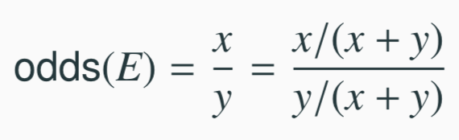

Odds
Odds are another way of quantifying the probability of an event, commonly used in gambling (and logistic regression).
For some event E,
Similarly, if we are told the odds of E are x to y then
which implies
27

Slide 5
Example - Donner Party
In 1846 the Donner and Reed families left Springfield, Illinois, for California by covered wagon. In July, the Donner Party, as it became known, reached Fort Bridger, Wyoming. There its leaders decided to attempt a new and untested rote to the Sacramento Valley. Having reached its full size of 87 people and 20 wagons, the party was delayed by a difficult crossing of the Wasatch Range and again in the crossing of the desert west of the Great Salt Lake. The group became stranded in the eastern Sierra Nevada mountains when the region was hit by heavy snows in late October. By the time the last survivor was rescued on April 21, 1847, 40 of the 87 members had died from famine and exposure to extreme cold.
From Ramsey, F.L. and Schafer, D.W. (2002). The Statistical Sleuth: A Course in Methods of Data Analysis (2nd ed)

Slide 6
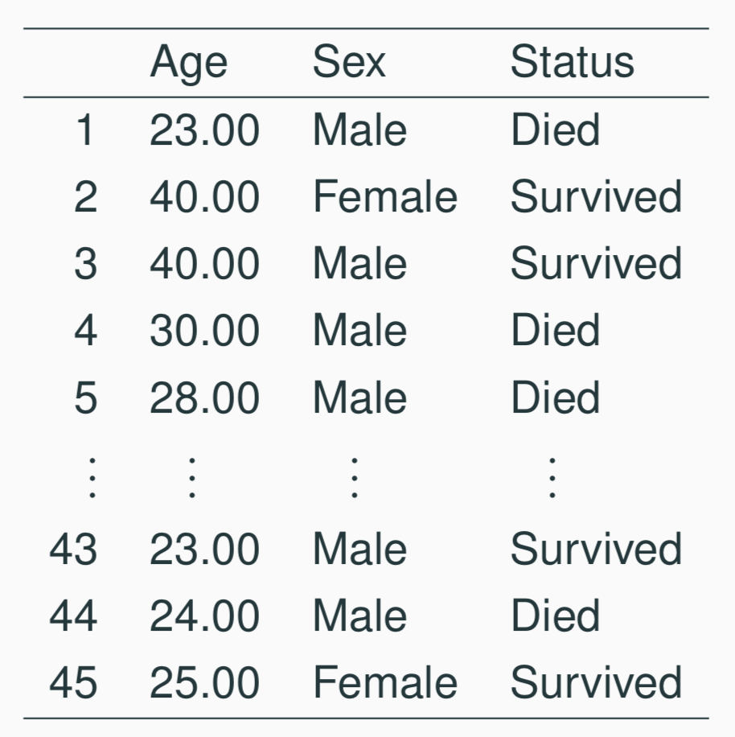
Example - Donner Party - Data
27

Slide 7
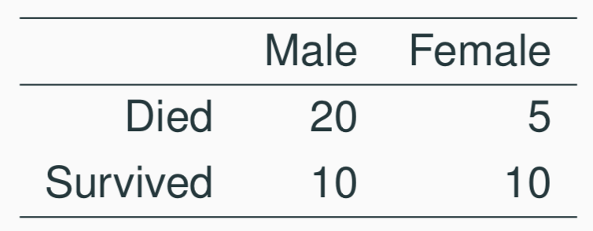
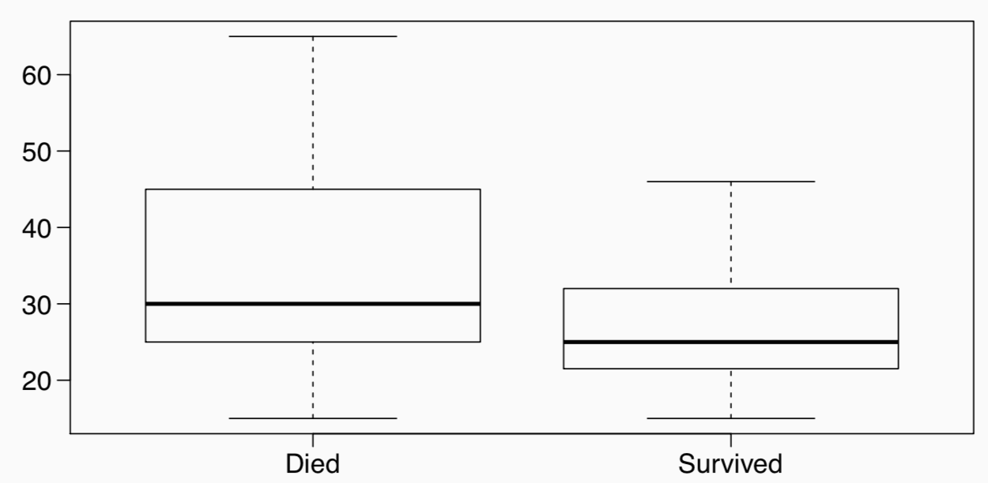
Example - Donner Party - EDA
Status vs Gender
Status vs Age
27

Slide 8
Example - Donner Party
It seems clear that both age and gender have an effect on someone’s survival, how do we come up with a model that will let us explore this relationship?
Even if we set Died to 0 and Survived to 1, this isn’t something we can transform our way out of - we need something more.
One way to think about the problem - we can treat Survived and Died as successes and failures arising from a binomial distribution where the probability of a success is given by a transformation of a linear model of the predictors.
27

Slide 9
Generalized linear models
It turns out that this is a very general way of addressing this type of problem in regression, and the resulting models are called generalized linear models (GLMs). Logistic regression is just one example of this type of model.
27

Slide 10
Generalized linear models
It turns out that this is a very general way of addressing this type of problem in regression, and the resulting models are called generalized linear models (GLMs). Logistic regression is just one example of this type of model.
All generalized linear models have the following three characteristics:
A probability distribution describing the outcome variable
A linear model: η = β₀ +β₁X₁ +···+β_{n}X_{n}.
A link function that relates the linear model to the parameter of the outcome distribution: g(p) = η or p = g⁻¹(η).
27

Slide 11
Logistic Regression
Logistic regression is a GLM used to model a binary categorical variable using numerical and categorical predictors.
We assume a binomial distribution produced the outcome variable and we therefore want to model p the probability of success for a given set of predictors.
27

Slide 12
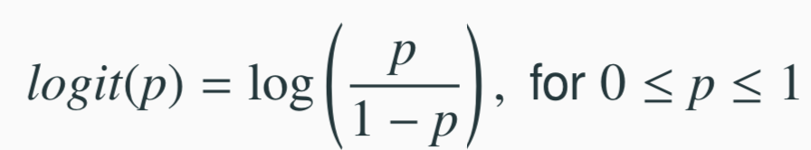
Logistic Regression
Logistic regression is a GLM used to model a binary categorical variable using numerical and categorical predictors.
We assume a binomial distribution produced the outcome variable and we therefore want to model p the probability of success for a given set of predictors.
To finish specifying the Logistic model we just need to establish a reasonable link function that connects η to p. There are a variety of options but the most commonly used is the logit function.
Logit function
27

Slide 13
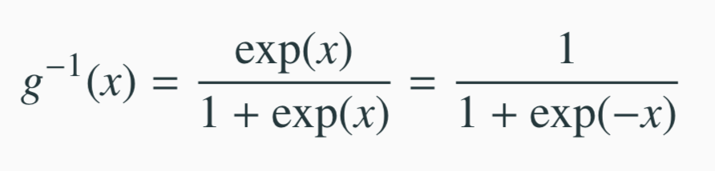
Properties of the Logit
The logit function takes a value between 0 and 1 and maps it to a value between −∞ and ∞.
Inverse logit (logistic) function (called expit in SciPy)
The inverse logit function takes a value between −∞ and ∞ and maps it to a value between 0 and 1.
This formulation also has some use when it comes to interpreting
the model as logit can be interpreted as the log odds of a success, more on this later.
27

Slide 14
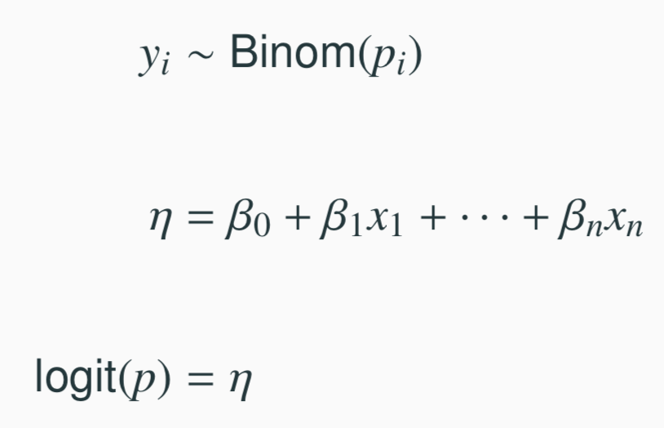
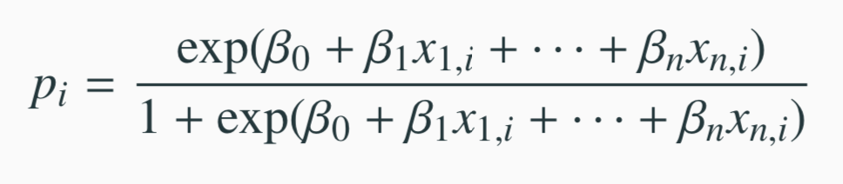
The logistic regression model
The three GLM criteria give us:
Outcome should be 1 or 0 with some probability
Calculate a regular regression: could return any number
Inverse logit gives the probablity of 1
From which we arrive at,
27

Slide 15
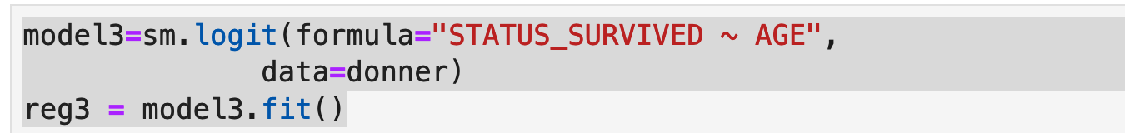
Fitting Using python
As before, but instead of OLS, we say use the logit function
Note that we have to create the dummy variables automatically
OLS does this for us, but not logit (a known problem)

Slide 16
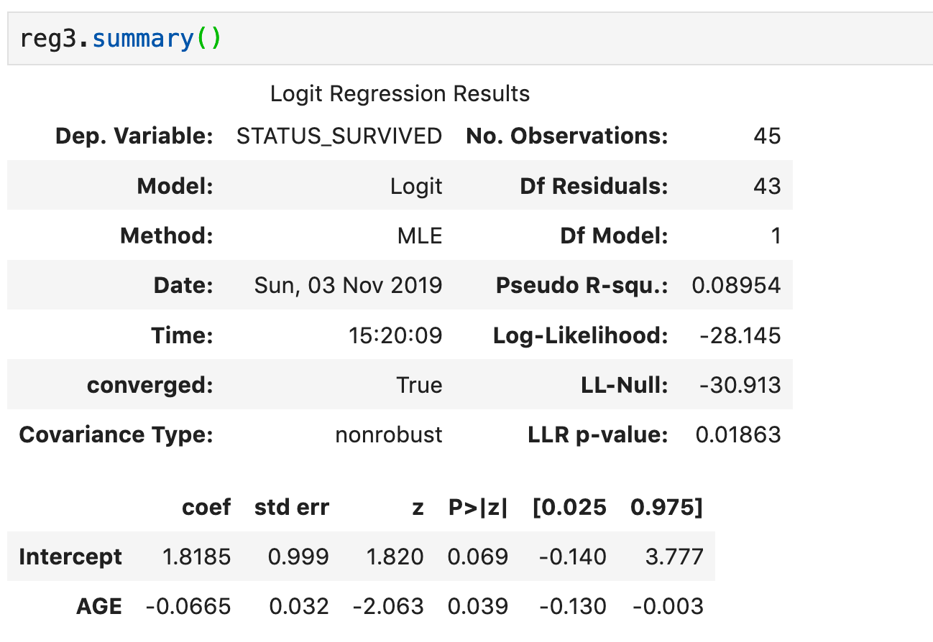
OUTPUT

Slide 17
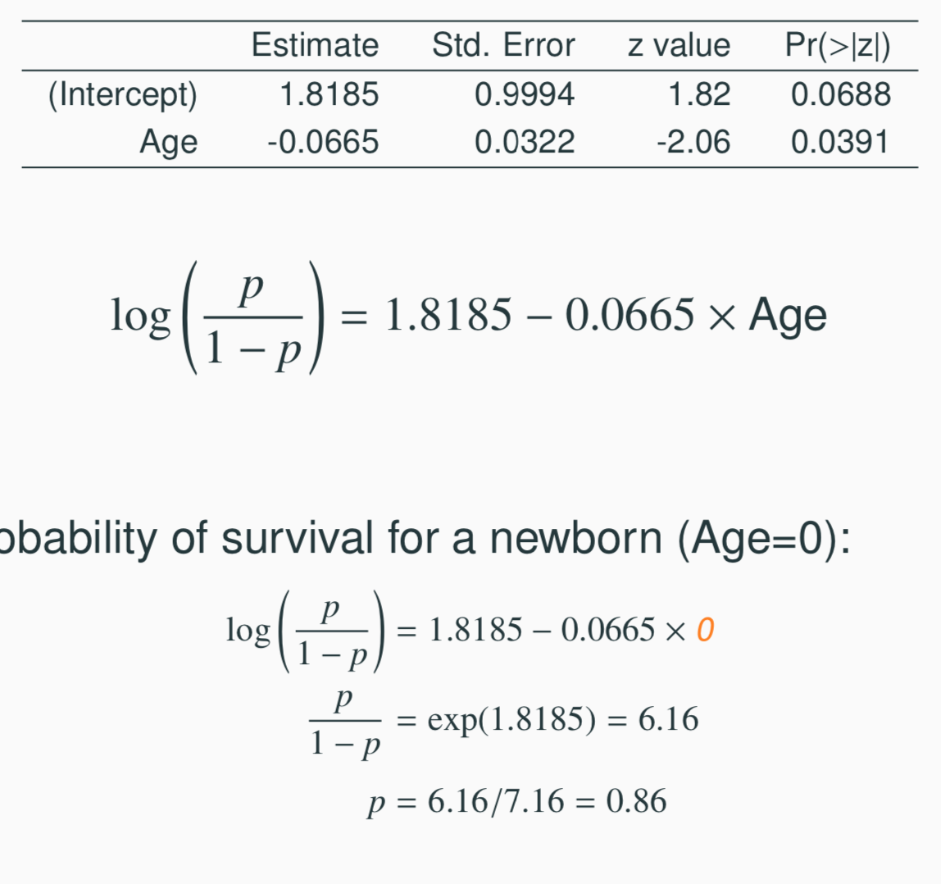
Example - Donner Party - Prediction
Model:
Odds / Probability of survival for a newborn (Age=0):
27

Slide 18
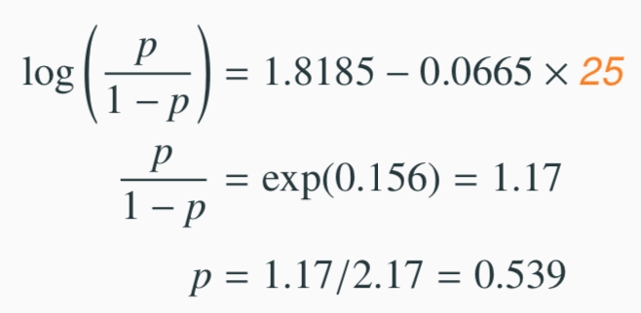
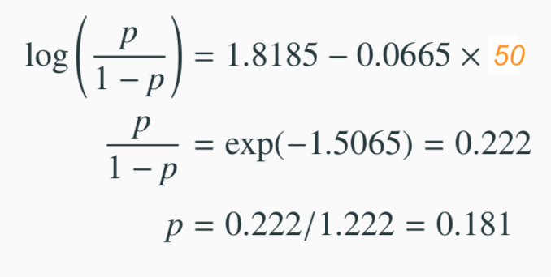
Example - Donner Party - Prediction
Odds / Probability of survival for a 25 year old:
Odds / Probability of survival for a 50 year old:
27

Slide 19
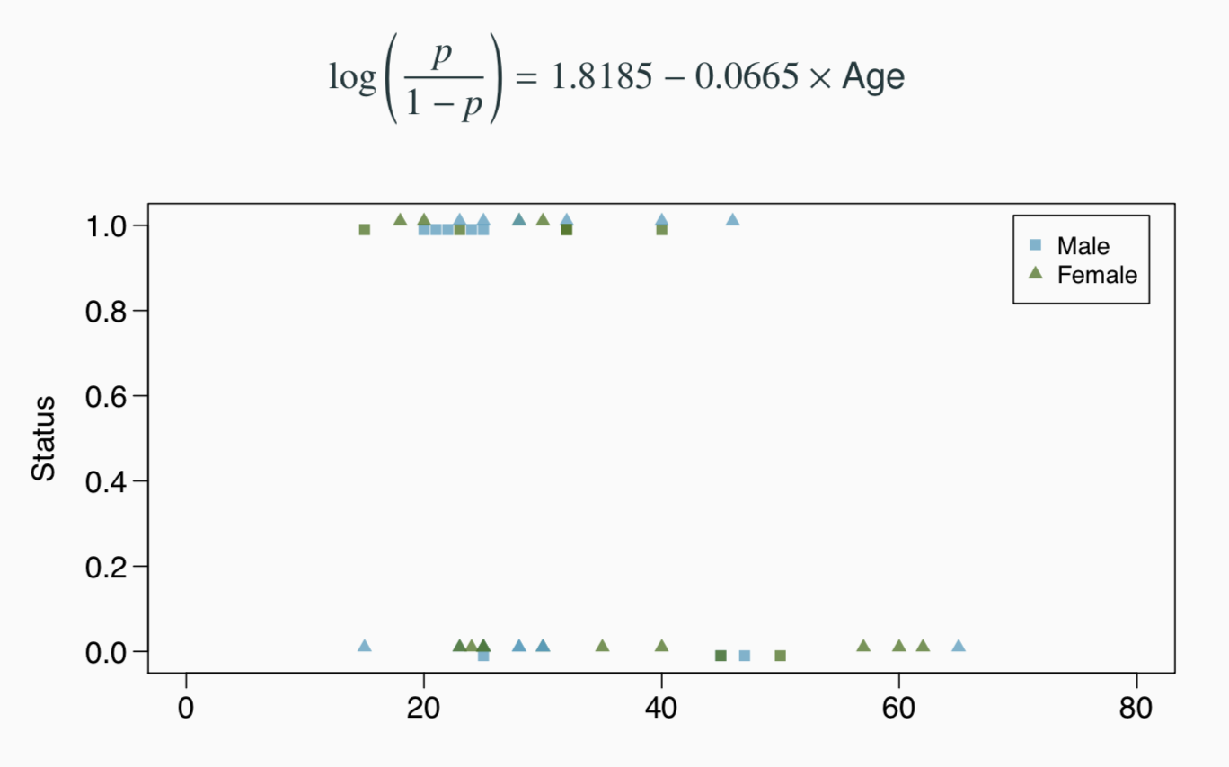
Example - Donner Party - Prediction (cont.)
27

Slide 20
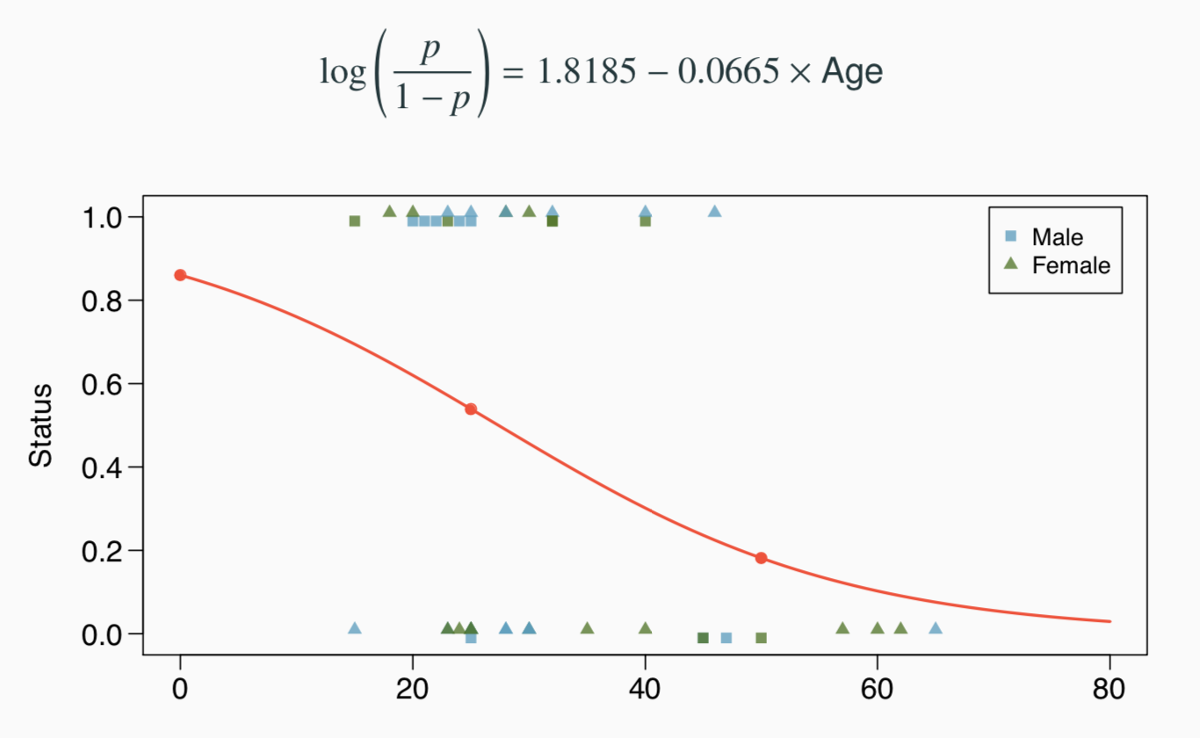
Example - Donner Party - Prediction (cont.)
27

Slide 21
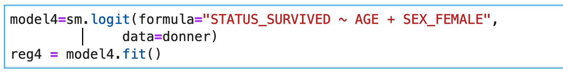
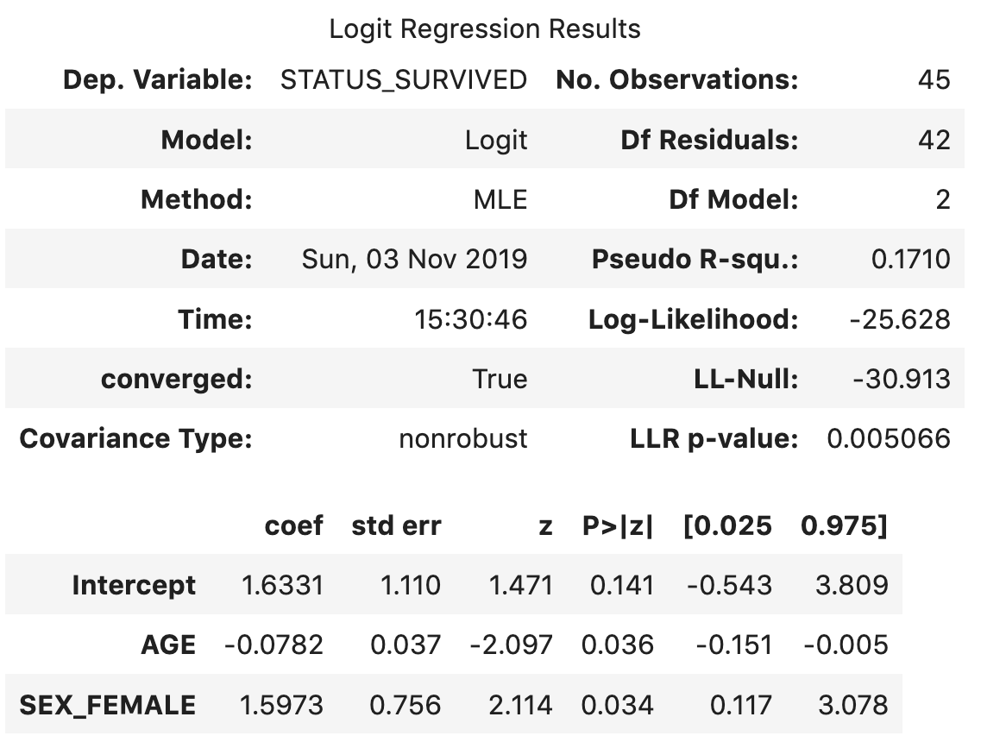
Multiple variables similar

Slide 22
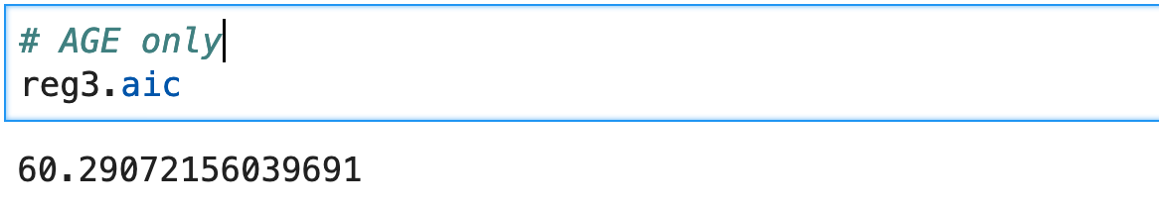
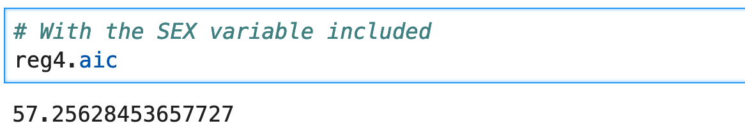
Is it better?
Use AIC (Akaike Information Criterion)
smaller is better
measures the tradeoff between the accuracy of the model and the complexity of the model

Slide 23
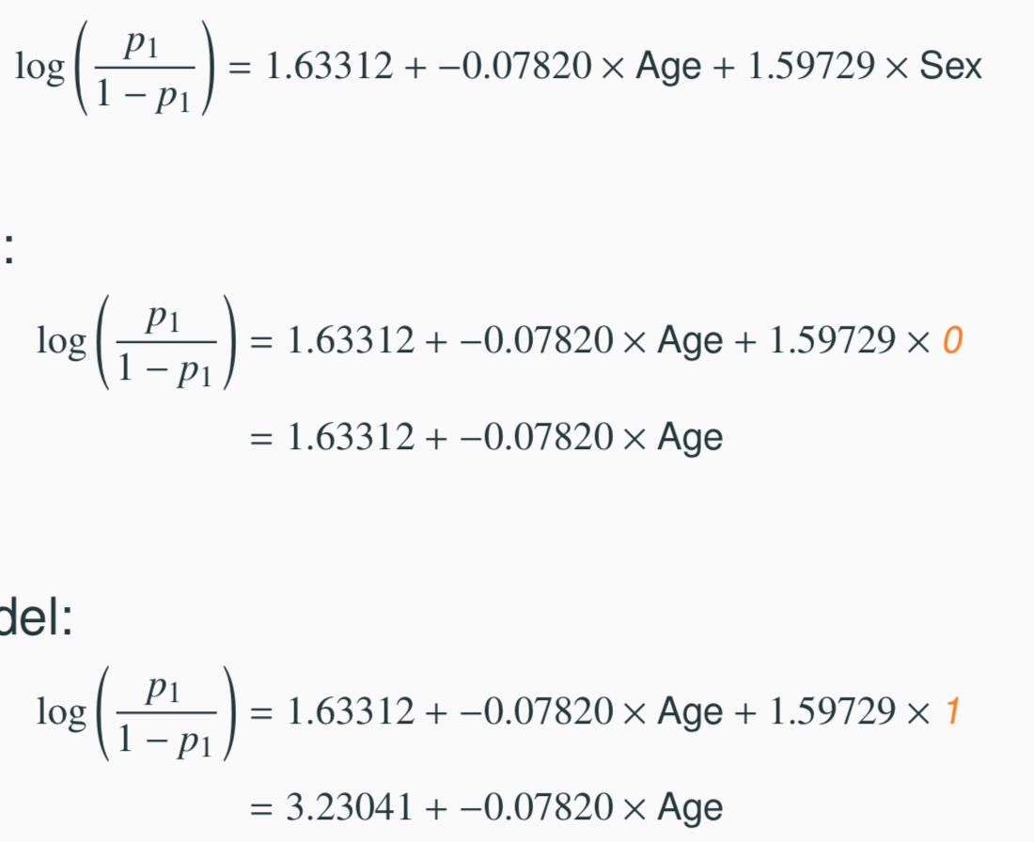
Example - Donner Party - Gender Models
Just like MLR we can plug in gender to arrive at two status vs age models for men and women respectively.
General model:
Male model:
Female model:
Effectively just changes the "intercept"
27

Slide 24
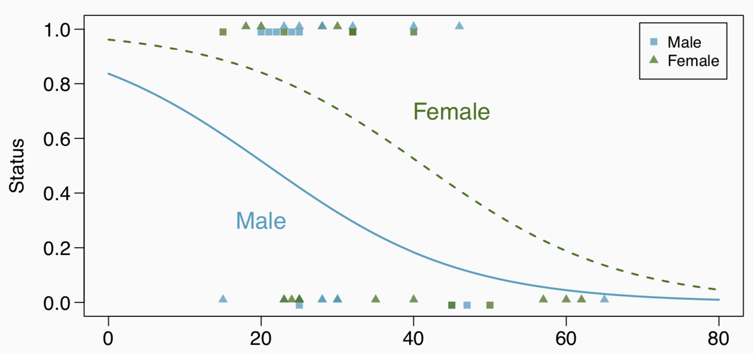
Example - Donner Party - Gender Models (cont.)
27

